Slide 1
FarmCast: Weather-Based Farming Management System
SRS presentation
Mohamed Elfaki
Firas Nazar
Omar Ahmed
Ahmed Salmi

Slide 2


Introduction
FarmCast is a weather-based management system
Designed to enhance farming efficiency and sustainability
Purpose:
Provide tools to help farmers
Address key farming challenges

Slide 3
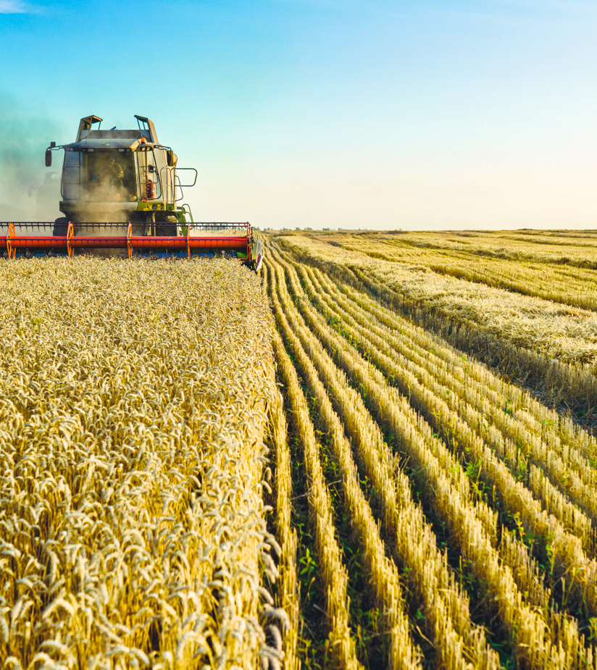
Scope
Smallholder farmers targeted through the mobile app
Commercial farmers targeted through the web platform

Slide 4
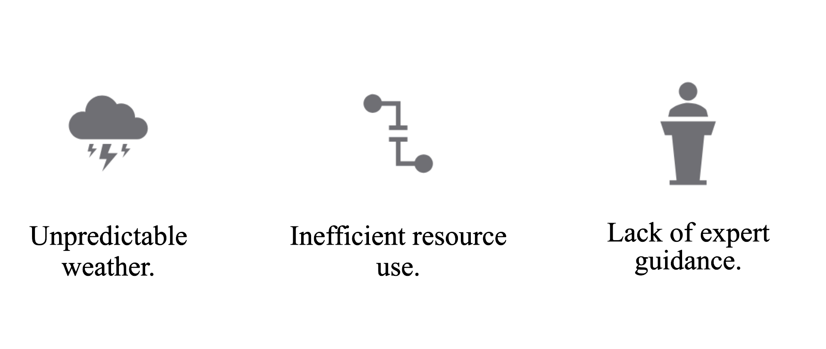

Current Problems with Farming
FarmCast solves these problems with key functional requirements which will be looking at later

Slide 5
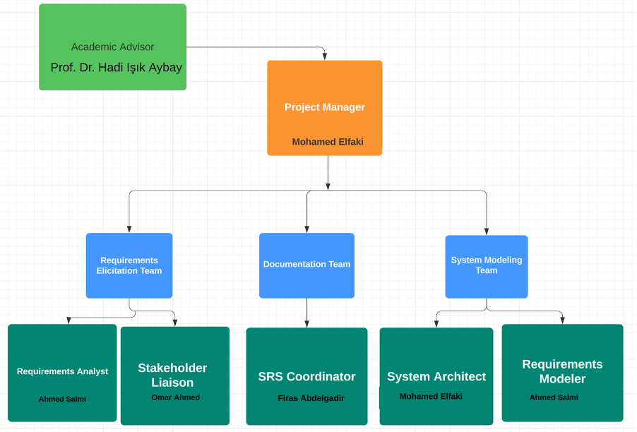
Diagrams: Organizational

Slide 6
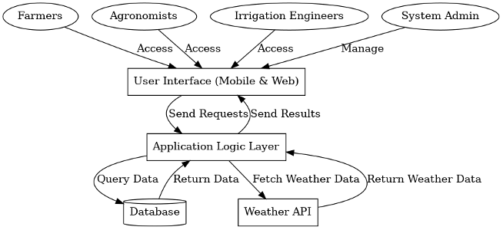
Diagrams: System Architecture

Slide 7
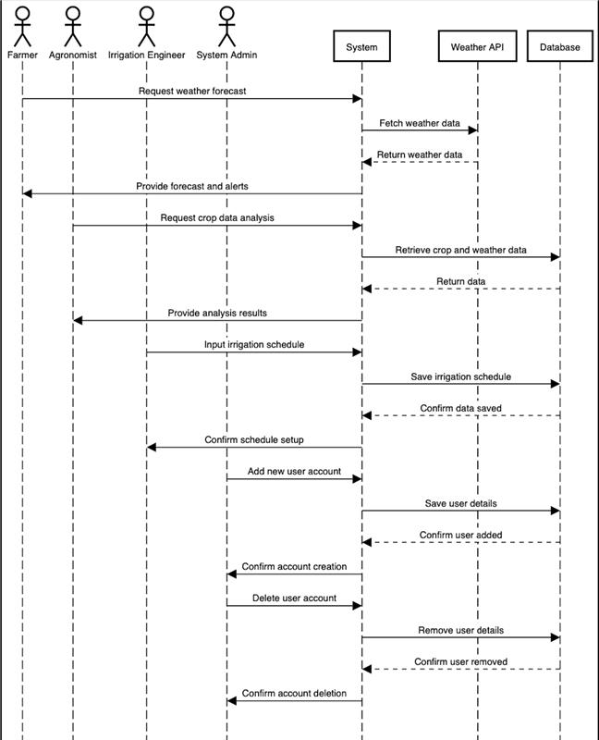
Diagrams: Sequence

Slide 8

Functional Requirements: User registration
REQ-1: New users shall be able to register a new account
REQ-2: Users shall be able to update their profile details
REQ-3: Users shall be able to customize weather alert preferences
REQ-4: Users shall be able to enable two-factor authentication

Slide 9
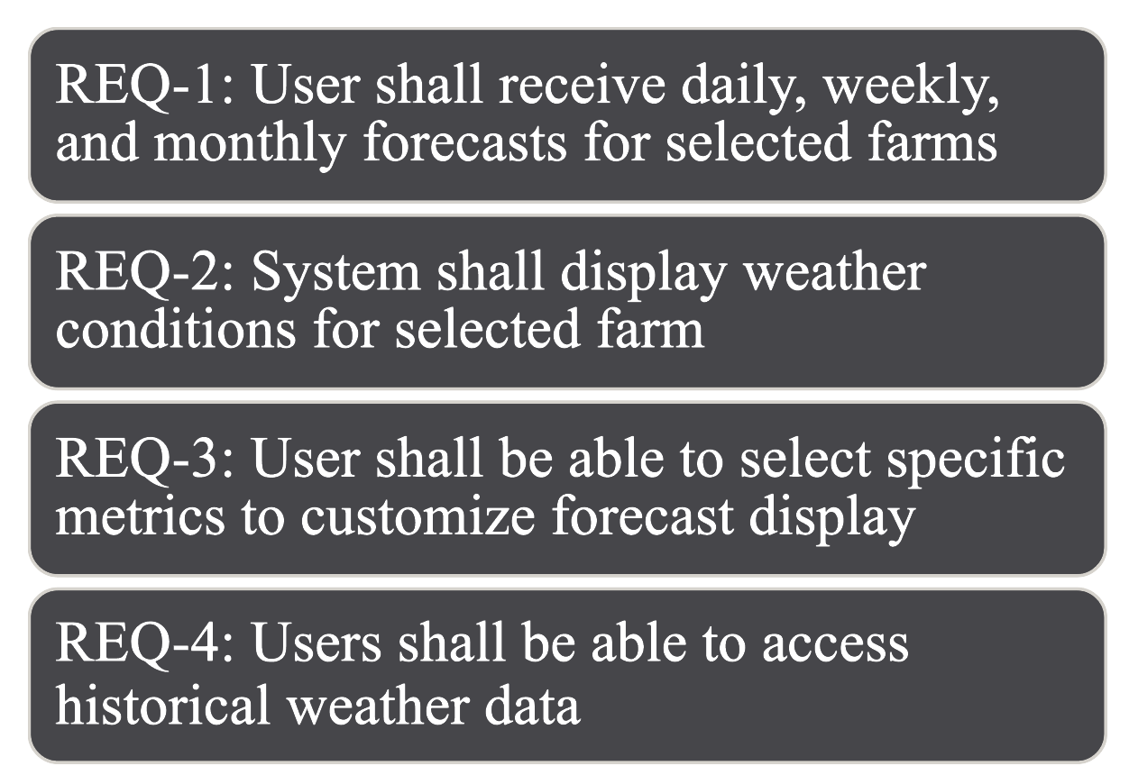

Functional Requirements: Weather Forecasting

Slide 10
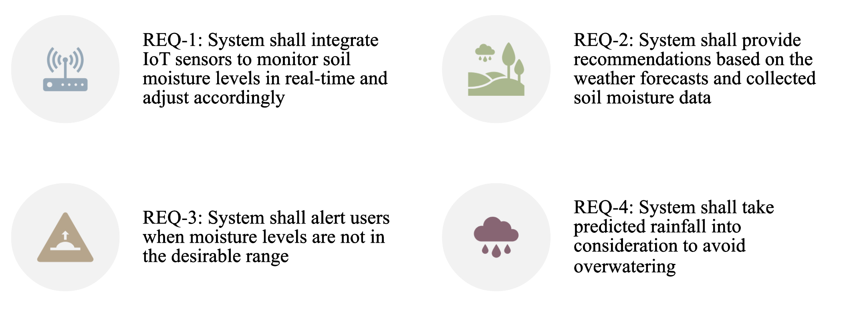
Functional Requirements: Irrigation Scheduling

Slide 11
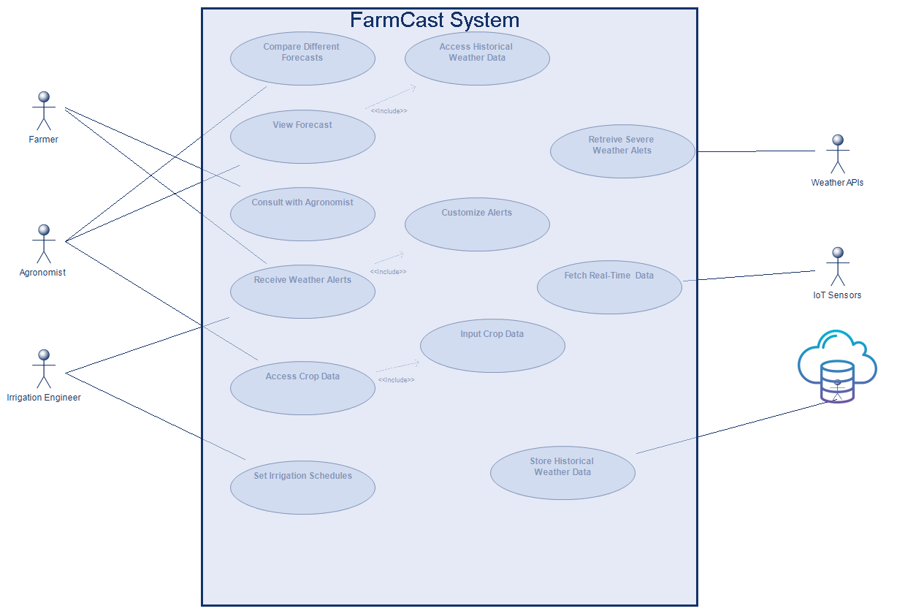

Diagrams: Use case

Slide 12

Non-Functional Requirements
1.Performance
The system should react to user requests within 3 seconds.
On smartphones, hitting the icon must cause the program to open in less than 2 seconds.
The latency of weather notifications, must be less than 1 second
2.Security
All accounts should have multi-factor authentication (MFA)
Within 24 to 48 hours, address any security vulnerabilities found.
Carry out vulnerability assessments and penetration testing,

Slide 13
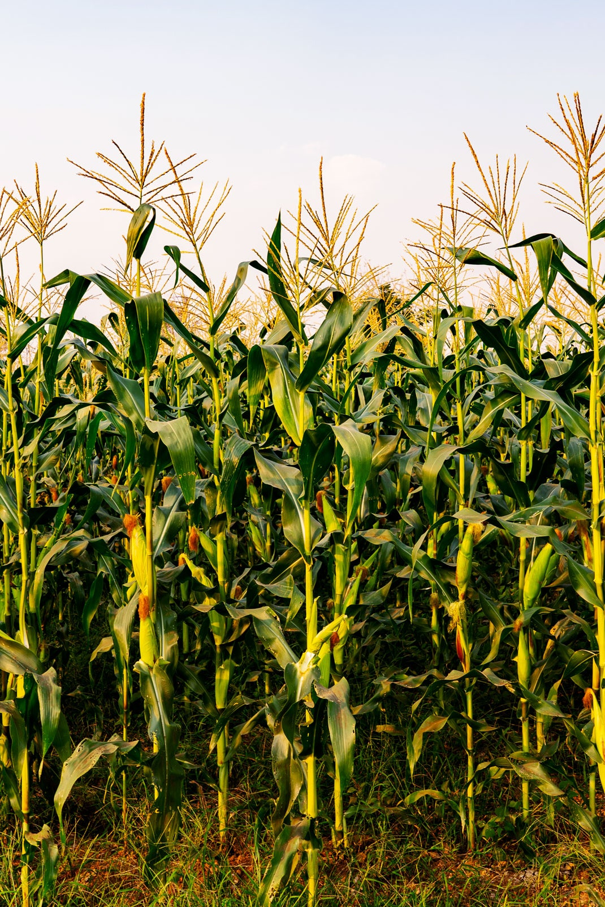
Non-Functional Requirements
3.Usability
Account setup and basic feature exploration can be finished by non-technical users in 30 minutes.
Translating the program into ten main languages.
Maintain uniformity across platforms.
4.Data Accuracy
Update the data every 30 minutes.
Make sure the accuracy rate is at least 99%

Slide 14

Non-Functional Requirements
5. Portability
Verify compatibility across different platforms
Create an application that is completely responsive
6. Reliability
Put error-handling procedures in place to recover from partial failures
Do backups every fifteen minutes.

Slide 15
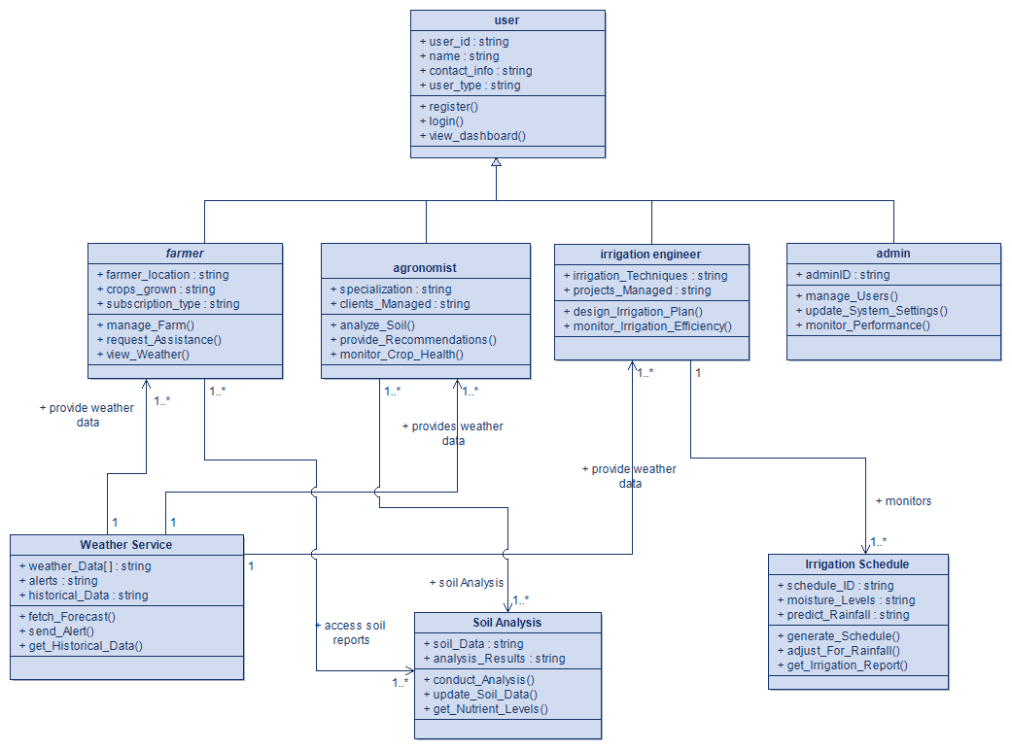
Diagrams: Class

Slide 16
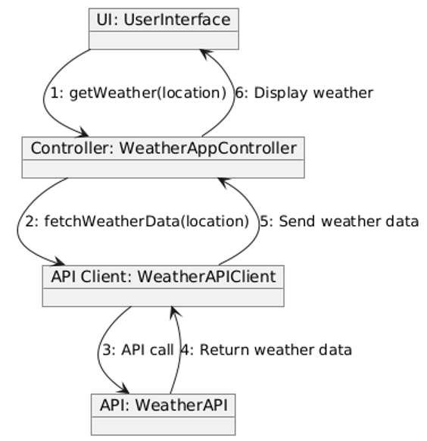
Diagrams: Collaboration

Slide 17
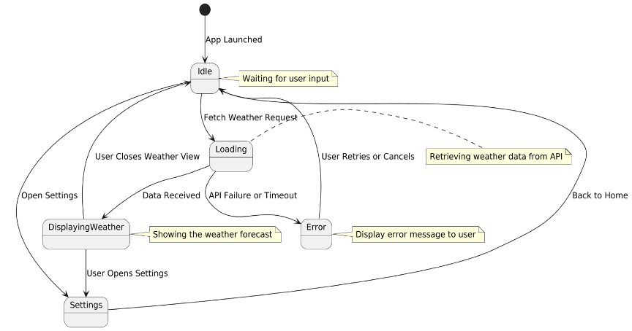
Diagrams: State machine

