Slide 1
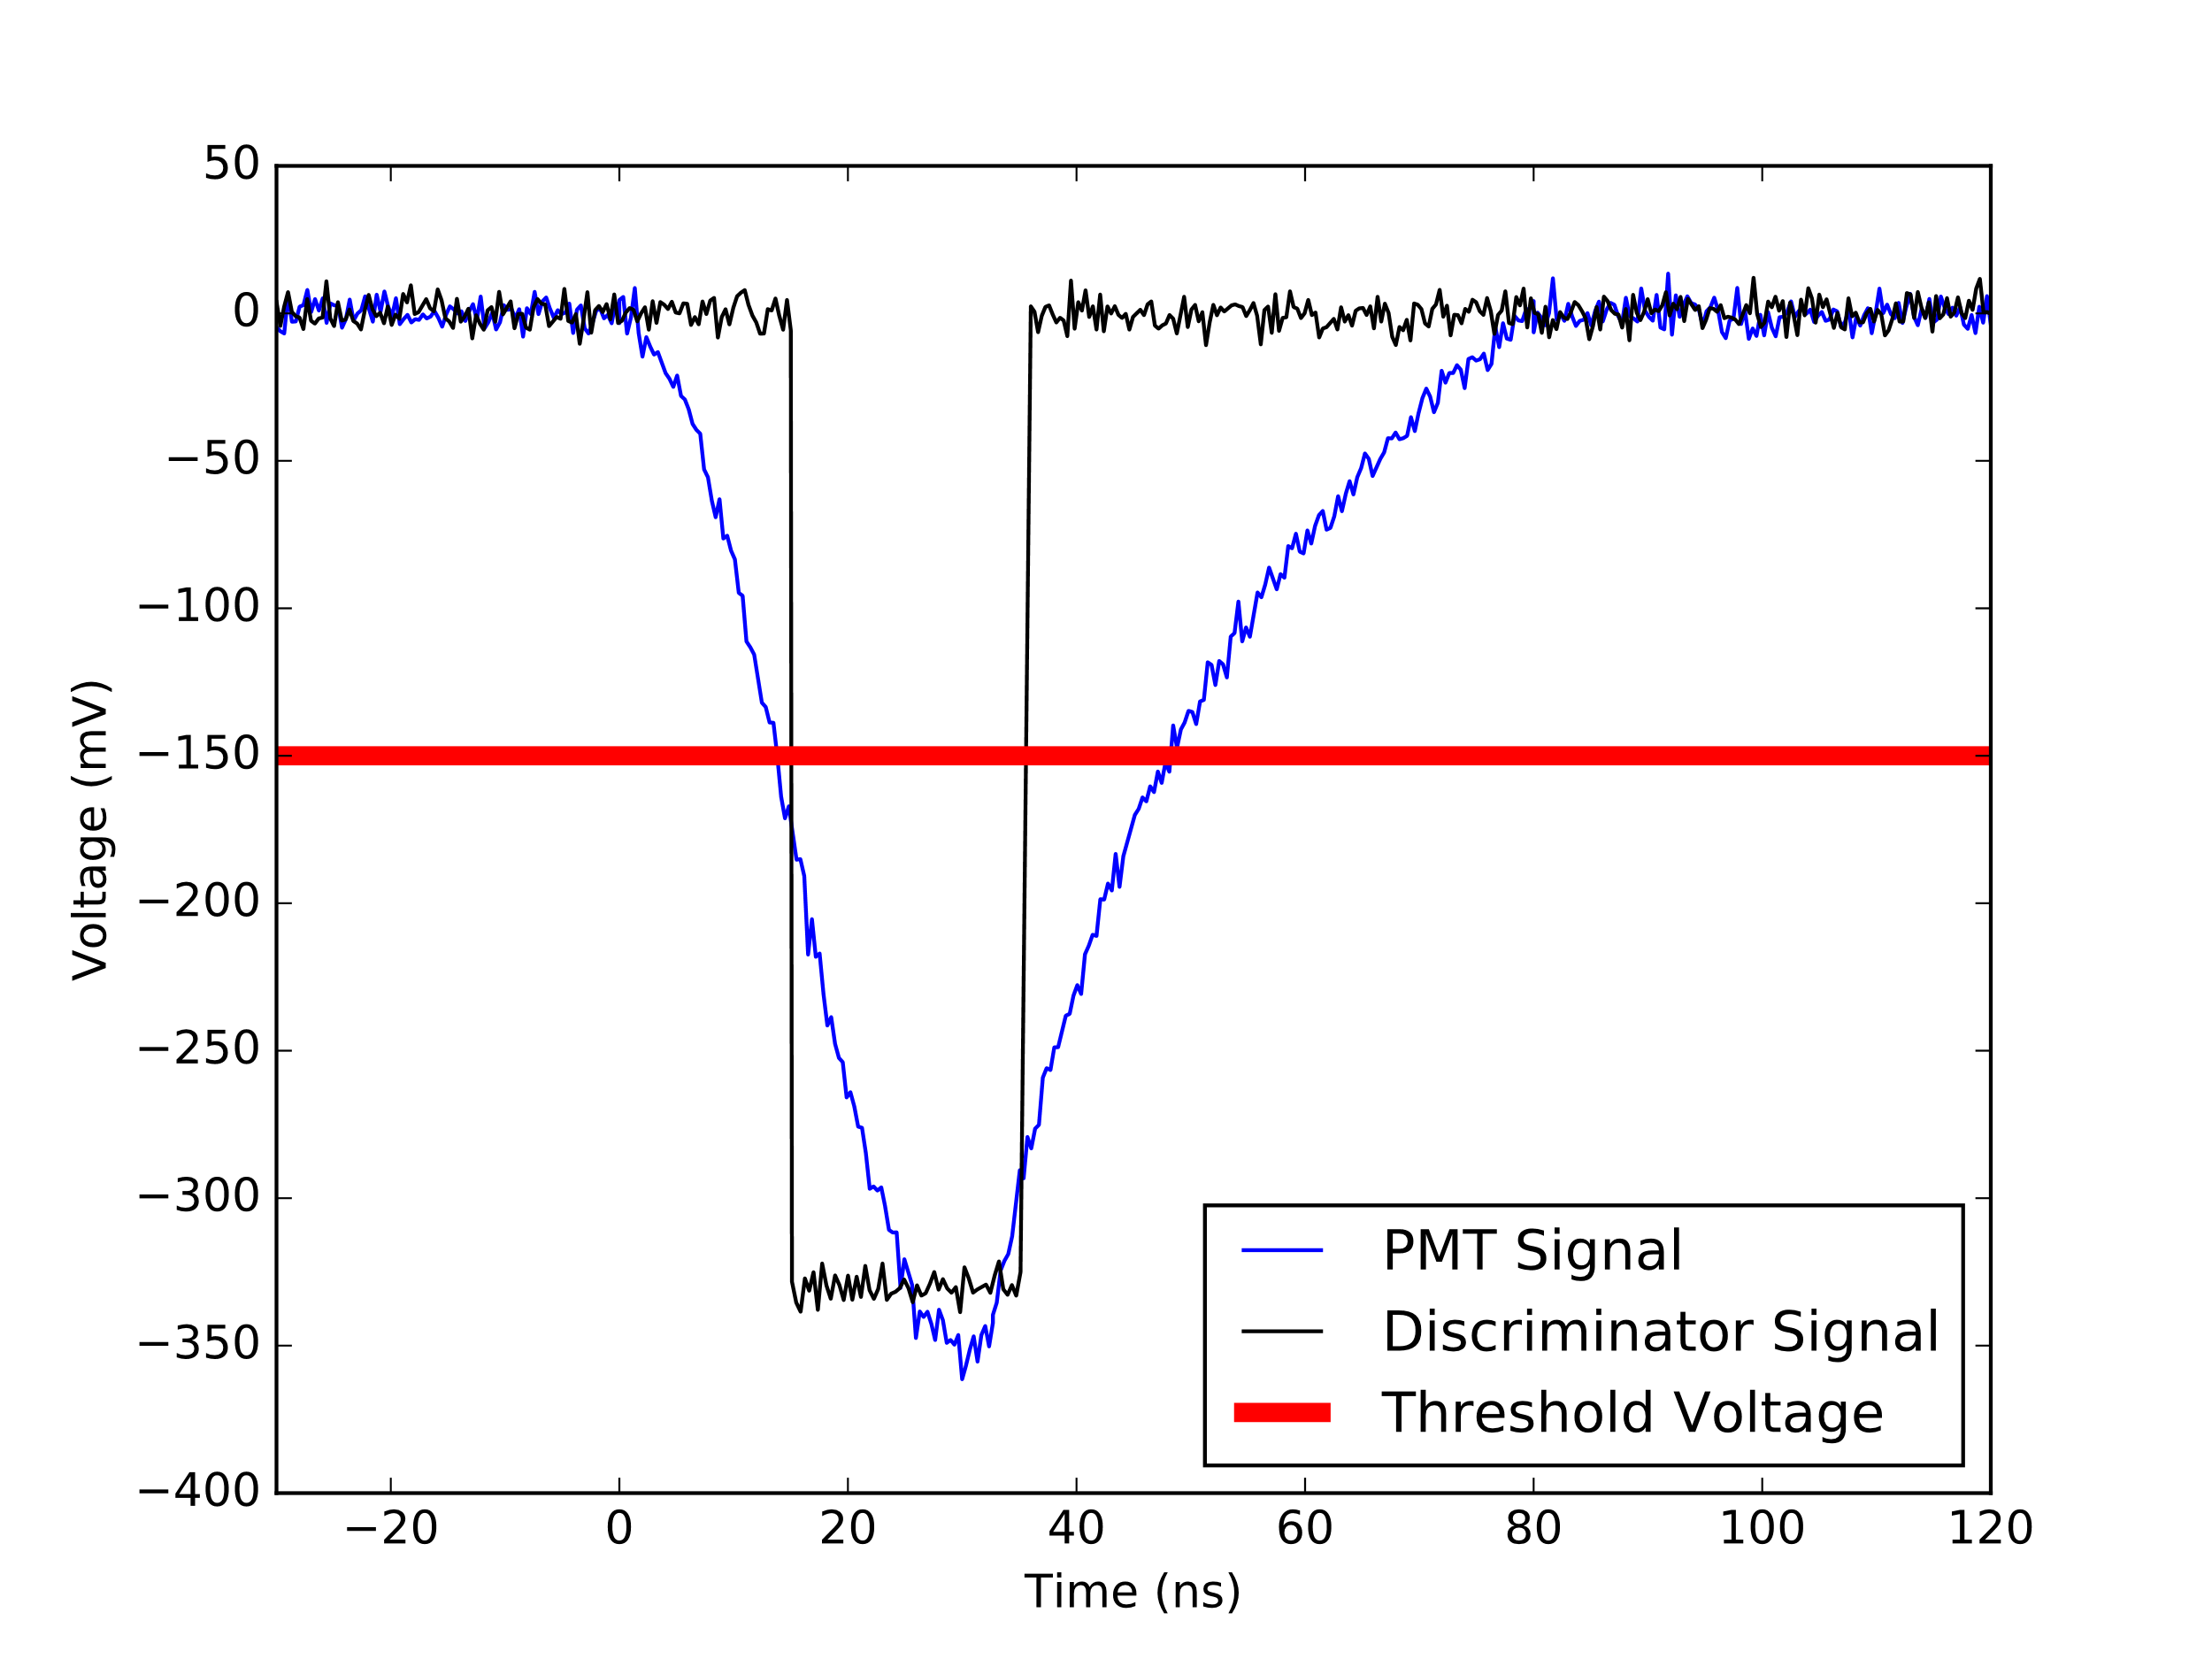
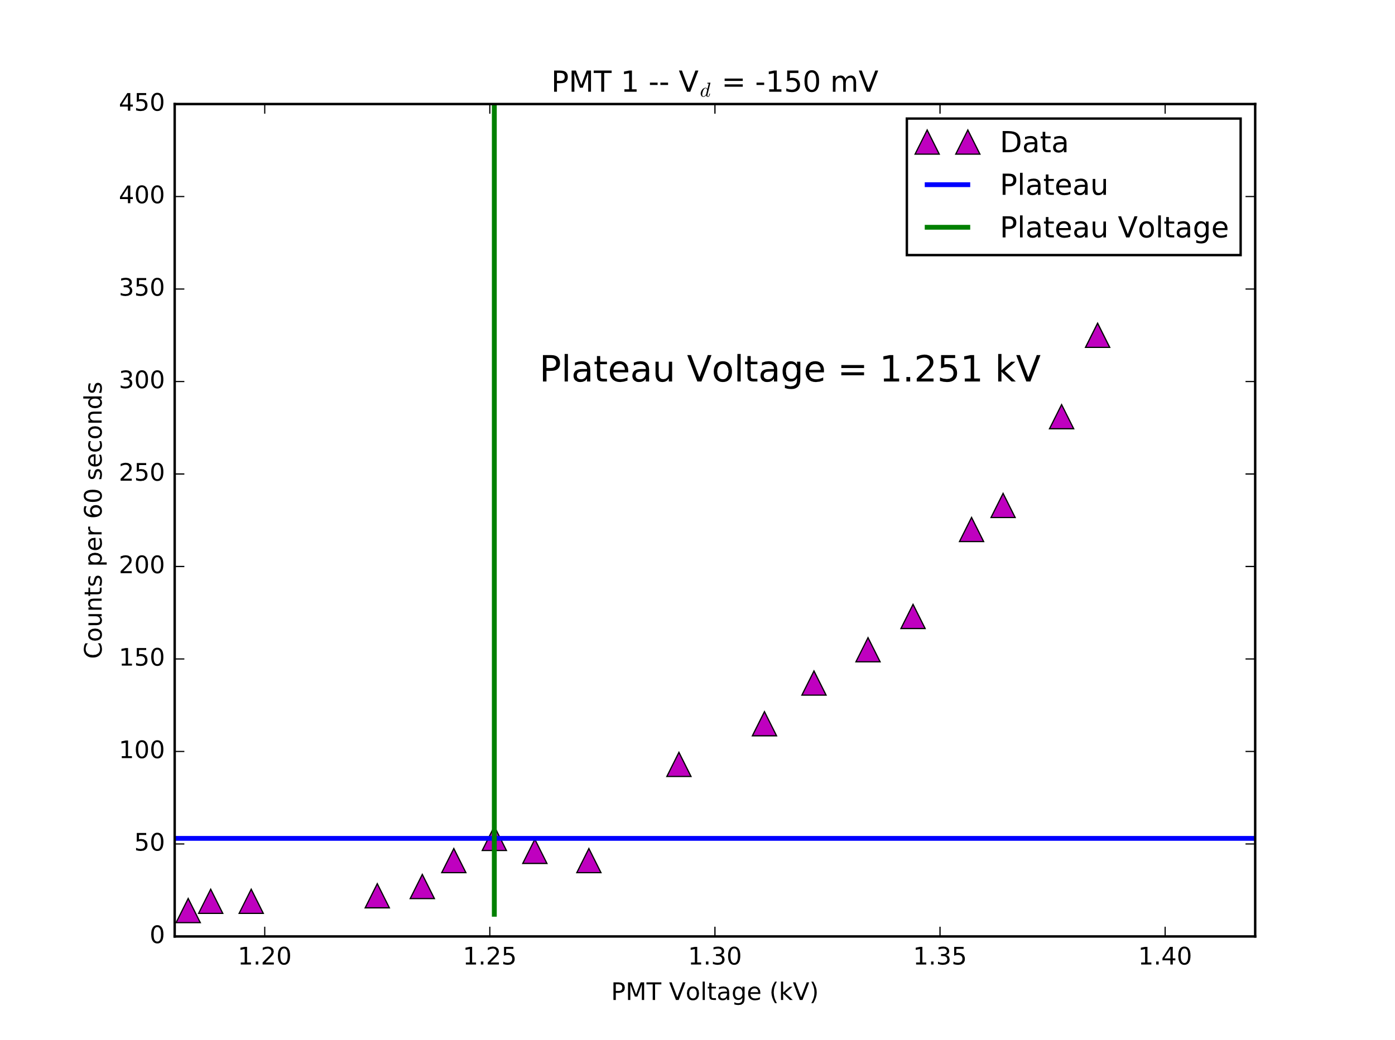
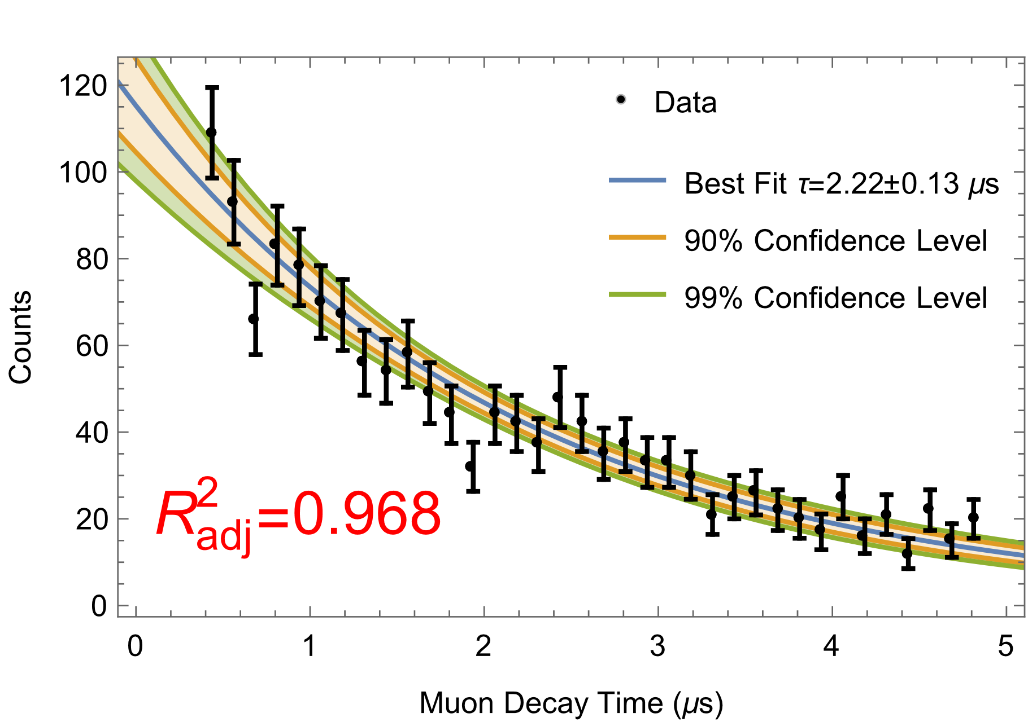
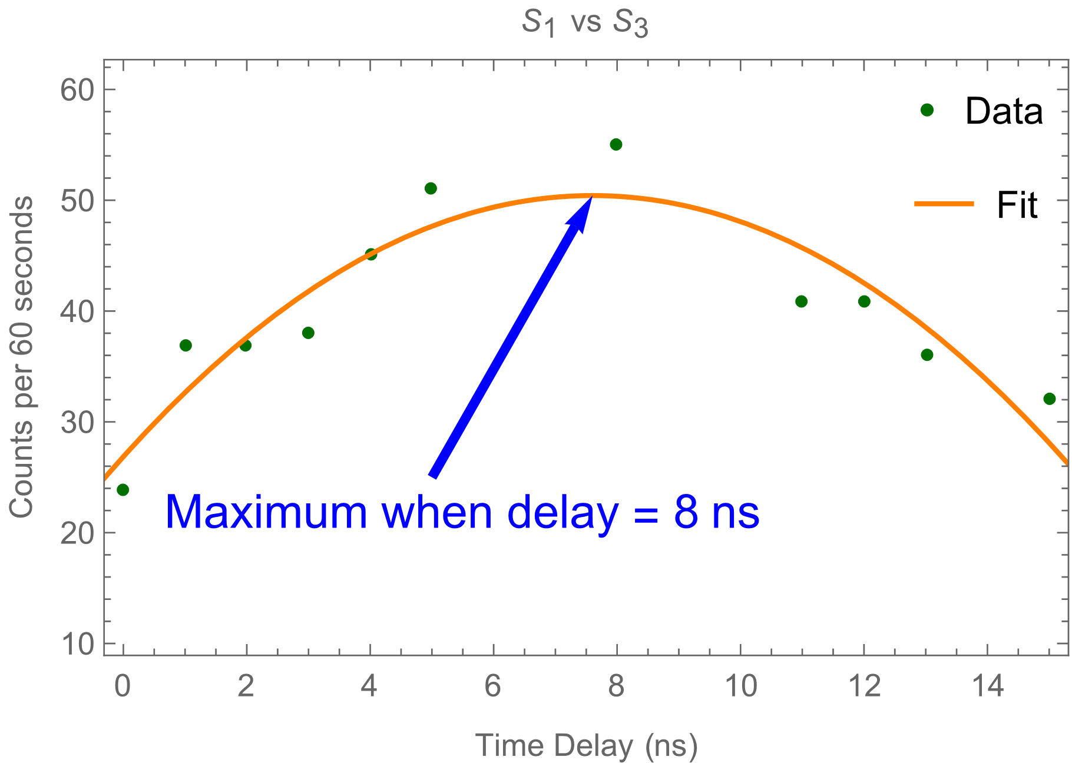







$$ν_{μ}$$
$$μ^{−}$$
$$ℯ^{−}$$
$$W$$
$$\overline{ν_{ℯ}}$$
Figure 1. Feynman diagram of a muon decaying into a mu neutrino, an electron, and an anti-electron neutrino. Muon and electron number is conserved in this diagram.
Figure 2. Oscilloscope data of a muon decay in the PMT (blue), the discriminator’s response (black), and the discriminators threshold, or trigger voltage (red). Signals have been smoothed roughly.
Scintillator 1
$$HV_{1}$$
Discriminator
1
Time
Delay
S1
AND Gate
$$HV_{2}$$
S2
Scintillator 2
Discriminator
2
S3 Veto
START
PHA
$$\overline{TAC}$$
S1
OR
Gate
STOP
$$HV_{3}$$
S2
Scintillator 3
Discriminator
3
S3
Figure 3. Electronic logic and counting circuit used in the experiment. TAC is short for time-to-amplitude converter.
Figure 5. Determination of plateau voltage for the top-most PMT. A voltage of 1.251 kV was selected because it yielded the maximum number of counts and was almost immediately before the sharp increase.
Figure 4. Histogram of decay times from our PHA with error bars (black) and best fit as determined by Mathematica’s NonlinearModelFit (blue). The confidence bands indicate how confident we are that the actual result lies within the band. i.e. we are 90% confident that the actual muon lifetime model lies within the orange band and 99% confident that it lies within the green band. (color online).
Figure 6. Plot of delay calibration between the first and third discriminator. A value of 8 on the x-axis indicates that $S_{3}$ takes 8 ns longer than $S_{1}$ to reach the TAC.

