Slide 1
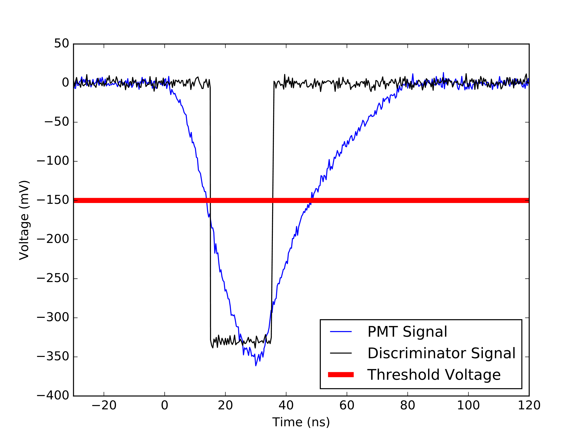






$$ν_{μ}$$
$$μ^{−}$$
$$ℯ^{−}$$
$$W$$
$$\overline{ν_{ℯ}}$$
Figure 1. Feynman diagram of a muon decaying into a mu neutrino, an electron, and an anti-electron neutrino. Muon and electron number is conserved in this diagram.
Figure 2. Oscilloscope data of a muon decay in the PMT (blue), the discriminator’s response (black), and the discriminators threshold, or trigger voltage (red).

