Slide 1
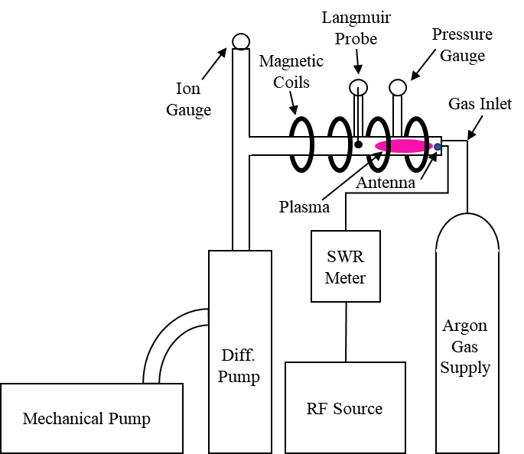
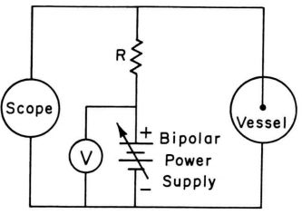
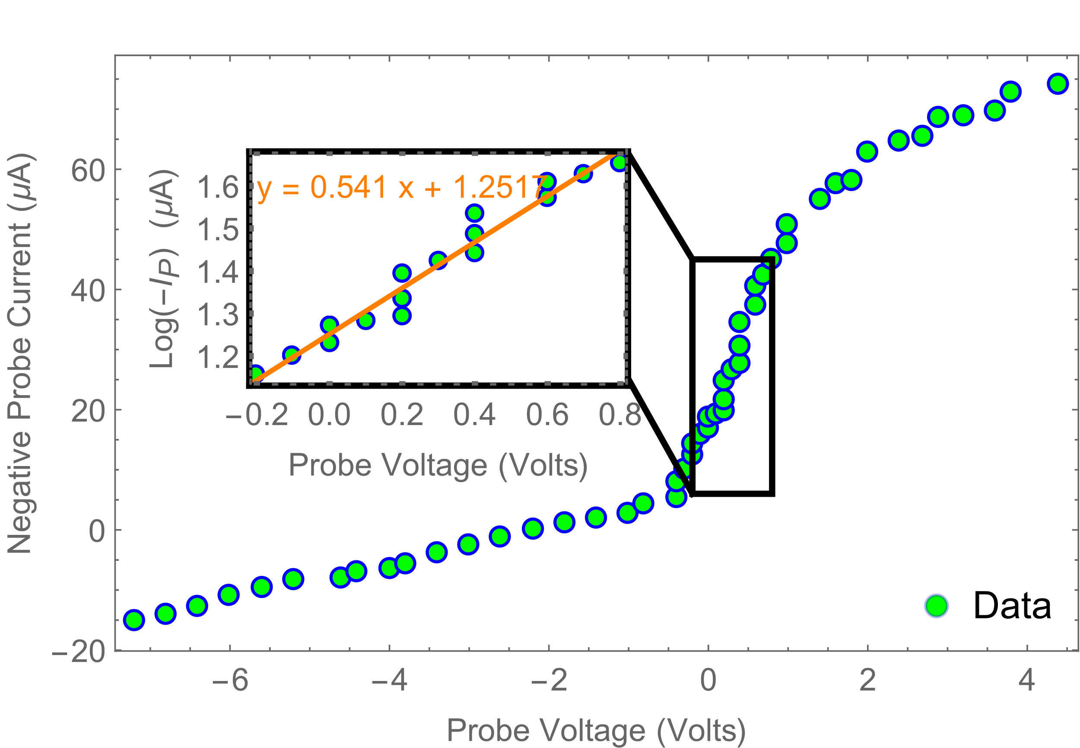
Langmuir Probe
Pressure
Gauge
Magnetic
Coils
Ion Gauge
Gas Inlet
Plasma
Antenna
SWR
Meter
Argon
Gas
Supply
Figure 1. Cartoon schematic of the device and apparatus. “Diff. Pump” refers to the diffusion pump which allows us to pump down to a much lower vacuum than we would be able to with only a mechanical pump. “SWR Meter” refers to the standing wave ratio meter which measures the forward and reflected power from the RF source to determine how much power is being transmitted by the antenna.
Diff.
Pump
Mechanical Pump
RF Source
Figure X. Circuit diagram of our voltage sweeping circuit. R is the resistance of the mixer.
Figure X. Larger plot: negative probe current vs. probe voltage. Smaller plot: Log of the negative probe current vs. probe voltage. The orange line represents the best fit using a linear least squares regression.

