Slide 1
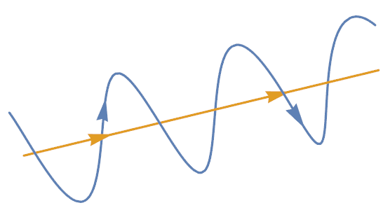
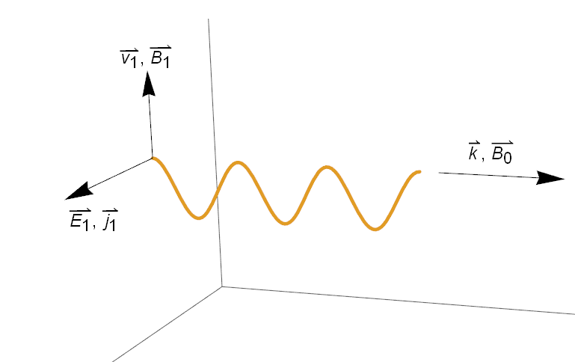
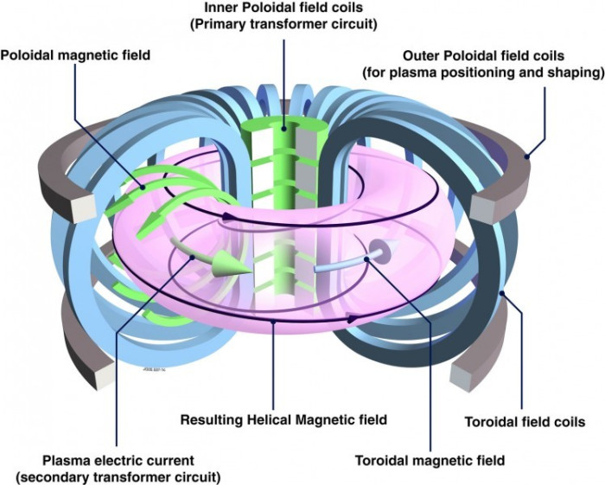


$$B$$
Figure 1. Graphical representation of the path of a charged particle (blue) travelling along a magnetic field line (yellow).
Figure 2. Geometry of an Alfvén wave. The was $k$ along $B_{0}$, $E_{1}$ and $j_{1}$ perpendicular to $B_{0}$ and $B_{1}$ and $v_{1}$ perpendicular to both $B_{0}$ and $E_{1}$.
Not Used. Cartoon of a tokamak device with plasma shown in purple. The blue toroidal field coils produce a strong magnetic field in the toroidal direction. Similarly, the green and grey poloidal field coils create a magnetic field in the poloidal field. The toroidal and poloidal fields combine to form a closed helical magnetic field in the toroidal direction.

Slide 2
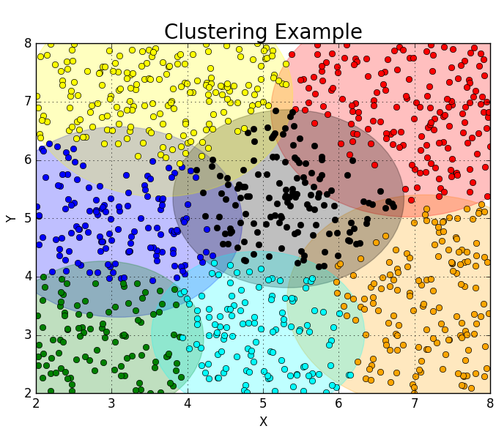
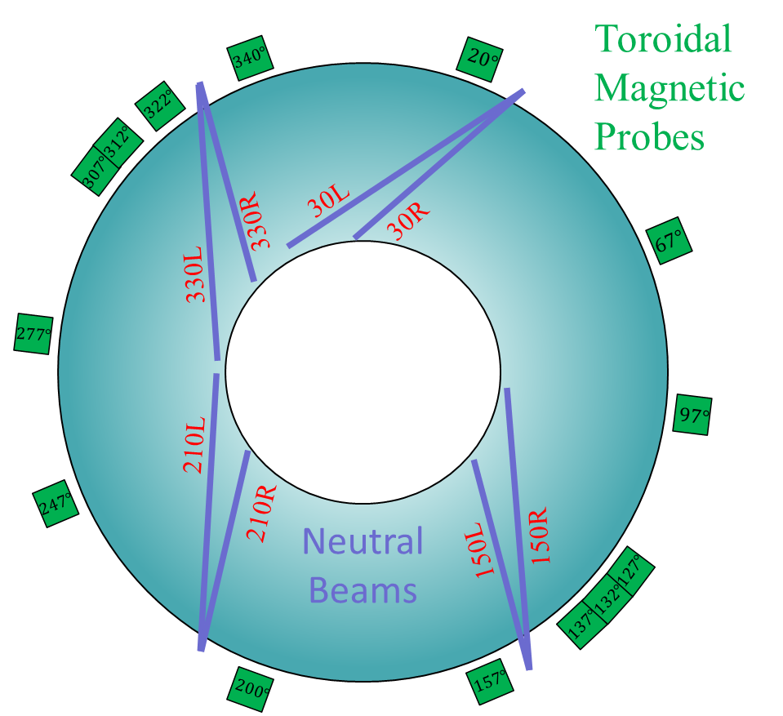
Figure 3. Cartoon of top down view of DIII-D. The 4-pairs of neutral beam injectors are shown in purple and the various toroidal magnetic Mirnov probes are shown in green with their angular position indicated.
Figure 5. Sample output from ClusteringExample.py using 1000 random data points and a k-means algorithm with 7 total clusters.

Slide 3
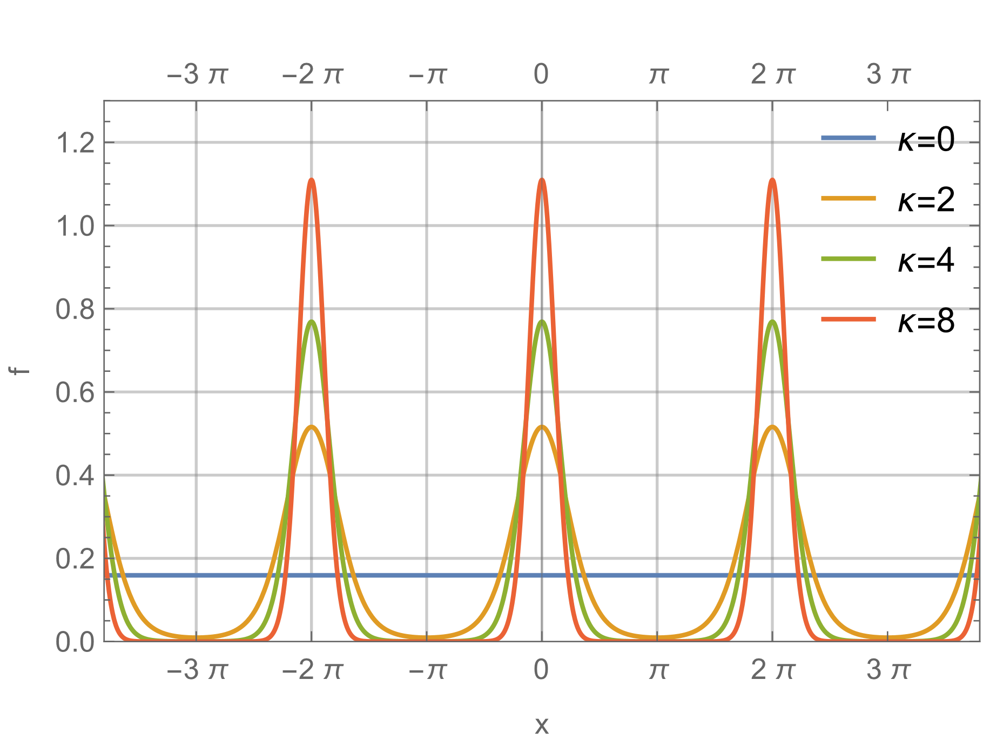
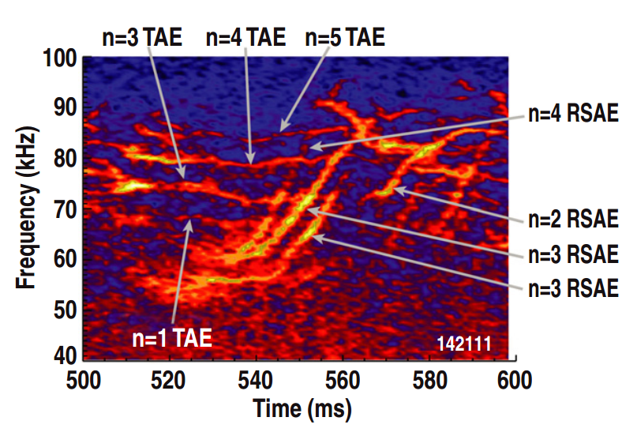
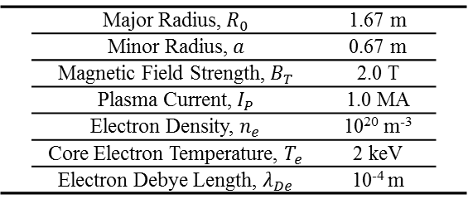

 | Major Radius, $R_{0}$ | 1.67 m
 | Minor Radius, $a$ | 0.67 m
 | Magnetic Field Strength, $B_{T}$ | 2.0 T
 | Plasma Current, $I_{P}$ | 1.0 MA
 | Electron Density, $n_{e}$ | 10²⁰ m⁻³
 | Core Electron Temperature, $T_{e}$ | 2 keV
 | Electron Debye Length, $λ_{De}$ | 10⁻⁴ m
Table 1. Typical plasma parameters at DIII-D.
Figure 4. Example of a von-mises distribution function with the mean, $μ$, centered at 0 with several different $κ$ values. $κ$ set equal to 0 represents a uniform distribution function.
Figure 5. Frequency vs. Time spectrogram for shot 142111 with different Alfvén eigenmodes identified. Figure taken from.
 | Shot | Time Window (ms)
F | 153071 | 2800 – 3000 | F
F | 153072 | 2800 – 3000 | F
F | 152932 | 2500 – 2700 | F
F | 152938 | 3000 – 3200 | F
F | 157399 | 2300 – 2500 | F
F | 157400 | 2300 – 2500 | F
F | 157401 | 2300 – 2500 | F
F | 157402 | 2300 – 2500 | F
Table 2. Shot list and time windows used for the verification process. Each shot has a 200 ms time window which we are interested in.

Slide 4
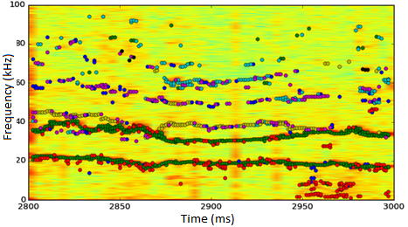
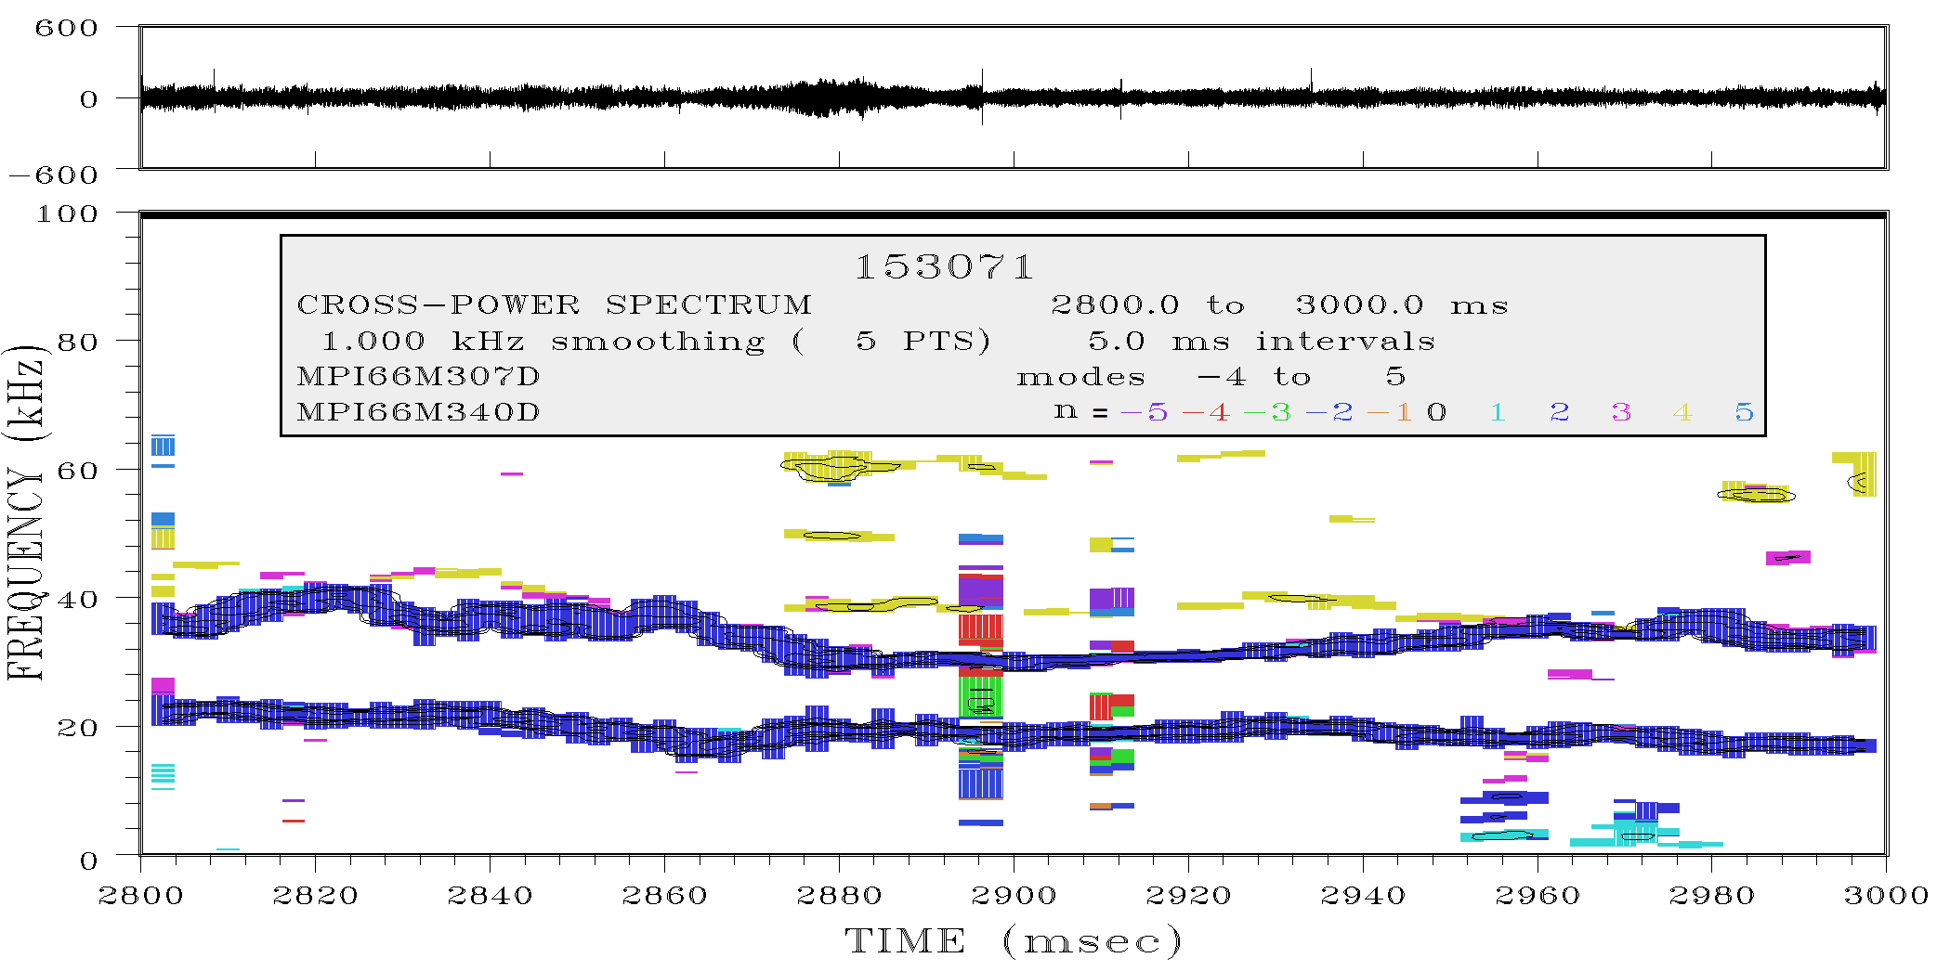
Figure X. Comparison with our clustering algorithm (top) with a different mode identifying algorithm (bottom). Top: Different clusters plotted in different colors. Bottom: Different toroidal mode numbers plotted in different colors.

