Slide 1
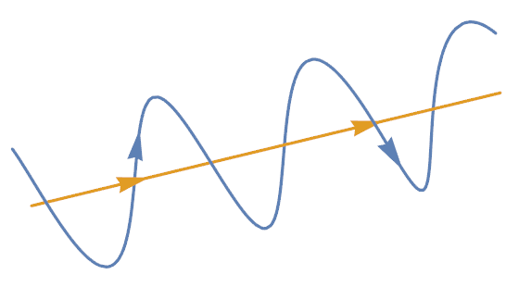
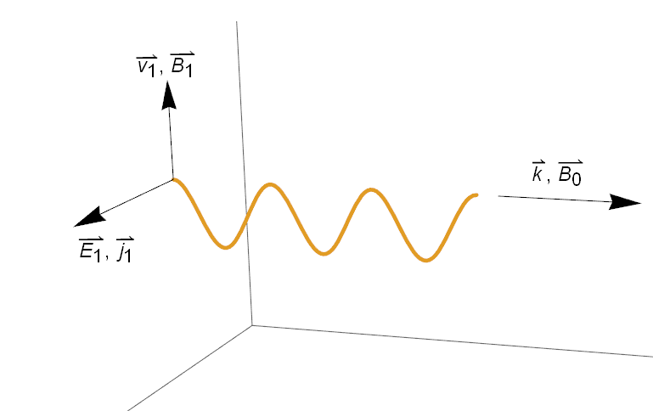


$$B$$
Figure 1. Graphical representation of the path of a charged particle (blue) travelling along a magnetic field line (yellow).
Figure 2. Geometry of an Alfvén wave. The was $k$ along $B_{0}$, $E_{1}$ and $j_{1}$ perpendicular to $B_{0}$ and $B_{1}$ and $v_{1}$ perpendicular to both $B_{0}$ and $E_{1}$.

