Slide 1
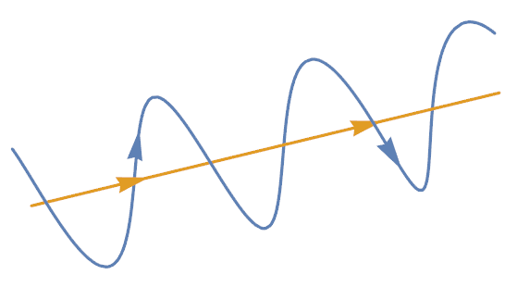

$$B$$
Figure 1. Graphical representation of the path of a charged particle (blue) travelling along a magnetic field line (yellow).

