Slide 1
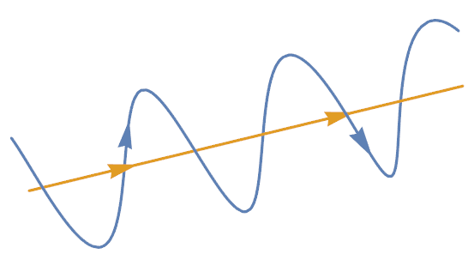
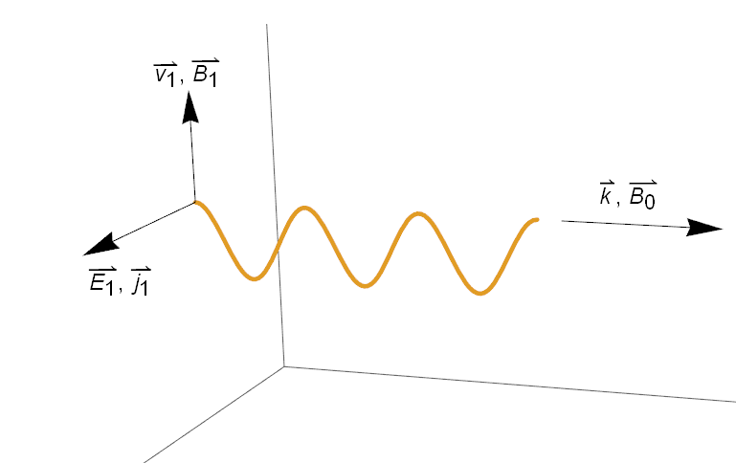
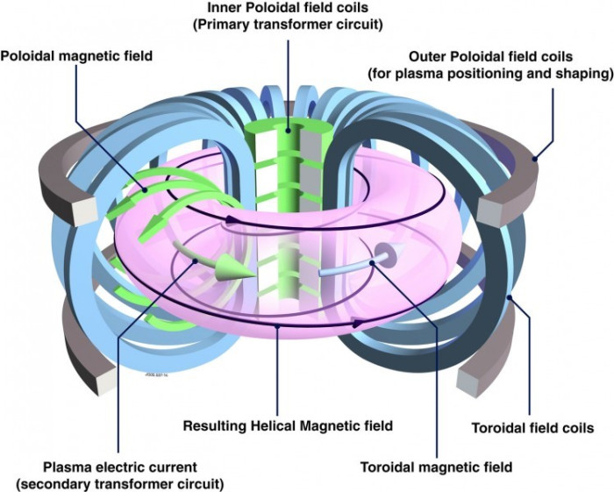


$$B$$
Figure 1. Graphical representation of the path of a charged particle (blue) travelling along a magnetic field line (yellow).
Figure 2. Geometry of an Alfvén wave. The was $k$ along $B_{0}$, $E_{1}$ and $j_{1}$ perpendicular to $B_{0}$ and $B_{1}$ and $v_{1}$ perpendicular to both $B_{0}$ and $E_{1}$.
Figure 3. Cartoon of a tokamak device with plasma shown in purple. The blue toroidal field coils produce a strong magnetic field in the toroidal direction. Similarly, the green and grey poloidal field coils create a magnetic field in the poloidal field. The toroidal and poloidal fields combine to form a closed helical magnetic field in the toroidal direction.

Slide 2
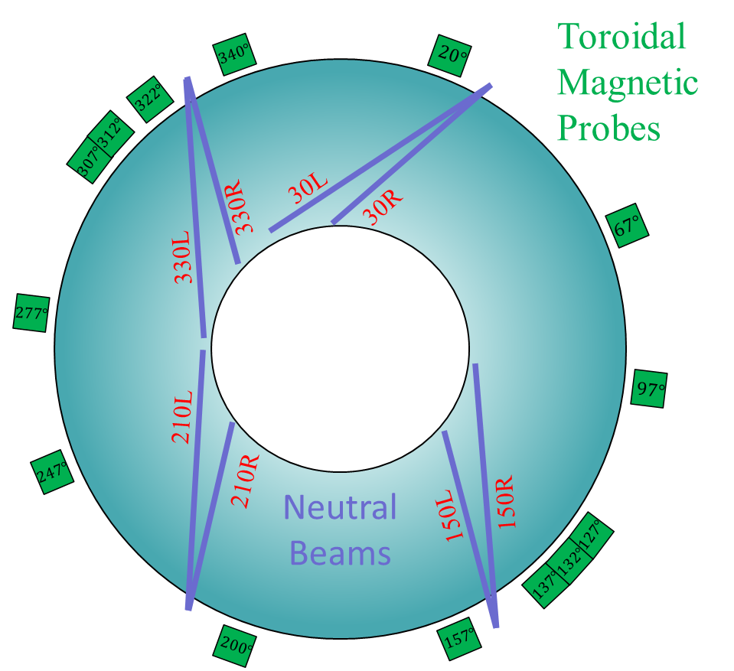
Figure 4. Cartoon of top down view of DIII-D. The 4-pairs of neutral beam injectors are shown in purple and the various toroidal magnetic Mirnov probes are shown in green with their angular position indicated.

