Slide 1
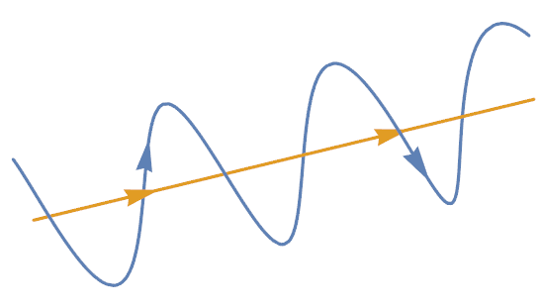
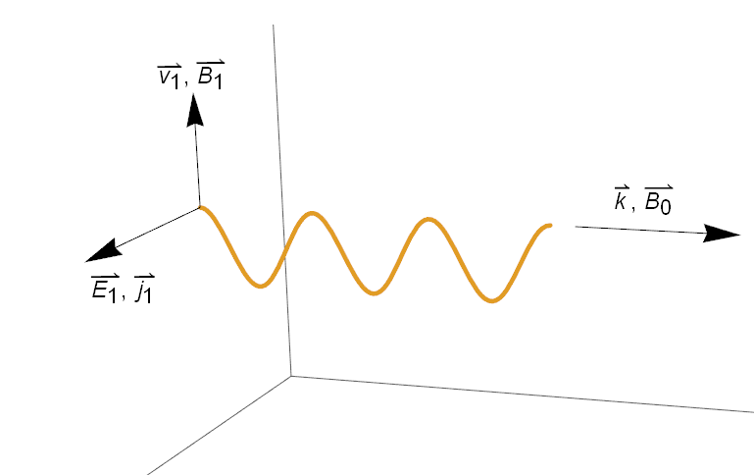
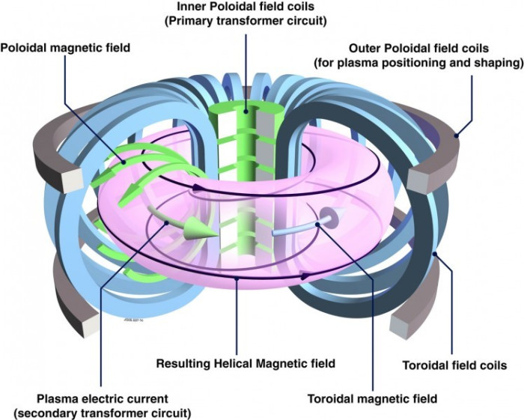


$$B$$
Figure 1. Graphical representation of the path of a charged particle (blue) travelling along a magnetic field line (yellow).
Figure 2. Geometry of an Alfvén wave. The was $k$ along $B_{0}$, $E_{1}$ and $j_{1}$ perpendicular to $B_{0}$ and $B_{1}$ and $v_{1}$ perpendicular to both $B_{0}$ and $E_{1}$.
Not Used. Cartoon of a tokamak device with plasma shown in purple. The blue toroidal field coils produce a strong magnetic field in the toroidal direction. Similarly, the green and grey poloidal field coils create a magnetic field in the poloidal field. The toroidal and poloidal fields combine to form a closed helical magnetic field in the toroidal direction.

Slide 2
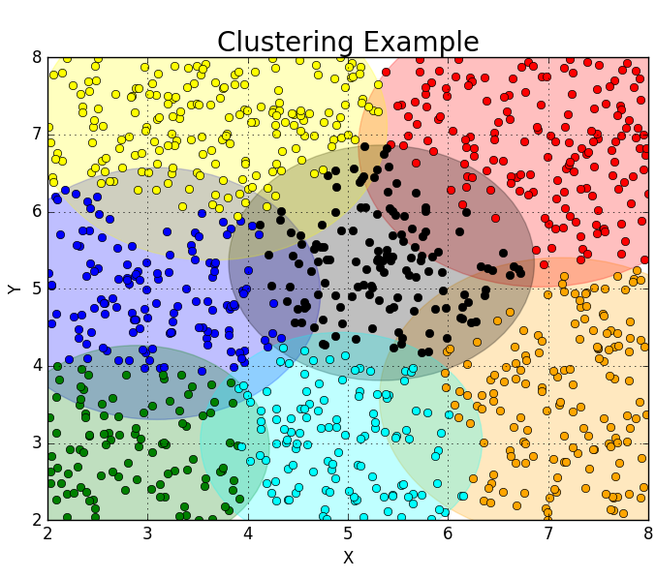
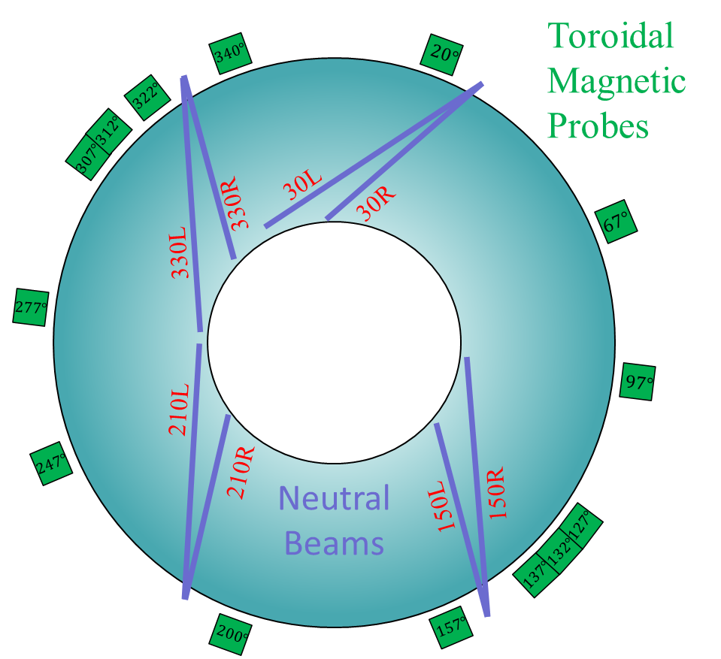
Figure 3. Cartoon of top down view of DIII-D. The 4-pairs of neutral beam injectors are shown in purple and the various toroidal magnetic Mirnov probes are shown in green with their angular position indicated.
Figure 5. Sample output from ClusteringExample.py using 1000 random data points and a k-means algorithm with 7 total clusters.

