Slide 1
Elderly People Remote Monitoring with Human Activity Recognition (HAR) Based on Smartphone Data
Submitted By:
Asraful Islam Kajol (ID:18101082)
Anushka Azad (ID:18101084)
Reem Hossain (ID:18101100)
1

Slide 2
Context
Motivation
Social/Ethical Issue
Environmental/Sustainability Issue
Background Study
Proposed Solution
Time Schedule
CEP Mapping

Slide 3
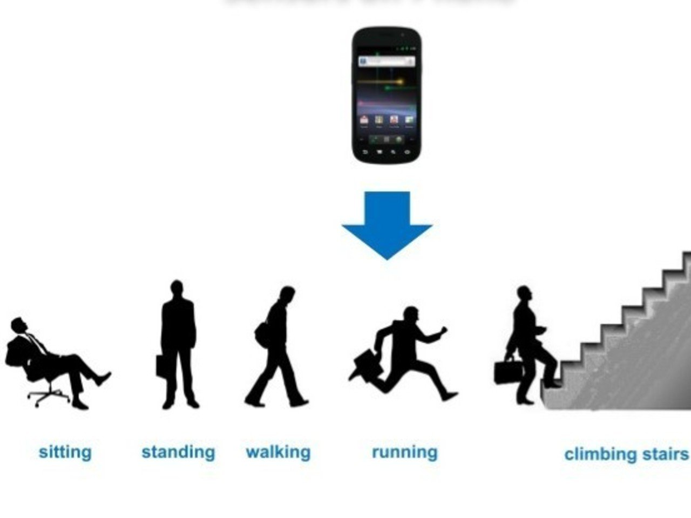
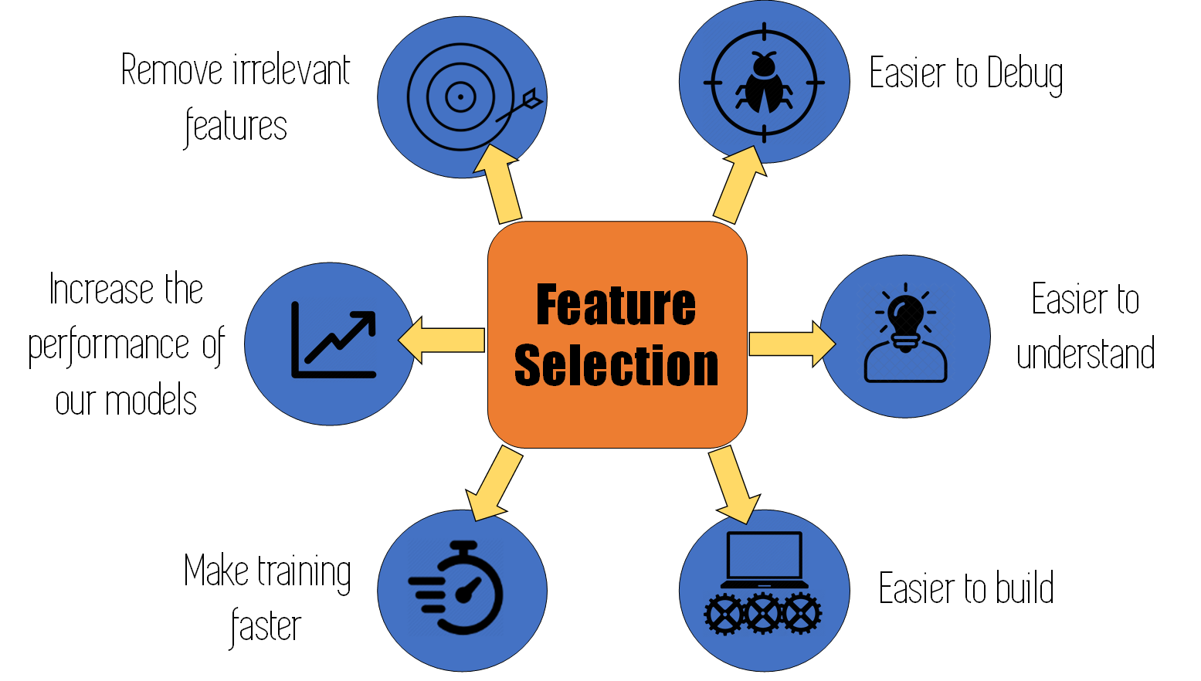
Motivation
Wide range of HAR applications.
Remote monitoring of daily activities.
Potentially assist to manage and reduce the chance of many diseases.
State of fitness, thereby depicting the standard of people’s life.
Effective monitoring and recognition of physical activities.
In less time and effective.

Slide 4

Social/Ethical Issues
No one can commit any illegal activities.
Personal privacy shall be protected.
Data is not transmitted or shared without user authority.
Integrity of data will be ensured.

Slide 5

Environmental/Sustainability Issues
Potential to accelerate environmental degradation.
Saves energy
limited hardwares is required

Slide 6

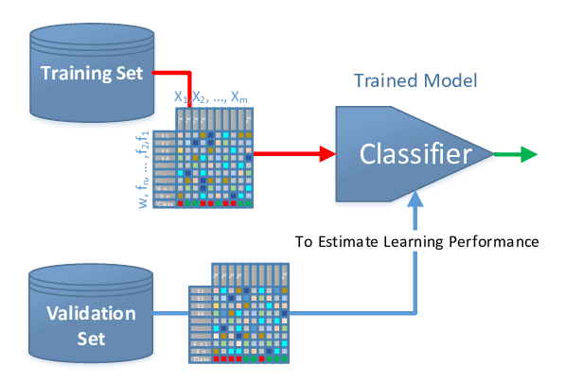
Background Study
Human Activity Recognition (HAR)
Machine Learning
Classifiers

Slide 7
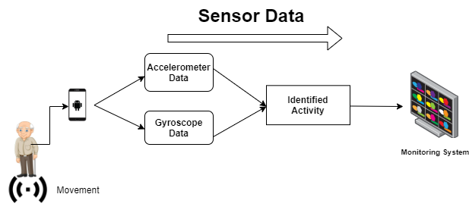
Proposed Solution
Figure-1: Basic Visualization of the Proposed Model

Slide 8
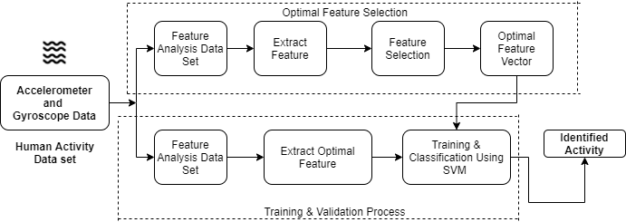
Proposed Solution Cont...
Figure-2: Sensor Data Classification and Identification of Activities.

Slide 9
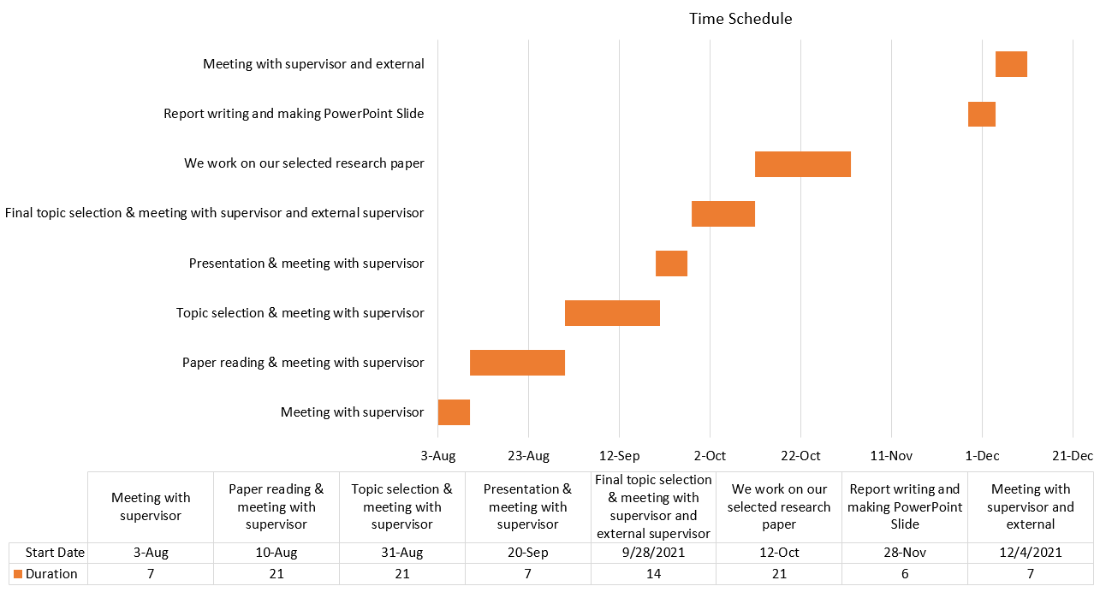
Time Schedule

Slide 10
CEP Mapping
How P’s are addressed through the research paper and mapping among Ps, COs, and Pos:
Ps | Attribute | How Ps are addressed through the project | COs | POs
P1 | Depth of Knowledge Requirement | Learning about supervised learning and classification algorithms, design, backend (Machine learning), (K5, K6). | CO1 CO4 CO5 CO8 CO10 | PO2 PO6 PO8 PO11 PO1
P2 | Range of Conflicting Requirement | Conflicting requirement: lots of sensor data we need for our research proposal may not be close to validation points. | CO1 CO2 | PO2 PO3
P3 | Depth of Analysis Required | Depth of analysis of requirements is needed to ensure system performance. | CO1 CO4 CO5 CO8 | PO2 PO6 PO8 PO11

Slide 11
CEP Mapping Cont….
P4 | Familiarity of Issues | To prevent various difficulties to handle smartphone disutility, accelerometer and gyroscope inefficacy, and error in the result of the classifier. | CO9 | PO12
P7 | Interdependence | Project involves a number of interdependent subsystems (components) like smartphones, monitoring systems. | CO8 | PO11

Slide 12
CEP Mapping Cont...
How A’s are addressed through the research paper:
As | Attribute | How As are addressed through the research paper
A1 | Range Of Resources | Our research paper requires the use of diverse resources including users and monitoring using the motion sensor data of activities of elder people.
A2 | Level of Interaction | Human activity recognition requires much more accuracy to our proposed system.

Slide 13
CEP Mapping Cont...
A3 | Innovation | This paper needs to be updated with innovative and creative ideas to improve the performance of sensor data.
A4 | Familiarity | To prevent various difficulties to handle smartphone disutility, accelerometer and gyroscope inefficacy and error in the result of classifier and also apply them into any future work.

Slide 14
Thanks!
Any questions?

