Slide 2
Pheromone Illumina library Giovanni Schiesaro

Slide 3
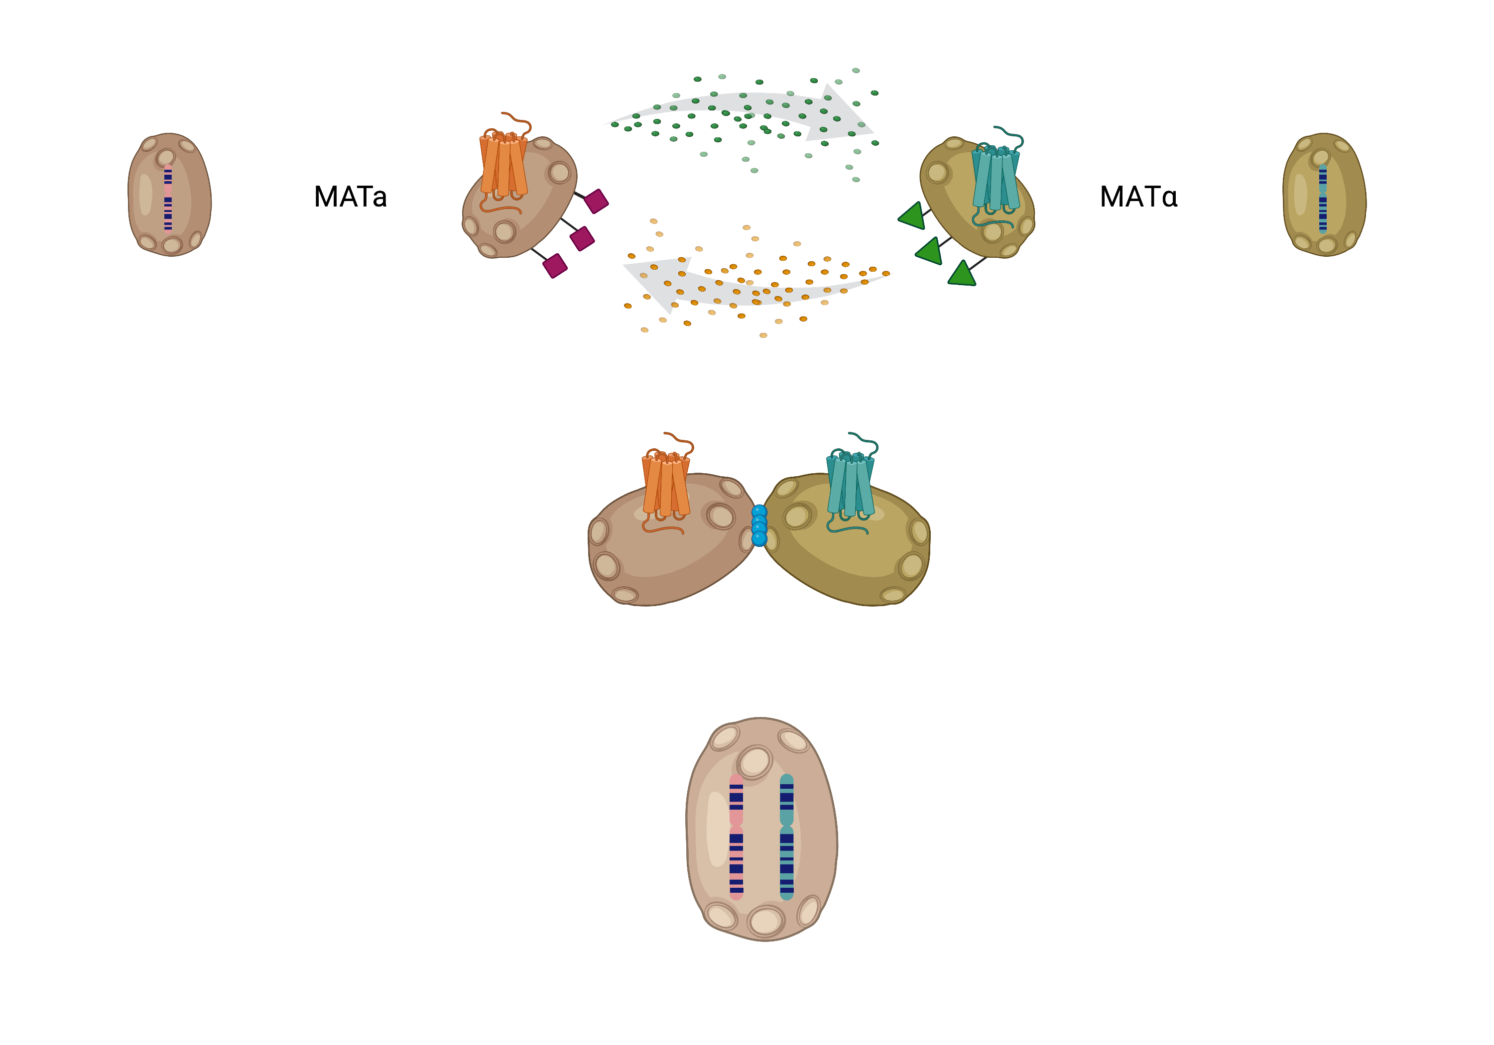
Can we exploit yeast mating for investigating receptor-ligand interaction?
candidate peptide
Ste2
hGPCR
messenger strain
Receiver strain
α factor
Selection of diploids that contains the association receptor-ligand in double selection media

Slide 4
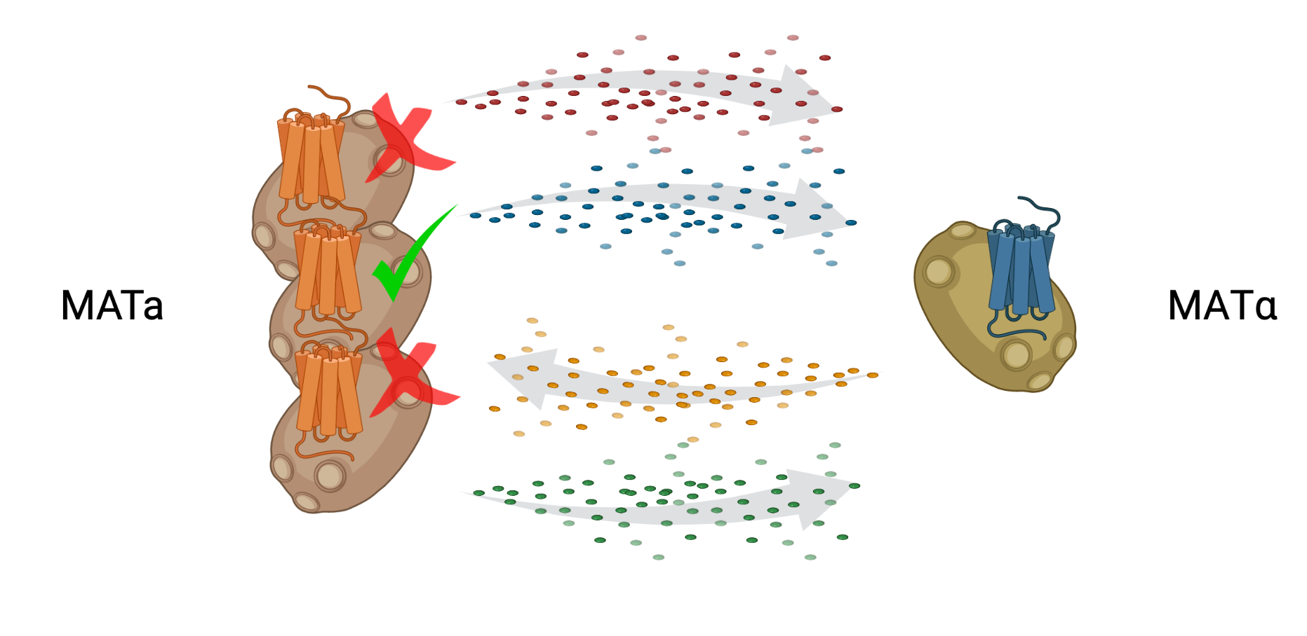
Many pheromones strains against one GPCR strain Pheromone Agonist library
Library of variants
receptor
WCXXXPGQPCW
8.000 variants at the AA level
≈ 262.000 variants at the DNA level
Solution space in these 3 AA

Slide 5
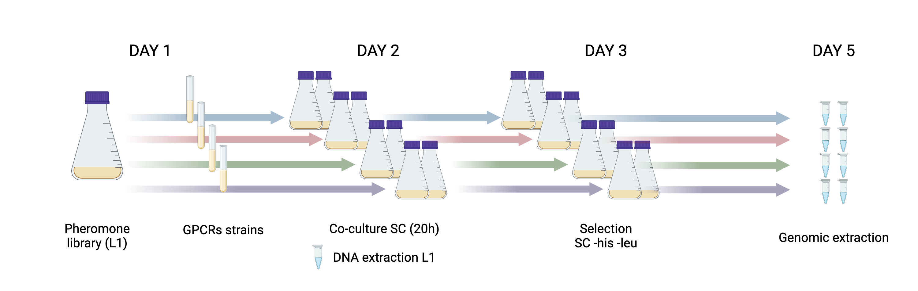
Workflow
4 GPCRs
Each GPCR has been co-incubated with the pheromone library (2 biological replicate)

Slide 6
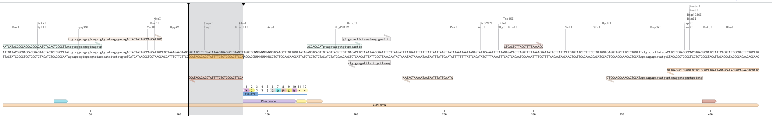
What I did
Alligned every read with a reference sequence: “AGCTTCAGCCTCTCTTTTATCGAGAGATACC”
After the alignment, return the DNA pheromone seq on the right.
Merge the two datasets on the DNA seq, and calculate the average frequency of any DNA seq
For every value add the translation WCXXXPGQPCW** (where * is a stop codon)
Merge the dataset with the starting library 9L1 at the DNA level
sum sequences that have the same translation
Normalize each translation with the formula:
(Average 2 bio rep frequency – initial frequency)/initial frequency

Slide 7
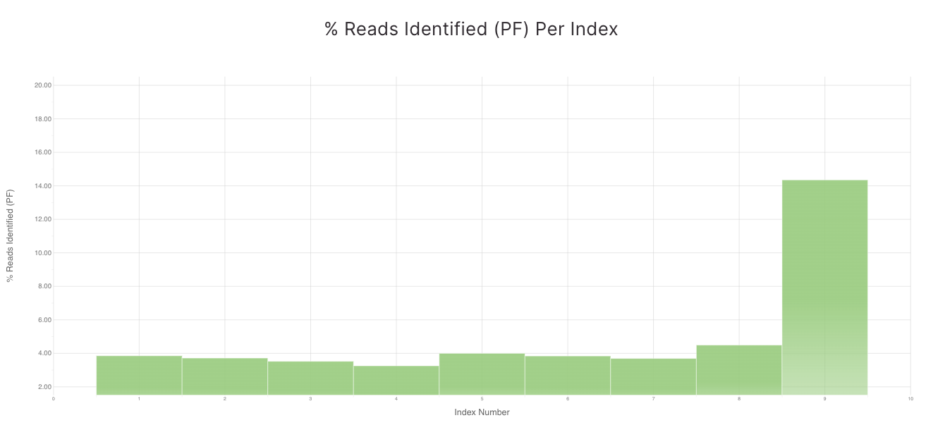
ID and results
Sample_ID | Sample_Name | Description | I7_Index_ID | index | I5_Index_ID | index2 | Sample_Project
1FgAgo1 | 1FgAgo1 |  | S501 | GCGATCTA | N701 | TAAGGCGA | PheromoneAgonistLibrary
2FgAgo2 | 2FgAgo2 |  | S501 | GCGATCTA | N702 | CGTACTAG | PheromoneAgonistLibrary
3BbAgo1 | 3BbAgo1 |  | S501 | GCGATCTA | N703 | AGGCAGAA | PheromoneAgonistLibrary
4BbAgo2 | 4BbAgo2 |  | S501 | GCGATCTA | N704 | TCCTGAGC | PheromoneAgonistLibrary
5BcAgo1 | 5BcAgo1 |  | S501 | GCGATCTA | N705 | GGACTCCT | PheromoneAgonistLibrary
6BcAgo2 | 6BcAgo2 |  | S501 | GCGATCTA | N706 | TAGGCATG | PheromoneAgonistLibrary
7FoAgo1 | 7FoAgo1 |  | S501 | GCGATCTA | N707 | CTCTCTAC | PheromoneAgonistLibrary
8FoAgo2 | 8FoAgo2 |  | S501 | GCGATCTA | N708 | CAGAGAGG | PheromoneAgonistLibrary
9L1 | 9L1 | Starting library | S501 | GCGATCTA | N709 | GCTACGCT | PheromoneAgonistLibrary
All library pooled togher
≈ 55% starting library
≈45 % rest

Slide 8
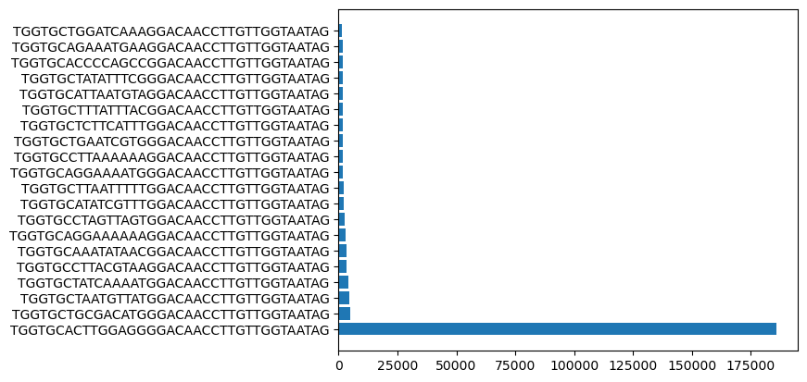
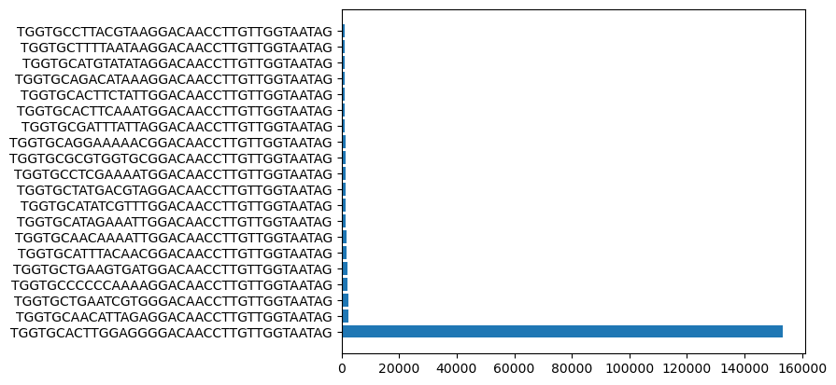

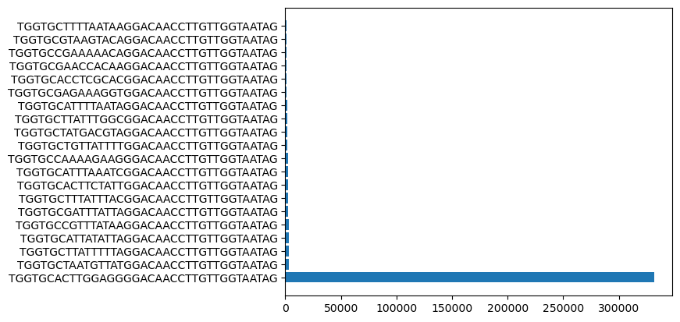
Top 20 counts in the libraries (1 bio rep)
Fg GPCR
Bb GPCR
By looking at the total counts
1 seq is way more present
than the rest
This seq is coding for a know pheromone.
Bc GPCR
Fo GPCR

Slide 9
Issues I faced
No quality control on the sequences. I’ve aligned everything with my reference sequence.
Arbitrary thresholds
(10 reads for every mini library and 50 for the starting library)
Different thresholds give different results
There is a clear result: In each library the pheromone seq WCTWRPGQPCW has been highly enriched. I’m not sure about the rest. NB: at the DNA level this sequence was the most present in the starting library (9L1) without any enrichment (physiological role?)

Slide 10
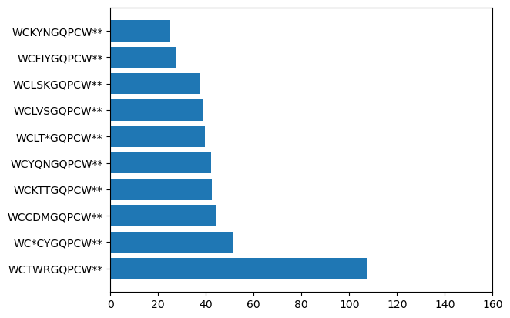
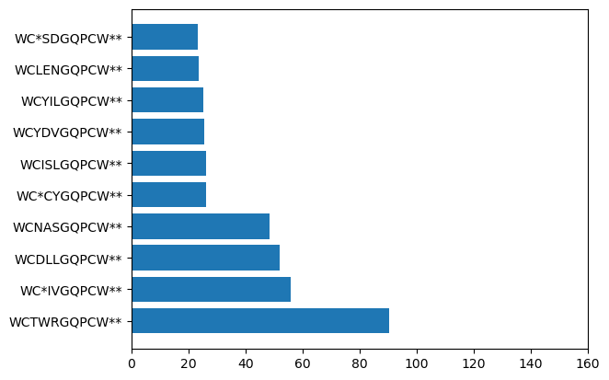
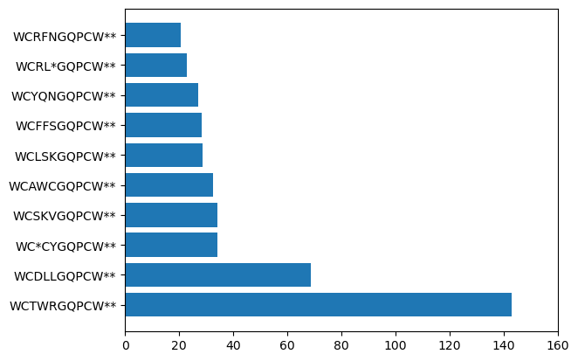
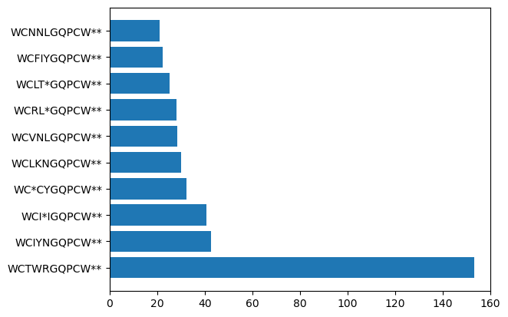
Fg GPCR
Bb GPCR
Results after normalization
Bc GPCR
Fo GPCR
With the 2 bioreps

Slide 11
Pheromone Illumina library Data processing update Mathias

Slide 12
Processing Amplicon reads
Used the Natrix workflow:
Quality Control (QC) - FastQC is used for initial quality check
Filtering – prinseq filters out low quality reads
Dereplication & Clustering – DADA2 is used to cluster reads into Amplicon Sequence Variants (ASVs).
Chimera Removal - VSEARCH is used for chimera detection and removal.
Final Data - The count table is saved in CSV format. (I had to modify the code slightly here because of the high number of counts).
Normalization – the count table is normalized to Reads per Million (RPM) to allow for cross sample comparisons.

Slide 13
QC
QC looks good – we lose around 0.3 – 0.5% of the reads.
Total number of reads after QC

Slide 14
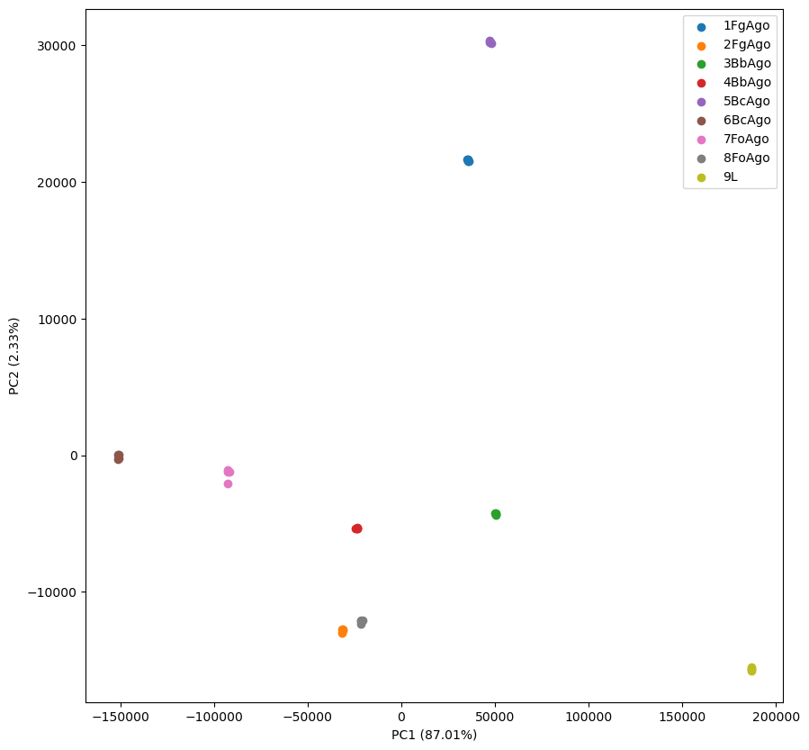
Thresholding
Thinking of using correlation between biological replicates to determine a threshold (noise is less likely to be correlated between replicates, so removing the noise should increase the correlation).
Need help defining the replication.
How were the samples sequenced (number of lanes?)

Slide 15
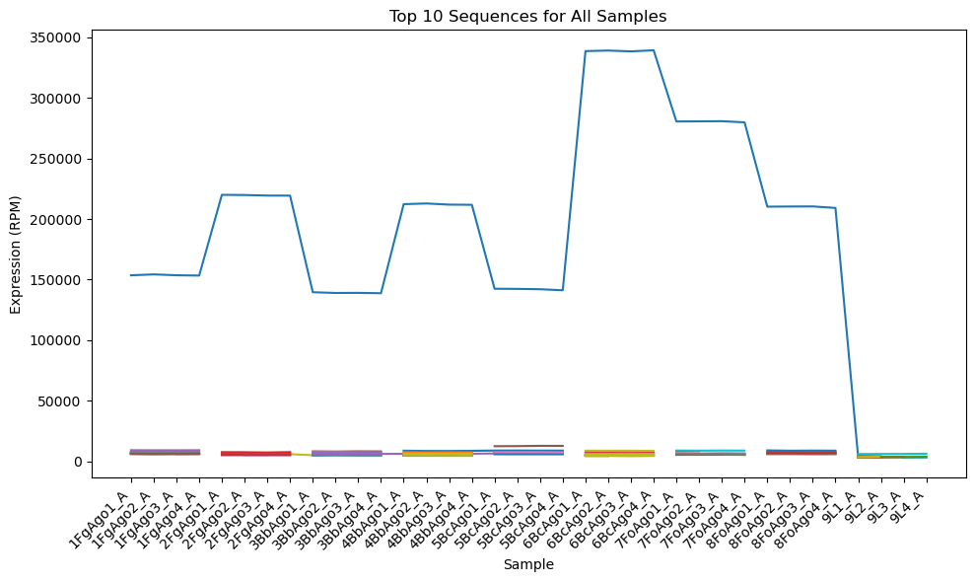
Prelim results
There is one sequence that is dominating all samples:
ACTACTATTGCCAGCATTGCTGCTAAAGAAGAAGGGGTATCTCTCGATAAAAGAGAGGCTGAAGCTTGGTGCACTTGGAGGGGACAACCTTGTTGGTAATAGAGGACAGATGTAGATACGTTGTTGACACTTCTAAATAAGCGAATTTCTT

