Slide 1
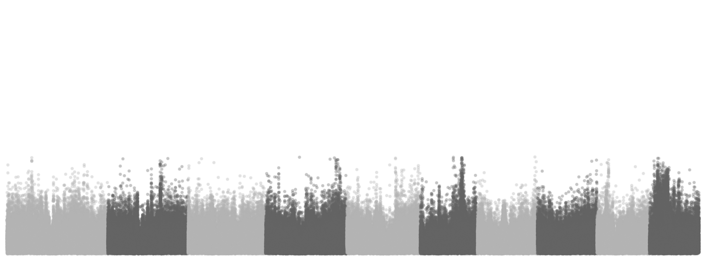
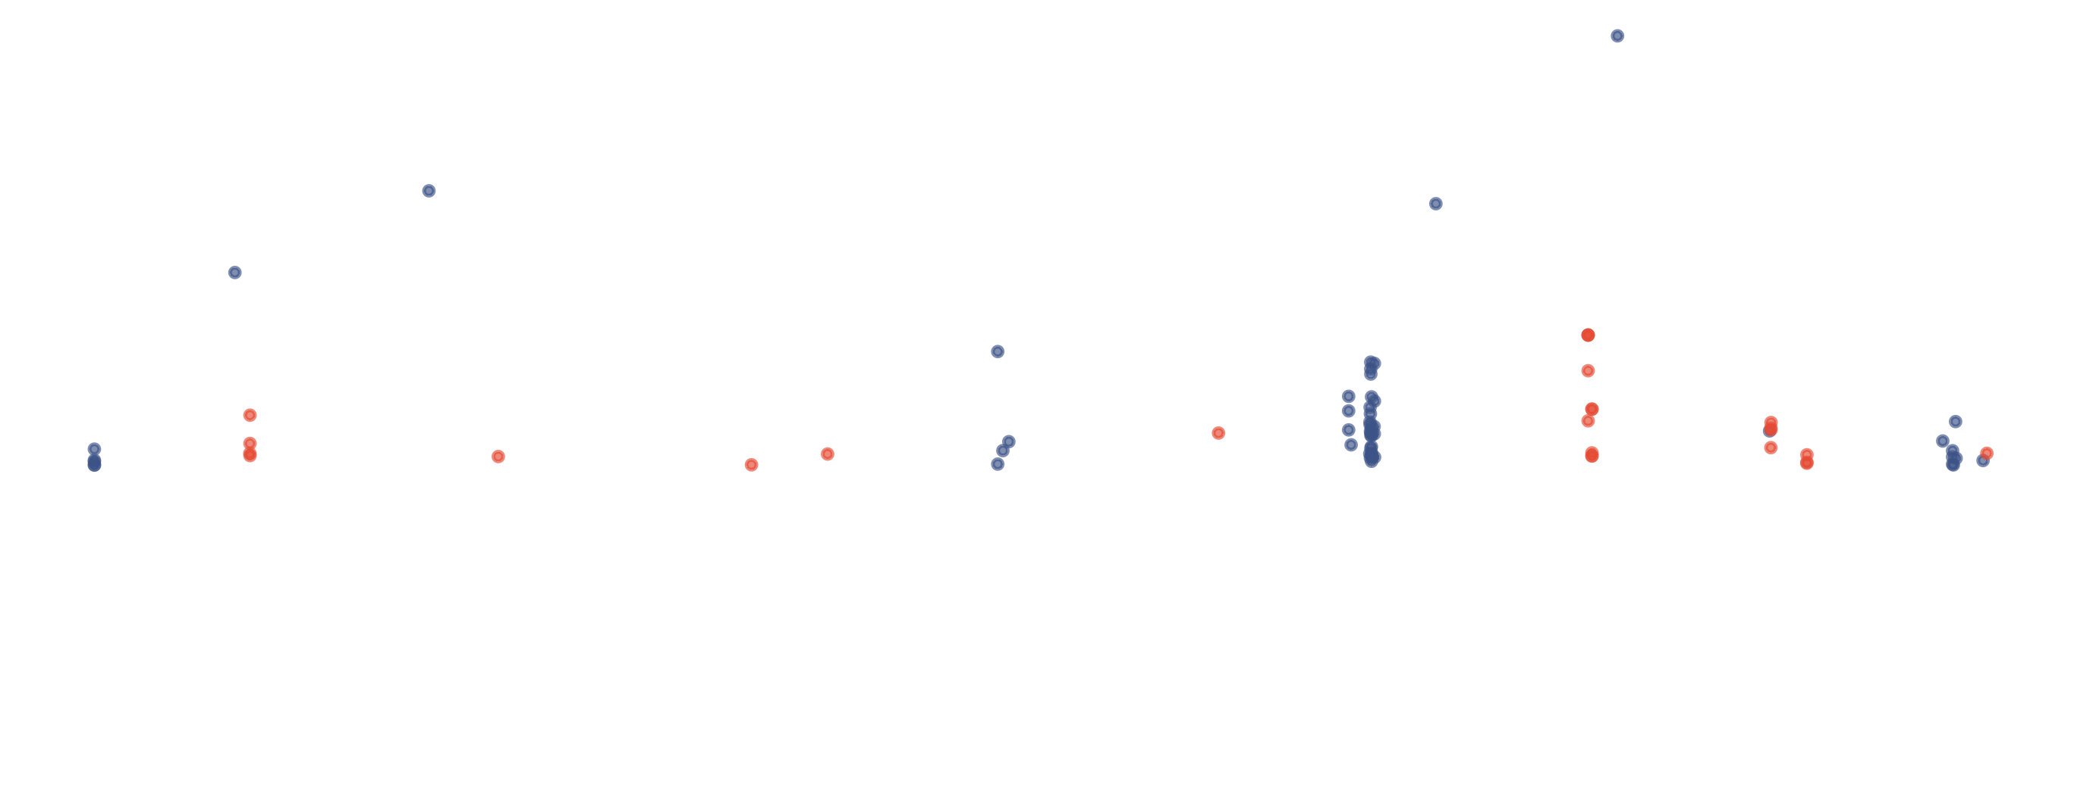
Pantoea
Burkholderia
10
)
P
(
10
g
o
l
−
5
0
Chr1
Chr2
Chr3
Chr4
Chr5
Chr6
Chr7
Chr8
Chr9
Chr10
Chromosome

