Slide 1
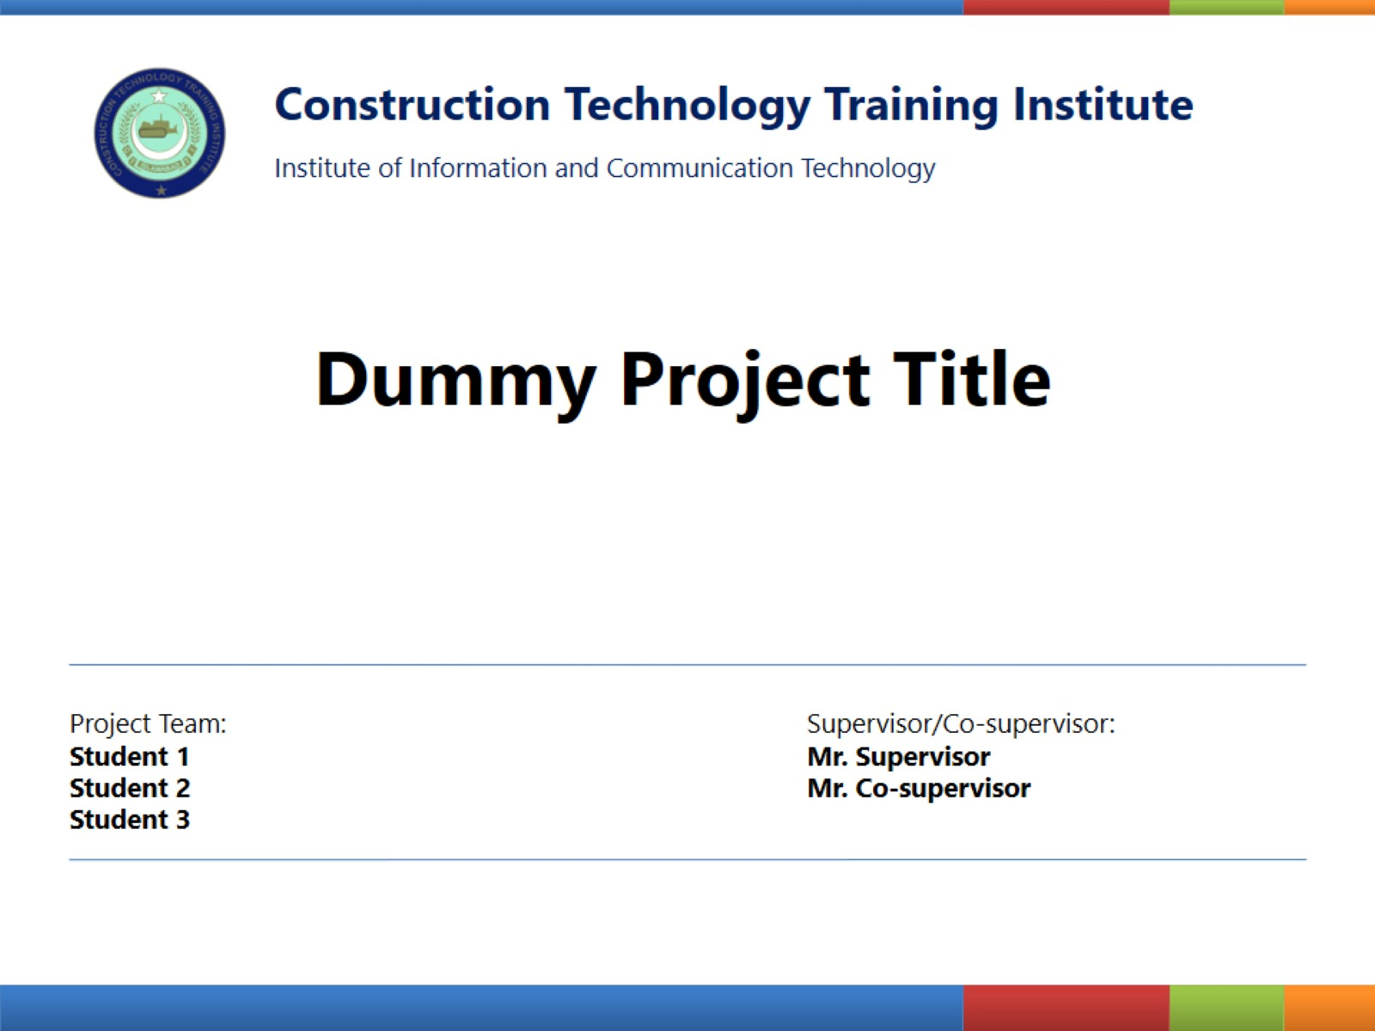
Construction Technology Training Institute
Institute of Information and Communication Technology
FINAL YEAR PROJECT
SYNTHETICA
Deepfake Image Detection System
PROJECT TEAM:
SUPERVISOR:
Uzair Ghani
Muhammad Uzair
Umer Yasir
Muhammad Bilal
Muhammad Sufyan
Mr. Hassan Ayaz
ICT Department, CTTI Islamabad
SESSION: 2023 - 2026

Slide 2
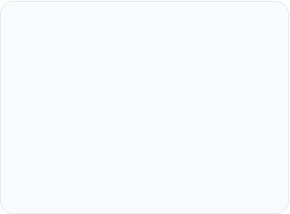





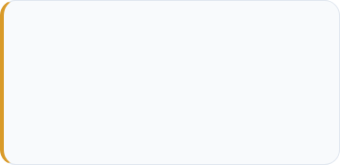
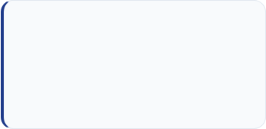
Problem Statement
Across every professional sector, the lack of verification tools is creating a "Post-Truth" environment.
Social Media
Rapid spread of viral
misinformation.
Journalism
AI documents bypass
manual KYC checks.
Legal
Courts face fabricated
"Deepfake Evidence".
Banking
AI documents bypass
manual KYC checks.
The Alarming Statistics
900%
Annual Growth
Flooding digital channels faster than manual monitoring can handle.
>50%
Human Inaccuracy
Trained experts fail at detection, equating to a random coin flip.
60%
Synthetic Content
Analysts estimate nearly all online visual
media will be AI-generated by 2026.

Slide 3


Problem Statement
Meet Ahmad, a Digital Forensic Specialist. He is the first line of defense, but he is currently fighting an impossible battle .
The Naked Eye Limitation
The Weight of Responsibility
Modern AI forgeries are flawless. Human detection through pixel inspection is no longer effective.
Verifying a fake as "Real" cements fraudulent narratives into official records. There is zero room for human error.
The Technology Void
The Trust Crisis
Experts are increasingly forced to guess. In digital forensics, guessing is a systemic failure.
Relying on standard photo viewers leaves experts completely vulnerable to sophisticated AI forgeries.

Slide 4
Project Introduction
For professionals like Ahmad, who did not even know a solution was possible, Synthetica serves as the first line of defense.
From Guesswork to Science: It is a high-performance detective engine designed to tell the investigator exactly what they cannot see: Is this image Real or Fake.
A New Standard of Truth: Delivers a 98.46% validated accuracy rate, establishing a scientific foundation for forensic reporting.
Immediate Accessibility: Accessible by web, the portal processes uploads and generates
verdicts in under 14 seconds.
Empowering the Expert: It gives him the "Digital Microscope" he was missing, allowing him to regain control over the integrity of his work.

Slide 5

Aims & Objectives
Performance: Zero latency via localized inference.
Detection: Achieve >98% accuracy.
Pipeline: Implement a Double-Tier system for result reliability
Explainability: Generate Grad-CAM visual heatmaps.
Persistence: Cloud-based forensic audit logs.

Slide 6


Key Features
Beyond the "Black Box" (Explainable AI)
Moves beyond binary detection by providing visual Grad-CAM heatmaps and easy to understand graphs to explicitly prove where and how an image was manipulated.
Sovereign Balanced Ensemble (SBE)
Calculates a highly robust final verdict using a refined mathematical formula combining the models and different libraries
Cross-Platform Availability
Features a responsive web architecture ensuring full functionality across both high-end desktop workstations and Android mobile devices.

Slide 7

Dataset Aggregation
Our system was trained on an aggregated master-set of 227,000 images, moving beyond small academic samples to ensure real-world robustness:
20K
7K
200K
prithivsakthiur/deepfake-vs-real-20k
prithivsakthiur/deepfake-vs-real-8k.
muhammadbilal6305/200k-real-vs-ai-visuals-by-mbilal
10K
Custom scraped Real and High-quality AI-generated visual content from
the current High-end models.
Filtering Process: Every image passed through a filter to remove duplicates and a recursive search to purge corrupted data tensors.

Slide 8
Preprocessing & Selection
Model Selection: Xception Core
Powered by the Xception architecture which is an CNN.
Maps spatial (chin, eyes etc.) and cross-channel (colors) correlations separately, making it highly sensitive to unnatural pixel patterns.
Cloud Fine-Tuning Environment
Trained on high-VRAM NVIDIA T4 Tensor Core GPUs provided by Colab.
Unfrozen base layers adapted with low learning rates to catch microscopic frequency artifacts invisible to the human eye.
Face
Geometry
Texture
Eyes
Lighting
Xception (Model 1)
Xception ++ (Model 2)
It is a model trained on publicly available dataset
It is a model trained specially on high-quality self collected dataset

Slide 9




Smart Logic Gates
To eliminate false positives and handle poor data quality, two critical "gates" were engineered into the system:
Non-Face Filter
Quality-Aware Logic
Uses MTCNN-based detection. If the system fails to detect a high-confidence human face, it bypasses neural inference to classify the content as "Non-Photographic."
Solves the "WhatsApp Problem." It crops the human face then calculates sharpness. If quality is too low, it issues a reliability warning to the investigator.

Slide 10

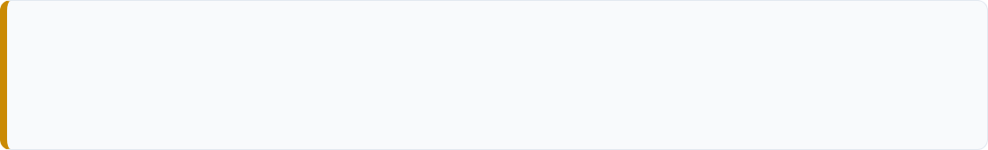
The Forensic Pipeline
Every image undergoes a "Double-Tier" interrogation to ensure the final verdict is grounded in multiple forms of evidence:
TIER 1: METADATA & PROVENANCE
Scans internal headers for "AI Signatures" (Midjourney, DALL-E) and C2PA cryptographic manifests. If Tier 1 flags a manifest, the AI core is bypassed for an instant FAKE verdict.
TIER 2: NEURAL & SPECTRAL SCAN
Triggered if metadata is clean. The Xception Core maps structural pixel patterns while the Frequency Analysis engine detects invisible spectral artifacts in the wave domain.

Slide 11
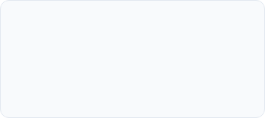

Final Answer Calculation
To prevent "Neural Overconfidence," we refined the weighting to a 35/35/10/10/10 distribution. This ensures physical math carries equal weight to AI intuition.
70% AI Core
10% Frequency
10% Noise
10% Edge Logic
Primary neural pattern recognition
of facial features.
FFT-based search for
"Checkerboard" GAN artifacts.
Identifies, measures random
variations in brightness or color (grain/static)
ELA-based search for boundary and compression inconsistency.
Verdict = (Xception × 0.35) + (Xception++ × 0.35) + (Freq × 0.1) +
(Edge × 0.1) + (Noise x 0.1)

Slide 12
.
Cloud Database Design
Synthetica utilizes Convex, a cloud-native, document-oriented database, to enable real-time synchronization of forensic reports across devices.
Persistent User History
Optimized Storage
Configured to maintain a high-speed rolling history of the last 11 scans per user. This limit ensures high performance and high-speed retrieval while providing a comprehensive audit trail for recent digital investigations.
Secure Retrieval
Cross-Platform
Forensic audit logs, graphs, heatmaps, and probability scores are tied directly to user accounts.
Allows investigators to start a scan on a
desktop and instantly review results on mobile.

Slide 13
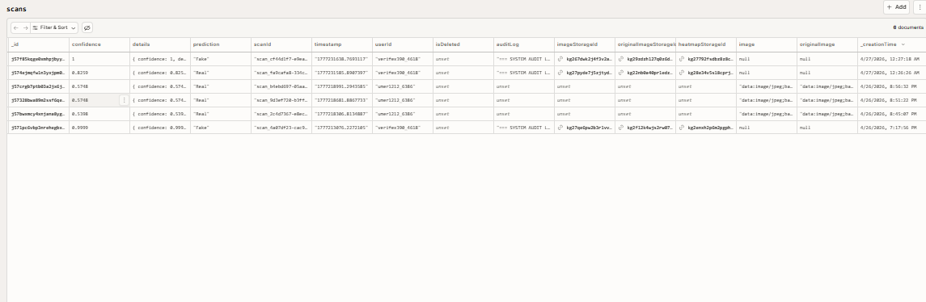
.
Scans Table

Slide 14
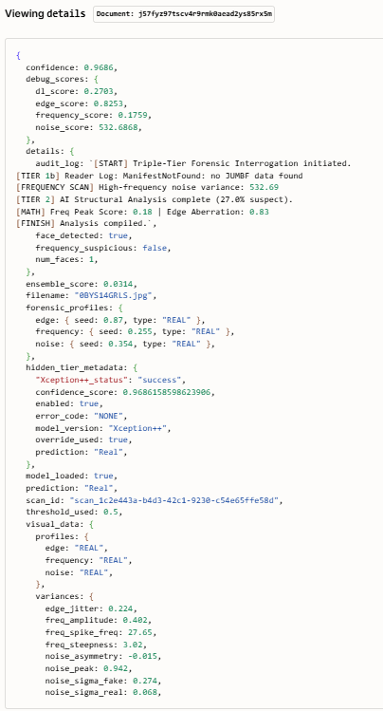
.
Audit log
cd /var/www/verifexdocker compose up -d --build --force-recreatedocker compose pscurl -fsS http://127.0.0.1:8501/health

Slide 15
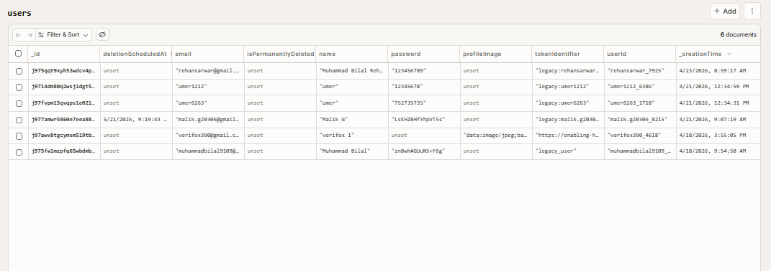
.
User Table

Slide 16
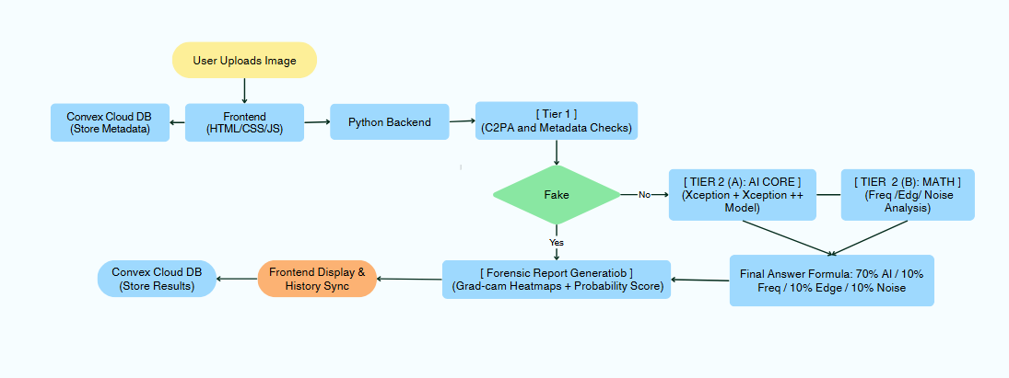
System Architecture

Slide 17
System Architecture
Live Demo (verifexapp.com)

Slide 18




System Feasibility
Technical
Economic
Behavioral
Python ecosystem ensures
highly compatible with AI
libraries like TensorFlow and PyTorch.
Open-source models
eliminate licensing fees;
minimal one-time hosting
costs.
The inclusion of a
“Graphs and Heatmap" helps
users understand the
"why" behind a verdict.

Slide 19
Results & Metrics
Edge Continuity (ELA): 97.8% Consistent
98.46%
Noise Variance: 97.2% Match
Frequency FFT: 98.1% Accuracy
Validation Accuracy
Deployment: Successfully live at verifexapp.com
The system bridges the gap between binary AI theory and practical forensic verification tools for digital investigators.

Slide 20
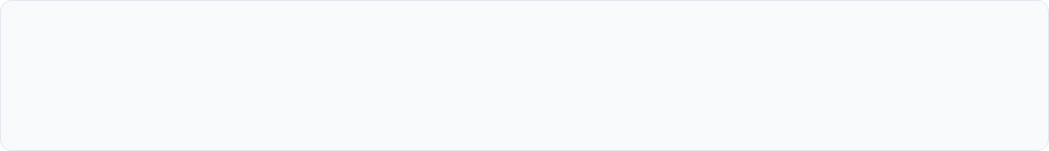
Conclusion & Future Scope
Synthetica demonstrates that deepfake detection requires more than an accurate network; it requires a transparent ecosystem. We have successfully engineered a professional-grade verification tool for the ICT sector.
Future Roadmap
Expansion
Audio Forensics: Voice clone detection.
Browser Extension: Real-time checks.
Video Deepfakes: Frame-by-frame scans.
C2PA: Support for emerging AI manifests.

Slide 21

Questions?
Thank you for your attention.
www.verifexapp.com

