Slide 1



VENTUS GPGPU运行GEMM分析
大规模GEMM三爆虚拟机，高性能Ventus长困资源牢
2025-高级模拟及射频集成电路设计南京大学集成电路学院

Slide 2

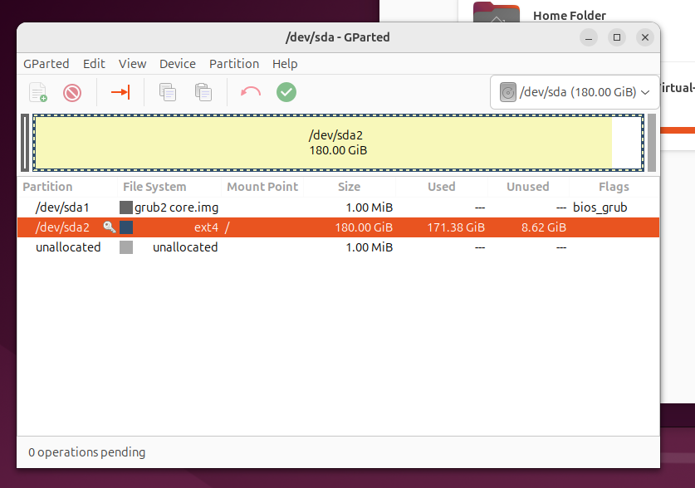

01
大规模GEMM运算

Slide 3
目录
1. Ventus官方给出的理论性能
2. 测试[4096,4096,4096]的KFLOPS

Slide 4
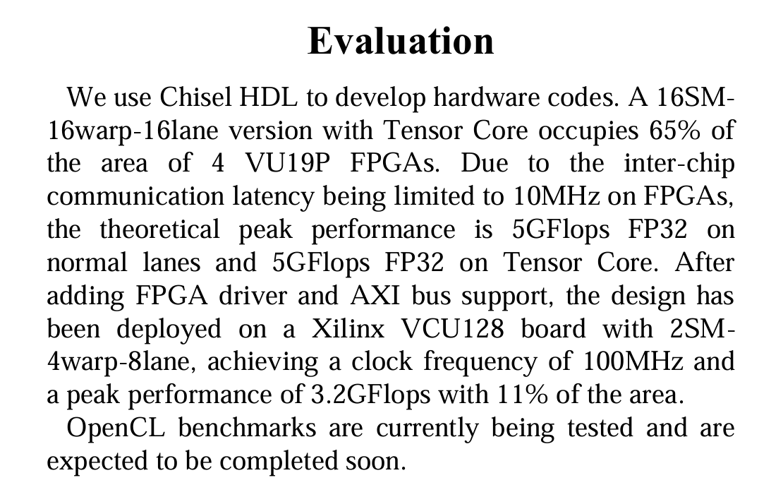
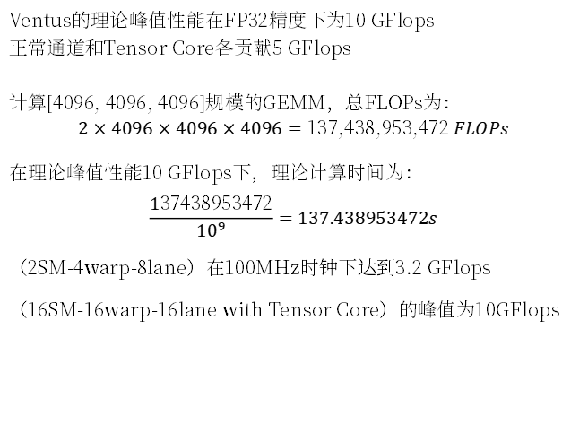
01
理论性能
论文中对性能的评估：
Ventus的理论峰值性能在FP32精度下为10 GFlops
正常通道和Tensor Core各贡献5 GFlops
计算[4096, 4096, 4096]规模的GEMM，总FLOPs为：
$$2×4096×4096×4096=137,438,953,472 FLOPs$$
在理论峰值性能10 GFlops下，理论计算时间为：
$$\frac{137438953472}{{10}^{9}}=137.438953472s$$
（2SM-4warp-8lane）在100MHz时钟下达到3.2 GFlops
（16SM-16warp-16lane with Tensor Core）的峰值为10GFlops

Slide 5
01
理论性能
硬件峰值性能：峰值性能基准为3.2 GFLOPS。
性能缩放趋势：性能随矩阵大小增加而提升，但提升速率逐渐放缓。对于较大矩阵，当矩阵大小加倍时，性能约增加30%。
运行时间计算：运行时间基于GEMM操作数量（2 × M × N × K）除以性能（GFLOPS）计算。对于[4096,4096,4096]，操作数量为2 × 4096³ = 137,438,953,472 FLOP。
因此，[4096,4096,4096]的推理结果如下：
执行时间：约33,680秒
性能：约0.00408 GFLOPS
峰值百分比：约0.12%

Slide 6
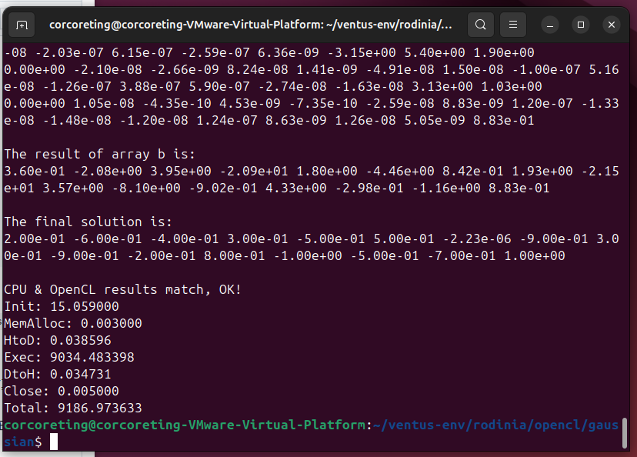
01
理论性能
Spike仿真：

Slide 7
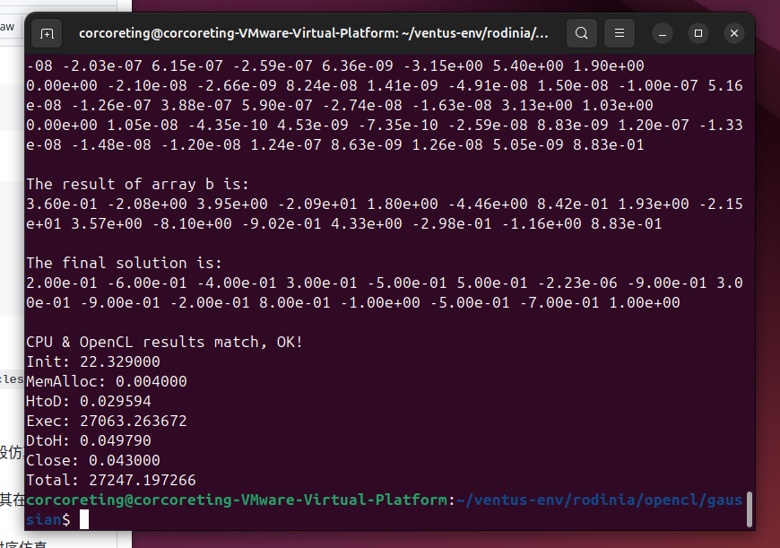
01
理论性能
RTLsim仿真：

Slide 8
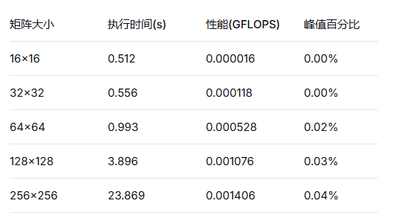
01
理论性能
仿真结果：
1. cyclesim仿真
2. 每周期flops
FP32 = 4Byte
2MNK =2M^3
MN+MK+NK=3M^2
CPU:10-100
GPU:100-300
（推算）
512*512 146.0 0.00184 0.05%
1024*1024 895.5 0.00240 0.07%
2048*2048 5486 0.00313 0.09%
4096*4096 33680 0.00408 0.12%

Slide 9
01
大规模GEMM运算
基于Ventus硬件规格：
流多处理器: 2个
每SM warp数: 4个
每warp lane数: 8个
时钟频率: 100MHz
实测峰值: 3.2 GFlops (25%理论效率)
矩阵大小 | 状态 | 性能(GFlops) | 效率 | 执行时间
64×64 | 成功 | 0.001 | 0.02% | 1.024s
128×128 | 成功 | 0.001 | 0.03% | 3.860s
256×256 | 成功 | 0.001 | 0.03% | 35.215s
512×512 | 失败
4096×4096×4096 GEMM理论估算：
总运算量: 137,438,953,472 次浮点运算
理论执行时间: ~429秒 (7.15分钟)
预期性能: ~0.32 GFlops (考虑内存带宽限制)
预期效率: ~10%

Slide 10
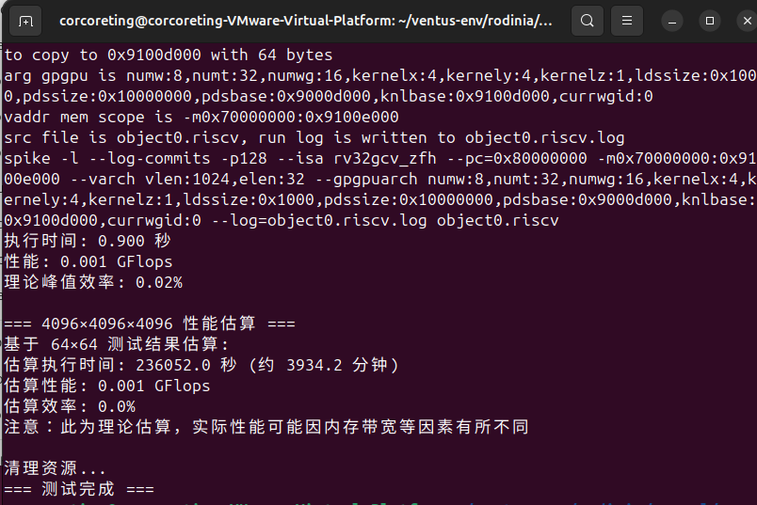
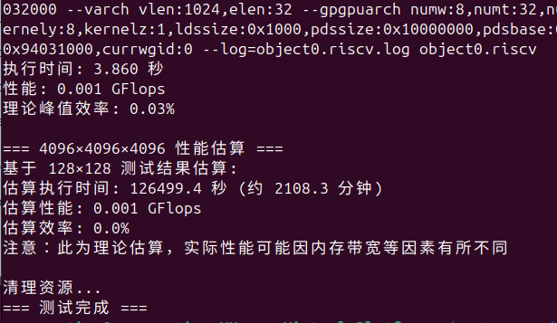
01
大规模GEMM运算

Slide 11
01
大规模GEMM运算
平台/设备已找到并初始化
设备全局内存：1.00 GB，最大分配：0.49 GB → 足以支持 4096³（A+B+C 总计约 192 MiB）。
最大工作组大小：256 以及 最大工作项大小：[256,256,256] → 我们的 本地大小 16×16=256 是允许的最大值。
编译器标志：CL2.0，-cl-fast-relaxed-math -cl-mad-enable，目标 riscv32，CPU ventus-gpgpu
工作网格与内核匹配
kernelx:16,kernely:16和 numwg:256（对于 256×256 且使用 16×16 tile，会得到 16×16=256 个工作组）。本地内存：ldssize:0x1000 = 每个工作组 4 KiB。我们的tile内核使用两个 16×16 tile = 2×256 个浮点数 ×4B = 2048 B，远低于 4 KiB。（这也解释了为什么不能将tile大小提升到 32×32：那样会是 8192 B > 4 KiB。）
为什么 GFLOPS 数值看起来很小
在 Spike 上运行时启用了提交日志（命令行中的 -l --log-commits）。这会让模拟器运行极其缓慢。
数值：256³ 的运算量 =（2MNK = 33,554,432）。基准测试：30.63 秒 → 约 0.0011 GFLOPS。tile化：16.66 秒 → 约 0.0020 GFLOPS，提速 1.84 倍（很好：即使在模拟中，tile化也有帮助）。
扩展到 4096×4096×4096
时间随（O(n³)）扩展。从 256 到 4096 是（16³ = 4096 倍）。
你的tile化 256³ 时间 16.66 秒 × 4096 ≈ 68,300 秒 ≈ 19 小时。
因此，以这种方式运行 4096³ 是不切实际的。
下一步操作（使 4096³ 可行）
1. 关闭 Spike 日志和额外输出（可大幅提升速度）：
export VENTUS_DEBUG=0 export VENTUS_SILENT=1
2. 对于大尺寸，仅运行tile化内核，以减少一半的编译/启动开销。在切换到 4096³ 时，可在 main.c 中注释掉基准测试调用。
3. 4096³ 的内存检查：
A：4096×4096×4B = 64 MiB B：64 MiB C：64 MiB
总计 ≈ 192 MiB < 最大分配 0.49 GB 且 < 全局内存 1 GB。
禁用日志后的快速合理性目标
256³ 应远快于 16.7 秒。仍应看到 Result: OK。驱动程序打印的 Spike 命令不应包含 --log-commits。

Slide 12
01
大规模GEMM运算
RTLsim仿真结果：
[info] vt_buf_free: vaddr=0x90001000, size=0x40 [ventus.cpp:156]
[info] vt_buf_free: vaddr=0x90fff000, size=0x1000000 [ventus.cpp:156]
[info] vt_buf_free: vaddr=0x90000000, size=0x10 [ventus.cpp:156]
[debug] vt_copy_from_dev: dev_addr=0x9000b000, size=0x4000, taskID=0, kernelID=0 [ventus.cpp:219]
Time: 8918.157654 s
Performance: 0.000000 GFLOPS
Theoretical peak percentage: 0.0000%
Verification: expected=128.0, actual=128.0, error=0.000000
[info] vt_buf_free: vaddr=0x90003000, size=0x4000 [ventus.cpp:156]
[info] vt_buf_free: vaddr=0x90007000, size=0x4000 [ventus.cpp:156]
[info] vt_buf_free: vaddr=0x9000b000, size=0x4000 [ventus.cpp:156]
=== Testing gemm_tiled_fixed with N=64 ===
### options: -DPOCL_DEVICE_ADDRESS_BITS=32 -D__USE_CLANG_OPENCL_C_H -xcl -Dinline= -I. -cl-kernel-arg-info -D GEMM_TILED -D TILE=16 -D__ENDIAN_LITTLE__=1 -DCL_DEVICE_MAX_GLOBAL_VARIABLE_SIZE=0 -D__OPENCL_VERSION__=200 -cl-std=CL2.0 -D__OPENCL_C_VERSION__=200 -Dcl_khr_fp64=1 -D__opencl_c_generic_address_space=1 -D__opencl_c_named_address_space_builtins=1 -cl-ext=-all,+cl_khr_fp64,+__opencl_c_generic_address_space,+__opencl_c_named_address_space_builtins -fno-builtin -triple=riscv32 -target-cpu ventus-gpgpu user_options: -D GEMM_TILED -D TILE=16
### Triple: riscv32, CPU: ventus-gpgpu
[2025-11-08 17:27:29.062] [info] [pocl_ventus.cc:1509] running compiler "/home/corcoreting/ventus-env/install/bin/clang -cl-std=CL2.0 -target riscv32 -mcpu=ventus-gpgpu object0.cl -o object0.riscv -nodefaultlibs -Wl,/home/corcoreting/ventus-env/install/lib/crt0.o -Wl,/home/corcoreting/ventus-env/install/lib/riscv32clc.o -Wl,--gc-sections -L/home/corcoreting/ventus-env/install/lib -lworkitem -I/home/corcoreting/ventus-env/installinclude/clc -O1 -Wl,-T,/home/corcoreting/ventus-env/install/lib/ldscripts/ventus/elf32lriscv.ld -Wl,--init=gemm_naive -w -D__opencl_c_generic_address_space=1 -D__opencl_c_named_address_space_builtins=1 -D__OPENCL_VERSION__=200 -D GEMM_TILED -D TILE=16
"
[debug] vt_buf_alloc: vaddr_recommand=0x7fff6feb9bf8, vaddr_allocated=0x90003000, size=0x4000, taskID=0 [ventus.cpp:137]
[debug] vt_copy_to_dev: dev_addr=0x90003000, size=0x4000, taskID=0, kernelID=0 [ventus.cpp:205]
[debug] vt_buf_alloc: vaddr_recommand=0x79a2d6982a90, vaddr_allocated=0x90007000, size=0x4000, taskID=0 [ventus.cpp:137]
[debug] vt_copy_to_dev: dev_addr=0x90007000, size=0x4000, taskID=0, kernelID=0 [ventus.cpp:205]
Work configuration: global(64,64), local(16,16)
[debug] vt_buf_alloc: vaddr_recommand=0x3c3ce889f02e0300, vaddr_allocated=0x9000b000, size=0x4000, taskID=0 [ventus.cpp:137]
[debug] vt_buf_alloc: vaddr_recommand=0x0, vaddr_allocated=0x90000000, size=0x10, taskID=0 [ventus.cpp:137]
[debug] vt_copy_to_dev: dev_addr=0x90000000, size=0x10, taskID=0, kernelID=0 [ventus.cpp:205]
[debug] vt_upload_kernel_file object0.riscv: vaddr=0x80000000, size=0xd58 [ventus.cpp:296]
[debug] vt_upload_kernel_file object0.riscv: vaddr=0x80001000, size=0x1000 [ventus.cpp:296]
[debug] vt_upload_kernel_file object0.riscv: vaddr=0x80002000, size=0x18 [ventus.cpp:296]
[debug] vt_upload_kernel_file object0.riscv: vaddr=0x80003000, size=0x20 [ventus.cpp:296]
[debug] vt_buf_alloc: vaddr_recommand=0x7fff00000008, vaddr_allocated=0x90fff000, size=0x1000000, taskID=0 [ventus.cpp:137]
[debug] vt_buf_alloc: vaddr_recommand=0x7fff6feb8ee0, vaddr_allocated=0x90001000, size=0x40, taskID=0 [ventus.cpp:137]
[debug] vt_copy_to_dev: dev_addr=0x90001000, size=0x40, taskID=0, kernelID=0 [ventus.cpp:205]
[debug] kernel metadata: kernel_id=0, kernel_size=[4, 4, 1], wf_size=32, wg_size=8, metaDataBaseAddr=0x90001000, ldsSize=0x1000, pdsSize=0x1000, sgprUsage=64, vgprUsage=64, pdsBaseAddr=0x90fff000 [ventus.cpp:248]
[RTL debug]@1000030000
[RTL debug]@1000040000
[RTL debug]@1000050000
[info] vt_buf_free: vaddr=0x90001000, size=0x40 [ventus.cpp:156]
[info] vt_buf_free: vaddr=0x90fff000, size=0x1000000 [ventus.cpp:156]
[info] vt_buf_free: vaddr=0x90000000, size=0x10 [ventus.cpp:156]
[debug] vt_copy_from_dev: dev_addr=0x9000b000, size=0x4000, taskID=0, kernelID=0 [ventus.cpp:219]
Time: 1.040661 s
Performance: 0.000504 GFLOPS
Theoretical peak percentage: 0.0101%
Verification: expected=128.0, actual=128.0, error=0.000000
[info] vt_buf_free: vaddr=0x90003000, size=0x4000 [ventus.cpp:156]
[info] vt_buf_free: vaddr=0x90007000, size=0x4000 [ventus.cpp:156]
[info] vt_buf_free: vaddr=0x9000b000, size=0x4000 [ventus.cpp:156]
=== Testing gemm_vectorized with N=64 ===
### options: -DPOCL_DEVICE_ADDRESS_BITS=32 -D__USE_CLANG_OPENCL_C_H -xcl -Dinline= -I. -cl-kernel-arg-info -D GEMM_TILED -D TILE=16 -D__ENDIAN_LITTLE__=1 -DCL_DEVICE_MAX_GLOBAL_VARIABLE_SIZE=0 -D__OPENCL_VERSION__=200 -cl-std=CL2.0 -D__OPENCL_C_VERSION__=200 -Dcl_khr_fp64=1 -D__opencl_c_generic_address_space=1 -D__opencl_c_named_address_space_builtins=1 -cl-ext=-all,+cl_khr_fp64,+__opencl_c_generic_address_space,+__opencl_c_named_address_space_builtins -fno-builtin -triple=riscv32 -target-cpu ventus-gpgpu user_options: -D GEMM_TILED -D TILE=16
### Triple: riscv32, CPU: ventus-gpgpu
[2025-11-08 17:27:30.263] [info] [pocl_ventus.cc:1509] running compiler "/home/corcoreting/ventus-env/install/bin/clang -cl-std=CL2.0 -target riscv32 -mcpu=ventus-gpgpu object0.cl -o object0.riscv -nodefaultlibs -Wl,/home/corcoreting/ventus-env/install/lib/crt0.o -Wl,/home/corcoreting/ventus-env/install/lib/riscv32clc.o -Wl,--gc-sections -L/home/corcoreting/ventus-env/install/lib -lworkitem -I/home/corcoreting/ventus-env/installinclude/clc -O1 -Wl,-T,/home/corcoreting/ventus-env/install/lib/ldscripts/ventus/elf32lriscv.ld -Wl,--init=gemm_naive -w -D__opencl_c_generic_address_space=1 -D__opencl_c_named_address_space_builtins=1 -D__OPENCL_VERSION__=200 -D GEMM_TILED -D TILE=16
"
[debug] vt_buf_alloc: vaddr_recommand=0x7fff6feb9bf8, vaddr_allocated=0x90003000, size=0x4000, taskID=0 [ventus.cpp:137]
[debug] vt_copy_to_dev: dev_addr=0x90003000, size=0x4000, taskID=0, kernelID=0 [ventus.cpp:205]
[debug] vt_buf_alloc: vaddr_recommand=0x79a2d6982a90, vaddr_allocated=0x90007000, size=0x4000, taskID=0 [ventus.cpp:137]
[debug] vt_copy_to_dev: dev_addr=0x90007000, size=0x4000, taskID=0, kernelID=0 [ventus.cpp:205]
Work configuration: global(64,64), local(8,8)
[debug] vt_buf_alloc: vaddr_recommand=0x3c3ce889f02e0300, vaddr_allocated=0x9000b000, size=0x4000, taskID=0 [ventus.cpp:137]
[debug] vt_buf_alloc: vaddr_recommand=0x0, vaddr_allocated=0x90000000, size=0x10, taskID=0 [ventus.cpp:137]
[debug] vt_copy_to_dev: dev_addr=0x90000000, size=0x10, taskID=0, kernelID=0 [ventus.cpp:205]
[debug] vt_upload_kernel_file object0.riscv: vaddr=0x80000000, size=0xd58 [ventus.cpp:296]
[debug] vt_upload_kernel_file object0.riscv: vaddr=0x80001000, size=0x1000 [ventus.cpp:296]
[debug] vt_upload_kernel_file object0.riscv: vaddr=0x80002000, size=0x18 [ventus.cpp:296]
[debug] vt_upload_kernel_file object0.riscv: vaddr=0x80003000, size=0x20 [ventus.cpp:296]
[debug] vt_buf_alloc: vaddr_recommand=0x7fff00000008, vaddr_allocated=0x90fff000, size=0x1000000, taskID=0 [ventus.cpp:137]
[debug] vt_buf_alloc: vaddr_recommand=0x7fff6feb8ee0, vaddr_allocated=0x90001000, size=0x40, taskID=0 [ventus.cpp:137]
[debug] vt_copy_to_dev: dev_addr=0x90001000, size=0x40, taskID=0, kernelID=0 [ventus.cpp:205]
[debug] kernel metadata: kernel_id=0, kernel_size=[8, 8, 1], wf_size=32, wg_size=2, metaDataBaseAddr=0x90001000, ldsSize=0x1000, pdsSize=0x1000, sgprUsage=64, vgprUsage=64, pdsBaseAddr=0x90fff000 [ventus.cpp:248]
[RTL debug]@1000060000
[RTL debug]@1000070000
[info] vt_buf_free: vaddr=0x90001000, size=0x40 [ventus.cpp:156]
[info] vt_buf_free: vaddr=0x90fff000, size=0x1000000 [ventus.cpp:156]
[info] vt_buf_free: vaddr=0x90000000, size=0x10 [ventus.cpp:156]
[debug] vt_copy_from_dev: dev_addr=0x9000b000, size=0x4000, taskID=0, kernelID=0 [ventus.cpp:219]
Time: 1.047683 s
Performance: 0.000500 GFLOPS
Theoretical peak percentage: 0.0100%
Verification: expected=128.0, actual=128.0, error=0.000000
[info] vt_buf_free: vaddr=0x90003000, size=0x4000 [ventus.cpp:156]
[info] vt_buf_free: vaddr=0x90007000, size=0x4000 [ventus.cpp:156]
[info] vt_buf_free: vaddr=0x9000b000, size=0x4000 [ventus.cpp:156]
=== Testing gemm_naive with N=128 ===
### options: -DPOCL_DEVICE_ADDRESS_BITS=32 -D__USE_CLANG_OPENCL_C_H -xcl -Dinline= -I. -cl-kernel-arg-info -D GEMM_TILED -D TILE=16 -D__ENDIAN_LITTLE__=1 -DCL_DEVICE_MAX_GLOBAL_VARIABLE_SIZE=0 -D__OPENCL_VERSION__=200 -cl-std=CL2.0 -D__OPENCL_C_VERSION__=200 -Dcl_khr_fp64=1 -D__opencl_c_generic_address_space=1 -D__opencl_c_named_address_space_builtins=1 -cl-ext=-all,+cl_khr_fp64,+__opencl_c_generic_address_space,+__opencl_c_named_address_space_builtins -fno-builtin -triple=riscv32 -target-cpu ventus-gpgpu user_options: -D GEMM_TILED -D TILE=16
### Triple: riscv32, CPU: ventus-gpgpu
[2025-11-08 17:27:31.474] [info] [pocl_ventus.cc:1509] running compiler "/home/corcoreting/ventus-env/install/bin/clang -cl-std=CL2.0 -target riscv32 -mcpu=ventus-gpgpu object4.cl -o object4.riscv -nodefaultlibs -Wl,/home/corcoreting/ventus-env/install/lib/crt0.o -Wl,/home/corcoreting/ventus-env/install/lib/riscv32clc.o -Wl,--gc-sections -L/home/corcoreting/ventus-env/install/lib -lworkitem -I/home/corcoreting/ventus-env/installinclude/clc -O1 -Wl,-T,/home/corcoreting/ventus-env/install/lib/ldscripts/ventus/elf32lriscv.ld -Wl,--init=gemm_naive -w -D__opencl_c_generic_address_space=1 -D__opencl_c_named_address_space_builtins=1 -D__OPENCL_VERSION__=200 -D GEMM_TILED -D TILE=16
"
[debug] vt_buf_alloc: vaddr_recommand=0x7fff6feb9bf8, vaddr_allocated=0x9000f000, size=0x10000, taskID=0 [ventus.cpp:137]
[debug] vt_copy_to_dev: dev_addr=0x9000f000, size=0x10000, taskID=0, kernelID=0 [ventus.cpp:205]
[debug] vt_buf_alloc: vaddr_recommand=0x79a2d6982a90, vaddr_allocated=0x9001f000, size=0x10000, taskID=0 [ventus.cpp:137]
[debug] vt_copy_to_dev: dev_addr=0x9001f000, size=0x10000, taskID=0, kernelID=0 [ventus.cpp:205]
Work configuration: global(128,128), local(8,8)
[debug] vt_buf_alloc: vaddr_recommand=0x3c3ce889f02e0300, vaddr_allocated=0x9002f000, size=0x10000, taskID=0 [ventus.cpp:137]
[debug] vt_buf_alloc: vaddr_recommand=0x0, vaddr_allocated=0x90000000, size=0x10, taskID=0 [ventus.cpp:137]
[debug] vt_copy_to_dev: dev_addr=0x90000000, size=0x10, taskID=0, kernelID=0 [ventus.cpp:205]
[debug] vt_upload_kernel_file object4.riscv: vaddr=0x80000000, size=0xd58 [ventus.cpp:296]
[debug] vt_upload_kernel_file object4.riscv: vaddr=0x80001000, size=0x1000 [ventus.cpp:296]
[debug] vt_upload_kernel_file object4.riscv: vaddr=0x80002000, size=0x18 [ventus.cpp:296]
[debug] vt_upload_kernel_file object4.riscv: vaddr=0x80003000, size=0x20 [ventus.cpp:296]
[debug] vt_buf_alloc: vaddr_recommand=0x7fff00000008, vaddr_allocated=0x93fff000, size=0x4000000, taskID=0 [ventus.cpp:137]
[debug] vt_buf_alloc: vaddr_recommand=0x7fff6feb8ee0, vaddr_allocated=0x90001000, size=0x40, taskID=0 [ventus.cpp:137]
[debug] vt_copy_to_dev: dev_addr=0x90001000, size=0x40, taskID=0, kernelID=0 [ventus.cpp:205]
[debug] kernel metadata: kernel_id=0, kernel_size=[16, 16, 1], wf_size=32, wg_size=2, metaDataBaseAddr=0x90001000, ldsSize=0x1000, pdsSize=0x1000, sgprUsage=64, vgprUsage=64, pdsBaseAddr=0x93fff000 [ventus.cpp:248]
[RTL debug]@1000080000
[RTL debug]@1000090000
[RTL debug]@1000100000
[info] vt_buf_free: vaddr=0x90001000, size=0x40 [ventus.cpp:156]
[info] vt_buf_free: vaddr=0x93fff000, size=0x4000000 [ventus.cpp:156]
[info] vt_buf_free: vaddr=0x90000000, size=0x10 [ventus.cpp:156]
[debug] vt_copy_from_dev: dev_addr=0x9002f000, size=0x10000, taskID=0, kernelID=0 [ventus.cpp:219]
[RTL error]@1000100000 PMEM page at 0x9003e000 not allocated, read as all zero
[RTL error]@1000100000 PMEM page at 0x9003d000 not allocated, read as all zero
[RTL error]@1000100000 PMEM page at 0x9003c000 not allocated, read as all zero
[RTL error]@1000100000 PMEM page at 0x9003b000 not allocated, read as all zero
[RTL error]@1000100000 PMEM page at 0x9003a000 not allocated, read as all zero
[RTL error]@1000100000 PMEM page at 0x90039000 not allocated, read as all zero
[RTL error]@1000100000 PMEM page at 0x90038000 not allocated, read as all zero
[RTL error]@1000100000 PMEM page at 0x90037000 not allocated, read as all zero
[RTL error]@1000100000 PMEM page at 0x90036000 not allocated, read as all zero
[RTL error]@1000100000 PMEM page at 0x90035000 not allocated, read as all zero
[RTL error]@1000100000 PMEM page at 0x90034000 not allocated, read as all zero
[RTL error]@1000100000 PMEM page at 0x90033000 not allocated, read as all zero
[RTL error]@1000100000 PMEM page at 0x90032000 not allocated, read as all zero
[RTL error]@1000100000 PMEM page at 0x90031000 not allocated, read as all zero
[RTL error]@1000100000 PMEM page at 0x90030000 not allocated, read as all zero
[RTL error]@1000100000 PMEM page at 0x9002f000 not allocated, read as all zero
Time: 1.052747 s
Performance: 0.003984 GFLOPS
Theoretical peak percentage: 0.0797%
Verification: expected=256.0, actual=0.0, error=256.000000
[info] vt_buf_free: vaddr=0x9000f000, size=0x10000 [ventus.cpp:156]
[info] vt_buf_free: vaddr=0x9001f000, size=0x10000 [ventus.cpp:156]
[info] vt_buf_free: vaddr=0x9002f000, size=0x10000 [ventus.cpp:156]
=== Testing gemm_tiled with N=128 ===
### options: -DPOCL_DEVICE_ADDRESS_BITS=32 -D__USE_CLANG_OPENCL_C_H -xcl -Dinline= -I. -cl-kernel-arg-info -D GEMM_TILED -D TILE=16 -D__ENDIAN_LITTLE__=1 -DCL_DEVICE_MAX_GLOBAL_VARIABLE_SIZE=0 -D__OPENCL_VERSION__=200 -cl-std=CL2.0 -D__OPENCL_C_VERSION__=200 -Dcl_khr_fp64=1 -D__opencl_c_generic_address_space=1 -D__opencl_c_named_address_space_builtins=1 -cl-ext=-all,+cl_khr_fp64,+__opencl_c_generic_address_space,+__opencl_c_named_address_space_builtins -fno-builtin -triple=riscv32 -target-cpu ventus-gpgpu user_options: -D GEMM_TILED -D TILE=16
### Triple: riscv32, CPU: ventus-gpgpu
[2025-11-08 17:27:32.682] [info] [pocl_ventus.cc:1509] running compiler "/home/corcoreting/ventus-env/install/bin/clang -cl-std=CL2.0 -target riscv32 -mcpu=ventus-gpgpu object5.cl -o object5.riscv -nodefaultlibs -Wl,/home/corcoreting/ventus-env/install/lib/crt0.o -Wl,/home/corcoreting/ventus-env/install/lib/riscv32clc.o -Wl,--gc-sections -L/home/corcoreting/ventus-env/install/lib -lworkitem -I/home/corcoreting/ventus-env/installinclude/clc -O1 -Wl,-T,/home/corcoreting/ventus-env/install/lib/ldscripts/ventus/elf32lriscv.ld -Wl,--init=gemm_naive -w -D__opencl_c_generic_address_space=1 -D__opencl_c_named_address_space_builtins=1 -D__OPENCL_VERSION__=200 -D GEMM_TILED -D TILE=16
"
[debug] vt_buf_alloc: vaddr_recommand=0x7fff6feb9bf8, vaddr_allocated=0x9000f000, size=0x10000, taskID=0 [ventus.cpp:137]
[debug] vt_copy_to_dev: dev_addr=0x9000f000, size=0x10000, taskID=0, kernelID=0 [ventus.cpp:205]
[debug] vt_buf_alloc: vaddr_recommand=0x79a2d6982a90, vaddr_allocated=0x9001f000, size=0x10000, taskID=0 [ventus.cpp:137]
[debug] vt_copy_to_dev: dev_addr=0x9001f000, size=0x10000, taskID=0, kernelID=0 [ventus.cpp:205]
Work configuration: global(128,128), local(16,16)
[debug] vt_buf_alloc: vaddr_recommand=0x3c3ce889f02e0300, vaddr_allocated=0x9002f000, size=0x10000, taskID=0 [ventus.cpp:137]
[debug] vt_buf_alloc: vaddr_recommand=0x0, vaddr_allocated=0x90000000, size=0x10, taskID=0 [ventus.cpp:137]
[debug] vt_copy_to_dev: dev_addr=0x90000000, size=0x10, taskID=0, kernelID=0 [ventus.cpp:205]
[debug] vt_upload_kernel_file object5.riscv: vaddr=0x80000000, size=0xd58 [ventus.cpp:296]
[debug] vt_upload_kernel_file object5.riscv: vaddr=0x80001000, size=0x1000 [ventus.cpp:296]
[debug] vt_upload_kernel_file object5.riscv: vaddr=0x80002000, size=0x18 [ventus.cpp:296]
[debug] vt_upload_kernel_file object5.riscv: vaddr=0x80003000, size=0x20 [ventus.cpp:296]
[debug] vt_buf_alloc: vaddr_recommand=0x7fff00000008, vaddr_allocated=0x93fff000, size=0x4000000, taskID=0 [ventus.cpp:137]
[debug] vt_buf_alloc: vaddr_recommand=0x7fff6feb8ee0, vaddr_allocated=0x90001000, size=0x40, taskID=0 [ventus.cpp:137]
[debug] vt_copy_to_dev: dev_addr=0x90001000, size=0x40, taskID=0, kernelID=0 [ventus.cpp:205]
[debug] kernel metadata: kernel_id=0, kernel_size=[8, 8, 1], wf_size=32, wg_size=8, metaDataBaseAddr=0x90001000, ldsSize=0x1000, pdsSize=0x1000, sgprUsage=64, vgprUsage=64, pdsBaseAddr=0x93fff000 [ventus.cpp:248]
[RTL debug]@1000110000
[RTL debug]@1000120000
[info] vt_buf_free: vaddr=0x90001000, size=0x40 [ventus.cpp:156]
[info] vt_buf_free: vaddr=0x93fff000, size=0x4000000 [ventus.cpp:156]
[info] vt_buf_free: vaddr=0x90000000, size=0x10 [ventus.cpp:156]
[debug] vt_copy_from_dev: dev_addr=0x9002f000, size=0x10000, taskID=0, kernelID=0 [ventus.cpp:219]
[RTL error]@1000125000 PMEM page at 0x9003e000 not allocated, read as all zero
[RTL error]@1000125000 PMEM page at 0x9003d000 not allocated, read as all zero
[RTL error]@1000125000 PMEM page at 0x9003c000 not allocated, read as all zero
[RTL error]@1000125000 PMEM page at 0x9003b000 not allocated, read as all zero
[RTL error]@1000125000 PMEM page at 0x9003a000 not allocated, read as all zero
[RTL error]@1000125000 PMEM page at 0x90039000 not allocated, read as all zero
[RTL error]@1000125000 PMEM page at 0x90038000 not allocated, read as all zero
[RTL error]@1000125000 PMEM page at 0x90037000 not allocated, read as all zero
[RTL error]@1000125000 PMEM page at 0x90036000 not allocated, read as all zero
[RTL error]@1000125000 PMEM page at 0x90035000 not allocated, read as all zero
[RTL error]@1000125000 PMEM page at 0x90034000 not allocated, read as all zero
[RTL error]@1000125000 PMEM page at 0x90033000 not allocated, read as all zero
[RTL error]@1000125000 PMEM page at 0x90032000 not allocated, read as all zero
[RTL error]@1000125000 PMEM page at 0x90031000 not allocated, read as all zero
[RTL error]@1000125000 PMEM page at 0x90030000 not allocated, read as all zero
[RTL error]@1000125000 PMEM page at 0x9002f000 not allocated, read as all zero
Time: 1.040861 s
Performance: 0.004030 GFLOPS
Theoretical peak percentage: 0.0806%
Verification: expected=256.0, actual=0.0, error=256.000000
[info] vt_buf_free: vaddr=0x9000f000, size=0x10000 [ventus.cpp:156]
[info] vt_buf_free: vaddr=0x9001f000, size=0x10000 [ventus.cpp:156]
[info] vt_buf_free: vaddr=0x9002f000, size=0x10000 [ventus.cpp:156]
=== Testing gemm_tiled_fixed with N=128 ===
### options: -DPOCL_DEVICE_ADDRESS_BITS=32 -D__USE_CLANG_OPENCL_C_H -xcl -Dinline= -I. -cl-kernel-arg-info -D GEMM_TILED -D TILE=16 -D__ENDIAN_LITTLE__=1 -DCL_DEVICE_MAX_GLOBAL_VARIABLE_SIZE=0 -D__OPENCL_VERSION__=200 -cl-std=CL2.0 -D__OPENCL_C_VERSION__=200 -Dcl_khr_fp64=1 -D__opencl_c_generic_address_space=1 -D__opencl_c_named_address_space_builtins=1 -cl-ext=-all,+cl_khr_fp64,+__opencl_c_generic_address_space,+__opencl_c_named_address_space_builtins -fno-builtin -triple=riscv32 -target-cpu ventus-gpgpu user_options: -D GEMM_TILED -D TILE=16
### Triple: riscv32, CPU: ventus-gpgpu
[2025-11-08 17:27:33.881] [info] [pocl_ventus.cc:1509] running compiler "/home/corcoreting/ventus-env/install/bin/clang -cl-std=CL2.0 -target riscv32 -mcpu=ventus-gpgpu object5.cl -o object5.riscv -nodefaultlibs -Wl,/home/corcoreting/ventus-env/install/lib/crt0.o -Wl,/home/corcoreting/ventus-env/install/lib/riscv32clc.o -Wl,--gc-sections -L/home/corcoreting/ventus-env/install/lib -lworkitem -I/home/corcoreting/ventus-env/installinclude/clc -O1 -Wl,-T,/home/corcoreting/ventus-env/install/lib/ldscripts/ventus/elf32lriscv.ld -Wl,--init=gemm_naive -w -D__opencl_c_generic_address_space=1 -D__opencl_c_named_address_space_builtins=1 -D__OPENCL_VERSION__=200 -D GEMM_TILED -D TILE=16
"
[debug] vt_buf_alloc: vaddr_recommand=0x7fff6feb9bf8, vaddr_allocated=0x9000f000, size=0x10000, taskID=0 [ventus.cpp:137]
[debug] vt_copy_to_dev: dev_addr=0x9000f000, size=0x10000, taskID=0, kernelID=0 [ventus.cpp:205]
[debug] vt_buf_alloc: vaddr_recommand=0x79a2d6982a90, vaddr_allocated=0x9001f000, size=0x10000, taskID=0 [ventus.cpp:137]
[debug] vt_copy_to_dev: dev_addr=0x9001f000, size=0x10000, taskID=0, kernelID=0 [ventus.cpp:205]
Work configuration: global(128,128), local(16,16)
[debug] vt_buf_alloc: vaddr_recommand=0x3c3ce889f02e0300, vaddr_allocated=0x9002f000, size=0x10000, taskID=0 [ventus.cpp:137]
[debug] vt_buf_alloc: vaddr_recommand=0x0, vaddr_allocated=0x90000000, size=0x10, taskID=0 [ventus.cpp:137]
[debug] vt_copy_to_dev: dev_addr=0x90000000, size=0x10, taskID=0, kernelID=0 [ventus.cpp:205]
[debug] vt_upload_kernel_file object5.riscv: vaddr=0x80000000, size=0xd58 [ventus.cpp:296]
[debug] vt_upload_kernel_file object5.riscv: vaddr=0x80001000, size=0x1000 [ventus.cpp:296]
[debug] vt_upload_kernel_file object5.riscv: vaddr=0x80002000, size=0x18 [ventus.cpp:296]
[debug] vt_upload_kernel_file object5.riscv: vaddr=0x80003000, size=0x20 [ventus.cpp:296]
[debug] vt_buf_alloc: vaddr_recommand=0x7fff00000008, vaddr_allocated=0x93fff000, size=0x4000000, taskID=0 [ventus.cpp:137]
[debug] vt_buf_alloc: vaddr_recommand=0x7fff6feb8ee0, vaddr_allocated=0x90001000, size=0x40, taskID=0 [ventus.cpp:137]
[debug] vt_copy_to_dev: dev_addr=0x90001000, size=0x40, taskID=0, kernelID=0 [ventus.cpp:205]
[debug] kernel metadata: kernel_id=0, kernel_size=[8, 8, 1], wf_size=32, wg_size=8, metaDataBaseAddr=0x90001000, ldsSize=0x1000, pdsSize=0x1000, sgprUsage=64, vgprUsage=64, pdsBaseAddr=0x93fff000 [ventus.cpp:248]
[RTL debug]@1000130000
[RTL debug]@1000140000
[RTL debug]@1000150000
[info] vt_buf_free: vaddr=0x90001000, size=0x40 [ventus.cpp:156]
[info] vt_buf_free: vaddr=0x93fff000, size=0x4000000 [ventus.cpp:156]
[info] vt_buf_free: vaddr=0x90000000, size=0x10 [ventus.cpp:156]
[debug] vt_copy_from_dev: dev_addr=0x9002f000, size=0x10000, taskID=0, kernelID=0 [ventus.cpp:219]
[RTL error]@1000150000 PMEM page at 0x9003e000 not allocated, read as all zero
[RTL error]@1000150000 PMEM page at 0x9003d000 not allocated, read as all zero
[RTL error]@1000150000 PMEM page at 0x9003c000 not allocated, read as all zero
[RTL error]@1000150000 PMEM page at 0x9003b000 not allocated, read as all zero
[RTL error]@1000150000 PMEM page at 0x9003a000 not allocated, read as all zero
[RTL error]@1000150000 PMEM page at 0x90039000 not allocated, read as all zero
[RTL error]@1000150000 PMEM page at 0x90038000 not allocated, read as all zero
[RTL error]@1000150000 PMEM page at 0x90037000 not allocated, read as all zero
[RTL error]@1000150000 PMEM page at 0x90036000 not allocated, read as all zero
[RTL error]@1000150000 PMEM page at 0x90035000 not allocated, read as all zero
[RTL error]@1000150000 PMEM page at 0x90034000 not allocated, read as all zero
[RTL error]@1000150000 PMEM page at 0x90033000 not allocated, read as all zero
[RTL error]@1000150000 PMEM page at 0x90032000 not allocated, read as all zero
[RTL error]@1000150000 PMEM page at 0x90031000 not allocated, read as all zero
[RTL error]@1000150000 PMEM page at 0x90030000 not allocated, read as all zero
[RTL error]@1000150000 PMEM page at 0x9002f000 not allocated, read as all zero
Time: 1.056359 s
Performance: 0.003971 GFLOPS
Theoretical peak percentage: 0.0794%
Verification: expected=256.0, actual=0.0, error=256.000000
[info] vt_buf_free: vaddr=0x9000f000, size=0x10000 [ventus.cpp:156]
[info] vt_buf_free: vaddr=0x9001f000, size=0x10000 [ventus.cpp:156]
[info] vt_buf_free: vaddr=0x9002f000, size=0x10000 [ventus.cpp:156]
=== Testing gemm_vectorized with N=128 ===
### options: -DPOCL_DEVICE_ADDRESS_BITS=32 -D__USE_CLANG_OPENCL_C_H -xcl -Dinline= -I. -cl-kernel-arg-info -D GEMM_TILED -D TILE=16 -D__ENDIAN_LITTLE__=1 -DCL_DEVICE_MAX_GLOBAL_VARIABLE_SIZE=0 -D__OPENCL_VERSION__=200 -cl-std=CL2.0 -D__OPENCL_C_VERSION__=200 -Dcl_khr_fp64=1 -D__opencl_c_generic_address_space=1 -D__opencl_c_named_address_space_builtins=1 -cl-ext=-all,+cl_khr_fp64,+__opencl_c_generic_address_space,+__opencl_c_named_address_space_builtins -fno-builtin -triple=riscv32 -target-cpu ventus-gpgpu user_options: -D GEMM_TILED -D TILE=16
### Triple: riscv32, CPU: ventus-gpgpu
[2025-11-08 17:27:35.092] [info] [pocl_ventus.cc:1509] running compiler "/home/corcoreting/ventus-env/install/bin/clang -cl-std=CL2.0 -target riscv32 -mcpu=ventus-gpgpu object5.cl -o object5.riscv -nodefaultlibs -Wl,/home/corcoreting/ventus-env/install/lib/crt0.o -Wl,/home/corcoreting/ventus-env/install/lib/riscv32clc.o -Wl,--gc-sections -L/home/corcoreting/ventus-env/install/lib -lworkitem -I/home/corcoreting/ventus-env/installinclude/clc -O1 -Wl,-T,/home/corcoreting/ventus-env/install/lib/ldscripts/ventus/elf32lriscv.ld -Wl,--init=gemm_naive -w -D__opencl_c_generic_address_space=1 -D__opencl_c_named_address_space_builtins=1 -D__OPENCL_VERSION__=200 -D GEMM_TILED -D TILE=16
"
[debug] vt_buf_alloc: vaddr_recommand=0x7fff6feb9bf8, vaddr_allocated=0x9000f000, size=0x10000, taskID=0 [ventus.cpp:137]
[debug] vt_copy_to_dev: dev_addr=0x9000f000, size=0x10000, taskID=0, kernelID=0 [ventus.cpp:205]
[debug] vt_buf_alloc: vaddr_recommand=0x79a2d6982a90, vaddr_allocated=0x9001f000, size=0x10000, taskID=0 [ventus.cpp:137]
[debug] vt_copy_to_dev: dev_addr=0x9001f000, size=0x10000, taskID=0, kernelID=0 [ventus.cpp:205]
Work configuration: global(128,128), local(8,8)
[debug] vt_buf_alloc: vaddr_recommand=0x3c3ce889f02e0300, vaddr_allocated=0x9002f000, size=0x10000, taskID=0 [ventus.cpp:137]
[debug] vt_buf_alloc: vaddr_recommand=0x0, vaddr_allocated=0x90000000, size=0x10, taskID=0 [ventus.cpp:137]
[debug] vt_copy_to_dev: dev_addr=0x90000000, size=0x10, taskID=0, kernelID=0 [ventus.cpp:205]
[debug] vt_upload_kernel_file object5.riscv: vaddr=0x80000000, size=0xd58 [ventus.cpp:296]
[debug] vt_upload_kernel_file object5.riscv: vaddr=0x80001000, size=0x1000 [ventus.cpp:296]
[debug] vt_upload_kernel_file object5.riscv: vaddr=0x80002000, size=0x18 [ventus.cpp:296]
[debug] vt_upload_kernel_file object5.riscv: vaddr=0x80003000, size=0x20 [ventus.cpp:296]
[debug] vt_buf_alloc: vaddr_recommand=0x7fff00000008, vaddr_allocated=0x93fff000, size=0x4000000, taskID=0 [ventus.cpp:137]
[debug] vt_buf_alloc: vaddr_recommand=0x7fff6feb8ee0, vaddr_allocated=0x90001000, size=0x40, taskID=0 [ventus.cpp:137]
[debug] vt_copy_to_dev: dev_addr=0x90001000, size=0x40, taskID=0, kernelID=0 [ventus.cpp:205]
[debug] kernel metadata: kernel_id=0, kernel_size=[16, 16, 1], wf_size=32, wg_size=2, metaDataBaseAddr=0x90001000, ldsSize=0x1000, pdsSize=0x1000, sgprUsage=64, vgprUsage=64, pdsBaseAddr=0x93fff000 [ventus.cpp:248]
[RTL debug]@1000160000
[RTL debug]@1000170000
[info] vt_buf_free: vaddr=0x90001000, size=0x40 [ventus.cpp:156]
[info] vt_buf_free: vaddr=0x93fff000, size=0x4000000 [ventus.cpp:156]
[info] vt_buf_free: vaddr=0x90000000, size=0x10 [ventus.cpp:156]
[debug] vt_copy_from_dev: dev_addr=0x9002f000, size=0x10000, taskID=0, kernelID=0 [ventus.cpp:219]
[RTL error]@1000175000 PMEM page at 0x9003e000 not allocated, read as all zero
[RTL error]@1000175000 PMEM page at 0x9003d000 not allocated, read as all zero
[RTL error]@1000175000 PMEM page at 0x9003c000 not allocated, read as all zero
[RTL error]@1000175000 PMEM page at 0x9003b000 not allocated, read as all zero
[RTL error]@1000175000 PMEM page at 0x9003a000 not allocated, read as all zero
[RTL error]@1000175000 PMEM page at 0x90039000 not allocated, read as all zero
[RTL error]@1000175000 PMEM page at 0x90038000 not allocated, read as all zero
[RTL error]@1000175000 PMEM page at 0x90037000 not allocated, read as all zero
[RTL error]@1000175000 PMEM page at 0x90036000 not allocated, read as all zero
[RTL error]@1000175000 PMEM page at 0x90035000 not allocated, read as all zero
[RTL error]@1000175000 PMEM page at 0x90034000 not allocated, read as all zero
[RTL error]@1000175000 PMEM page at 0x90033000 not allocated, read as all zero
[RTL error]@1000175000 PMEM page at 0x90032000 not allocated, read as all zero
[RTL error]@1000175000 PMEM page at 0x90031000 not allocated, read as all zero
[RTL error]@1000175000 PMEM page at 0x90030000 not allocated, read as all zero
[RTL error]@1000175000 PMEM page at 0x9002f000 not allocated, read as all zero
Time: 1.079404 s
Performance: 0.003886 GFLOPS
Theoretical peak percentage: 0.0777%
Verification: expected=256.0, actual=0.0, error=256.000000
[info] vt_buf_free: vaddr=0x9000f000, size=0x10000 [ventus.cpp:156]
[info] vt_buf_free: vaddr=0x9001f000, size=0x10000 [ventus.cpp:156]
[info] vt_buf_free: vaddr=0x9002f000, size=0x10000 [ventus.cpp:156]

Slide 13
01
大规模GEMM运算
=== Testing gemm_tiled_fixed with N=64 ===
Time: 1.040661 s
Performance: 0.000504 GFLOPS
Theoretical peak percentage: 0.0101%
Verification: expected=128.0, actual=128.0, error=0.000000
=== Testing gemm_vectorized with N=64 ===
Time: 1.047683 s
Performance: 0.000500 GFLOPS
Theoretical peak percentage: 0.0100%
Verification: expected=128.0, actual=128.0, error=0.000000
=== Testing gemm_naive with N=128 ===
[RTL error]@1000100000 PMEM page at 0x90031000 not allocated, read as all zero
[RTL error]@1000100000 PMEM page at 0x90030000 not allocated, read as all zero
[RTL error]@1000100000 PMEM page at 0x9002f000 not allocated, read as all zero
Time: 1.052747 s
Performance: 0.003984 GFLOPS
Theoretical peak percentage: 0.0797%
Verification: expected=256.0, actual=0.0, error=256.000000
=== Testing gemm_tiled with N=128 ===
Time: 1.040861 s
Performance: 0.004030 GFLOPS
Theoretical peak percentage: 0.0806%
Time: 1.056359 s
Performance: 0.003971 GFLOPS
Theoretical peak percentage: 0.0794%
Verification: expected=256.0, actual=0.0, error=256.000000
=== Testing gemm_vectorized with N=128 ===
Time: 1.079404 s
Performance: 0.003886 GFLOPS
Theoretical peak percentage: 0.0777%
Verification: expected=256.0, actual=0.0, error=256.000000

Slide 14
01
大规模GEMM运算
矩阵大小 | 状态 | 性能(GFlops) | 执行时间
64×64 | 成功 | 0.0005 | 1.40661s
128×128 | 失败 | 未分配的内存页访问错误
256×256 |  | cyclesim
512×512

Slide 15

01
大规模GEMM运算

Slide 16

谢谢观看！
日期：2025年10月20日

