Slide 1
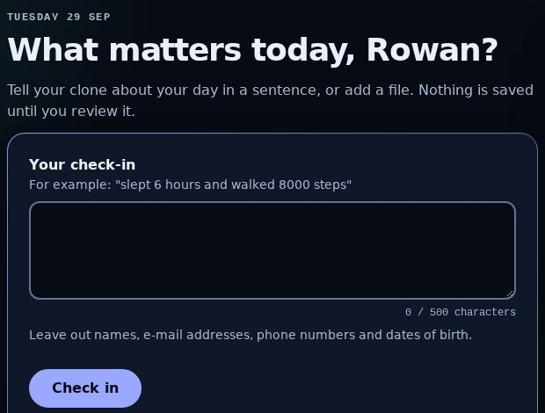
Clinical Human Clone · Team Syntropy · [Wellness] Sustaining Healthy Behaviors
TEMPLATE PENDING
Clinical Human Clone
Goals and barriers change week to week. Generic reminders don't show what they know about you, or why they suggest something.
Who it is for
A person trying to keep a healthy routine going, whose week does not look like last week.
What the prototype does
Check in in a sentence, review what the system understood, see where every value came from, and choose a next step.
Team aim, not a result: a health record the person can see, correct and act on.
Check-in screen, hosted build (fictional member)
Synthetic / simulated results · Synthetic data only · Not medical advice · Not tested with people
1 / 9
Notes:
Ledger rows: L37 (challenge numbering), L41 (framing follows the challenge statements; no rubric published), L71 (team name and aim as the owner supplied them). No statistic about the problem: the pack has no sourced figure for it. Illustration: /#today on the hosted build.
Screens: real captures of the hosted build (daypart/build 4ba3adb), 2026-11-11

Slide 2
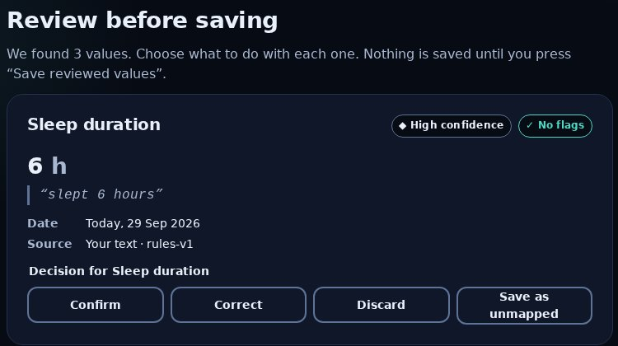
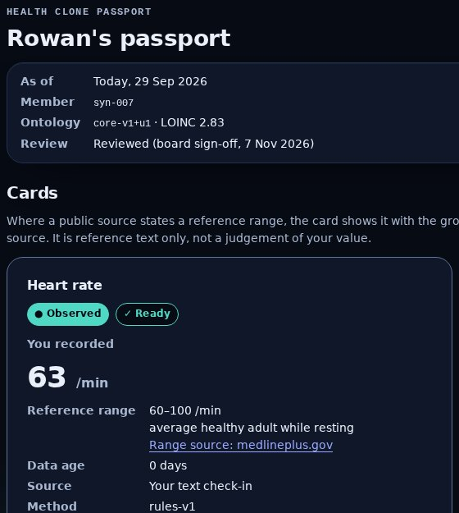
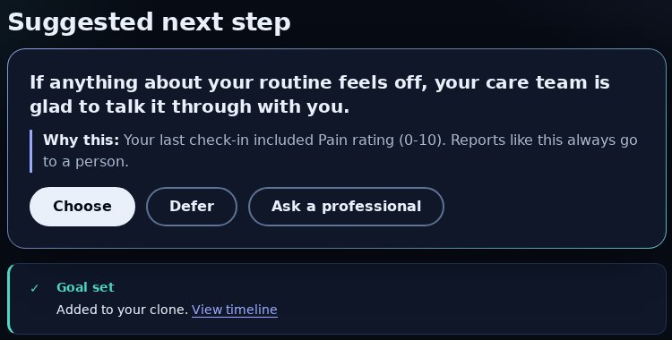
Clinical Human Clone · Team Syntropy · [Wellness] Sustaining Healthy Behaviors
TEMPLATE PENDING
The experience
Check in, review what the system understood, see it in your passport, and choose a next step. Nothing is saved until you confirm it.
1 Check in
2 Review
3 Passport
4 Next step
One sentence, or one of 4 bundled synthetic files. Voice and video show as not available.
One sentence gave 3 values, each with the words it came from. “mood 3 out of 5” gave none.
Each card: observed or simulated, data age, source and method.
Choose, defer or ask a professional. After a pain report it routes to a person.
Synthetic / simulated results · Synthetic data only · Not medical advice · Not tested with people
2 / 9
Notes:
Ledger rows: L5 (nothing reaches memory before the review), L45 (3 proposals from the four-part sentence; mood gives none), L49, L53 (next step choose/defer/ask), L55 (4 bundled synthetic files only). Screens: /#today, /#review, /#passport, /#next on the hosted build, 2026-11-10.
Screens: real captures of the hosted build (daypart/build 4ba3adb), 2026-11-11

Slide 3
Clinical Human Clone · Team Syntropy · [Wellness] Sustaining Healthy Behaviors
TEMPLATE PENDING
How it works
One reproducible path: check-in, proposed values, your review, a scoped memory, the passport and a bounded next step. Each step leaves a trace.
Live, on every check-in
Check-in
Safety checks
Proposals
Your review
Memory
Passport and next step
→
→
→
→
→
a sentence or a bundled synthetic file
crisis language and personal data stop here
fixed rules; each value keeps its words and method
confirm, correct or discard, all at once
confirmed values only, append-only
next step passes the boundary rules
Offline, separate from the live path
Synthetic members and scenarios
Evaluation
Training
Frozen comparison
→
→
→
175 members, fixed seeds
141 held-out synthetic prompts
2 fine-tuning stages; a reward model and a small policy
shown in the research console
Synthetic / simulated results · Synthetic data only · Not medical advice · Not tested with people
3 / 9
Notes:
Ledger rows: L6 (deterministic rules, no model call at runtime), L9 (proposal schema revalidated), L10 (crisis check before extraction), L11 (personal-data refusal), L24 (next step passes boundary rules), L43 (hosted build), L57 (two training stages), L59 (141 held-out prompts), L67 (175 synthetic members), L76 and L79 (reward model and policy, synthetic only). No box for anything not built.
Screens: real captures of the hosted build (daypart/build 4ba3adb), 2026-11-11

Slide 4
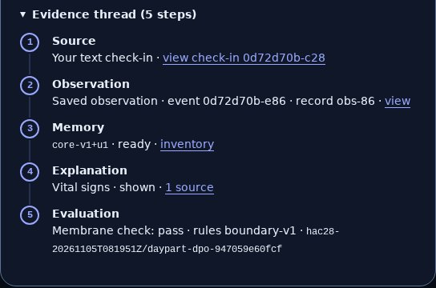
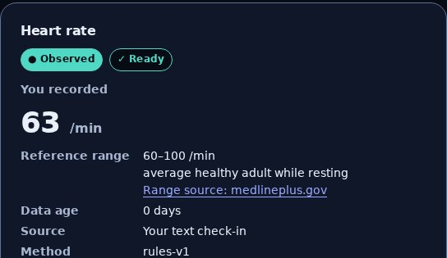
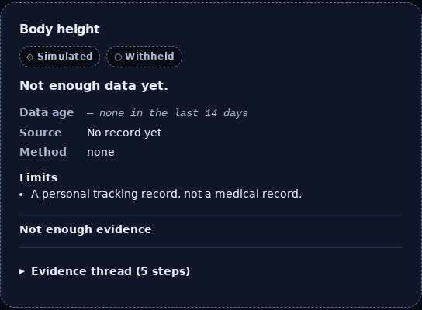
Clinical Human Clone · Team Syntropy · [Wellness] Sustaining Healthy Behaviors
TEMPLATE PENDING
Interpretability
Every value shows where it came from, when, how sure the system is, and what it withholds.
The evidence thread
A range, never a verdict
Withheld, not guessed
5 steps, from the check-in to the saved value, its memory version, a public source and the safety check.
Where a public page states a reference range, it sits beside the value. Nothing is marked high, low or abnormal.
No value in the last 14 days: the card shows no number and says so.
What it does not know: the inventory lists 5 gaps: lab results, conditions, medications, care history, screenings and check-ups.
Synthetic / simulated results · Synthetic data only · Not medical advice · Not tested with people
4 / 9
Notes:
Ledger rows: L21 (5-step evidence thread), L22 (ready only if at most 14 days old; otherwise withheld, no number), L20 (range shown, never interpreted), L50 (4 of 24 cards show a sourced range), L51 (pain card withheld at 16 days on the prepared member), L54 (5 gaps). Screens: /#passport on the hosted build after a synthetic check-in.
Screens: real captures of the hosted build (daypart/build 4ba3adb), 2026-11-11

Slide 5
Clinical Human Clone · Team Syntropy · [Wellness] Sustaining Healthy Behaviors
TEMPLATE PENDING
Learning and evidence
Two fine-tuning stages beat the base model on 141 held-out synthetic prompts, and a small learned policy was tested with simulated members. None of it is a patient outcome.
Boundary pass rate: prompts passed, of 141 held-out synthetic prompts, seed 0
Simulator: coaching approaches
150 simulated episodes (50 scenarios × 3 seeds), 14 days each. Mean simulated adherence, 0 to 1:
0.840 learned policy (slide 6)
0.833 always problem-solving
0.719 random
0.637 no support
Base model
45 of 141 (32%)
90 of its 141 replies were empty: most of the gap is empty output, not unsafe text.
Fine-tuned (stage 1)
141 of 141 (100%)
Preference-tuned (stage 2)
141 of 141 (100%)
Weak slice: lapse-recovery check, check-in prompts passed, of 51
SIMULATED · a message-type policy, not a language model
Fine-tuned (stage 1)
7 of 51 (14%)
One seed only, so no spread across seeds is reported. Held-out prompts are synthetic, not written by people.
Preference-tuned (stage 2)
6 of 51 (12%)
Synthetic / simulated results · Synthetic data only · Not medical advice · Not tested with people
5 / 9
Notes:
Ledger rows: L57 (two stages ran), L58 (question library, reward model and GRPO ran, synthetic), L79 (GRPO 0.840 vs 0.833 best scripted, 0 violations), L59 (141 prompts, 51 check-in + 90 probe, seed 0, one seed), L60 (base 45/141, SFT and DPO 141/141), L61 (90 of 141 base replies empty), L62 (lapse-recovery 7/51 SFT, 6/51 DPO), L63 (promotion gates passed), L66 (scripted baselines 0.637 / 0.833 / 0.719, 150 episodes). Illustration source: /admin#lab (Results) on the hosted build. 'Fine-tuned' = SFT, 'Preference-tuned' = DPO.
Screens: real captures of the hosted build (daypart/build 4ba3adb), 2026-11-11

Slide 6
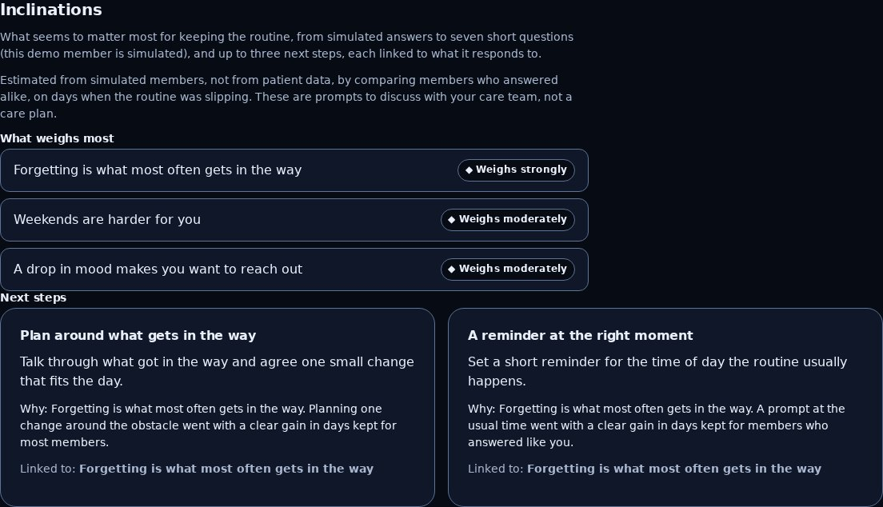
Clinical Human Clone · Team Syntropy · [Wellness] Sustaining Healthy Behaviors
TEMPLATE PENDING
What helps this member
Seven short questions, a reward model you can read term by term, and a small learned policy turn simulated answers into next steps, each with its reason.
1 Question library (Jev)
7 check-in questions. On 58 held-out simulated members the answers recover each hidden trait 76–91% of the time (chance 17–33%).
2 Reward model
Every score is a sum of named terms that add up exactly. Its top message type matches the simulator's for 83% of held-out members (chance 17%). It predicts no better than status alone (AUC 0.833 vs 0.834): its value is the explanation.
3 Learned policy (GRPO)
Mean simulated adherence 0.840 against 0.833 for the best scripted approach and 0.637 with no support, 0 rule violations. Small gain, same-day reward only.
Passport, Inclinations: what weighs most and linked next steps (simulated member)
SIMULATED · answers and members are synthetic · CPU only, no new spend
Synthetic / simulated results · Synthetic data only · Not medical advice · Not tested with people
6 / 9
Notes:
Ledger rows: L74 (7 questions), L75 (76–91% recovery on 58 held-out simulated members, chance 17–33%), L76 (score is a sum of named terms that add up exactly), L77 (AUC 0.833, log loss 0.408 vs 0.597 base rate; status-only comparator AUC 0.834, so the gain is attribution), L78 (rank correlation 0.75; top message type matches for 83%, chance 17%), L79 (GRPO 0.840, 0.856 on held-out members, vs 0.833 best scripted and 0.637 no support; 0 violations; CPU only), L80 (Inclinations section: drivers and up to 3 linked next steps with reasons; fails closed), L81 (hosted re-probe). Screen: /#passport Inclinations on the hosted build 4ba3adb. Technical appendix section 4a.
Screens: real captures of the hosted build (daypart/build 4ba3adb), 2026-11-11

Slide 7
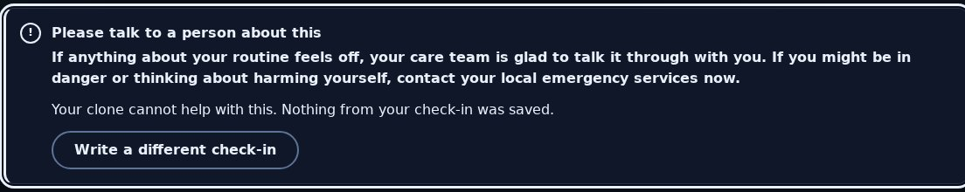
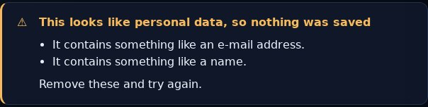
Clinical Human Clone · Team Syntropy · [Wellness] Sustaining Healthy Behaviors
TEMPLATE PENDING
Responsible AI and limits
The prototype refuses what it should not do, and shows you when it does.
Crisis language: a fixed hand-off to a person. Nothing is extracted or saved.
Personal data: refused whole. Nothing is saved.
Real health data: switched off
There is no screen to turn it on. If asked directly, the server refuses (403): 12 of 12 governance gates are open and unassigned, and enabling real input also needs a code change.
Limits
Synthetic data only. No diagnosis, treatment or dosing. No clinical review: content carries a board sign-off, not a clinician's.
The boundary rules caught 74 of 74 labelled violations, with 0 false alarms on 128 compliant rows of a 202-row test set. That is a measurement on that set, not a proof.
Synthetic / simulated results · Synthetic data only · Not medical advice · Not tested with people
7 / 9
Notes:
Ledger rows: L47 (crisis hand-off, not extracted), L48 (e-mail and self-name refused whole, 422), L56 (403 build_disallowed, 12 of 12 gates open; re-checked on 4ba3adb, 2026-11-11), L33 (real input cannot be enabled), L65 (74/74, 0 false positives on 128 compliant rows, 202-row corpus; a measurement, not a proof), L73 (no clinical evidence). Screens: /#today on the hosted build 4ba3adb, 2026-11-11. The real-input screen was removed in HAC-76; the refusal is the API's.
Screens: real captures of the hosted build (daypart/build 4ba3adb), 2026-11-11

Slide 8
Clinical Human Clone · Team Syntropy · [Wellness] Sustaining Healthy Behaviors
TEMPLATE PENDING
Feasibility and path to deployment
It runs today as a hosted prototype. Reaching people needs consent, privacy, security, clinical oversight and a validation study first.
Runs today. Redeployed only when every check passes; the hosted journey passed 9 of 9 steps.
Path to clinical validation: none started
1
Name a qualified clinical reviewer and the intended use
CONCEPT
Governance gates for real input: 12 of 12 open
2
Close the 12 governance gates; real input also needs a code change
CONCEPT
Lawful basis
Incident response
3
Clinical review of content, rules and boundary rules
CONCEPT
Informed consent
Processor terms
Access control
Jurisdiction review
4
Stronger evaluation: more seeds, a larger set written by people
CONCEPT
Encryption
Clinical intended use
5
Consented, supervised pilot with a pre-registered measure
CONCEPT
Retention and deletion
Qualified oversight
Audit log
Regulatory classification
6
Then decide whether the learned policy is used with people
CONCEPT
No cost, latency or scale figure: none is measured.
Synthetic / simulated results · Synthetic data only · Not medical advice · Not tested with people
8 / 9
Notes:
Ledger rows: L43 (hosted build, deployed by CI after every gate), L44 (hosted smoke 9 of 9), L12 (journals in memory only, single container), L33 (real input cannot be enabled), L56 (12 of 12 gates open), L73 (no clinical evidence), P9 (no cost or scale figure). Validation path: technical-appendix.md section 9; every step is concept, not started.
Screens: real captures of the hosted build (daypart/build 4ba3adb), 2026-11-11

Slide 9
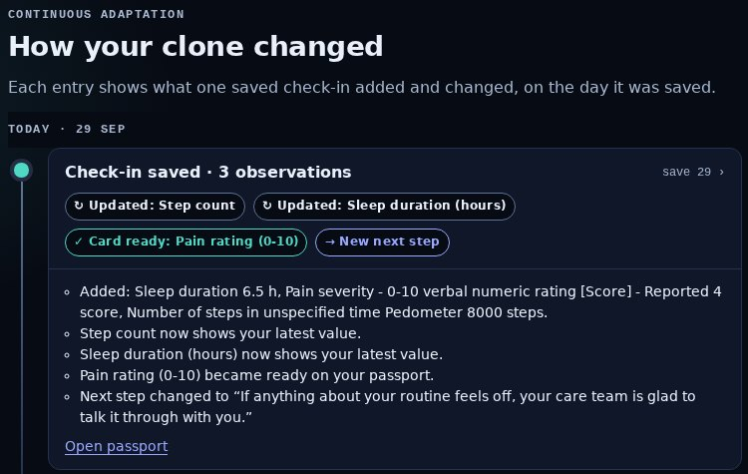
Clinical Human Clone · Team Syntropy · [Wellness] Sustaining Healthy Behaviors
TEMPLATE PENDING
Impact and next steps
What it would take to show this helps people: a named clinical reviewer, a consented pilot and a pre-registered measure.
Next steps
1.
Name a clinical reviewer
CONCEPT
2.
Close the 12 governance gates
CONCEPT
3.
Grow the learned policy beyond message type
CONCEPT
4.
Run a consented pilot with a pre-registered measure
CONCEPT
Aim, not a result: people keep healthy routines with a record they can see, correct and act on.
Timeline: what each saved check-in changed (fictional member)
Prototype https://supermomo668--daypart-demo-playground.us-east.modal.run
Source https://github.com/Syntropy-Health/longevity-memory-sdk
Synthetic / simulated results · Synthetic data only · Not medical advice · Not tested with people
9 / 9
Notes:
Ledger rows: L52 (timeline lists every saved check-in), L58 and L79 (a small message-type policy ran on simulated members; growing it is concept), L71 (aim as the owner supplied it), L73 (no clinical evidence). Any impact statement is an aim, never a result. Screen: /#timeline on the hosted build.
Screens: real captures of the hosted build (daypart/build 4ba3adb), 2026-11-11

