Slide 1
Topic
Presentation on Full Stack Project
Doctors Appointment Booking App
by
G-4
Shruti Dhiman : 2310991053
Syona Chandna:2310991062
Tanisha : 2310991064
Supervised by: Rahul Sir
Department of Computer Science and Engineering, Chitkara University, Punjab

Slide 2
Table of Contents
Problem Statement
Objective / Purpose
Main Topics / Sections (Depends on your topic)
Future Scope
Conclusion
References (if applicable)
Q&A / Discussion

Slide 3
Problem Statement
Manual booking is time – consuming and error-prone
Patients face difficulties scheduling appointments efficiently
Lack of Transparency in current system
Need for digital solution for booking, rescheduling, and tracking
Admins require control for confirmations, cancellations, and reports

Slide 4
Objective / Purpose
User-Friendly Platform: Allows patients to easily book appointments online without visiting the clinic.
Doctor Schedule Management: Doctors can efficiently manage and view their appointments to avoid conflicts.
Admin Panel: Admins can confirm, reschedule, cancel appointments, and generate reports.
Real-Time Notifications: Sends instant alerts to patients, doctors, and admins about updates or changes.
Secure Data Storage: Stores all patient, doctor, and appointment information safely using MongoDB.

Slide 5
Main Topics / Sections
System Overview: The application allows patients to book appointments online, doctors to manage schedules, and admins to oversee the process.
Features: Includes patient booking, doctor schedule management, and admin panel controls for confirmations and reports
Database Design: Uses MongoDB to securely store patient, doctor, and appointment information.
Technologies Used: Built with Node.js, Express.js, MongoDB, and HTML/CSS/JS for frontend and backend development.
Workflow / Screens: Users log in, book appointments, receive confirmations, and get real-time notifications.

Slide 6
Future Scope
Mobile App Version: Develop Android and iOS apps for easier appointment booking on the go.
Calendar Integration: Sync appointments with calendars and send automated reminders.
Online Payment System: Enable patients to pay for appointments securely online.
AI-Based Recommendations: Suggest doctors or appointment times based on patient history and preferences.
Analytics Tools: Provide insights for hospital management to improve efficiency and decision-making.

Slide 7
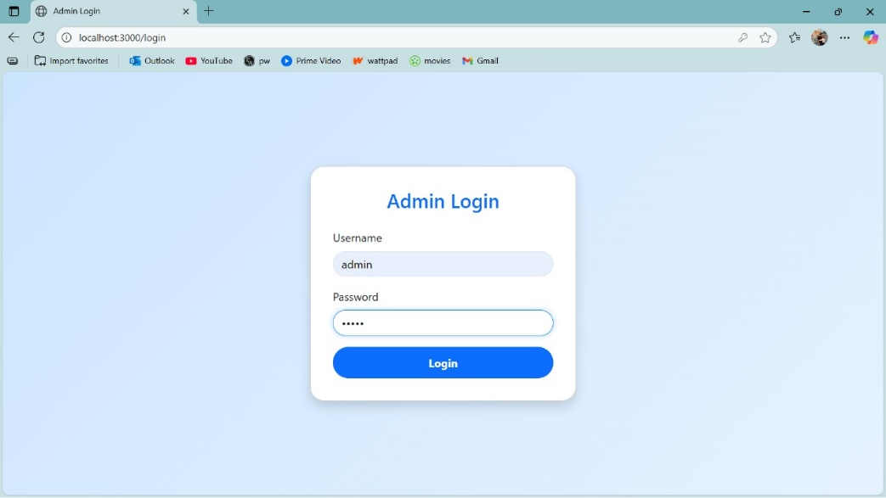
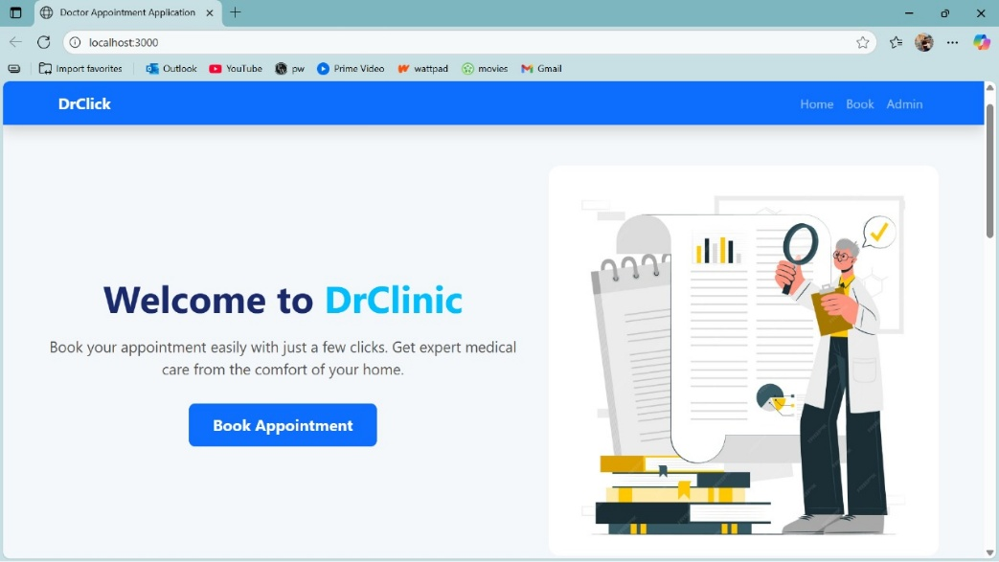
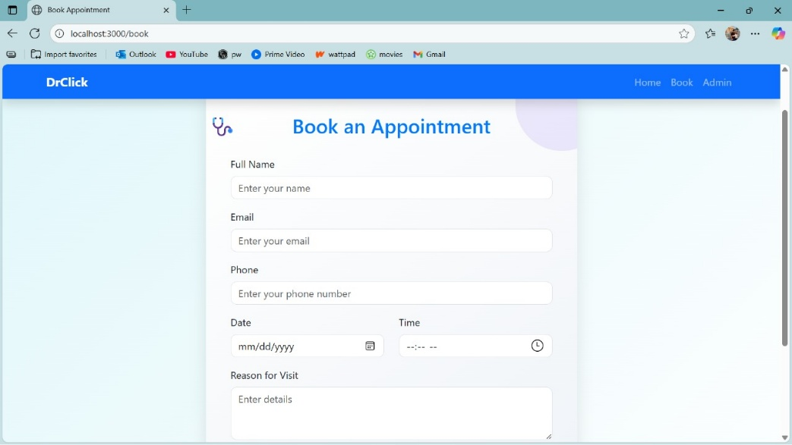
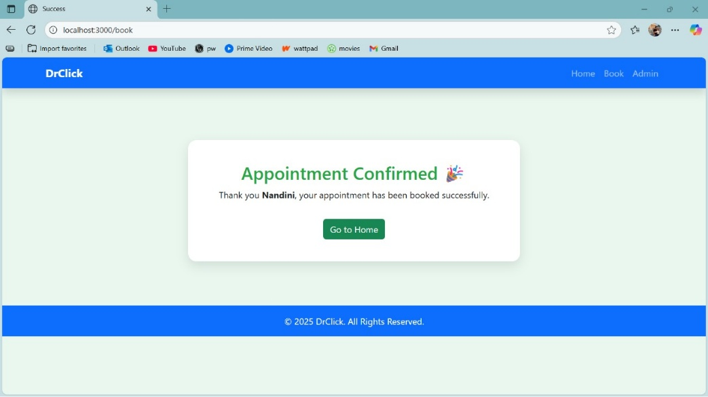
Project Snippets

Slide 8
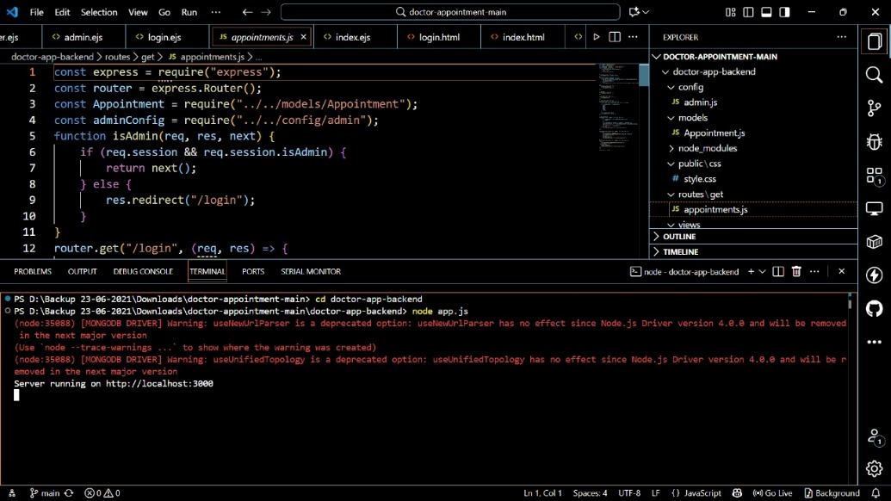
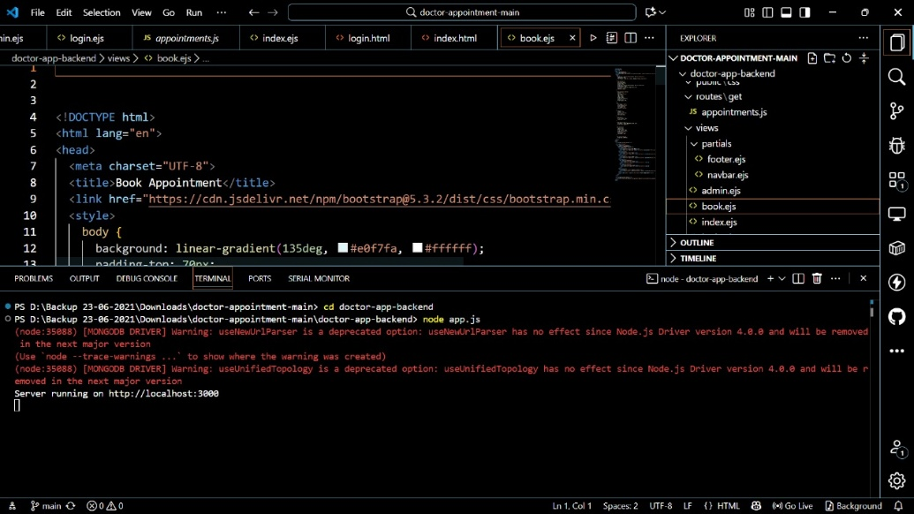
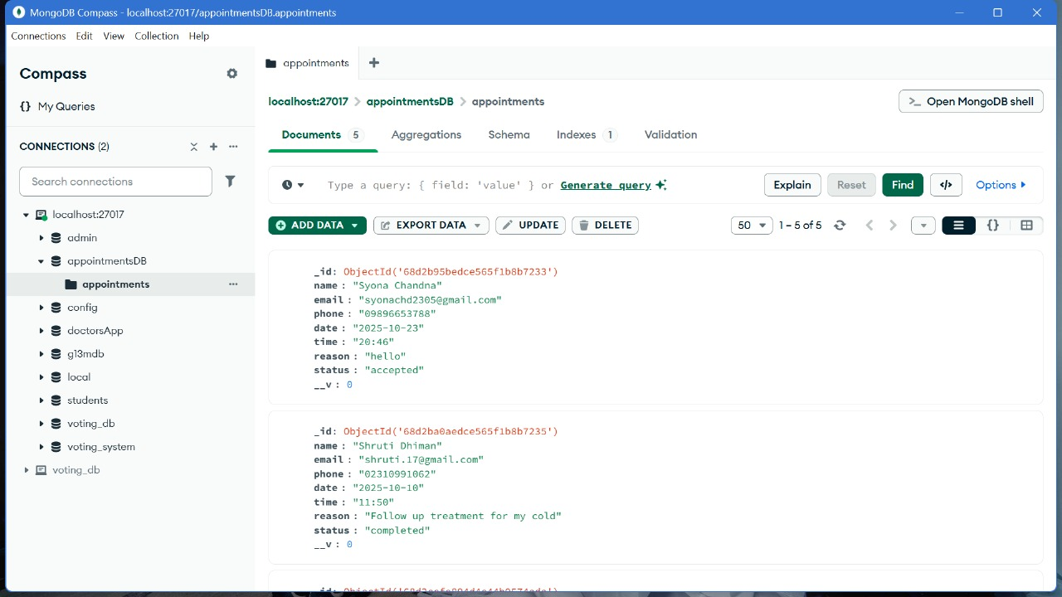
Code Snippets

Slide 9
Conclusion
Simplifies booking and management: Makes appointment scheduling faster and more organized.
Reduces errors and waiting times: Minimizes mistakes and shortens patient waiting periods.
Improves satisfaction and efficiency: Enhances patient experience and administrative workflow.
Secure and scalable: MongoDB ensures safe, reliable, and expandable data storage.
Real-time notifications: Keeps patients, doctors, and admins informed about updates, cancellations, or rescheduling instantly.

Slide 10
References
Official Documentation: Documentation for libraries, frameworks, and tools used in the project, as well as APIs or services integrated.
https://www.google.com/
Tutorials and Guides: Online tutorials, guides, blog posts, and educational videos that provided assistance or insights during development.
https://www.geeksforgeeks.org/
Code Repositories: GitHub repositories or other code repositories where code snippets, examples, or inspiration were found.
https://chat.openai.com/
Forums and Communities: Online forums, such as Stack Overflow or Reddit, and developer communities where questions were asked, advice was sought, or discussions were participated in.
Personal Communication: Mentors, peers who provided guidance, feedback, or support during development.

Slide 11
Q&A / Discussion
1. Ensuring Cross-Device Responsiveness
Challenge: Creating a user interface that works smoothly across desktops, tablets, and mobile devices.
Solution: Applied responsive design using HTML, CSS, and optionally React.js, and tested the platform on multiple devices to ensure patients and doctors can access appointment booking and admin features seamlessly.
2. Dynamic Data Handling
Challenge: Efficiently fetching and displaying patient, doctor, and appointment data without slowing down the system.
Solution: Optimized MongoDB queries and implemented indexing, along with efficient API endpoints in Node.js/Express.js to ensure fast retrieval and real-time updates for bookings and confirmations.
3. Admin Panel and Appointment Management
Challenge: Allowing administrators to manage confirmations, cancellations, rescheduling, and reports while handling multiple requests simultaneously.
Solution: Built a robust admin panel with secure role-based access, real-time notifications, and CRUD operations in Node.js, enabling smooth control over appointments and reporting.

Slide 12
Q&A / Discussion
4. Scalability of the Backend
Challenge: Designing a backend capable of handling an increasing number of patients, doctors, and concurrent appointment requests.
Solution: Used Node.js and Express.js with MongoDB to handle multiple concurrent API requests, ensuring scalable and reliable performance as the user base grows.
5. Real-Time Notifications and Reminders
Challenge: Ensuring patients, doctors, and admins are immediately informed of appointment bookings, cancellations, or updates.
Solution: Implemented real-time notifications using Node.js and integrated email/SMS alerts to keep all users updated instantly, reducing missed appointments and improving communication efficiency.

