Slide 1

Group Immigration in Greece
The Story of Afghan Asylum-Seekers
By Syona Negi

Slide 2
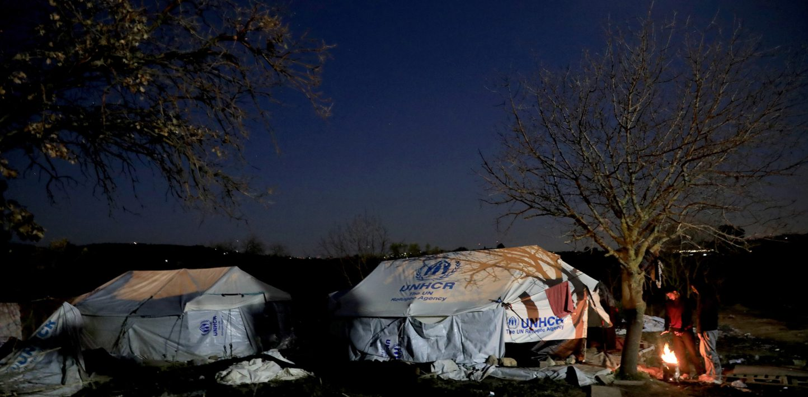
Afghan asylum-seeker’s Journey
In 2021, the Taliban took over Kabul, leading insecurity and violence into the country’s borders. This push factor compelled Afghans to seek refuge in Europe, starting step migration towards safer countries. Their journey began through Iran and Turkey which took about 20 days then traveled by boat to Greece or Italy. Afghans awaiting entrance would stay in camps on Greece’s many refugee camps. These camps had poor hygiene and low sanitation methods. Greece had already experienced mass migration from recent years and deemed Turkey suitable for migration and settling. This policy did not halt the flow of immigrants traveling to Greece, reaching 3,260 applications while only 41% were accepted. Afghan migrants who were not accepted were in a “legal limbo” not being able to return to Turkey or reapply.

Slide 3
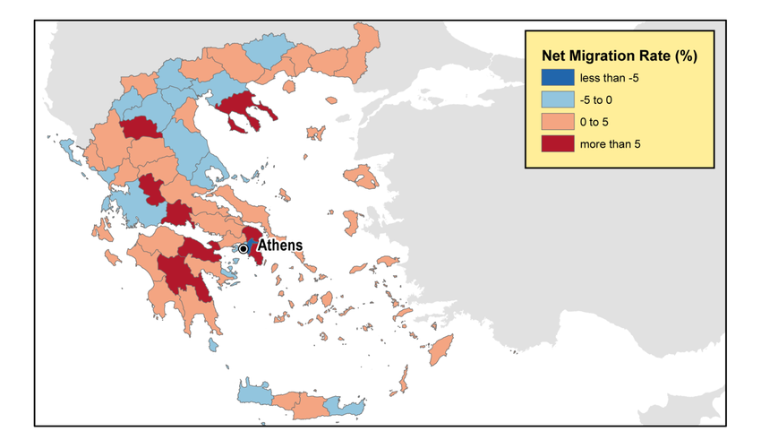
Push and Pull Factors For Afghan Asylum-See
Greece has experienced a heavy period of emigration where people fleeing from the communist regime seek shelter in other countries. Greece provided for these refugees in closer proximity and had a higher standard of living; it was a prime opportunity for refugees to become self-employed and start businesses in Athens. Afghan refugees have suffered through generations of war, a weak economy, poverty, etc.: all causes for their will to migrate out of Afghanistan. Afghans became one of the largest group applying for asylum in Greece as an entrance into Europe; however, many groups were rejected in a period(July to September of 2021) where Greece refused to recognize most asylum-seekers who applied. In March of 2022, Greece changed its policies to an acceptance rate of 95%, increasing the quota of immigrants.

Slide 4
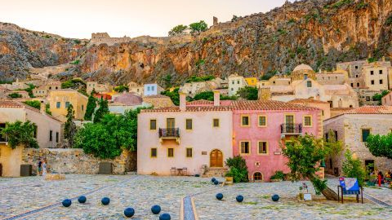
Immigration to Greece
Greece has experienced periods of mass immigration and emigration. The primary occupants who choose to migrate to Greece usually come from Bulgaria, Albania, Russia, and so on. Most migrants travel to Greece because of its rich culture, affordable living, and Mediterranean diet, but also the gateway it provides to other European nations. Greece has also experienced a period where many people were emigrating, because of the economic depression in the late 1900’s and the 2009 Economic Crisis. War was also a major reason some chose to move from and to, as World War II conditions and the Greek Civil War. Afghan immigrants were seeking asylum and protection from their home country after suffering under the Taliban regime and war, bringing unbridled violence and insecurity. They started a dangerous journey to Europe where they settled, still tied to their culture and safety.

Slide 5
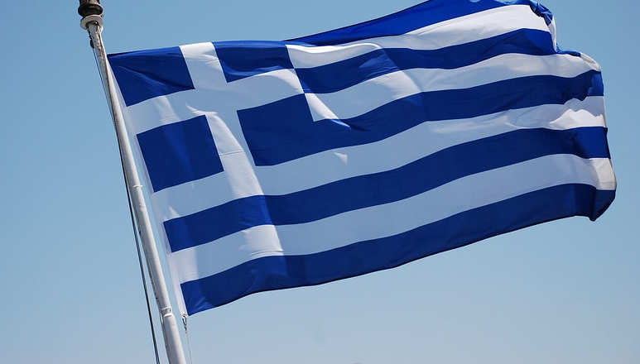
Afghan Migrants’ Impact
Economical | Greece’s GDP was facing a time of developing economy, migrants led an increased working class | Greece’s GDP rapidly increased in 2021 making way for an economic upturn | Most Afghans worked in agriculture, domestic labor, or entrepreneurship
Social-Cultural | Afghan culture mixed with Greece’s and Europe's | New spices were introduced to European culture | Greece created restrictive asylum policies
Political | Greece instituted a new policy due to migrants: Safe Third Country Policy | Relocation diffusion may influence elections | International(and domestic) criticism of the Safe Third Country Policy
Environmental | Greece suffered high temperatures in 2021, but no direct correlation | The Agriculture Industry increased as Afghan immigrants started work | The arable land percentage also increased as a result of the expansion of the industry

Slide 6
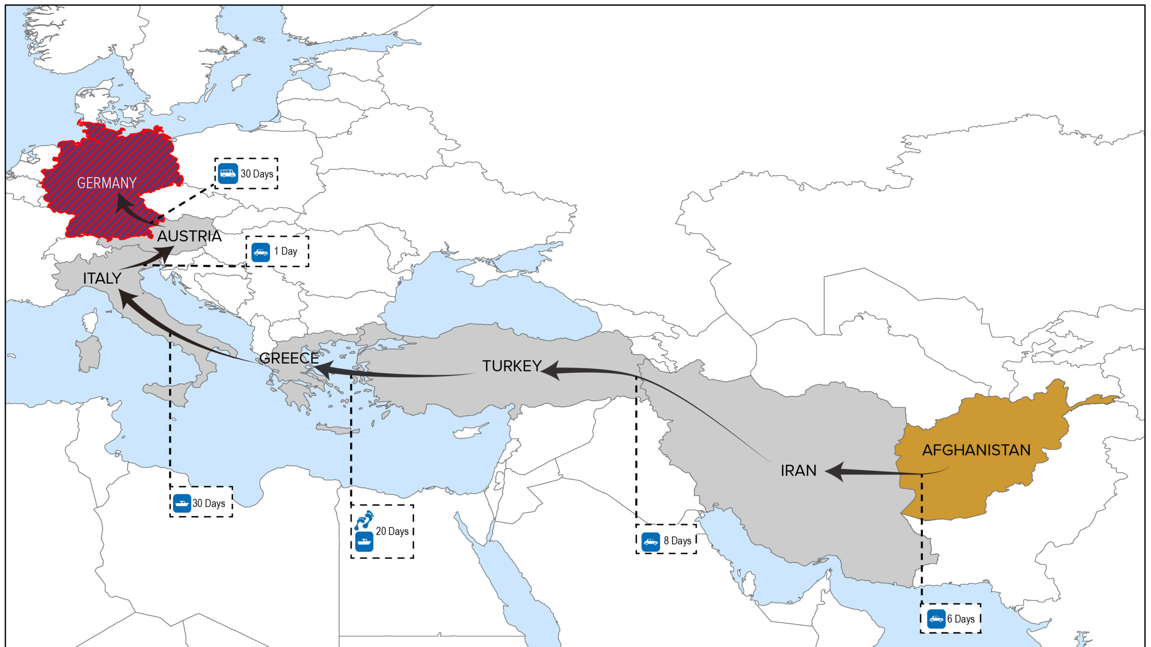
This map indicates the patterns of movement throughout the Middle East to Europe. Afghan migrants who were escaping from the Taliban's Regime passed through Iran, Turkey, and waited for acceptance to Greece(usually their pathway to Europe). Many times, migrants were documented to cross borders illegally and die by border control. Greece had restrictive policies on acceptance in mid-September of 2021, declaring Turkey, Albania, and North Macedonia as potential locations for asylum-seekers. Greece’s Safe Third Country Policy was met with heavy criticism. When migrants arrived in the refugee camps on Greece’s islands, they waited –sometimes months– before rejection or acceptance.
Map of Afghan Migration

Slide 7
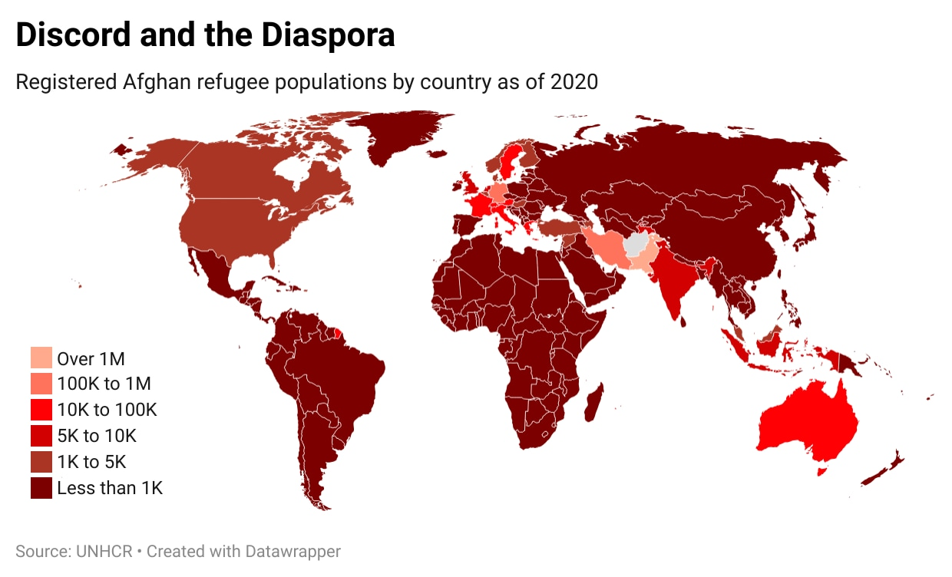
Afghan Density Globally
Afghan migrants primarily seek asylum in European nations where safety is prioritized. Greece was home to more than 13,000 Afghan migrants in 2020. In 2021, when migration rates increased, each month more than 2,000 were admitted for travel.
In December of 2021, data shows that 28,543 (24% of total Afghan refugees) refugees and 9,142 (25% of total asylum-seekers) asylum-seekers immigrated to Greece, making them the largest population of asylum seekers in Greece and the second largest refugees.

Slide 8
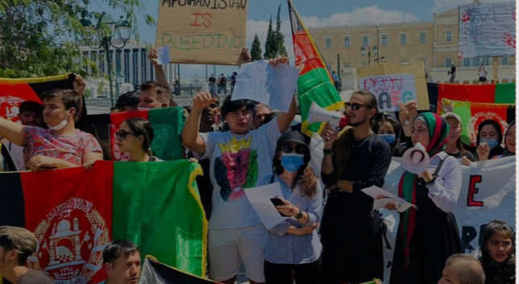
Afghan Migrant’s Remittances
Afghan Migrant’s Remittances
Afghan culture is strongly family-based; they feel a sense of responsibility to those less fortunate than themselves. Thus, they offer remittances, or money made in another country, to their families. In 2018, it was documented over one-fifth of the Afghan migrants sent remittances back to Afghanistan, but remittances rate dropped as the Taliban took over in 2021. Though many migrants had great difficulty finding jobs or programs to aid them, they were determined to help their families. Those who used Greece as an entrance to Europe and temporarily worked, would have a harder time to send money back. Greece also limited the integration the migrants had with the economy in certain periods, even further challenging the migrant’s status as workers for their families. A wide variety of refugees and asylum-seekers were hung in legal limbo neither accepted nor rejected from the Greek government. Hence, they were not able to send any money to their origin country.
The Afghan migrants

Slide 9

Afghan Food reaching Greece
The same year of the mass Afghan migration, the International Rescue Committee started a “Recipes for Home” series which highlighted Afghan food. A woman waiting for acceptance to Greece shared her fusion the two cultures: Bolani, an Afghan dish, and Greek yogurt. Afghan asylum-seekers used their traditional dishes and flavors to preserve their culture while in camps. The spread of Afghan cuisine still holds relevant, as many restaurants have sprouted highlighting Afghan dishes. Their dishes spread everywhere they cooked, maintaining their strong ties to their culture. This dispersed culture with relocation diffusion, or the spread of culture traits through migration. Greece welcomed not only the people but their dishes, cultures, and language, nurturing a new generation who live in safety and their own culture. Though it was harder to enter Greece in March to September in 2021, Greece did try to accommodate as many immigrants as possible, welcoming more than 2500 immigrants every 2-3 months. Most who are granted asylum settle in Athens.

Slide 10

Afghans’ Suitcase
Afghan migrants didn’t have much, but they refused to let go of their culture, so they started shaping Europe's, introducing different spices and foods. As asylum-seekers, migrants couldn’t not afford to carry so much. According to Medium’s article “What’s In My Bag”, a reference to a Syrian mother going to Greece with her infant daughter, the mother had brought socks, diapers, legal documents, and an assortment of medicine all to support her daughter. When arrival per Greece, she was given two jars of food from two Greek men who had seen her baby. An Afghan immigrant who was attempting to chain migrate to his friend in Germany took money, 2 clothes, face-whitening cream, and hair gel. He states, “I want my skin to be white and my hair to be spiked. I don’t want them to know I’m a refugee. I think that someone will spot me and call the police, because I’m illegal.” Migrants immigrating to Greece suffered hardship throughout the journey further attributing to the friction of distance theory.

Slide 11

Citations
Citations
Esfahani, Tara Ansari; Ekholm, Pernilla, AFGHANS IN GREECE, September 28, 2025, https://www.rescue.org/sites/default/files/2022-09/IRC_Hellas_Afghans_in_Greece_EN_0.pdf
Impact Initiatives, Migration: A study on Afghan returnees from Europe, their motivations and challenges to reintegration | Impact, September 28, 2025, https://www.impact-initiatives.org/stories/migration-a-study-on-afghan-returnees-from-europe-their-motivations-and-challenges-to-reintegration/
Safe third country - Asylum Information Database: European Council on Refugees and Exiles, Asylum Information Database | European Council on Refugees and Exiles, June 28, 2024, September 28, 2025, https://asylumineurope.org/reports/country/greece/asylum-procedure/the-safe-country-concepts/safe-third-country/
Tomlinson, JJ, The Changing Dynamics of Afghan Migration after August 2021, March 2024, September 28, 2025, https://mixedmigration.org/wp-content/uploads/2023/03/266_Changing-Dynamics-Afghan-Migration.pdf
ANNUAL AGRICULTURAL STATISTICAL SURVEY: 2020, September 1, 2024, September 28, 2025, https://www.statistics.gr/documents/20181/18166418/Annual+Agricultural+Statistical+Survey+(Final+Results)+(+2020+).pdf/ba0e1942-afaf-12b2-1984-e065f6bd3d72?t=1693558783605
Borda, Balázs, Balogh, ANNUAL AGRICULTURAL STATISTICAL SURVEY: 2020, September 28, 2025, https://www.statistics.gr/documents/20181/18166418/Annual+Agricultural+Statistical+Survey+(Final+Results)+(+2020+).pdf/ba0e1942-afaf-12b2-1984-e065f6bd3d72?t=1693558783605
Greece - Data Commons, Home - Data Commons, September 28, 2025, https://datacommons.org/place/country/GRC?utm_medium=explore&mprop=amount&popt=EconomicActivity&cpv=activitySource%2CGrossDomesticProduction&hl=en

