Slide 1
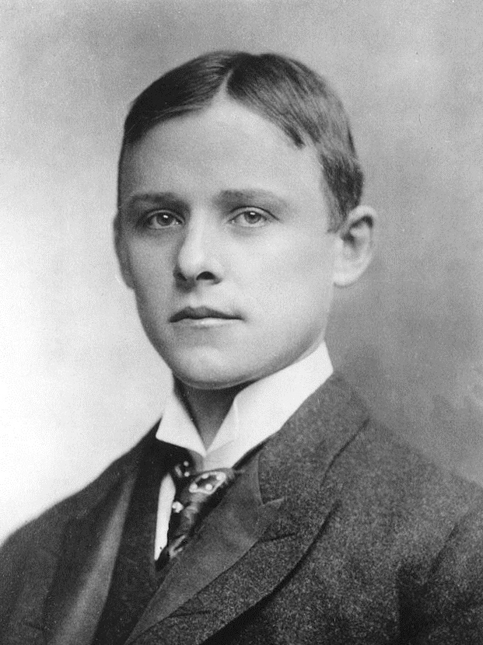
Charles Hall (1863-1914)
Education: After doing his undergraduate, Hall set up a lab at home for the purification of aluminum.
Location: Having done his undergraduate in Ohio, he arrived in Philadelphia for backers to fund his research.
Hall simultaneously discovered the process with French Paul Heroult.
O
H
O
H
H
H
Oxygen
Two Hydrogen
Water Molecule
Charles Hall only had John Dalton’s atomic model and theories and Micheal Faraday’s idea that atoms were related to electricity.
*Acts as Anode
Copper Clamp
*Carbon Lining acts as cathode
Anode*
Anode*
Alumina
Al O2
Electrolytic Cell
Al + CO2
Syona Negi
Grade 9
1B
Molten Aluminum
Steel Sheet*

Slide 2
Citations:
Atomic Theory Timeline Democritus ~450 BC John Dalton 1803 Michael Faraday, September 23, 2025, https://www.sas.upenn.edu/~dbalmer/eportfolio/nature_timeline.pdf
Aluminum Electrolysis - an overview | ScienceDirect Topics, September 23, 2025, https://www.sciencedirect.com/topics/engineering/aluminum-electrolysis
What Is John Dalton's Atomic Model?, Universe Today, September 23, 2025, https://www.universetoday.com/articles/john-daltons-atomic-model

