Slide 1

Object Oriented
Application Development
UML Basics
Q: What did the Java code say to the C code?
A: You've got no class.

Slide 2
Overview
Objective
  To learn Use Case Diagram & Sequence Diagram
Content
  Use Case Model (Diagram + Specifications)
  Sequence Diagram
After this module, you should be able to
  Explain that Use Case Model is used to capture requirements
  Explain the importance of modeling
  Read sequence diagrams
  Relate class/sequence diagrams to code
Object Oriented Application Development

Slide 3

Application Development Lifecycle
Includes the following phases
Time
Requirements
Design
Code
Integration
System Test
Object Oriented Application Development

Slide 4

Application Development Lifecycle
Iterative if one breaks down by subsets of requirements
Iteration 1
Iteration 2
Iteration 3
R
R
R
D
D
D
C
C
C
I
I
I
T
T
T
time
Object Oriented Application Development
Notes:
The earlier iterations should address the greatest risks in the project. Each iteration produces an executable release, an additional increment of the system.
Various people differentiates between iterative and incremental processes.
By "incremental development", it means a staging and scheduling strategy in which the various parts of the system are developed at different times or rates, and integrated as they are completed.
By "iterative development", it means a rework scheduling strategy in which time is set aside to revise and improve parts of the system. It does not presuppose incremental development, but works very well with it. The difference is that an increment may actually ship, whereas an iteration is examined for modification.

Slide 5
Use Case Model
A Use Case Model describes a system's functional requirements in terms of use cases.
XXXXXXXXXXXXXXXXXXXXXXXXX
XXXXXXXXXXXXXXXXXXXXXXXXX
Use Case Specification
- brief description
- flow of events
Use Case
Actor
Object Oriented Application Development
Notes:
Use cases are a way to document functional software requirements. The use case model consists of both diagrams and text. The diagram shows the visual overview of the system. The text gives the descriptions of the actors and the use cases.
The description of what happens is called the flow of events.
An actor is someone/something outside the system, acting in a role that interacts with the system.
A use case describes a sequence of interactions between actors and the system under consideration that occur when an actor uses the system to achieve a goal.
The system boundary is the boundary between the system being developed and the outside world.

Slide 6
Case Study: Use Case Diagram
Browse Catalog
Reserve Book
Borrow Book
Librarian
Patron
Renew Book
Return Book
Object Oriented Application Development

Slide 7
Case Study: Borrow Book UC Specifications
Actor
  Librarian
Precondition
  The librarian is logged in
Main flow of events
  This use case begins when the patron arrives at the counter with books to borrow.
  The librarian swipes the patron's membership card.
  The system displays the member's account details.
  The librarian swipes the barcode of the book to be borrowed.
  The system checks that the book is available for loan. If it is, the system records the loan line item and sets the book status to "On Loan".
  The librarian repeats step 4 – 6 until all the books have been swiped or the loan limit is reached.
  The librarian ends the transaction.
Alternate flow of events
  2a. Member has fine amount exceeding $5.
    The system displays the user's fine amount.
    The librarian collects the fine and selects the "pay fine" option.
    The system records the payment.
Object Oriented Application Development

Slide 8
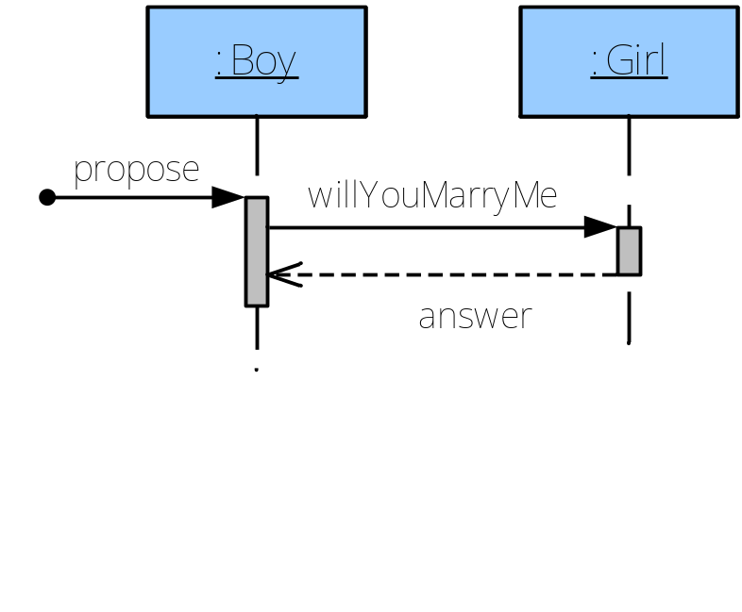


Sequence Diagram
Objects interact through messages
A message shows how one object asks another object to perform some activity
Model
Reality
will you marry me
yes
public class Boy {
private Girl g;
public void propose() {
boolean answer = g.willYouMarryMe();
}
}
Object Oriented Application Development

Slide 9
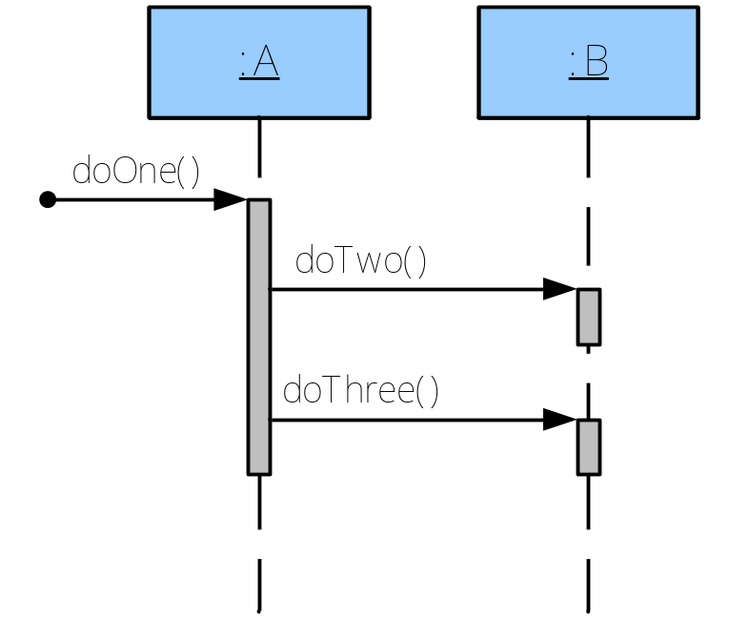
Sequence Diagram
Describe how a group of objects collaborate.
A
B
public class A {
private B myB = new B();
public void doOne() {
myB.doTwo();
myB.doThree();
}
}
Object Oriented Application Development

Slide 10
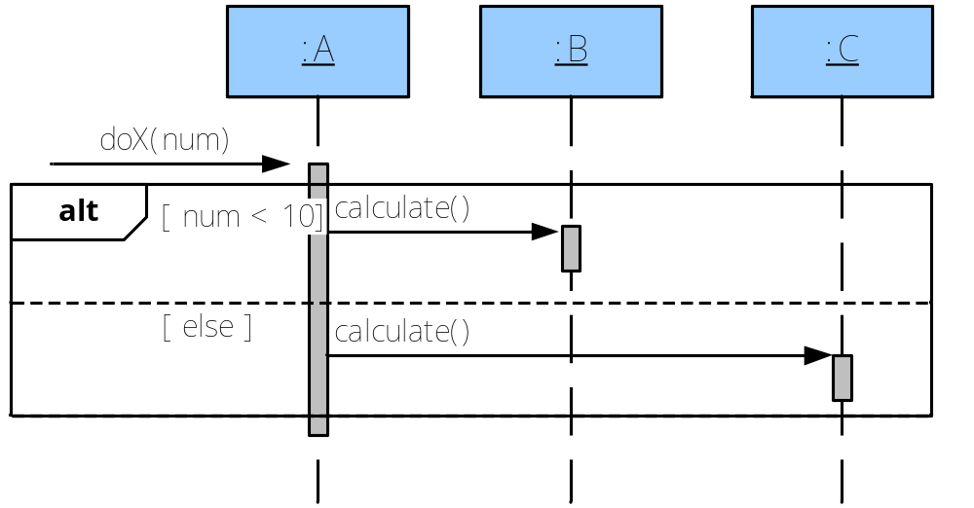
Sequence Diagram: Conditional Messages
Describe how a group of objects collaborate.
public class A {
public void doX(int num) {
B myB = new B();
C myC = new C();
if (num < 10) {
myB.calculate();
} else {
myC.calculate();
}
}
}
Object Oriented Application Development

Slide 11
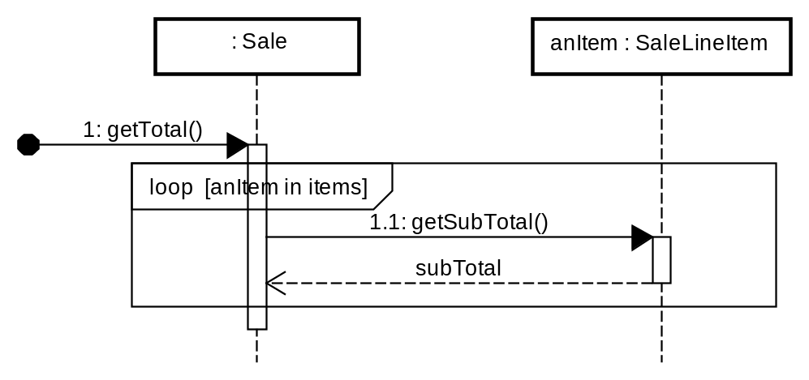
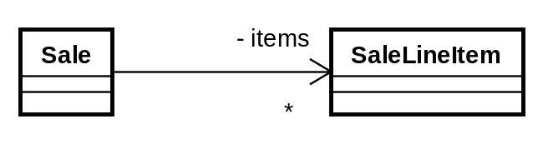
Sequence Diagram : Looping
describe how a group of objects collaborate.
public class Sale {
private ArrayList<SaleLineItem> items;
public double getTotal() {
double total = 0.0;
for (int i = 0 ; i < items.size() ; i++) {
SaleLineItem anItem = items.get(i);
total += anItem.getSubTotal();
}
return total;
}
}
Object Oriented Application Development
Notes:
1. Draw a class diagram for this!
2. Change loop [ anItem in items ]
3. Object ( items: SaleLineItem )

Slide 12
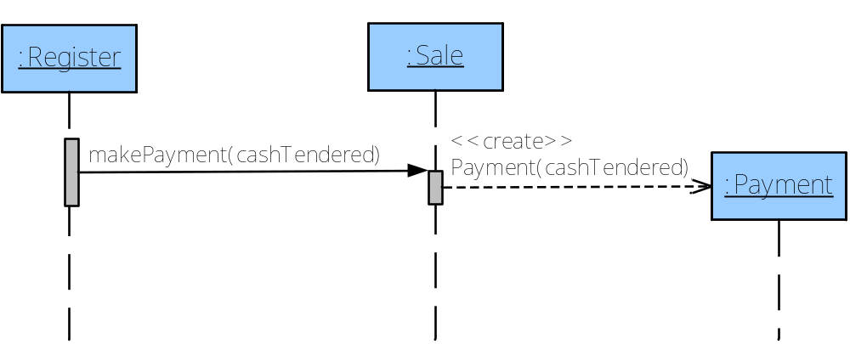
Sequence Diagram : Object Creation
Describe how a group of objects collaborate.
public class Sale {
private Payment p;
public void makePayment(double cashTendered) {
p = new Payment(cashTendered);
}
}
Object Oriented Application Development
Notes:
1. self-activation

Slide 13
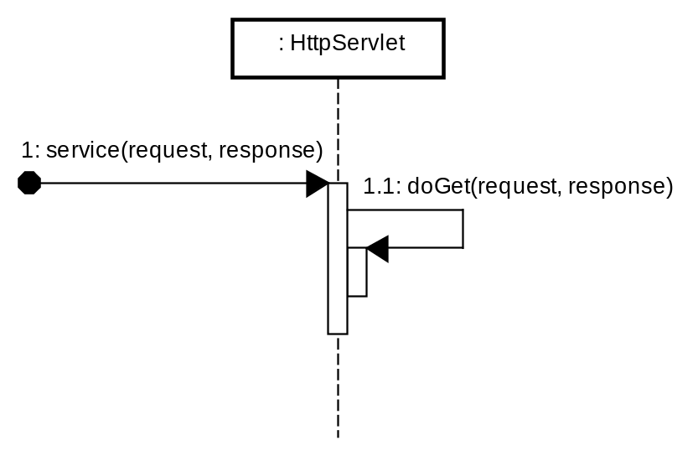
Sequence Diagram : Self-message
a message being sent from an object to itself by using a nested activation bar
public class HttpServlet{
public void service(HttpServletRequest request,
HttpServletResponse response) {
doGet(request, response);
}
}
Object Oriented Application Development
Notes:
1. self-activation

Slide 14
Notes for SDs
Arrow | Description
 | A synchronous message
 | An asynchronous message (not in syllabus)
 | A return message 1. Show them if they help clarify your diagram 2. Optional for methods that return nothing (void)
 | A participant's creation message
<<create>>
:Class
Object Oriented Application Development

Slide 15
Summary
Use Case Model is a way to capture functional requirements.
Sequence diagrams show the dynamic view of a system.
  Each message call on a sequence diagram is equivalent to a method call.
Sequence diagram is an artefact produced during the design stage of application development
Object Oriented Application Development

Slide 16

References
UML Distilled (http://blue.smu.edu.sg/distilled)
  Chapter 4. Sequence Diagrams
Applying UML and Patterns (http://blue.smu.edu.sg/applying)
  Chapter 15: UML Interaction Diagrams
UML basics: The sequence diagram
  http://www.ibm.com/developerworks/rational/library/3101.html
  A Journey into the IT Jungle (2nd Ed) (2008)
  Chapter 5 (OOAD)
Object Oriented Application Development

Slide 17
Tools
Astah Professional
  http://astah.net/student-license-request
Object Oriented Application Development

