Slide 1
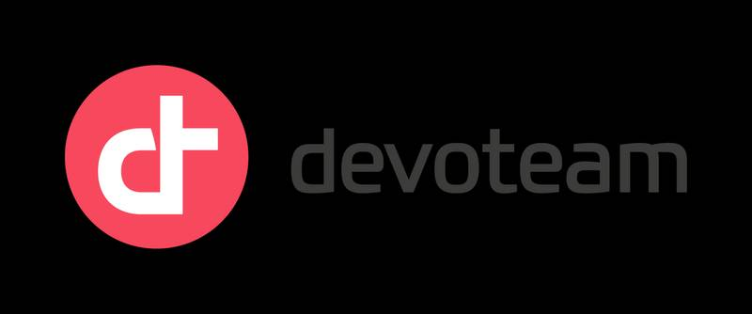




Senior developer Full Stack Java/Angular
4 years of experience
Z.A.O
A versatile developer with extensive experience designing and developing innovative solutions for startups and established companies. Expertise in Angular and Java, focusing on building robust and scalable web and mobile applications. Passionate about digital transformation, I combine technical skills and a collaborative approach to deliver solutions that meet the strategic objectives of projects.
Trainings & CERTIFICATIONS
Certifications 2024: GCP - Associate Cloud Engineer
( EN COURS )
RECENT KEY EXPERIENCES
Certifications 2024: Understanding the OWASP® Top 10 Security Threats (SKF100)
( EN COURS )
EZ-Pass - ClickBus Tunisie
Co-founder - CTO / Angular - Java - Ionic - Android native - RDB
3 years- Team of 3 developers
Tunisian Coast Guard - IsMaris Project
Développeur Full Stack Java/ JSF - Primefaces - RDB - J2EE - jBoss
1.5 year- 2 Developers and a Project Manager
First Delivery Group - Treasury & Main platform
Développeur Web Java et développement Koa.js - Angular - NodeJs
9 months- A team of 8 memberes
Institute of the Francophonie for Sustainable Development - TerVie
Développeur Android Java / Développeur Web NodeJs-Express-MongoDB
6 months- 2 developers supervised by the CTO
Ionbond IHI Group - Ionbond troubleshoot
Développeur Android Java
5 months- 2 Developers and a Project Manager
SIAM - Xivo
Technical consultant
3 months
Telnet Holding - Ingenico database parser
Intern
6 mois
Certifications 2024: Green Software for Practitioners (LFC131)
NB#: LF-nr30gsv5jx
Certifications 2024: Developing Secure Software (LFD121)
NB#: LF-uzz8mzxo1t
Diplôme 2020: Masters in IT Networks and telecommunications
ENET’Com : Sfax
LANGUES
Fluent
Fluent
Anglais
Français
Native
Arabe

Slide 2
Senior developer Full Stack Java/Angular
4 années d’expériences
Z.A.O
TECHNICAL SKILLS
Web Development
Front-End
Angular, TypeScript, NgRx, JavaScript, HTML, XML, XHTML, JSP, CSS, SCSS, jQuery, Material Design, Bootstrap, Ionic, AdobeXD
Back-End
Java 21, Jakarta, Spring Boot 3, Spring 6, Spring Webflux, Spring JPA, Spring Security, Keycloak, J2EE, JSF, PrimeFaces, Express
API & Microservices
Spring Cloud Gateway, Netflix Eureka, JAX-RS Jersey, REST API Design & Architecture, JWT (JSON Web Tokens), Spring Webflux, Resilience4j
Messaging
Pub/Sub (RabbitMQ, Kafka)
Mobile Development
Android (Java)
Cloud
Firebase, P4D, Kubernetes, Docker, Helm
Databases
MySQL, PostgreSQL, Redis, MongoDB, Firestore, SQLite
DevOps & CI/CD
Git, GitLab, Bitbucket, GitLab CI/CD, Jenkins, GitHub Actions
Monitoring & Observability
Zipkin, Micrometer, Grafana, Prometheus
Testing
Mockito, JUnit
ORMs
Hibernate, Prisma
Agile Principles & Project Management Tools
SCRUM, Kanban, JIRA
Operating Systems
Windows, Linux, MacOS
COMPÉTENCES FONCTIONNELLES
Methodology and Formalism
Analysis / UML Modeling Processes: Agile / Kanban
Software architecture
Technical / Functional Studies
Familiar with Microservices architecture
Quality Monitoring and Control
Functional and Technical Documentation

Slide 3

PROFESSIONAL EXPERIENCE
EZ - Pass
Full stack developer / Mobile Developer
Context :
EZ-Pass is developing a project that leverages the bus fleets of fleet managers to offer affordable transportation to individuals and business employees, thereby optimizing existing resources to meet local needs.
Responsibilities:
Development of all mobile (driver and passenger) and web applications (bus owners, business partners, showcase website).
Design and implementation of the functional and technical architecture of the applications.
Creation of user interfaces and UX/UI experience for the different platforms.
Management of deployment and publication on the app stores (App Store, Google Play).
Maintenance and improvement of existing features to ensure performance and security.
Deliverable:
Delivery of mobile applications (drivers, passengers), web applications (bus owners, partners), and a showcase website. Each solution has been developed, tested, and deployed to the stores (App Store, Google Play), ensuring high quality, performance, and security.
Technical environment:
Java 13 , J2EE , Jersey JAX-RS, Hibernate, JDBC , Angular, P4D Cloud, Firebase Authentication, Firebase, Firestore, jQuery, Angular, Bootstrap, Tailwind CSS, HTML/CSS, Développement mobile native Android (Java), Ionic.

Slide 4

PROFESSIONAL EXPERIENCE
Garde Nationale Maritime
Senior Developer / Java JSF
Contexte :
As a software engineering consultant and web developer for the Tunisian Coast Guard, I facilitated the coordination of critical systems for fleet management and port traffic operations, emphasizing stability and security. I used enterprise-grade technologies to detect fraudulent activity and unauthorized access.
Responsabilités :
Development of solutions centered on a robust reporting infrastructure to enable quick action and improve security measures.
Management of secure access and storage of sensitive documents across various levels of authority and geographic locations.
Design and development of algorithms to identify and flag violations, providing real-time information to stakeholders.
Management of user access levels based on their authorization, ensuring rigorous data management and controlled access.
Deliverable:
The project resulted in the implementation of a fleet and port traffic management system, featuring a secure platform for storing sensitive documents and real-time reporting. Algorithms were developed to detect violations and provide immediate information to stakeholders.
Technical environment:
Java 8 , JSF, PrimeFaces,, MySQL, Angular, Bootstrap, AdminLTE, Hibernate, jBoss, PicketLink, i18n, Html CSS, jQuery, Ajax, Quartz.

Slide 5
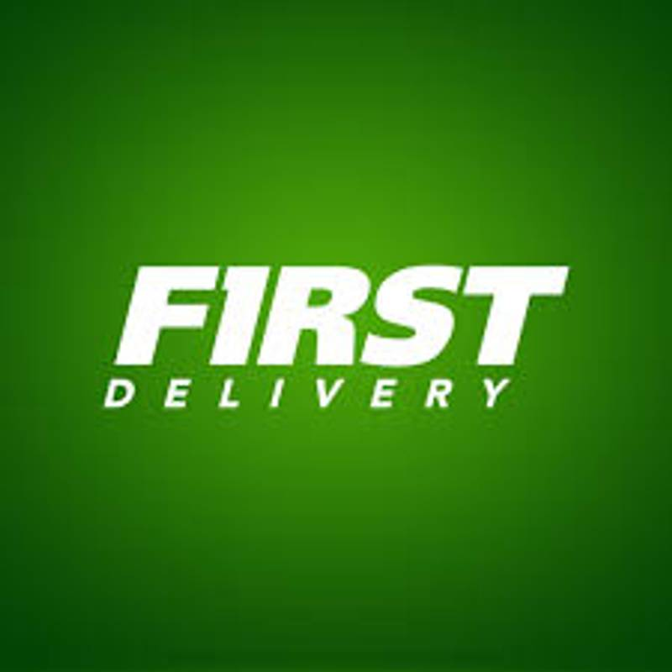
PROFESSIONAL EXPERIENCE
First Delivery Group
Node JS Developer
Context:
The project involved developing a comprehensive system to manage all operations of a delivery company, including package collection, delivery agent assignment, package tracking by users, as well as billing management and logistics backlog.
Responsibilities:
Managing partners: registering, tracking, and updating customer-related information in the system.
Developing and managing the financial aspect of the application, including billing for services and payment collection.
Tracking financial transactions related to drivers at the end of their shifts.
Integrating mechanisms for managing commissions and fees associated with delivery services.
Deliverable:
A comprehensive delivery operation management system was developed, enabling seamless management of partners, package collection, and agent assignment. The financial aspect was integrated, with billing and payment collection functionalities, as well as tracking of drivers' financial transactions. Commission and fee management mechanisms were implemented to optimize logistics processes and ensure transparency of operations.
Technical environment:
Koa.js, GitHub Actions, Jira, Vitest, PostgreSQL, Prisma, Vue.js, Angular, Tailwind CSS, OVH Cloud.

Slide 6
PROFESSIONAL EXPERIENCE
First Delivery Group
Full Stack Java Developer
Context :
For my first deliverable, I developed a web-based treasury application that allows each department to track its expenses and profits across different sites in several cities across Tunisia. This application aimed to provide a centralized view of financial flows, thereby facilitating administrative control of transactions to ensure rigorous and efficient management.
Responsibilities:
Developed a web-based treasury management application to track expenses and profits by department across multiple cities.
Designed the functional and technical architecture, integrated financial flows, and generated reports.
Created the user interface with a strong focus on UX/UI.
Deployed to the cloud and managed the security of sensitive data.
Provided ongoing maintenance and enhancements to optimize performance and meet user needs.
Deliverable:
The web application allows expense and profit tracking by department across different cities. It facilitates communication between department heads and administration while providing an electronic record of all overall transactions, exportable and shareable with the finance team.
Technical environment:
Java 13 , J2EE ; MySQL ; Docker ; Hibernate ; Bootstrap ; jQuery, AdobeXD.

Slide 7

PROFESSIONAL EXPERIENCE
The Institute of the Francophonie for Sustainable Development
Développeur Mobile (Java Android)
Contexte:
As a software engineering consultant and mobile developer for the Institute of the Francophonie for Sustainable Development, I developed a mobile application specifically for farmers in rural areas with low-cost phones. This application offers advice on land development based on climate and soil type.
Responsibilities:
Designed a mobile application with audio-visual descriptions to help farmers optimize land use.
Conducted extensive research and collaborated with experts to gain a deeper understanding of farming practices and user needs.
Developed a comprehensive solution integrating technical and agricultural knowledge to deliver real value to rural communities.
Deliverable:
The developed mobile application provides farmers with practical, location-specific advice to improve land use, with clear instructions via audio-visual descriptions. It also enables simple interaction, suitable for low-cost phones, and addresses the specific needs of rural areas.
Technical environment:
Java, Andoid, XML, Firebase Analytics, Text to speech

Slide 8

PROFESSIONAL EXPERIENCE
Ionbond IHI Group
Mobile Developer (Android Java)
Context:
The project aimed to create a solution that enables factory workers to quickly resolve common breakdowns by accessing a catalog of tailored solutions, thereby reducing downtime and enabling optimal production continuity.
Responsibilities:
Developed the mobile application for managing breakdowns and solutions.
Collaborated with the client to define and analyze different use cases.
Designed a scalable and extensible solution without requiring access to the source code.
Implemented offline support for continuous use in varied conditions.
Managed multiple scenarios and adapted the application to various specific user needs.
Deliverable:
The application allows adding breakdowns and their solutions via readable JSON files, facilitating its extension without modifying the source code. It offers workers quick access to solutions in three clicks, thereby optimizing troubleshooting and reducing downtime. Dynamic generation of user interfaces manages different types of visuals and images in real time. In addition, the analyzed data can be exported to Excel files, making it easy to share results with team members.
Functional and technical environment:
Java, Andoid, XML, Adobe XD, JSON

Slide 9

PROFESSIONAL EXPERIENCE
Telnet Holding
Intern (Java Developer)
Context:
Developers working on electronic payment terminals face difficulties troubleshooting their devices because they have to manually analyze the database content. There was a need for a tool that would enable automatic parsing and error detection.
Responsibilities:
Analyze Ingenic standard database schema for payment terminals (POS)
Develop an algorithm to parse hexadecimal dumps and display them in a user-readable format.
Create a drag-and-drop user interface for easy dump file processing.
Add an export function for analyzed data to Excel format, including converting hexadecimal values to text and readable values.
Deliverable:
The project successfully developed an application that automatically parses hexadecimal dumps, converts them into a readable format, and displays them in a user-friendly interface. The results can be exported to Excel, facilitating the sharing of analyzed data with team members and simplifying the management of errors in electronic payment terminals.
Functional and technical environment:
Java, JavaFX, JAXB, XML, Encoding/Decoding, POI Library, SVN

Slide 10

EXPERIENCES PROFESSIONNELLES
SIAM
Technical Consultant
Context:
The company SIAM was facing challenges in customizing its VoIP telephone system to meet the specific needs of its various teams. In addition, the company's online visibility needed improvement to better position itself in its field.
Responsibilities:
System access management, user account management, and configuration customization to meet the specific needs of the company.
Assistance with the implementation, configuration, and deployment of XiVO on local servers.
Deliverable:
The project resulted in the implementation of a fully customized XiVO VoIP telephone system, tailored to the specific needs of the company.
Functional and technical environment:
CENTOS, IPBX, XiVo, PostGres, Html CSS

