Slide 1
Mobile Robots Mini-Project : GPS Signal Following
Arreguit Jonathan
Konrad Dorian
Missri Salah-Eddine
Tauxe David
Group N°11 (GPS 1)

Slide 2
Hypothesis
Dimension decoupling
Can work independently on X, Y and Z axis
Waypoint data received (position & velocity of tracked Quadcopter) has no error.

Slide 3
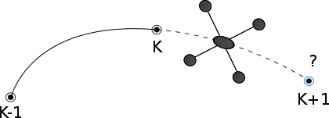
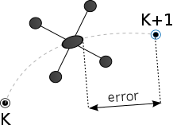
Approach
Prediction
Control

Slide 4
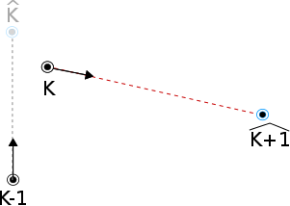
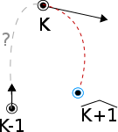
Prediction
Use different motion models
Constant velocity motion model
Constant acceleration motion model
Possibility of using Bézier interoplation to get better estimate of acceleration

Slide 5
Kalman
Permet de formaliser la démarche et de prendre en compte des incertitudes sur l’accelération.
Decoupling the Kalman predictor (assumption)
Constant velocity motion model
􏰂 xk =xk−1 +x ̇k−1∆t
Constant acceleration motion model
x k = x k − 1 + x ̇ k − 1 ∆ t + 1 x ̈ k − 1 ∆ t 2 2
x ̇ k = x ̇ k − 1 + x ̈ k − 1 ∆ t

Slide 6
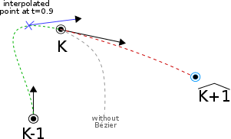
Bézier
Idea : use Bézier interpolation in order to obtain an estimation of the trajectory before the last received waypoint. This allows us to get a better estimate of the acceleration.

Slide 7
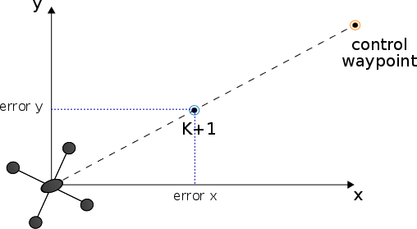
Control : PID

Slide 8
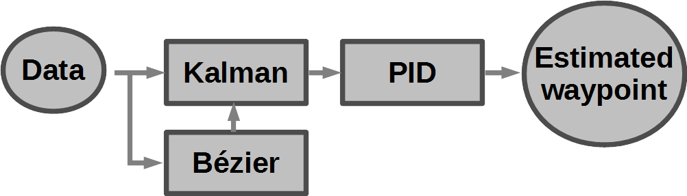
System

Slide 9
Conclusion
The more complex the motion model, the more accurate the predictor. But one has to keep in mind the computational cost.
Further possible optimisation :
Consider a motion model specific to the quadrotor tracked (necessitates a more advanced analysis of the dynamics of the plateform)
Consider that the waypoint data is not perfect (i.e. consider GPS data noise)

