Slide 1

Mobile Robots Mini-Project GPS Signal Following
Arreguit Jonathan
Konrad Dorian
Missri Salah-Eddine
Tauxe David
Group N°11 (GPS 1)

Slide 2
Hypothesis
The dimensions are decoupled
We can work independently on X, Y and Z axis
The waypoint data received (position & velocity of tracked quadrotor) has no error

Slide 3
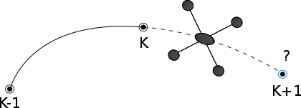
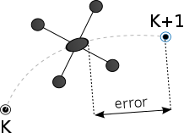
Approach
Prediction
Control

Slide 4
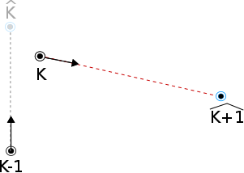
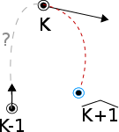
Prediction
Use different motion models
Constant velocity motion model
Constant acceleration motion model
Possibility of using Bézier interoplation to get better estimate of acceleration

Slide 5
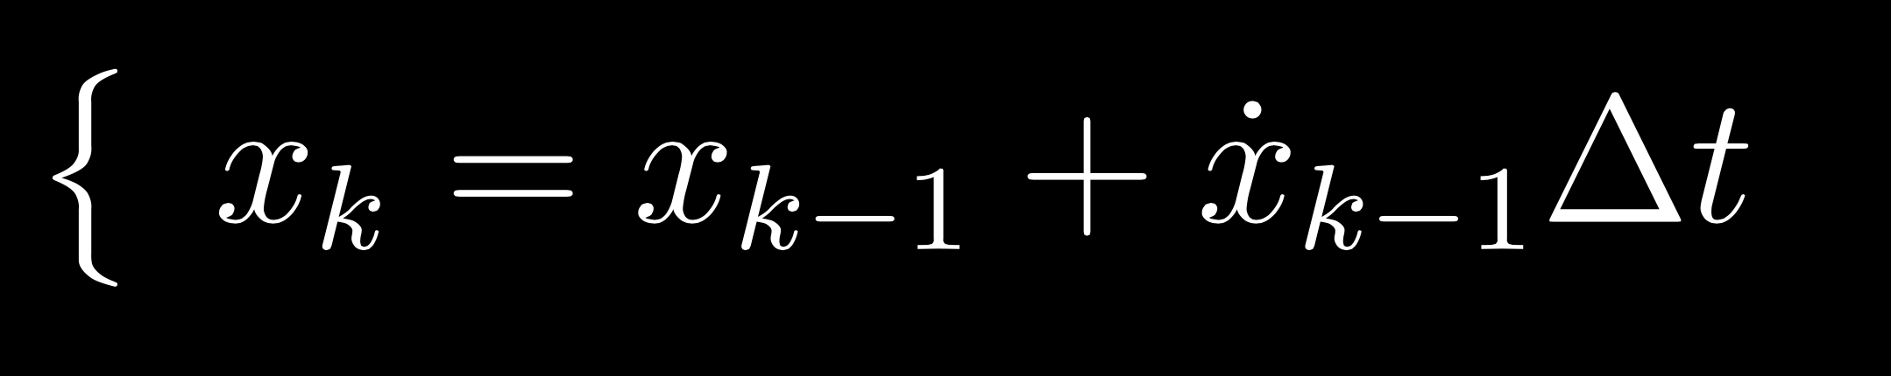
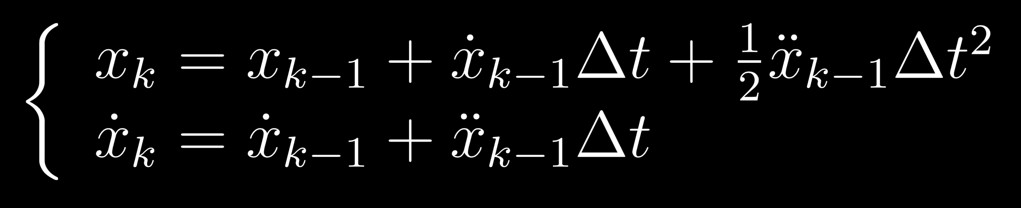
Kalman predictor
Kalman filter used as a predictor:
Prediction loop runs constantly
Correction of the prediction happens only when there is a new measurement (ie received waypoint)
Constant velocity motion model
Constant acceleration motion model

Slide 6
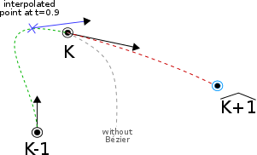
Bézier
Idea : use Bézier interpolation in order to obtain an estimation of the trajectory before the last received waypoint. This allows us to get a better estimate of the acceleration.

Slide 7
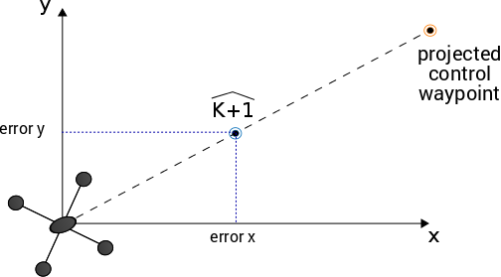
Control : PID

Slide 8
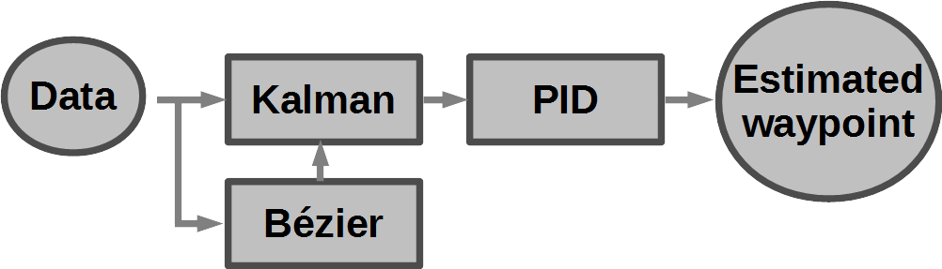
System

Slide 9
Conclusion
The more complex the motion model, the more accurate the predictor. But one has to keep in mind the computational cost.
Further possible optimisation :
Consider a motion model specific to the quadrotor tracked (necessitates a more advanced analysis of the dynamics of the plateform)
Consider that the waypoint data is not perfect (i.e. consider GPS data noise)

