Slide 1
Master Thesis : Sequence Mining on the cloud

Slide 2
Based on last year’s paper :
An Efficient Algorithm for Mining Frequent Sequence with Constraint Programming
Authors : John O.R Aoga, Tias Guns, Pierre Schauss
Prefix-span based algorithm offering record breaking perfomances and great modularity, including the possibility to add new constrains !
Notes:
Other commercial application of hadoop
Log and/or clickstream analysis of various kinds
marketing analytics
machine learning and/or sophisticated data mining
image processing
processing of XML messages
web crawling and/or text processing
general archiving, including of relational/tabular data, e.g. for compliance

Slide 3
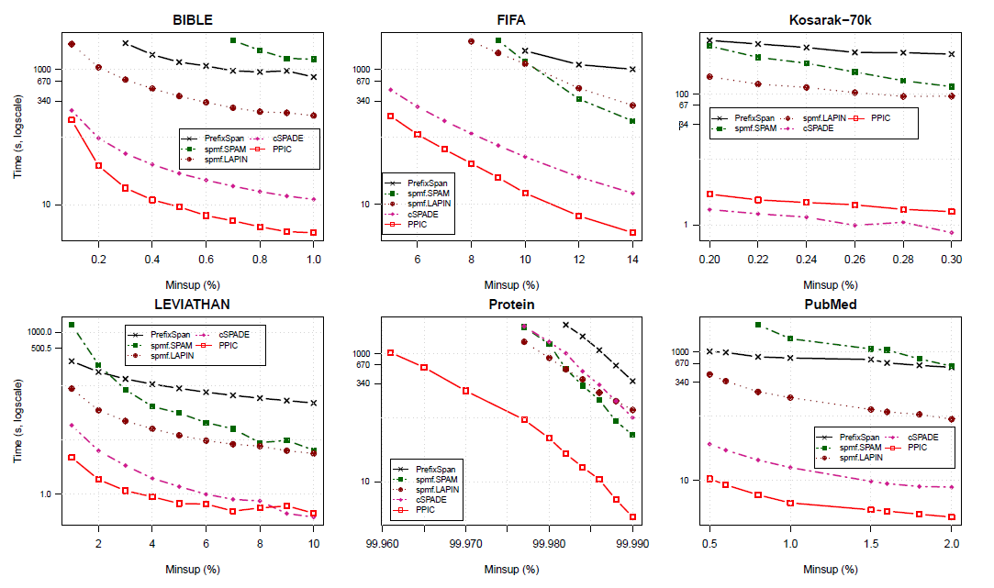
Performances :

Slide 4
But …
The resulting system is not as scalable as some of the most advanced mining systems …
The purpose of this master thesis is thus to make it scalable
A quick analysis reveals that Prefix-span is an algorithm that apply the same operation to many items. It is thus an embarrassingly parallel problem.
=> Easily implemented with Map-reduce

Slide 5
Reminder : a simple MapReduce flow
Reduce
Worker
Map
Worker
Blue: 4
Reduce
Worker
Green: 4
Map
Worker
Reduce
Worker
Black : 3
Map
Worker
Reduce
Worker
Gray: 1
Map
Worker
Reduce
Worker
Orange: 4
Notes:
Divide & Conquer approach to process big data in parallel
One-pass algorithm => One call of map, one call of reduce
Inconvenient :
Barrier between Map and Reduce
‣ Map phase as fast as the slowest map task
‣ Idem for reduce
‣ Reducer starts working when it has all its data (>< functional programming one)
=> An efficient implementation must be able to detect and reschedule stragglers

Slide 6
Hadoop vs Spark

Slide 7

Hadoop
Notes:
Notes

Slide 8
What is hadoop ?
An open-source software framework for large-scale processing :
Implementation of MapReduce
Hadoop Distributed File System (HDFS)
YARN – an associated resource-management platform for managing compute resources and scheduling/monitoring applications
Notes:
Commercial application of hadoop
Log and/or clickstream analysis of various kinds
marketing analytics
machine learning and/or sophisticated data mining
image processing
processing of XML messages
web crawling and/or text processing
general archiving, including of relational/tabular data, e.g. for compliance

Slide 9
Hadoop does the job
Aside from some base ingredients which need to be implemented, Hadoop takes care of scheduling, data repartition and failure recovery !

Slide 10
But how ?
3 components :
The file system (HDFS) (distributed across all nodes):
Stores the inputs, outputs, and temporary results
The driver program (executes on one node):
Specifies where to find the inputs, the outputs
Specifies what mapper and reducer to use
Can customize behavior of the execution
The runtime system (controls nodes):
Supervises the execution of tasks

Slide 11
But how ?
3 components :
The file system (HDFS) (distributed across all nodes):
Stores the inputs, outputs, and temporary results
The driver program (executes on one node):
Specifies where to find the inputs, the outputs
Specifies what mapper and reducer to use
Can customize behavior of the execution
The runtime system (controls nodes):
Supervises the execution of tasks
The only thing that the programmer needs to implement !

Slide 12
The driver program
3 + 1 ingredients :
Mapper : Create/Modify key value pairs
Reducer : Aggregate values with the same keys
Driver : Specifies which inputs to use, where to put the outputs
Coordinate usage of Map, Reduce and Combiner
Combiner : Can work on the result of each mapper to ease the shuffle’s work.
=> less (key, values) pairs emitted = more efficient !
Also helps to reduce bandwith usage between nodes

Slide 13
The runtime system
Client
Name node
Assign job to cluster
Master node
Job tracker
Data transfer
Slave node
Slave node
Slave node
Task tracker
Task tracker
Task tracker
Data node
Data node
Data node
Map
Reduce
Map
Reduce
Map
Reduce
Notes:
Master node => What nodes is available, what is busy, what is down
Job tracker => What node does what part of what job, what has already been done, what’s left to do
Assign data to data node and task to task tracker.
For example, the master node tries to assign job to node which already have most of the data in their data node. => Locality principle
Data replicated in multiple data node for failure resistance (standard replica = 3)
To deal with straggler, either prepare backup tasks or reschedule the work to faster nodes

Slide 14
The runtime system - Failure recovery ?
What If a slave node crashes ?
Find a copy of the input data => Restart the job elsewhere
Works thanks to data replication
What if the master crashes ?
Hadoop 1.0 : The namenode was a single point of failure (SPOF)
Hadoop 2.0 : A backup namenode runs alongside the active namenode. He does not take decision but listen to everything happening. If the active master goes down, the standby namenode becomes active and a new standby namenode is prepared.
If both crash together, everything is still lost …
Notes:
State stored in two files: fsimage and edits
fsimage: Snapshot of file system metadata
edits: Changes since last snapshot
This allows suspend – stop – restart operation on the namenode
=> Not reliable for failure recovery

Slide 15
The file system
Hadoop file system (HDFS) :
Specialised file system using tradeoffs that works well for MapReduce tasks
Very large read-only or append-only files (Giga/Terrabyte of data)
Sequentiel acces pattern => No random read/write => Records are immutable !
High throughput + high capacity
In exchange, HDFS is unsuited for :
Storing lots of small files
high-latency access
Multiple writers
Notes:
HDFS :
HDFS stores file system metadata and application data separately.
Metadata is stored on a dedicated server, called the NameNode. Application data are stored on other servers called DataNodes.
All servers are fully connected and communicate with each other using TCP-based protocols.
Files are stored as sets of (large) blocks
Default block size: 64 MB (ext4 default is 4kB!)
A file spans at least a block (special arrangement made for small files in specific blocks)
Blocks are replicated for durability and availability
An application adds data to HDFS by creating a new file
and writing the data to it. After the file is closed, the bytes written
cannot be altered or removed except that new data can be
added to the file by reopening the file for append.
Namespace is managed by a single name node
Actual data transfer is directly between client & data node
=> Added bandwidth use on the client side !
HDFS do not use data protection mechanisms such as RAID to make the data
durable. Instead, like GFS, the file content is replicated on multiple DataNodes for reliability.
It has the added advantage that data transfer bandwidth is multiplied, and there are more opportunities for locating computation near the needed data.
RAID (originally redundant array of inexpensive disks, now commonly redundant array of independent disks) is a data storage virtualization technology that combines multiple physical disk drive components into a single logical unit for the purposes of data redundancy, performance improvement, or both.
Also :
A persistent record of the image written to disk is called a
checkpoint. The journal is a write-ahead commit log for
changes to the file system that must be persistent.
The CheckpointNode periodically combines the existing
checkpoint and journal to create a new checkpoint and an
empty journal. The CheckpointNode usually runs on a different
host from the NameNode since it has the same memory requirements
as the NameNode. It downloads the current checkpoint
and journal files from the NameNode, merges them locally,
and returns the new checkpoint back to the NameNode
Creating periodic checkpoints is one way to protect the file
system metadata. The system can start from the most recent
checkpoint if all other persistent copies of the namespace image
or journal are unavailable
For random read and write :
Hbase (Hadoop databse) on the other hand is great for this. If you want to read a small record, you will only read that small record.
The Apache Hive ™ data warehouse software facilitates reading, writing, and managing large datasets residing in distributed storage using SQL.
Pig™: A high-level data-flow language and execution framework for parallel computation.

Slide 16
Hadoop’s limitation :
Hadoop’s security model is disabled by default due to sheer complexity of enabling it
No encryption on storage or network level (faster computation but no security)
Unfit for fast computation of many small data batches
Inherent to the file system’s tradefoffs
Possible stability issues if latest stable version is not used
Due to the open source factor, some companies have lost days of work due to running unstable version of the framework.
Also …

Slide 17
A simple wordcount in Hadoop …
map(String key, String value) { // key: document name, line no // value: contents of line for each word w in value
emit(w, 1) //(Key, Value) }
reduce(String key, Iterator values) { // key: a word // values: a list of counts int result = 0; for each v in values: result += v; emit(key, result) }

Slide 18
… still require quite a bit of code !
map(String key, String value) { // key: document name, line no // value: contents of line for each word w in value
emit(w, 1) //(Key, Value) }
Import ...; //Lot’s of them
main(String[] args) throws Exception {
Configuration conf = new Configuration();
Job job = Job.getInstance(conf, "word count");
job.setJarByClass(WordCount.class);
job.setMapperClass(TokenizerMapper.class);
job.setCombinerClass(IntSumReducer.class);
job.setReducerClass(IntSumReducer.class);
job.setOutputKeyClass(Text.class);
job.setOutputValueClass(IntWritable.class);
FileInputFormat.addInputPath(job, ...);
FileOutputFormat.setOutputPath(job, ...);
System.exit(job.waitForCompletion(true) ? 0 : 1);
}
reduce(String key, Iterator values) { // key: a word // values: a list of counts int result = 0; for each v in values: result += v; emit(key, result) }

Slide 19

Spark

Slide 20
What is Spark ?
An open-source cluster computing framework providing implicit data parallelism and fault tolerance
Fast and general engine for large-scale data processing
Notes:
Available in multiple language, namely java, scala , python and R
It is designed to perform both batch processing (similar to MapReduce) and new workloads like streaming, interactive queries, and machine learning.

Slide 21
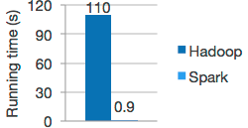
What is Spark ?
An open-source cluster computing framework providing implicit data parallelism and fault tolerance
Fast and general engine for large-scale data processing
An open-source cluster computing framework providing implicit data parallelism and fault tolerance
Fast and general engine for large-scale data processing
Claim to run at least 10x faster than Hadoop, and up to a 100x faster in the right conditions
Notes:
+ It’s compatible with multiple file management system such as :
HDFS, Hive, Hbase, Cassandra, …

Slide 22
What’s the trick ?
Notes:
What if, instead of storing to disk each time, we had

Slide 23
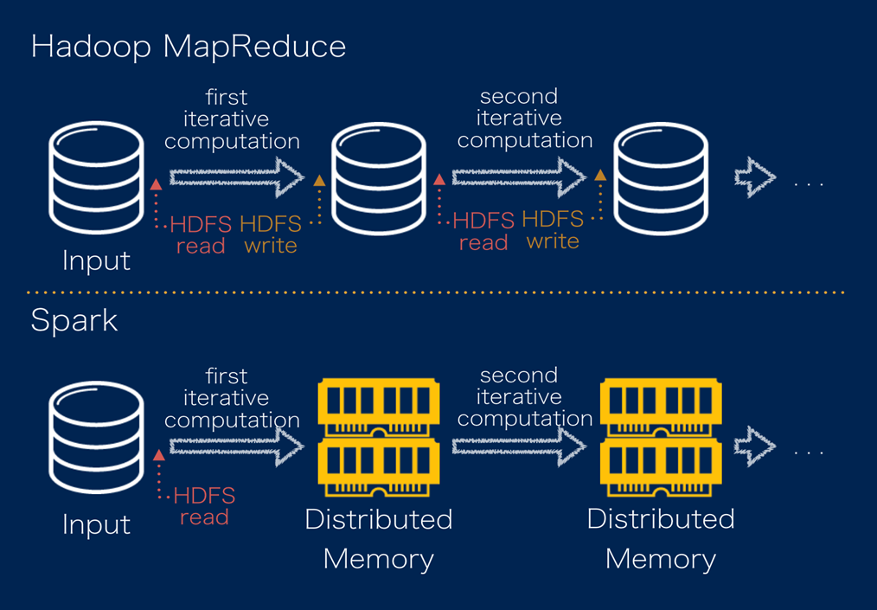
What’s the trick ?
A resilient distributed memory abstraction that is both fault-­tolerant and efficient.

Slide 24
What’s the trick ?
We Consider that we have one big block of ram, partitionned across multiple machines.
Parallel execution across the different partitions
Maximization of the ram’s usage
Recompute dataset that does not fit in memory.
Possibility to spill data to disk if it takes too long to recompute.
Notes:
Depending on the storage mode, recompute or spill data

Slide 25
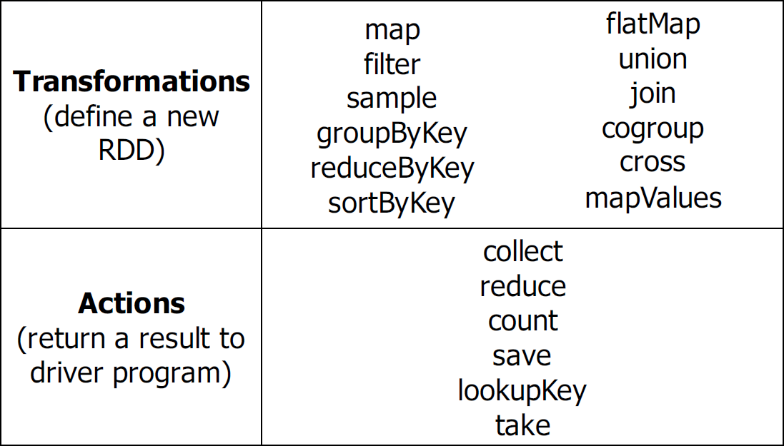
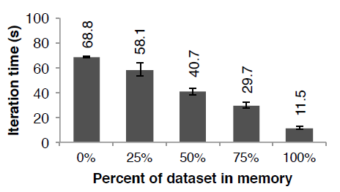
RDD - Resilient Distributed Datasets
What’s an RDD ?
A fault-tolerant, collection of records that can be operated on in parallel.
They are Immutable and lazily evaluated
They can only be built through coarse-­grained deterministic transformations (map, filter, join, …)
Notes:
Despite their modification restrictions, RDDs can express many parallel algorithms (where we apply the same operation to many items)
And are thus very efficient for embarrassingly parallel tasks.
Unify many programming models
Data flow models: MapReduce, SQL, …
Specialized iterative model
graph processing (Pregel),
iterative MapReduce (Haloop),
and more, we can mix those model

Slide 26
RDD - Resilient Distributed Datasets
How is it fault-tolerant ?
Efficient fault recovery using lineage !
Log the operation applied before execution (+ on what it was applied)
Recompute lost partition on failure, using the log’s data
No cost if nothing fails !

Slide 27
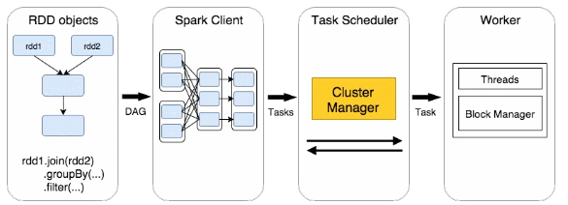
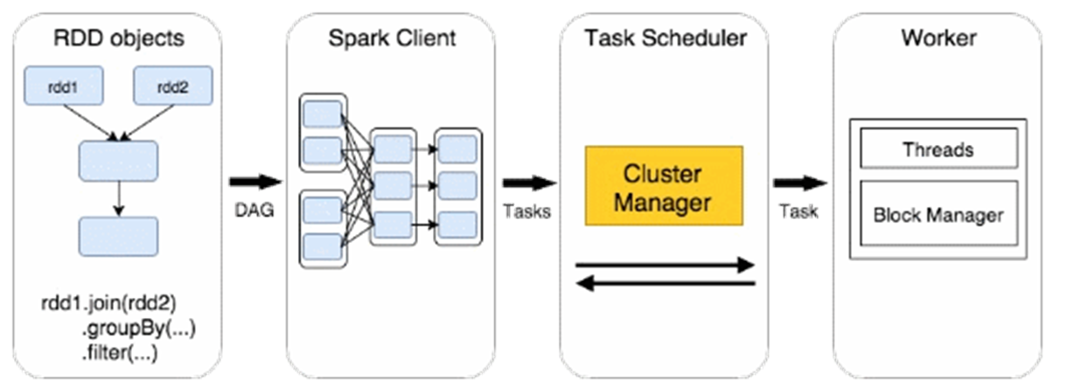
RDD at runtime ?
DAG
Tasks
Task
Notes:
DAG = directed acyclic graph

Slide 28

Spark – The runtime system :
Notes:
the SparkContext can connect to several types of cluster managers (either Spark’s own standalone cluster manager, Mesos or YARN),
Spark standalone cluster manager is a SPOF
Yarn, same as haddoop
Mesos, no SPOF
- Each application gets its own executor processes, which stay up for the duration of the whole application and run tasks in multiple threads. This has the benefit of isolating applications from each other, on both the scheduling side (each driver schedules its own tasks) and executor side (tasks from different applications run in different JVMs). However, it also means that data cannot be shared across different Spark applications (instances of SparkContext) without writing it to an external storage system.
- Spark is agnostic to the underlying cluster manager. As long as it can acquire executor processes, and these communicate with each other, it is relatively easy to run it even on a cluster manager that also supports other applications (e.g. Mesos/YARN).
The driver program must listen for and accept incoming connections from its executors throughout its lifetime (e.g., see spark.driver.port in the network config section).
As such, the driver program must be network addressable from the worker nodes.
- Because the driver schedules tasks on the cluster, it should be run close to the worker nodes, preferably on the same local area network. If you’d like to send requests to the cluster remotely, it’s better to open an RPC to the driver and have it submit operations from nearby than to run a driver far away from the worker nodes.

Slide 29
Spark vs Hadoop’s limitation :
Security ?
Network data encryption easily performed
Encryption of data stored by Spark in temporary local storage, is currently not available, but workaround exists such as configuring the cluster manager to store application data on encrypted disks
Fast computation of many small data batches ?
Efficient through a specialized API extension called Spark streaming !
Few change necessary in the code
Stability issues ?
Tuning garbage collection may be necessary to guarantee performances stability
Notes:
Since Spark uses a lot of memory, it is very hard to run multiple applications on the same computer.
Hadoop is more capable in that regard

Slide 30
Spark’s limitation ?
Designed for embarrassingly parallel tasks.
Thus, it is difficult to communicate between processes running on different cluster nodes.
Some sophisticated algorithms which need to know the state of processes running on other nodes, or to share data between nodes, are thus hard to implement…
Python API’s remains incomplete
Always remain a step or two behind Java and Scala’s API implementation …
Spark’s memory usage can affect other running applications …
The API is still young !
Random crazy error can be observed at very large scale …
Fine tuning for optimal performance of resilient process remains complicated …
Arcane knowledge of the configuration options is, at this point, necessary …
Garbage collection can cause performance issue, stopping all process until completed …
Notes:
http://www.infoworld.com/article/3004460/application-development/5-things-we-hate-about-spark.html
Intermittent compression/decompression errors during the shuffle stages …
What sort of crazy errors? For instance, on a recent engagement, I had a Spark job that had been working fine for over a week. Then, out of nowhere, it stopped. The executor logs were full of entries that pointed to compression/decompression errors during the shuffle stages.
There's an open ticket in Spark's Jira log that blames this on the Snappy compression scheme used during the shuffles. Oh, and the ticket points out it's intermittent.
Ticket => https://issues.apache.org/jira/browse/SPARK-4105

Slide 31
And what about code length ?

Slide 32
Well, we go from this …
map(String key, String value) { // key: document name, line no // value: contents of line for each word w in value
emit(w, 1) //(Key, Value) }
Import ...; //Lot’s of them
main(String[] args) throws Exception {
Configuration conf = new Configuration();
Job job = Job.getInstance(conf, "word count");
job.setJarByClass(WordCount.class);
job.setMapperClass(TokenizerMapper.class);
job.setCombinerClass(IntSumReducer.class);
job.setReducerClass(IntSumReducer.class);
job.setOutputKeyClass(Text.class);
job.setOutputValueClass(IntWritable.class);
FileInputFormat.addInputPath(job, ...);
FileOutputFormat.setOutputPath(job, ...);
System.exit(job.waitForCompletion(true) ? 0 : 1);
}
reduce(String key, Iterator values) { // key: a word // values: a list of counts int result = 0; for each v in values: result += v; emit(key, result) }

Slide 33
… to this !
//Imports
import org.apache.spark._
import org.apache.spark.SparkContext._
object WordCount {
def main(args: Array[String]) {
val conf = new SparkConf().setAppName("wordCount")
val sc = new SparkContext(conf)
//WordCount
val textFile = sc.textFile("hdfs://...")
val counts = textFile.flatMap(line => line.split(" "))
.map(word => (word, 1))
.reduceByKey(_ + _)
counts.saveAsTextFile("hdfs://...")
}
}

Slide 34
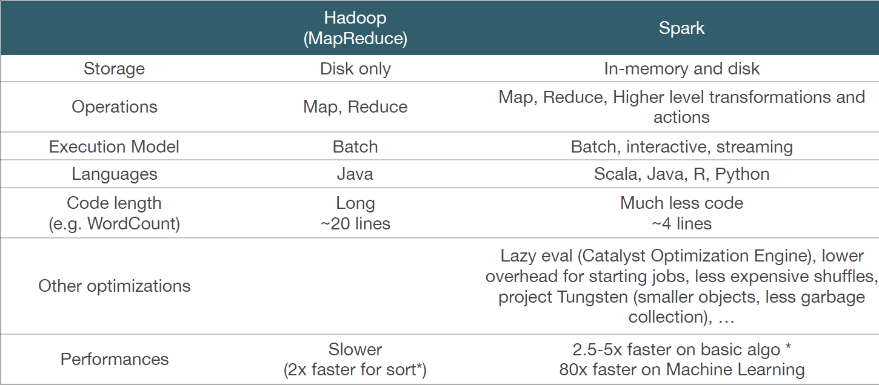
Final comparison :

Slide 35
The choosen one :
Notes:
Random crazy error are very rare !
Growing and active community
No need for communication between Prefix-span process
Effective for small and big batches with little chance thanks to spark streaming
=> An implementation of prefix span is already available on ML-Lib

Slide 36
Spark : ML-LIB
Spark disposes of a machine learning library, it gives acces to a number of machine learning algorithm going from classification and regression to pattern mining.
One of those algorithms being Prefix-span

Slide 37
ML-LIB’s Prefix-span :

Slide 38
ML-LIB’s Prefix-span :
3 + 1 phases :
[[A]], 3
[[B]], 2
[[E]], 2
[[A]], 3
[[B], [E]], 2
[[A], [E]], 2
[[A], [C]], 2
[[A, B]], 3
[[A, B], [E]], 2
<(AB) C H E>
<A (CB) (AB)>
<(AB) E>
<F>
Input
Ouput

Slide 39
ML-LIB’s Prefix-span :
3 + 1 phases :
Init phase :
Parallel search for frequent items on each itemset
The goal is to reshape the input
<(AB) C H E>
<A (CB) (AB)>
<(AB) E>
<F>
0 1 2 0 3 0 0 4 0
0 2 0 1 3 0 1 2 0
0 1 2 0 4 0
Notes:
Parallel search for frequent items on each itemset
NUM, COUNT => NUM; ID
(A, 3) => (A, 1)
(B, 3) => (B, 2)
(C, 2) => (C, 3)
(E, 2) => (E, 4)
Parallel modication of each itemset using result from search => Same function applied to every line
With the results, we create postfix items which contain an index. This we can know where we are in the itemsets without rewritting it each time.

Slide 40
ML-LIB’s Prefix-span :
3 + 1 phases :
Iter phase :
Parallel projection of prefixes, then Parallel growth of the prefixes
Then we collect the grown prefixes and keep the supported ones
Notes:
The projection of a prefix on a postfix, create a new postfix with (hopefully) a new start position

Slide 41
Example of a standard projection :
<A B C E>
<(CB) A (EC)>
<A B E>
A
<B C E>
<(EC)>
<B E>
B
<C E>
<E>
Notes:
The projection of a prefix on a postfix, create a new postfix with (hopefully) a new start position
The only thing that change is the start pointer (and the partial start pointers)

Slide 42
Example of a partial projection
Start
Project <A>
<(AB)(ABC)A>
<(ABC)A>
=> What about <(AB)>

Slide 43
Example of a partial projection
Start
Project <A>
<(AB)(ABC)A>
<(ABC)A>
<(_B)(ABC)A>
<(_BC)A>
Partial starts

Slide 44
Example of prefix growth
Start
<AA>, 1
<AB>, 1
<AC>, 1
Project <A>
<(AB)(ABC)A>
<(ABC)A>
Grow
<(_B)(ABC)A>
<(_BC)A>
<(AB)>, 2
<(AC)>, 1
Partial starts

Slide 45
ML-LIB’s Prefix-span :
3 + 1 phases :
Optionnal local execution phase :
Depending on the argument, we switch to parallel local execution on each machine
Each process compute prefixes on the whole itemset => Splitting the tree
At the end we collect the results from each processes
Notes:
The projection of a prefix on a postfix, create a new postfix with (hopefully) a new start position

Slide 46
ML-LIB’s Prefix-span :
3 + 1 phases :
Final phase :
We reshape the collected result to fit the input form
Notes:
The projection of a prefix on a postfix, create a new postfix with (hopefully) a new start position

Slide 47
Strong points of current implementation :
Postfixes are copied along with the list of item they were created from but the list of item in question is never modified outside of local execution (where it is done for performance reason)
Thus no memory waste besides reference pointer
Partial Local execution possible to speedup execution
During the partial execution step, the usage of memory may be important since all prefixes/postfixes combination will be stored in memory.
Overflow are thus possible but can be avoided by decreasing maxLocalProjDBSize.
If set to 0 => full execution in RDD
Notes:
Reusing objetcs in object across RDDs : http://apache-spark-user-list.1001560.n3.nabble.com/is-it-okay-to-reuse-objects-across-RDD-s-td4877.html
RDD store object references, those object are stocked in cache.
Technically, object can be modified (when they shouldn’t) => may crash => rerun pour recreer le RDD
As long as not modified, no problem in theory !

Slide 48
Weak points :
When projecting a prefix, we project from the base postfix, leading to repeated computation. It however makes the DAG easier to compute and reinforce locality.
With gain in bandwith, transfer time but lose in repetition.
In case of a full execution in memory (no local exec), we may lose time re-projecting very long prefixes …

Slide 49
Potential improvements :
Add constraints
Minimum pattern size, items constraints to specify which should be present in patterns, …
Make use of a last position map
Good for large item sets with few different type of items
=> Few memory usage, large speedup
Bad for relatively short item sets with a lot of different items
=> Large memory usage, small speedup
The ideal implementation would activate this option dynamically depending on the postfix concerned.
We would need to determine the best activation conditions
Use a slightly modified CP version of the original algorithm for the local execution part !
We would obtain an implementation with the best of both worlds !
Notes:
A last position map is required to implement PPDC and PPmixed

Slide 50
Applications :

Slide 51
Examples of applications :
What could be the uses for an efficient scalable version of sequential pattern mining ?
Shopping companies :
Customer shopping sequences
Web visit patterns
Healthcare :
Study the sequence of behaviors leading to modern life diseases (anorexia, alcoholism, drug addiction, …)
Patterns in medical records
DNA sequencing
Education :
Sequence of behaviours leading to team work problems
Sequence of behaviours favorising learning
Predict future courses demand (student that took course A and B will take C in the future)
And many, many mores …
Notes:
More examples , such as :
Telephone calling patterns, Weblog click streams
Natural disasters response and prediction (climate to predict storms way ahead)
stocks and markets
gene structures and protein function prediction
Pattern to detect plan failure in software engineering
In text databases to discover trends, for text categorization, for document classification and authorship identification.
Sequential intrusion behaviors in network attacks
Basically anything were we knowledge can be obtained through looking at the evolution of a system

Slide 52
Questions ?

Slide 53
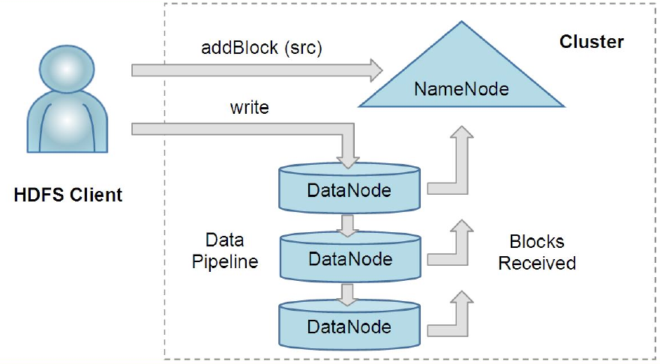
Annexe : HDFS
Notes:
An HDFS client creates a new file by giving its path to the NameNode. For each block of the file, the NameNode returns
a list of DataNodes to host its replicas. The client then pipelines data to the chosen DataNodes, which eventually confirm the
creation of the block replicas to the NameNode.

Slide 54
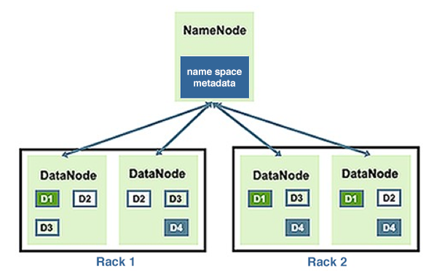
Annexe : HDFS

Slide 55
Annexe : DataFlow
Notes:
3 thread running on each node

Slide 56
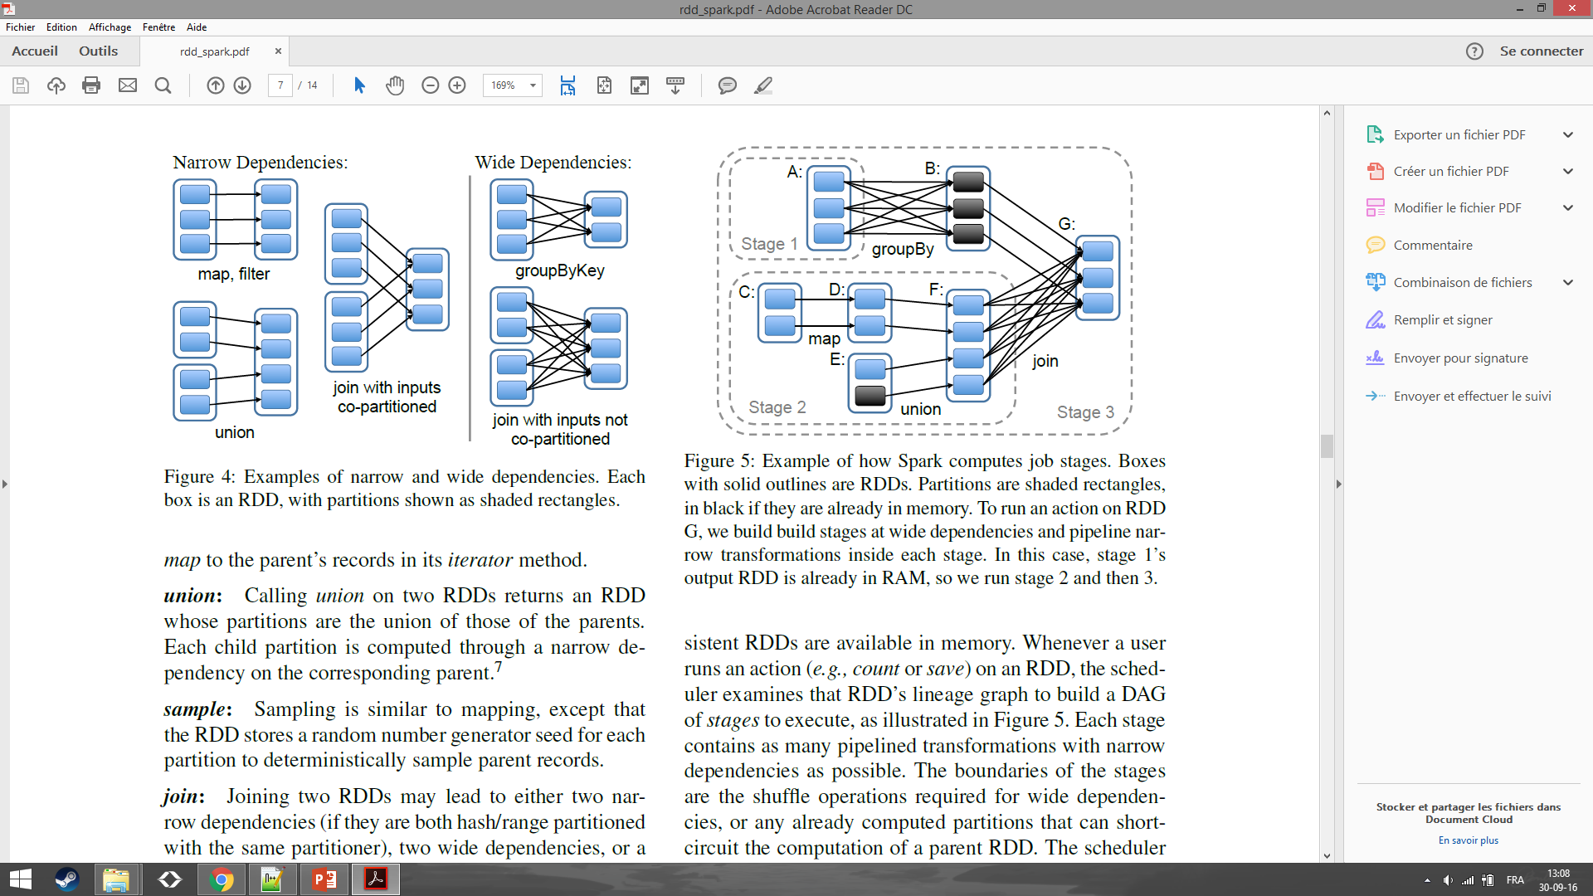
Annexe : RDD - Dependencies
Notes:
Examples of narrow and wide dependencies. Each
box is an RDD, with partitions shown as shaded rectangles
Narrow dependencies => an input partition is used to create AT MOST one output partition, Output partitions can have multiples inputs partitions !

Slide 57
Annexe : RDD – Computing job stages
Notes:
Example of how Spark computes job stages.
Boxes with solid outlines are RDDs. Partitions are shaded rectangles,
in black if they are already in memory.
To run an action on RDD G, we build build stages at wide dependencies and pipeline narrow
transformations inside each stage.
In this case, stage 1’s output RDD is already in RAM, so we run stage 2 and then 3.

Slide 58
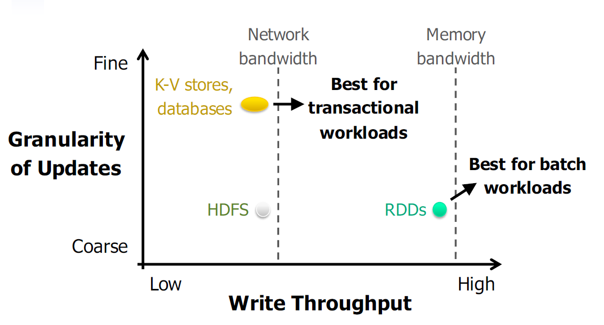
Annexe : RDD – Comparison

Slide 59
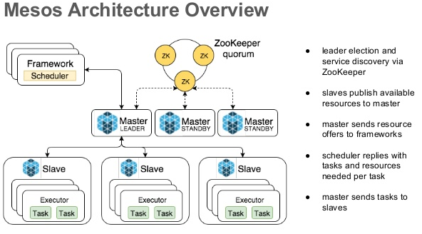
Annexe : Mesos

Slide 60
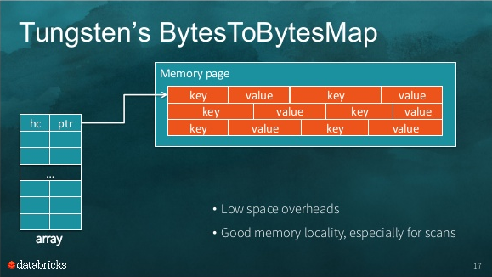
Annexe : project tungsten
Notes:
Project Tungsten focuses on substantially improving the efficiency of memory and CPU for Spark applications, to push performance closer to the limits of modern hardware.
This effort includes three initiatives:
Memory Management and Binary Processing: leveraging application semantics to manage memory explicitly and eliminate the overhead of JVM object model and garbage collection
Cache-aware computation: algorithms and data structures to exploit memory hierarchy
Code generation: using code generation to exploit modern compilers and CPUs
Project Tungsten will be the largest change to Spark’s execution engine since the project's inception.

Slide 61
References – Hadoop :
HDFS :
http://pages.cs.wisc.edu/~akella/CS838/F15/838-CloudPapers/hdfs.pdf
https://en.wikipedia.org/wiki/Apache_Hadoop
General :
https://github.com/mcanini/INGI2145-2015/blob/master/04-mapreduce.pdf
http://hadoop.apache.org/docs/current/

Slide 62
References – Spark :
RDD :
https://www.usenix.org/system/files/conference/nsdi12/nsdi12-final138.pdf
General :
https://github.com/mcanini/INGI2145-2015/blob/master/07-beyond-mapreduce.pdf
http://spark.apache.org/docs/latest/programming-guide.html
http://spark.apache.org/examples.html
http://www.slideshare.net/akirillov/data-processing-platforms-architectures-with-spark-mesos-akka-cassandra-and-kafka
http://www.uclouvain.be/en-cours-2016-LINGI2145.html

Slide 63
References – Project tungsten :
General :
http://www.slideshare.net/SparkSummit/deep-dive-into-project-tungsten-josh-rosen

Slide 64
References – Spark vs Hadoop
General :
http://www.vldb.org/pvldb/vol8/p2110-shi.pdf

Slide 65
References – Applications :
https://www.microsoft.com/en-us/research/wp-content/uploads/2012/01/gupta11b_apdsdm.pdf
http://forum.ai-directory.com/read.php?5,501,504
https://www.google.be/url?sa=t&rct=j&q=&esrc=s&source=web&cd=3&cad=rja&uact=8&ved=0ahUKEwjv-P-5gcTPAhWHWhQKHY2YD44QFgguMAI&url=http%3A%2F%2Fwww.is.informatik.uni-duisburg.de%2Fcourses%2Fim_ss09%2Ffolien%2FMiningSequentialPatterns.ppt&usg=AFQjCNECJAVgxZwUD5TlxwiBONKZ0E0yoA&sig2=t0DDIp2RmJQI-5O1KsOp8Q&bvm=bv.134495766,d.d24

Slide 66
TODO ?
Slides sur l’organisation interne des RDD ?
=> No paper on it, the few information I found point toward a similar implementatio thand HDFS but in memory …
Slides Tuto sur Spark ?
=> Is it necessary ?
PrefixSpan of ML-Lib
Explain algorithm ?
Example of a run ?

