Slide 1
Sequential Pattern Mining

Slide 2
Outline
What is sequence database and sequential pattern mining
Methods for sequential pattern mining
Constraint-based sequential pattern mining
Periodicity analysis for sequence data

Slide 3
Sequence Databases
A sequence database consists of ordered elements or events
Transaction databases vs. sequence databases
A transaction database
A sequence database
TID | itemsets
10 | a, b, d
20 | a, c, d
30 | a, d, e
40 | b, e, f
SID | sequences
10 | <a(abc)(ac)d(cf)>
20 | <(ad)c(bc)(ae)>
30 | <(ef)(ab)(df)cb>
40 | <eg(af)cbc>

Slide 4
Applications
Applications of sequential pattern mining
  Customer shopping sequences:
    First buy computer, then CD-ROM, and then digital camera, within 3 months.
  Medical treatments, natural disasters (e.g., earthquakes), science & eng. processes, stocks and markets, etc.
  Telephone calling patterns, Weblog click streams
  DNA sequences and gene structures

Slide 5
Subsequence vs. super sequence
A sequence is an ordered list of events, denoted < e₁ e₂ … e_{l} >
Given two sequences α=< a₁ a₂ … a_{n} > and β=< b₁ b₂ … b_{m} >
α is called a subsequence of β, denoted as α⊆ β, if there exist integers 1≤ j₁ < j₂ <…< j_{n} ≤m such that a₁ ⊆ b_{j1}, a₂ ⊆ b_{j2},…, a_{n} ⊆ b_{jn}
β is a super sequence of α
  E.g.α=< (ab), d> and β=< (abc), (de)>

Slide 6
What Is Sequential Pattern Mining?
Given a set of sequences and support threshold, find the complete set of frequent subsequences
A sequence : < (ef) (ab) (df) c b >
A sequence database
SID | sequence
10 | <a(abc)(ac)d(cf)>
20 | <(ad)c(bc)(ae)>
30 | <(ef)(ab)(df)cb>
40 | <eg(af)cbc>
An element may contain a set of items.
Items within an element are unordered
and we list them alphabetically.
<a(bc)dc> is a subsequence of <a(abc)(ac)d(cf)>
Given support threshold min_sup =2, <(ab)c> is a sequential pattern

Slide 7
Challenges on Sequential Pattern Mining
A huge number of possible sequential patterns are hidden in databases
A mining algorithm should
  find the complete set of patterns, when possible, satisfying the minimum support (frequency) threshold
  be highly efficient, scalable, involving only a small number of database scans
  be able to incorporate various kinds of user-specific constraints

Slide 8
Studies on Sequential Pattern Mining
Concept introduction and an initial Apriori-like algorithm
  Agrawal & Srikant. Mining sequential patterns, [ICDE’95]
Apriori-based method: GSP (Generalized Sequential Patterns: Srikant & Agrawal [EDBT’96])
Pattern-growth methods: FreeSpan & PrefixSpan (Han et al.KDD’00; Pei, et al. [ICDE’01])
Vertical format-based mining: SPADE (Zaki [Machine Leanining’00])
Constraint-based sequential pattern mining (SPIRIT: Garofalakis, Rastogi, Shim [VLDB’99]; Pei, Han, Wang [CIKM’02])
Mining closed sequential patterns: CloSpan (Yan, Han & Afshar [SDM’03])

Slide 9
Methods for sequential pattern mining
Apriori-based Approaches
  GSP
  SPADE
Pattern-Growth-based Approaches
  FreeSpan
  PrefixSpan

Slide 10
The Apriori Property of Sequential Patterns
A basic property: Apriori (Agrawal & Sirkant’94)
  If a sequence S is not frequent, then none of the super-sequences of S is frequent
  E.g, <hb> is infrequent so do <hab> and <(ah)b>
Seq. ID
Sequence
10
<(bd)cb(ac)>
Given support threshold min_sup =2
20
<(bf)(ce)b(fg)>
30
<(ah)(bf)abf>
40
<(be)(ce)d>
50
<a(bd)bcb(ade)>

Slide 11
GSP—Generalized Sequential Pattern Mining
GSP (Generalized Sequential Pattern) mining algorithm
Outline of the method
  Initially, every item in DB is a candidate of length-1
  for each level (i.e., sequences of length-k) do
    scan database to collect support count for each candidate sequence
    generate candidate length-(k+1) sequences from length-k frequent sequences using Apriori
  repeat until no frequent sequence or no candidate can be found
Major strength: Candidate pruning by Apriori

Slide 12
Finding Length-1 Sequential Patterns
Initial candidates:
  <a>, <b>, <c>, <d>, <e>, <f>, <g>, <h>
Scan database once, count support for candidates
Cand | Sup
<a> | 3
<b> | 5
<c> | 4
<d> | 3
<e> | 3
<f> | 2
<g> | 1
<h> | 1
min_sup =2
Seq. ID
Sequence
10
<(bd)cb(ac)>
20
<(bf)(ce)b(fg)>
30
<(ah)(bf)abf>
40
<(be)(ce)d>
50
<a(bd)bcb(ade)>

Slide 13
Generating Length-2 Candidates
 | <a> | <b> | <c> | <d> | <e> | <f>
<a> | <aa> | <ab> | <ac> | <ad> | <ae> | <af>
<b> | <ba> | <bb> | <bc> | <bd> | <be> | <bf>
<c> | <ca> | <cb> | <cc> | <cd> | <ce> | <cf>
<d> | <da> | <db> | <dc> | <dd> | <de> | <df>
<e> | <ea> | <eb> | <ec> | <ed> | <ee> | <ef>
<f> | <fa> | <fb> | <fc> | <fd> | <fe> | <ff>
51 length-2
Candidates
 | <a> | <b> | <c> | <d> | <e> | <f>
<a> |  | <(ab)> | <(ac)> | <(ad)> | <(ae)> | <(af)>
<b> |  |  | <(bc)> | <(bd)> | <(be)> | <(bf)>
<c> |  |  |  | <(cd)> | <(ce)> | <(cf)>
<d> |  |  |  |  | <(de)> | <(df)>
<e> |  |  |  |  |  | <(ef)>
<f>
Without Apriori property,
8*8+8*7/2=92 candidates
Apriori prunes
44.57% candidates

Slide 14
Finding Lenth-2 Sequential Patterns
Scan database one more time, collect support count for each length-2 candidate
There are 19 length-2 candidates which pass the minimum support threshold
  They are length-2 sequential patterns

Slide 15
The GSP Mining Process
5th scan: 1 cand. 1 length-5 seq. pat.
<(bd)cba>
Cand. cannot pass sup. threshold
4th scan: 8 cand. 6 length-4 seq. pat.
<abba> <(bd)bc> …
Cand. not in DB at all
3rd scan: 46 cand. 19 length-3 seq. pat. 20 cand. not in DB at all
<abb> <aab> <aba> <baa> <bab> …
2nd scan: 51 cand. 19 length-2 seq. pat. 10 cand. not in DB at all
<aa> <ab> … <af> <ba> <bb> … <ff> <(ab)> … <(ef)>
1st scan: 8 cand. 6 length-1 seq. pat.
<a> <b> <c> <d> <e> <f> <g> <h>
Seq. ID
Sequence
min_sup =2
10
<(bd)cb(ac)>
20
<(bf)(ce)b(fg)>
30
<(ah)(bf)abf>
40
<(be)(ce)d>
50
<a(bd)bcb(ade)>

Slide 16
The GSP Algorithm
Take sequences in form of <x> as length-1 candidates
Scan database once, find F₁, the set of length-1 sequential patterns
Let k=1; while F_{k} is not empty do
  Form C_{k+1}, the set of length-(k+1) candidates from F_{k};
  If C_{k+1} is not empty, scan database once, find F_{k+1}, the set of length-(k+1) sequential patterns
  Let k=k+1;

Slide 17
The GSP Algorithm
Benefits from the Apriori pruning
  Reduces search space
Bottlenecks
  Scans the database multiple times
  Generates a huge set of candidate sequences
There is a need for more efficient mining methods

Slide 18
The SPADE Algorithm
SPADE (Sequential PAttern Discovery using Equivalent Class) developed by Zaki 2001
A vertical format sequential pattern mining method
A sequence database is mapped to a large set of Item: <SID, EID>
Sequential pattern mining is performed by
  growing the subsequences (patterns) one item at a time by Apriori candidate generation

Slide 19
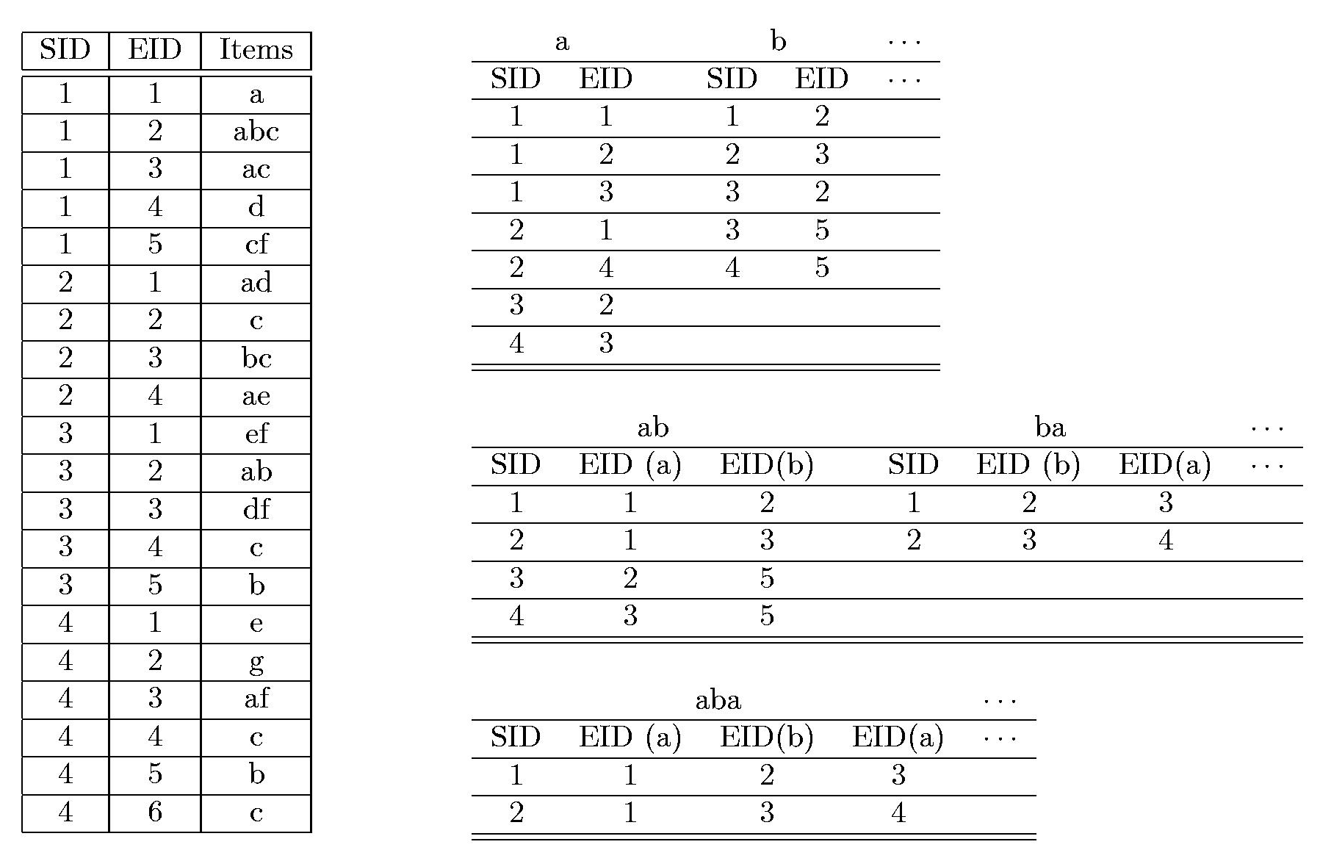
The SPADE Algorithm

Slide 20
Bottlenecks of Candidate Generate-and-test
A huge set of candidates generated.
  Especially 2-item candidate sequence.
Multiple Scans of database in mining.
  The length of each candidate grows by one at each database scan.
Inefficient for mining long sequential patterns.
  A long pattern grow up from short patterns
  An exponential number of short candidates

Slide 21
PrefixSpan (Prefix-Projected Sequential Pattern Growth)
PrefixSpan
  Projection-based
  But only prefix-based projection: less projections and quickly shrinking sequences
J.Pei, J.Han,… PrefixSpan : Mining sequential patterns efficiently by prefix-projected pattern growth. ICDE’01.

Slide 22
Prefix and Suffix (Projection)
<a>, <aa>, <a(ab)> and <a(abc)> are prefixes of sequence <a(abc)(ac)d(cf)>
Given sequence <a(abc)(ac)d(cf)>
Prefix | Suffix (Prefix-Based Projection)
<a> | <(abc)(ac)d(cf)>
<aa> | <(_bc)(ac)d(cf)>
<ab> | <(_c)(ac)d(cf)>

Slide 23
Mining Sequential Patterns by Prefix Projections
Step 1: find length-1 sequential patterns
  <a>, <b>, <c>, <d>, <e>, <f>
Step 2: divide search space. The complete set of seq. pat. can be partitioned into 6 subsets:
  The ones having prefix <a>;
  The ones having prefix <b>;
  …
  The ones having prefix <f>
SID | sequence
10 | <a(abc)(ac)d(cf)>
20 | <(ad)c(bc)(ae)>
30 | <(ef)(ab)(df)cb>
40 | <eg(af)cbc>

Slide 24
Finding Seq. Patterns with Prefix <a>
Only need to consider projections w.r.t. <a>
  <a>-projected database: <(abc)(ac)d(cf)>, <(_d)c(bc)(ae)>, <(_b)(df)cb>, <(_f)cbc>
Find all the length-2 seq. pat. Having prefix <a>: <aa>, <ab>, <(ab)>, <ac>, <ad>, <af>
  Further partition into 6 subsets
    Having prefix <aa>;
    …
    Having prefix <af>
SID | sequence
10 | <a(abc)(ac)d(cf)>
20 | <(ad)c(bc)(ae)>
30 | <(ef)(ab)(df)cb>
40 | <eg(af)cbc>

Slide 25
Completeness of PrefixSpan
SDB
SID | sequence
10 | <a(abc)(ac)d(cf)>
20 | <(ad)c(bc)(ae)>
30 | <(ef)(ab)(df)cb>
40 | <eg(af)cbc>
Length-1 sequential patterns
<a>, <b>, <c>, <d>, <e>, <f>
Having prefix <a>
Having prefix <c>, …, <f>
Having prefix <b>
<a>-projected database
<(abc)(ac)d(cf)>
<(_d)c(bc)(ae)>
<(_b)(df)cb>
<(_f)cbc>
<b>-projected database
…
Length-2 sequential
patterns
<aa>, <ab>, <(ab)>,
<ac>, <ad>, <af>
… …
Having prefix <aa>
Having prefix <af>
<aa>-proj. db
…
<af>-proj. db

Slide 26
The Algorithm of PrefixSpan
Input: A sequence database S, and the minimum support threshold min_sup
Output: The complete set of sequential patterns
Method: Call PrefixSpan(<>,0,S)
Subroutine PrefixSpan(α, l, S|α)
Parameters:
  α: sequential pattern,
  l: the length of α;
  S|α: the α-projected database, if α ≠<>; otherwise; the sequence database S

Slide 27
The Algorithm of PrefixSpan(2)
Method
1. Scan S|α once, find the set of frequent items b such that:
a) b can be assembled to the last element of α to form
a sequential pattern; or
b) <b> can be appended to α to form a sequential
pattern.
2. For each frequent item b, append it to α to form a sequential pattern α’, and output α’;
3. For each α’, construct α’-projected database S|α’, and call PrefixSpan(α’, l+1, S|α’).

Slide 28
Efficiency of PrefixSpan
No candidate sequence needs to be generated
Projected databases keep shrinking
Major cost of PrefixSpan: constructing projected databases
  Can be improved by bi-level projections

Slide 29
Optimization in PrefixSpan
Single level vs. bi-level projection
  Bi-level projection with 3-way checking may reduce the number and size of projected databases
Physical projection vs. pseudo-projection
  Pseudo-projection may reduce the effort of projection when the projected database fits in main memory
Parallel projection vs. partition projection
  Partition projection may avoid the blowup of disk space

Slide 30
Scaling Up by Bi-Level Projection
Partition search space based on length-2 sequential patterns
Only form projected databases and pursue recursive mining over bi-level projected databases

Slide 31
Speed-up by Pseudo-projection
Major cost of PrefixSpan: projection
  Postfixes of sequences often appear repeatedly in recursive projected databases
When (projected) database can be held in main memory, use pointers to form projections
  Pointer to the sequence
  Offset of the postfix
s=<a(abc)(ac)d(cf)>
<a>
s|<a>: ( , 2)
<(abc)(ac)d(cf)>
<ab>
s|<ab>: ( , 4)
<(_c)(ac)d(cf)>

Slide 32
Pseudo-Projection vs. Physical Projection
Pseudo-projection avoids physically copying postfixes
  Efficient in running time and space when database can be held in main memory
However, it is not efficient when database cannot fit in main memory
  Disk-based random accessing is very costly
Suggested Approach:
  Integration of physical and pseudo-projection
  Swapping to pseudo-projection when the data set fits in memory

Slide 33
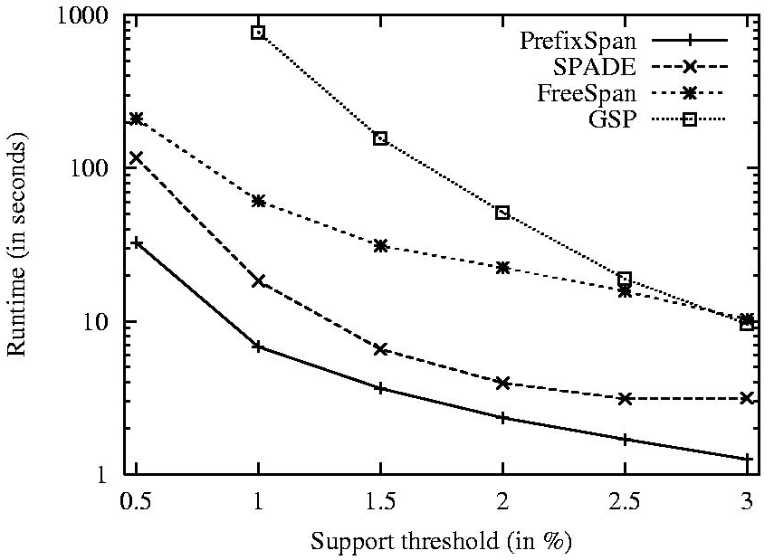
Performance on Data Set C10T8S8I8

Slide 34
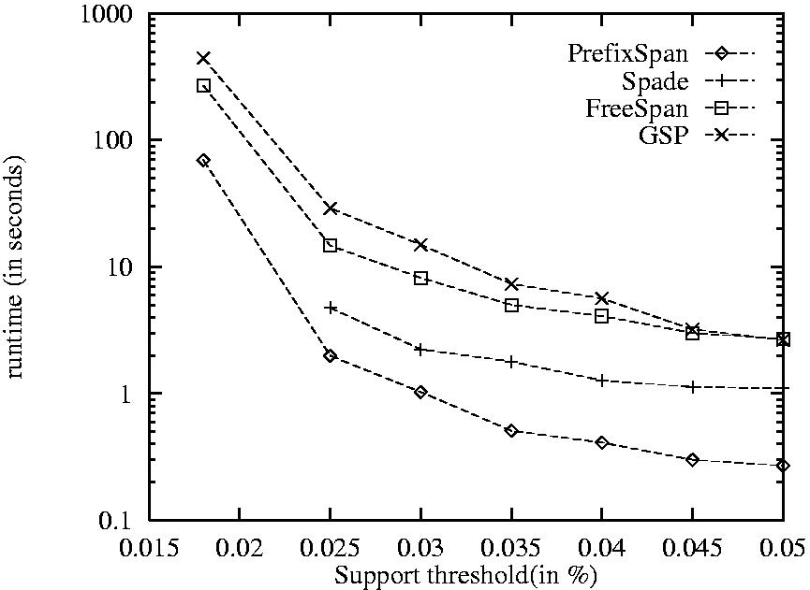
Performance on Data Set Gazelle

Slide 35
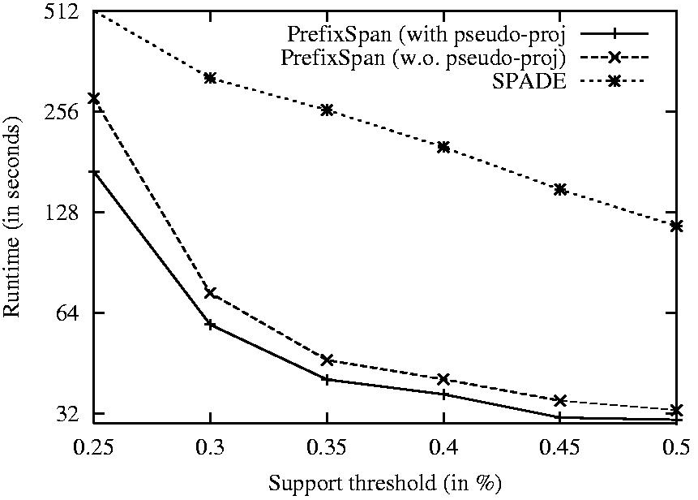
Effect of Pseudo-Projection

Slide 36
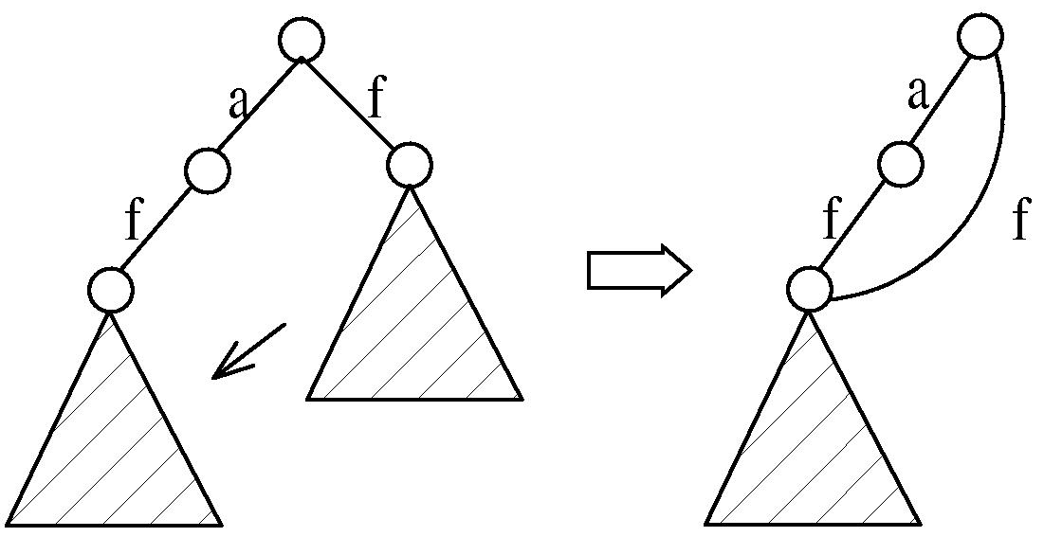
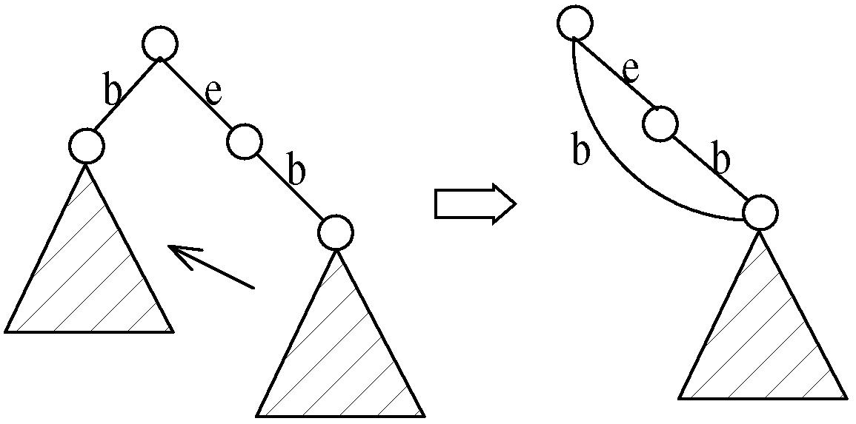
CloSpan: Mining Closed Sequential Patterns
A closed sequential pattern s: there exists no superpattern s’ such that s’ כ s, and s’ and s have the same support
Motivation: reduces the number of (redundant) patterns but attains the same expressive power
Using Backward Subpattern and Backward Superpattern pruning to prune redundant search space

Slide 37
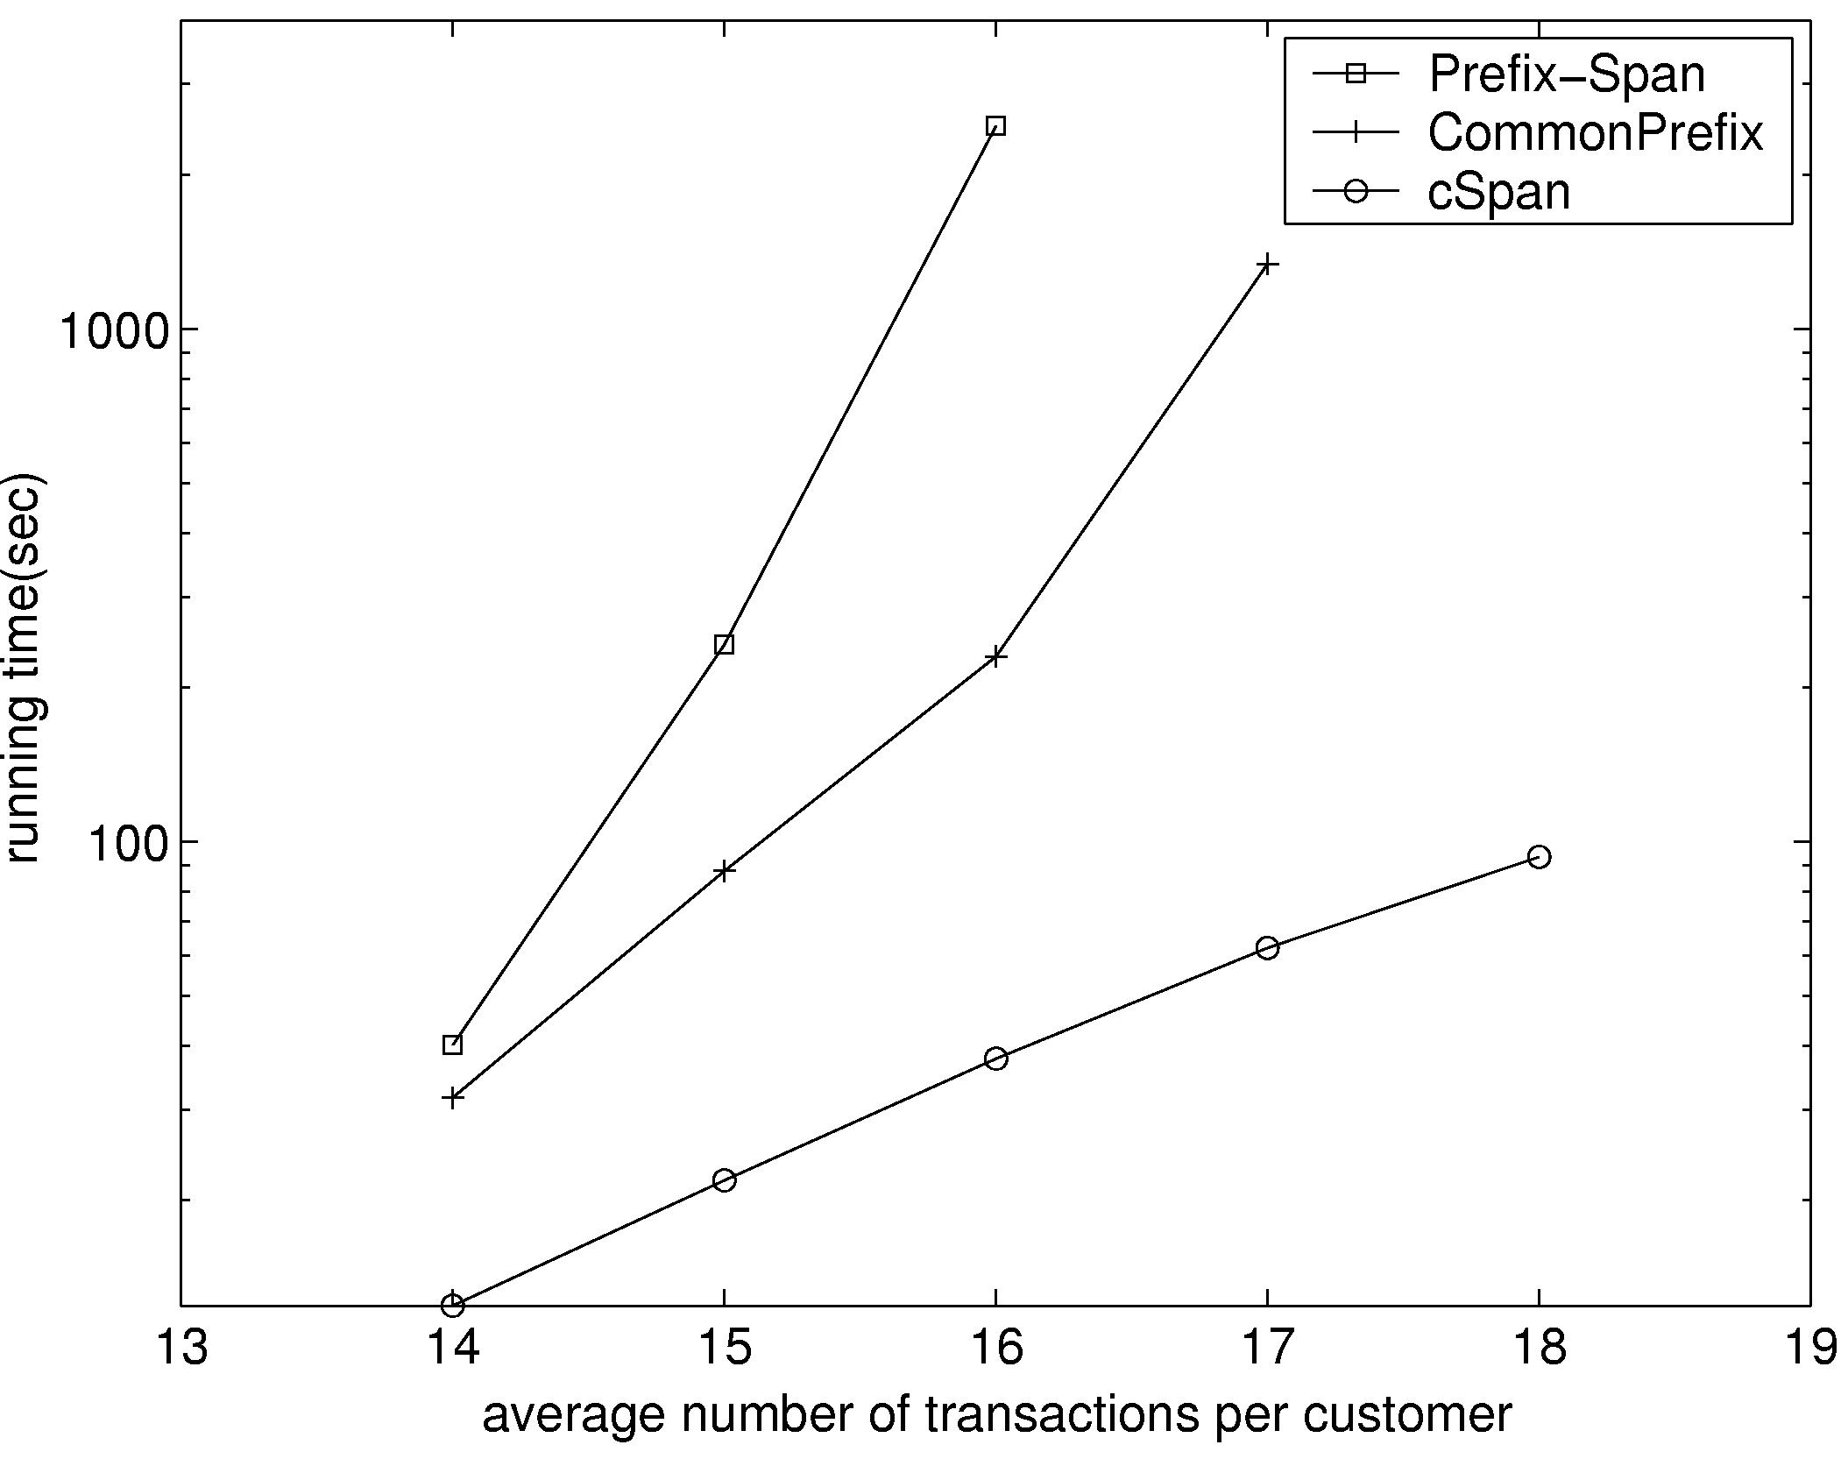
CloSpan: Performance Comparison with PrefixSpan

Slide 38
Constraints for Seq.-Pattern Mining
Item constraint
  Find web log patterns only about online-bookstores
Length constraint
  Find patterns having at least 20 items
Super pattern constraint
  Find super patterns of “PC 􀃆digital camera”
Aggregate constraint
  Find patterns that the average price of items is over $100

Slide 39
More Constraints
Regular expression constraint
  Find patterns “starting from Yahoo homepage, search for hotels in Washington DC area”
  Yahootravel(WashingtonDC|DC)(hotel|motel|lodging)
Duration constraint
  Find patterns about ±24 hours of a shooting
Gap constraint
  Find purchasing patterns such that “the gap between each consecutive purchases is less than 1 month”

Slide 40
From Sequential Patterns to Structured Patterns
Sets, sequences, trees, graphs, and other structures
  Transaction DB: Sets of items
    {{i₁, i₂, …, i_{m}}, …}
  Seq. DB: Sequences of sets:
    {<{i₁, i₂}, …, {i_{m}, i_{n}, i_{k}}>, …}
  Sets of Sequences:
    {{<i₁, i₂>, …, <i_{m}, i_{n}, i_{k}>}, …}
  Sets of trees: {t₁, t₂, …, t_{n}}
  Sets of graphs (mining for frequent subgraphs):
    {g₁, g₂, …, g_{n}}
Mining structured patterns in XML documents, bio-chemical structures, etc.

Slide 41
Episodes and Episode Pattern Mining
Other methods for specifying the kinds of patterns
  Serial episodes: A → B
  Parallel episodes: A & B
  Regular expressions: (A | B)C*(D → E)
Methods for episode pattern mining
  Variations of Apriori-like algorithms, e.g., GSP
  Database projection-based pattern growth
    Similar to the frequent pattern growth without candidate generation

Slide 42
Periodicity Analysis
Periodicity is everywhere: tides, seasons, daily power consumption, etc.
Full periodicity
  Every point in time contributes (precisely or approximately) to the periodicity
Partial periodicit: A more general notion
  Only some segments contribute to the periodicity
    Jim reads NY Times 7:00-7:30 am every week day
Cyclic association rules
  Associations which form cycles
Methods
  Full periodicity: FFT, other statistical analysis methods
  Partial and cyclic periodicity: Variations of Apriori-like mining methods

Slide 43
Summary
Sequential Pattern Mining is useful in many application, e.g. weblog analysis, financial market prediction, BioInformatics, etc.
It is similar to the frequent itemsets mining, but with consideration of ordering.
We have looked at different approaches that are descendants from two popular algorithms in mining frequent itemsets
  Candidates Generation: AprioriAll and GSP
  Pattern Growth: FreeSpan and PrefixSpan

