Slide 1
Expense Tracker
Del Mundo, Carlos Miguel B.
Ferol, John Sebastian Khyle M.
Malacas, Sigmund B.
Manansala, Nash A.
Musa, John Mark M.

Slide 2
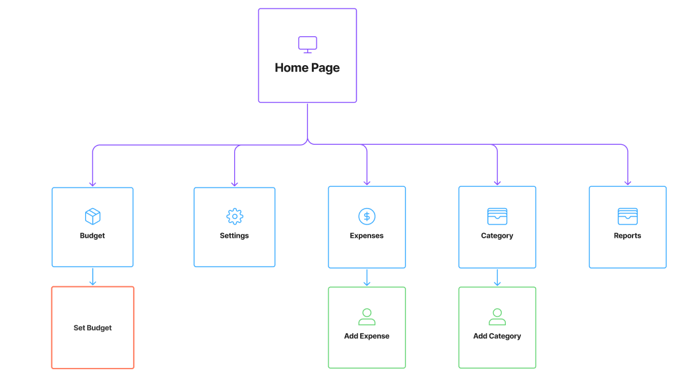
Purpose: The system helps users manage their money by letting them record expenses, group them into categories, set budgets, and see simple financial summaries. It also keeps each user’s data safe by using login protection and making sure users can only see their own information.
Sitemap:

Slide 3
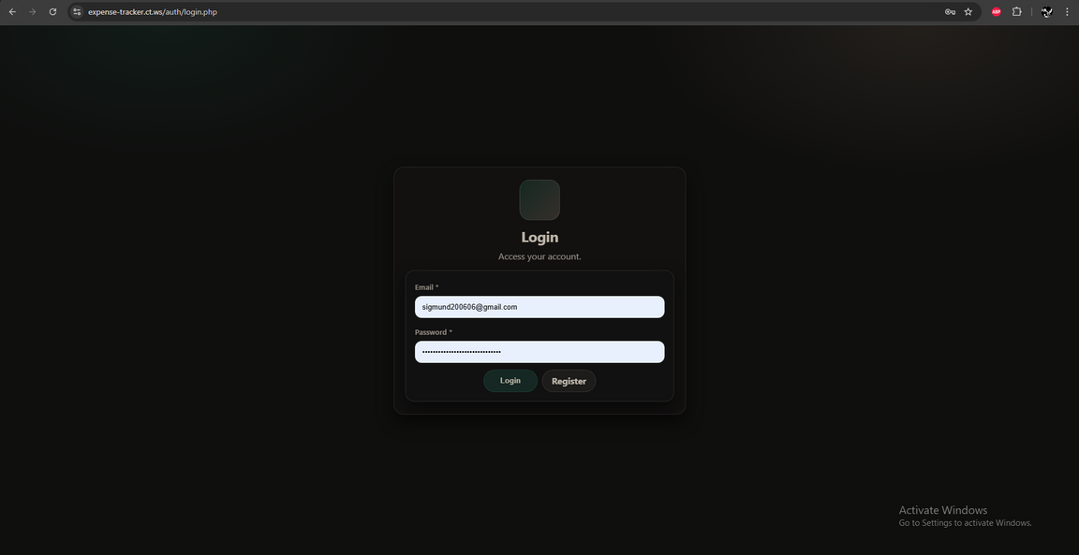
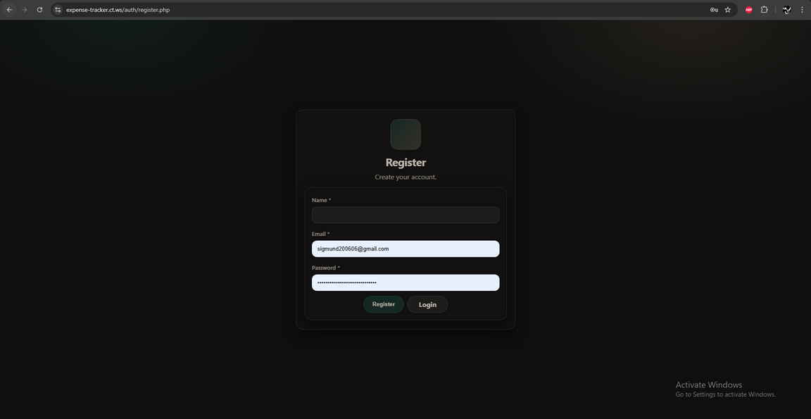
Register page
Login page

Slide 4
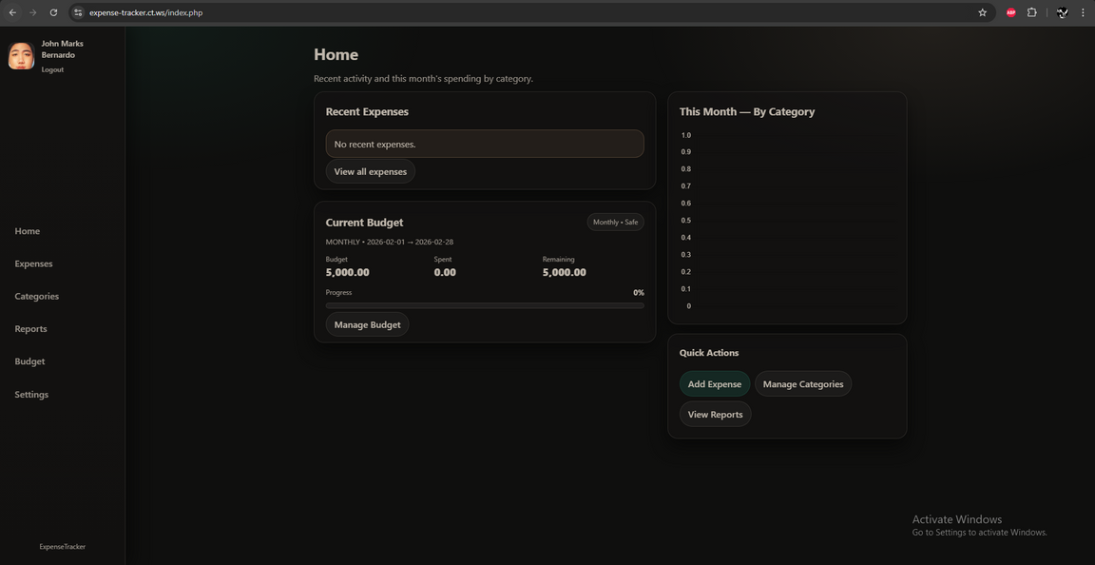
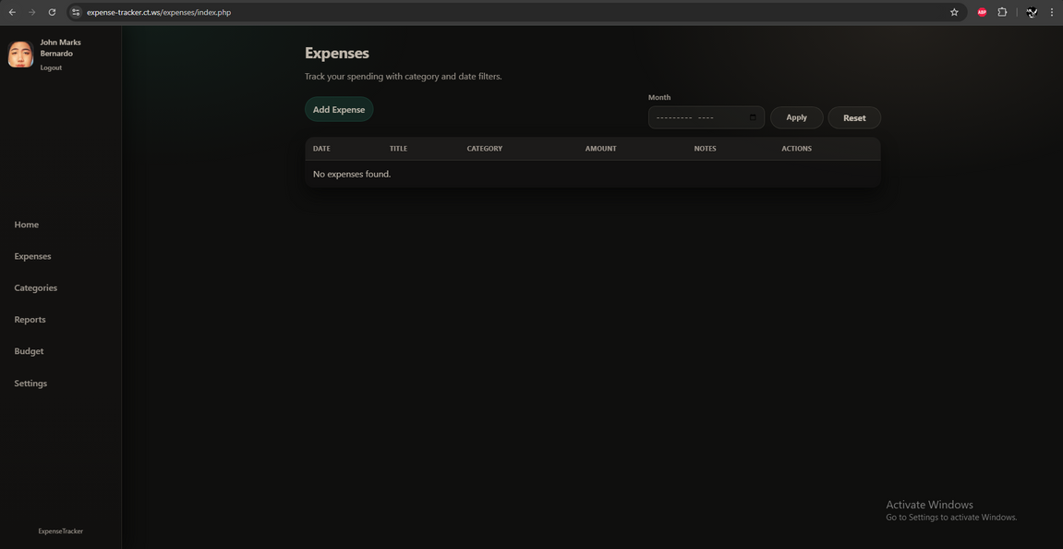
Home page
Expenses page

Slide 5
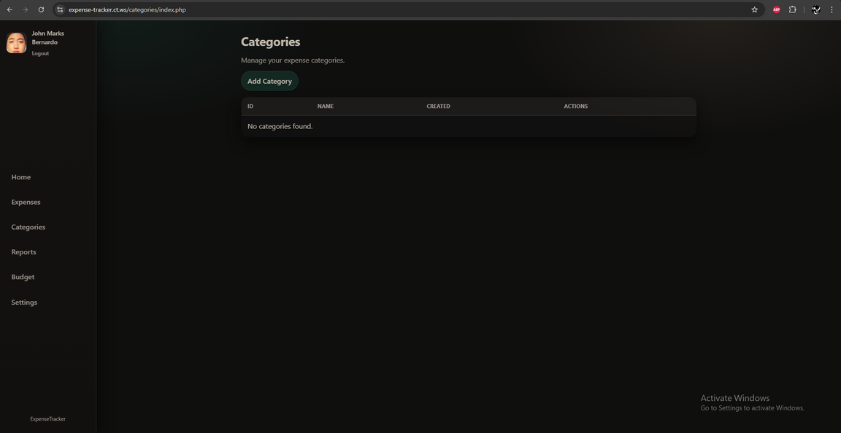
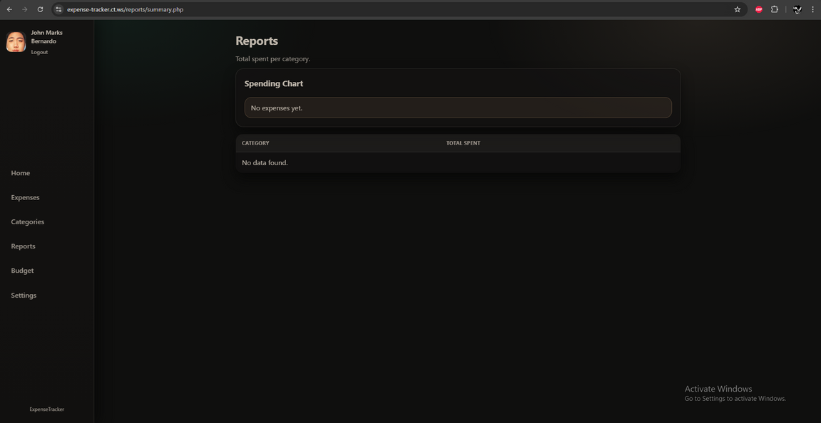
Categories page
Reports page

Slide 6
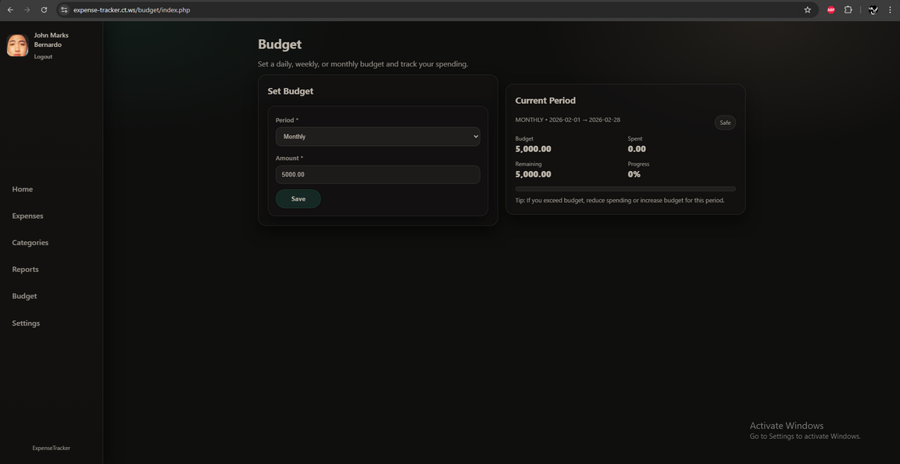
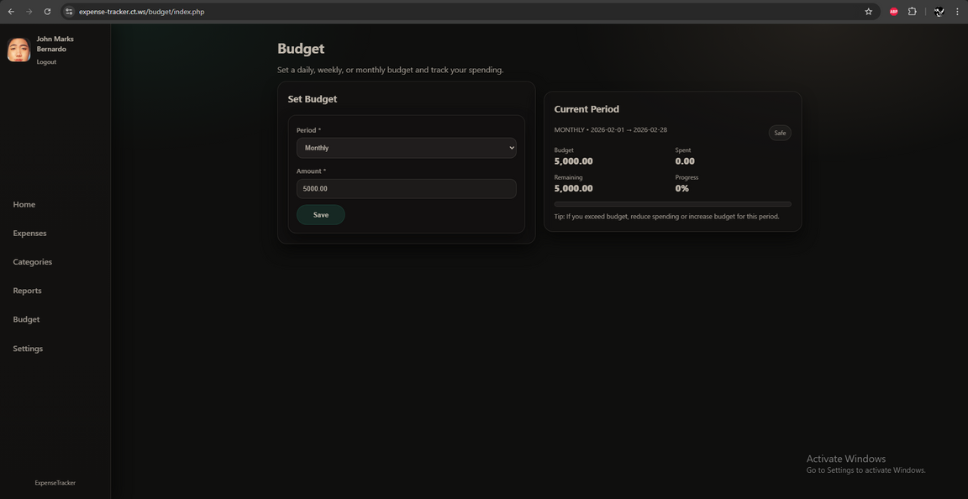
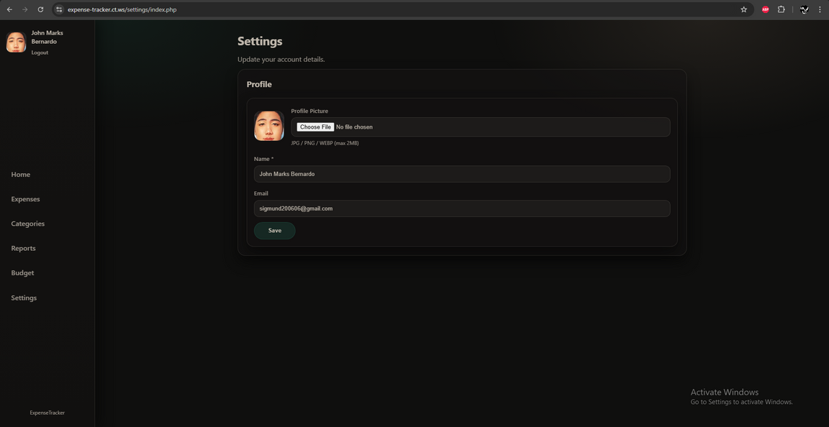
Budget page
Settings page

Slide 7
Navigation
• The website uses a fixed sidebar menu that allows users to quickly access main features such as Home, Expenses, Categories, Reports, Budget, and Settings.
• Clear page titles and buttons help users understand their current location in the system.
Responsive Design
• The website adjusts its layout depending on the device. While the design may look different on desktop and mobile, all features still work properly.
• Tables, cards, and forms automatically resize or reposition to fit the screen.
Accessibility
• Form labels and input fields are clearly defined to improve readability and usability.
• Sufficient color contrast is used to make text and buttons easy to see.
• Buttons and forms are large enough to be easily clickable.
Loading Speed
• The system uses optimized images and minimal animations to reduce loading time.
• Efficient HTML, CSS, and JavaScript code ensures smooth page transitions and faster performance.

Slide 8
Write Clear and Concise Content
• The website uses simple and clear labels for forms such as Email, Password, Amount, Category, and Notes
• Instructions and buttons are easy to understand to help users quickly perform actions like adding expenses or saving budget data
Organize Content
• The system uses headings such as Home, Expenses, Categories, Reports, Budget, and Settings
• Financial data is displayed using tables and cards for easier reading
• Information is grouped into sections to avoid clutter and improve readability

Slide 9
Platform Used
• The system was built from scratch using HTML, CSS, JavaScript, and PHP
Follow Best Practices
• Used standard HTML structure for layout and content display
• Used clean and organized CSS for consistent design and styling
• Used JavaScript and PHP for interactivity and backend processing
Test Functionality
• Verified that all navigation links and sidebar menu links function correctly and redirect users to the correct pages
• Tested login and registration forms to ensure proper authentication and data validation
• Tested expense creation, editing, and deletion to ensure database updates correctly
• Tested category and budget management features for proper saving and updating of data
• Verified that reports and dashboard summaries display accurate financial information

Slide 10
Design Tools
• The system UI was designed and developed from scratch
Development Tools
• Visual Studio Code
• GitHub
• InfinityFree
Testing Tools
• Localhost (Local Server Testing)
Content Management Systems (CMS)
• The system was built using custom code instead of CMS platforms

