Slide 1



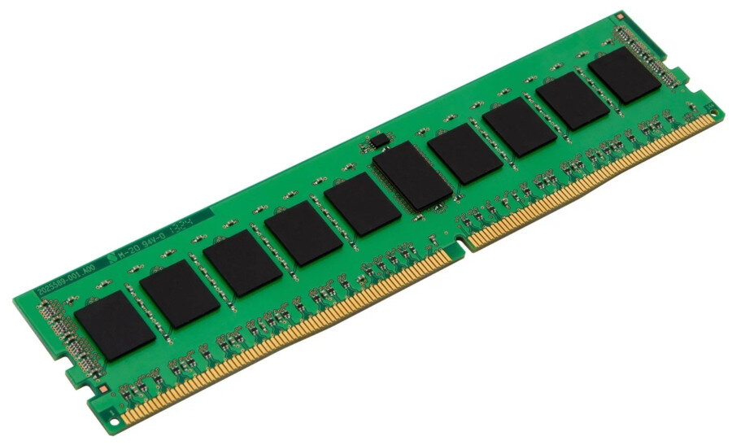

Fetch
RAM
Program counter
1st stage

Slide 2

Decode
Instructions
needed materials
1 + 2
2nd
stage

Slide 3
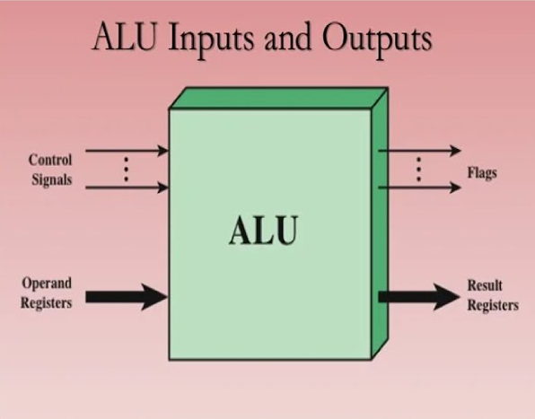
Execute
ALU
Actual action
= 3
3rd
stage

Slide 4

Memory
Memory Access
Action
LOAD: CPU reads from memory.
STORE: CPU writes to memory.
4th
stage

Slide 5
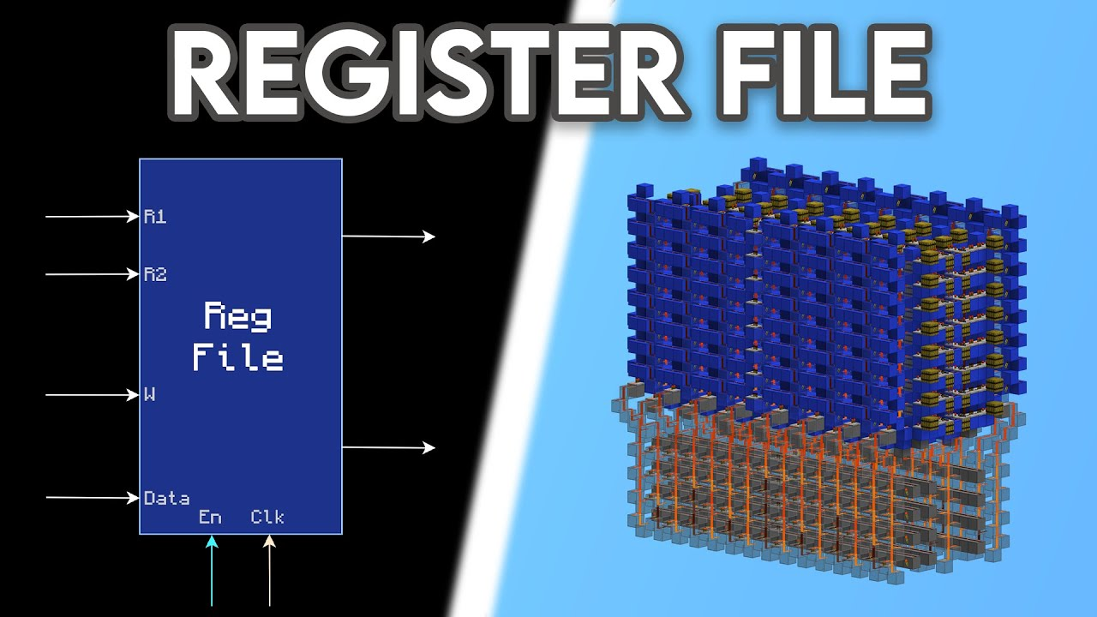
Write back
R1 = R2 + R3
5th
stage

