Slide 1






Slide 2
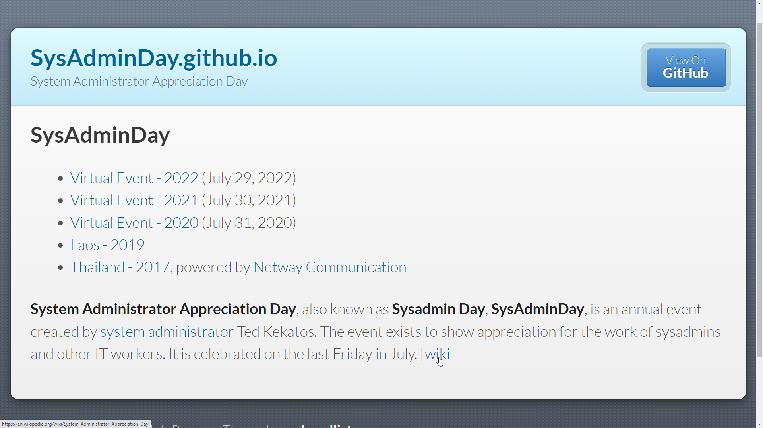

Slide 3




Notes:
Hillstone Firewall SG-6000-E1600P

