Slide 1
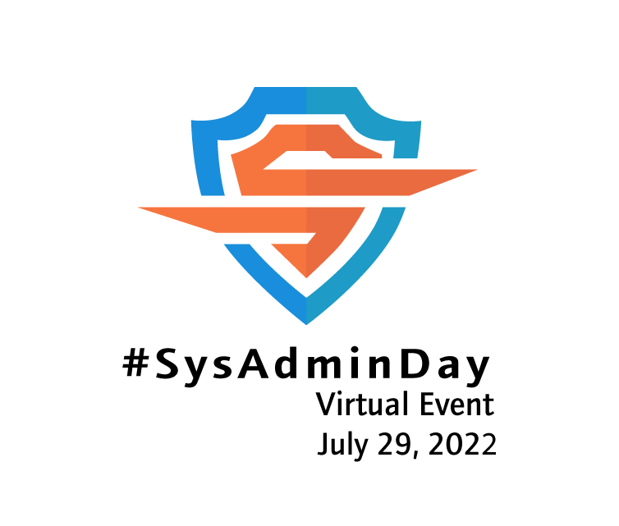





Slide 2
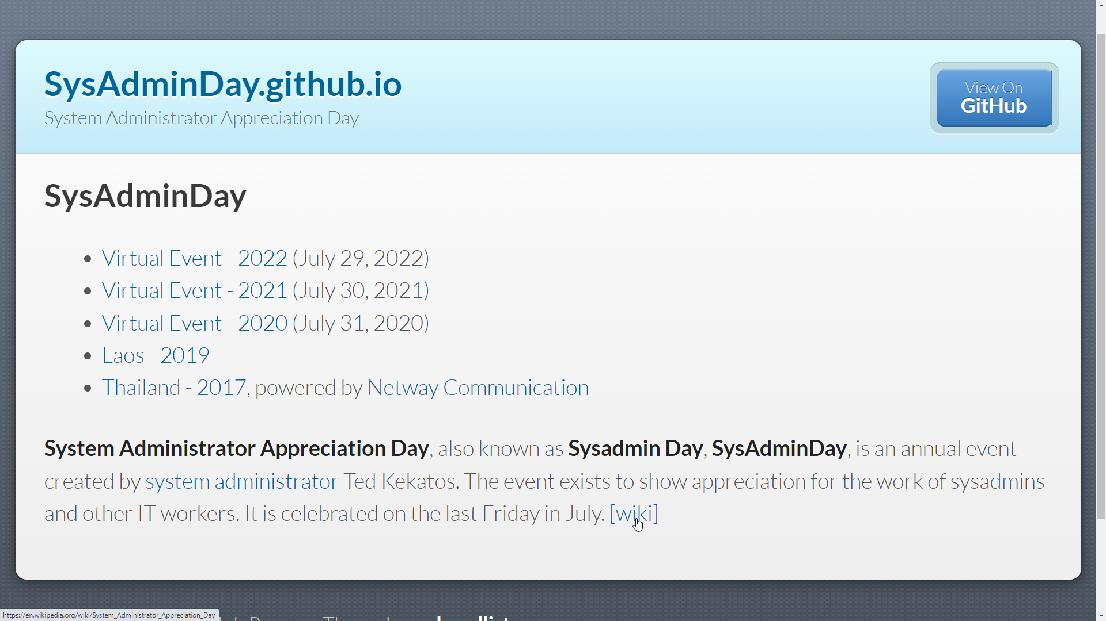

Slide 3


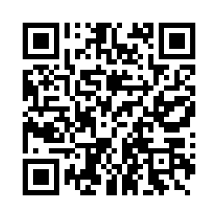

Notes:
Hillstone Firewall SG-6000-E1600P

Slide 4
Narongwuth Wudhikanakorn
Mixkung
Kitwipat Towattana
Chanyut Sinsuwannaruk
Arming Huang
Thakorn Su
Pimluck K.
Notes:
Hillstone Firewall SG-6000-E1600P

Slide 5


Slide 6
