Slide 1






Slide 2
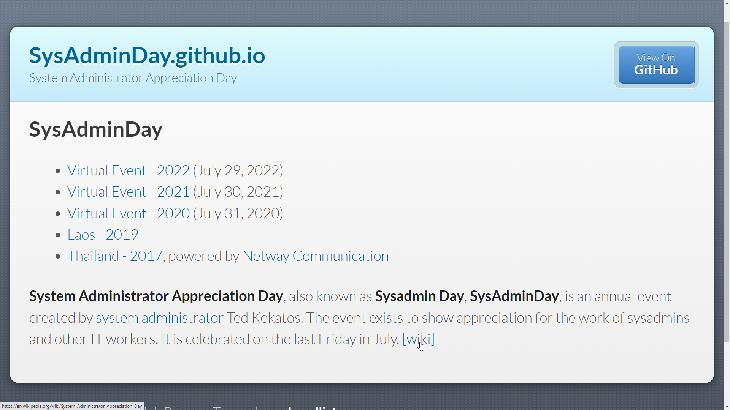

Slide 3



Notes:
Hillstone Firewall SG-6000-E1600P

