Slide 1




Bookmarks Birds
GAME CARD – WHO AM I

Slide 2
Bookmarks Birds
Select a Card to Play
1
2
3
4
5
6
7
8
9
10
11
12
13
14

Slide 3
Bookmarks Birds
Select a Card to Play
15
16
17
18
19
20
21
22
23
24
25
26
27
28

Slide 4
Bookmarks Birds
Select a Card to Play
29
30

Slide 5

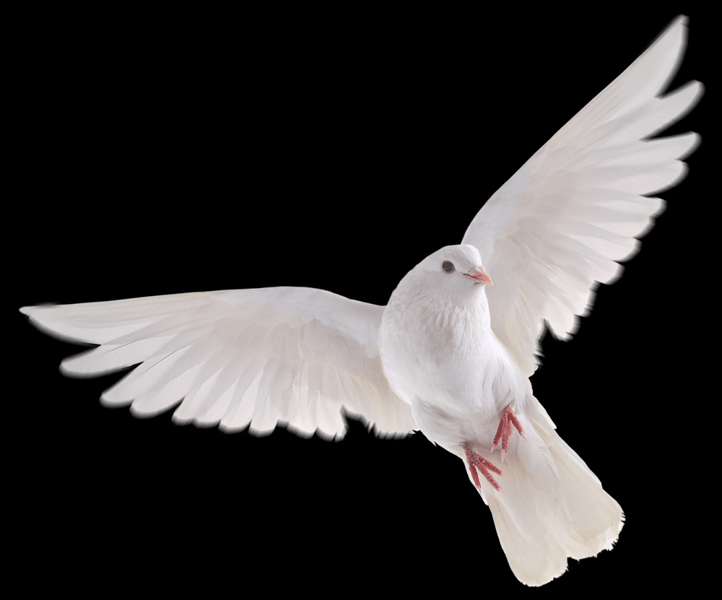
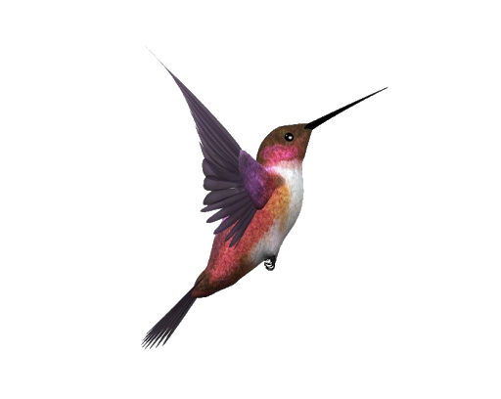
Bookmarks Birds
Who Am I
1
Born in 1597 B.C.E. to Amram and Jochebed.-Ex 6:20
AARON 1
His sons, Eleazar succeed him as priest in Israel.-Nu 20:28
He criticized Moses for marrying
Cushite woman.-Nu 12:1, 2
His sons, Nadab and Abihu, were
killed by Jehovah.-Le 10
His rod became a big snake.-Ex
7:9-12
The Nile River turned to blood when struck with his rod.-Ex 7:19- 21
Notes:
Aaron

Slide 6
Bookmarks Birds
Who Am I
2
The first person called a Hebrew.-Ge 14:13
ABRAHAM 1
He built an altar to Jehovah at
Bethel.-Ge 12:8
His wife, Keturah, bore him six
sons.-Ge 25:1, 2
He sent his servant to find a wife for his son.-Ge 24:4, 10
Was father of a son at 100 years of
age.-Ge 21:5
He came to be called Jehovah’s
friend.”-Jas 2:23
Notes:
ABRAHAM

Slide 7
Bookmarks Birds
Who Am I
3
He was not deceived.-1 Ti 2:14
ADAM 1
Enoch was seventh in line from
him.-Jude 14
Death ruled as king from him
down to Moses.-Ro 5:14
In him all are dying.-1 Co 15:22
He went into hiding from the face
of Jehovah.-Ge 3:8
He said: "This is at last bone of my
bones and flesh of my flesh.”-Ge
2:23
Notes:
ADAM

Slide 8
Bookmarks Birds
Who Am I
4
Paul entreated him to visit the
Corinthian Christians.-1 Co 16: 12
APOLLOS 1
Was a aquainted with only the
baptism of John.-Ac 18: 25
He thoroughly proved the Jews to
be wrong publicly.-Ac 18: 28
The way of God was more correctly expounded to him.-Ac 18
Was well versed in the Scriptures.- Ac 18: 24
An eloquent man from Alexandria.-Ac 18: 24
Notes:
APOLLOS

Slide 9
Bookmarks Birds
Who Am I
5
He said: "God is not a man that he
should tell lies.”-Nu 23: 19
BALAAM 1
He offered up seven bulls and seven rams on seven altars.- Nu 23: 1, 2
He "loved the reward of wrong
doing.”-2 Pe 2: 15
Jude called his course erroneous.- Jude 11
Son of Beor at Pethor.-Nu 22:5
An angel said to him: "Your way has been headlong against my will.”-Nu 22: 32
Notes:
BALAM

Slide 10
Bookmarks Birds
Who Am I
6
Mothered Shimea, Shobab, and
Nathan in Jerusalem.-1 Ch 3:5
BATH-SHEBA 1
She spoke to Solomon in behalf of
Adonijah.-1 Ki 2:19
Solomon had a throne set for her.-
1 Ki 2:19
Solomon "rose to meet her and
bowed down.”-1 Ki 2:19
Solomon’s mother.-1 Ki 1:30
She is represented in an illustration as a female lamb.- 2 Sa 12:3
Notes:
BATH-SHEBA

Slide 11
Bookmarks Birds
Let Play
7
Son of Uri the son of Hur.-Ex 31:2
BEZALEL 1
He overlaid the tabernacle’s panel frames with gold.-Ex 36:1,34
He made eleven tent cloths for the
tabernacle.-Ex 36: 1, 14
The copper altar he made was used by Solomon.-2 Ch 1:5
He made the ark of the covenant
out of acacia wood.-Ex 37:1
He made the lampstand of pure
gold.-Ex 37: 1, 17
Notes:
BEZALEL

Slide 12
Bookmarks Birds
Who Am I
8
He pulverized his grandmother’s
horrible idol.-2 Ch 15:16
ASA 1
He put Hanani the seer in the house of the stocks.-2 Ch 16:10
He was told: "There exists a reward for your activity.”- 2 Ch 15:7
He defeated one million Ethiopians.-2 Ch 14:9
He bribed Ben-hadad to break a
covenant.-2 Ch 16:3
His heart was complete with
Jehovah all his days.-1 Ki 15:14
Notes:
ASA

Slide 13
Bookmarks Birds
Who Am I
9
He built a city and named it after
his son Enoch.-Ge 4: 17
CAIN 1
He said: "My punishment for error is too great to carry.”- Ge 4:13
He became a wanderer and
fugitive.-Ge 4: 12
God did not look with any favor
upon his offering.-Ge 4:5
He bribed Ben-hadad to break a
covenant.-2 Ch 16:3
He assaulted his brother in a field
and killed him.-Ge 4:8
Notes:
CAIN

Slide 14
Bookmarks Birds
Who Am I
10
A devout man of Caesarea and one fearing God.-Ac 10:2
CORNELIUS 1
A man well reported by the whole nation of the Jews.-Ac 10:22
His prayers and gifts of mercy
ascended before God.-Ac 10:4
He and his household received holy spirit when Peter spoke.-Ac 10:44
An army officer of the "Italian
band.”-Ac 10:1
The first Gentile convert to
Christianity.-Ac 10:1, 45
Notes:
CORNELIUS

Slide 15
Bookmarks Birds
Let Play
11
Chief Armor-bearer for King
Saul.- 1 Sa 16:21
DAVID 1
Made preparation in great
quantities for the temple.-1 Ch 22
A man agreeable to God’s heart.-
Ac 13:22
He was skilled at playing the
harp.-1 Sa 16:18, 23
Jonathan was his very close
friend.-1 Sa 18:1
He killed a lion and bear while
tending sheep.- 1 Sa 17:34, 35
Notes:
DAVID

Slide 16
Bookmarks Birds
Let Play
12
He made an overlay for the altar out of copper fire holders.-Nu 16:39
ELEAZAR (High Priest) 1
He married one of the daughters of Putiel.-Ex 6:25
He was buried in the Hill of
Phinehas.-Jos 24:33
His brothers were Nadab, Abihu,
and Ithamar.-Ex 6:23
He assisted Joshua in distributing
the land of Canaan.-Jos 14:1
His son Phinehas struck down
Zimri and Cozbi.-Nu 25:7- 15
Notes:
ELEAZAR (High Priest) 1

Slide 17
Bookmarks Birds
Who Am I
13
The son of Barachel the Buzite.-
Job 32:2
ELIHU 1
He said age does not in itself make one wise.-Job 32: 9
He said he would not bestow a title on any man.-Job 32: 21
He reproved Job and extolled
Jehovah.-Job 35: 37
His anger blazed against Job.- Job
32:2
He said: "Let his flesh become
fresher than in youth.”- Job 33: 25
Notes:
ELIHU

Slide 18
Bookmarks Birds
Let Play
14
He lived 365 years.-Ge 5:23
ENOCH 1
Jared’s son.-Ge 5:18
Methuselah’s father.-Ge 5:21
He had the witness that he had
pleased God Well.-Heb 11:5
The seventh man in line from
Adam.-Jude 14
He went on walking with the true
God three hundred years.-Ge 5:22
Notes:
ENOCH

Slide 19
Bookmarks Birds
Who Am I
15
She said: "Let me not see it when
the child dies.”-Ge 21:16
HAGAR 1
She was found at the fountain on
the way to Shur.-Ge 16:7
She represented Sinai.-Ga 4: 25
She despised Sarah.-Ge 16:4
She corresponds with the
Jerusalem today.-Ga 4: 25
She wandered about in the
wilderness of Beer-sheba.-Ge 21:
14
Notes:
HAGAR

Slide 20
Bookmarks Birds
Who Am I
16
Beloved wife of Elkanah.-1 Sa 1
HANNAH 1
She was a woman hard pressed in spirit.-1 Sa 1:15
Out of the abundance of her
vexation she spoke.-1 Sa 1:16
She took her son to Shiloh as soon
as he was weaned.-1 Sa 1
Mother of Samuel the prophet.- 1
Sa 1:20
She said Jehovah is a killer and a
preserver of life.-1 Sa 2:6
Notes:
HANNAH

Slide 21
Bookmarks Birds
Who Am I
17
Son of Ahaz the king of Judah.-2
Ki 18:1
HEZEKIAH 1
As a king, he kept "sticking to
Jehovah.”-2 Ki 18:6
He said we have Jehovah to fight
our battles.-2 Ch 32:8
Jehovah added fifteen years to his life.-Isa 38:5
He prayed for deliverance from
Sennacherib.-2 Ki 19:20
He cut off the doors of Jehovah’s
temple.-2 Ki 18:16
Notes:
HEZEKIAH

Slide 22
Bookmarks Birds
Who Am I
18
He wrote God would annihilate
strength of kingdoms.-Hag 2:22
HAGGAI 1
He wrote Zerubbabel would be
set as a seal ring.-Hag 2:23
He prophesied in the second year
of Darius.-Hag 1:1
He wrote about the greater glory
of the later house.-Hag 2:9
He wrote Jehovah would rock
heavens, earth.-Hag 2:7
He wrote: “the desirable things”
must come in.-Hag 2:7
Notes:
HAGGAI

Slide 23
Bookmarks Birds
Who Am I
19
He stood at the right side of the
incense altar.-Lu 1:11, 19
GABRIEL
He was sent to give Daniel insight
and understanding.-Da 9
He said Daniel was someone very
desirable.-Da 9:23
He announced the coming birth of John the Baptist.-Lu 1:13
He told Mary she would give birth
to Jesus.-Lu 1:26- 31
The only materialized angel to give his name.-Da 10:13
Notes:
GABRIEL

Slide 24
Bookmarks Birds
Who Am I
20
He stood at the right side of the
incense altar.-Lu 1:11, 19
GABRIEL
He was sent to give Daniel insight
and understanding.-Da 9
He said Daniel was someone very
desirable.-Da 9:23
He announced the coming birth of John the Baptist.-Lu 1:13
He told Mary she would give birth
to Jesus.-Lu 1:26- 31
The only materialized angel to give his name.-Da 10:13
Notes:
GABRIEL

Slide 25
Bookmarks Birds
Who Am I
21
Jesus quoted him: ‘I want mercy
not sacrifice.’-Ho 6:6; Mt 12:7
HOSEA
Paul quoted him: ‘Where are your
stings, O Death?’-Ho 13:14
He wrote about sowing wind and
reaping a stormwind.-Ho 8:7
He wrote about people asking
mountains to cover them.-Ho 10:8
He wrote about people rejecting
knowledge.-Ho 4:6
He wrote: “Out of Egypt I called
My Book of Bible Stories son.”-
Ho 11:1
Notes:
HOSEA

Slide 26
Bookmarks Birds
Who Am I
23
Paul gave him a detailed account
of him ministry.
JAMES (Son of Joseph and Mary)
First named among the sons of
Joseph and Mary.-Mt 13:55
Jesus appeared to him, then to all
the apostles.-1 Co 15:7
He said that desire, when fertile,
gives birth to sin.-Jas 1:15
He said friendship with the world
is enmity with God.-Jas 4:4
He wrote: “Out of Egypt I called
My Book of Bible Stories son.”-
Ho 11:1
Notes:
JAMES (Son of Joseph and Mary)

Slide 27
Bookmarks Birds
Who Am I
24
He is first mentioned by name at
Genesis 2:4
JEHOVAH
Eve said: ‘I have produced a man
with his aid.’-Ge 4:1
Paul called him the "the King of
eternity.”-1 Ti 1:17
A thousand years are to him as
yesterday.-Ps 90:4
The Maker of heaven and earth.-Ps 124:8
He purposes to have his name
declared in all the earth.- Ex 9:16
Notes:
JEHOVAH

Slide 28
Bookmarks Birds
Who Am I
25
His sons were Moab and Ben-
Ammi.-Ge 19:37, 38
LOT
He escaped with his daughters to
Zoar.-Ge 19:22
o his sons-in-law he seemed like
a man who was joking.-Ge 19:14
His herdsmen quarreled with
Abraham’s herdsmen.-Ge 13:7
Jesus told Christians to remember this man’s wife.-Lu 17:32
He was greatly distressed by the
indulgence of law-defying people.-2 Pet 2:7
Notes:
LOT

Slide 29
Bookmarks Birds
Who Am I
26
He and his father were swifter than eagle.-2 Sa 1: 23
JONATHAN
People redeemed him from death.- 1 Sa 14: 45
His bow did turn back- 2 Sa 1: 22
David loved him more than
women.-2 Sa 1: 26
He and Saul are lamented in "The
Bow.”-2 Sa 1: 17, 18
He said: "You will be king over
Israel and I shall become second to you.”-1 Sa 23: 17
Notes:
JONATHAN

Slide 30
Bookmarks Birds
Who Am I
27
He said: "Do not interpretations
belong to God?”-Ge 40:8
JOSEPH (Son of Jacob)
He was sold to the Ishmaelites for
20 silver pieces.-Ge 37:28
His two sons were Manasseh and
Ephraim.-Ge 41:51, 52
Jacob’s first son by Rachel.- Ge
30:22- 24
He kissed his brothers and wept
over them.-Ge 45:14, 15
He said: "You will be king over
Israel and I shall become second to you.”-1 Sa 23: 17
Notes:
JOSEPH (Son of Jacob)

Slide 31
Bookmarks Birds
Who Am I
28
She continued sitting before Jesus’ grave with Mary.-Mt 27:61
MARY (Magdalene)
She said: "Rabboni! (which means Teacher!)”-Joh 20:16
She said: "I have seen the Lord.-Joh 20:18
Seven demons possessed her.- Lu 8:2
Jesus told her he had not yet
ascended to his Father.-Joh 20:17
She came with Mary early after the Sabbath to view Jesus’ grave.-Mt 28:1
Notes:
MARY (Magdalene)

Slide 32
Bookmarks Birds
Who Am I
28
She said: "Jehovah has looked
upon my wretchedness.”-Ge 29:32
LEAH
Her eyes had no luster.-Ge 29:17
Oldest daughter of Laban.- Ge
She bore six sons to Jacob.- Ge
29:32- 35; 30:16- 21
Two of her sons were Levi and
Judah.-Ge 29:34, 35
The wife Jacob loved less.-Ge
Notes:
LEAH

Slide 33
Bookmarks Birds
Who Am I
29
When he saw her weeping, Jesus
groaned in the spirit.-Joh 11:33
MARY (Sister of Martha)
Jesus said: "Let her . . . keep this
observance.”-Joh 12:7
Jews consoled her in her house after Lazarus’ death.-Joh 11:31
She sat down at the feet of the
Lord.-Lu 10:39
Jesus said she chose the good
portion.-Lu 10:42
The sister of Lazarus and Martha.-Joh 11:19
Notes:
MARY (Sister of Martha)

Slide 34
Bookmarks Birds
Who Am I
30
Paul called him "King of Righteousness” and "King of Peace.”-Heb 7:2
MELCHIZEDEK
King of Salem.-Ge 14: 18
Abraham gave him a tenth of
everything.-Ge 14: 20
Ancient priest of the Most High
God.-Ge 14: 18
He is mentioned in a sworn oath to David.-Ps 110:4
He was fatherless, motherless,
without genealogy.-Heb 7: 2, 3
Notes:
MELCHIZEDEK

Slide 35
Bookmarks Birds
Let Play
H
THE END

