Slide 1
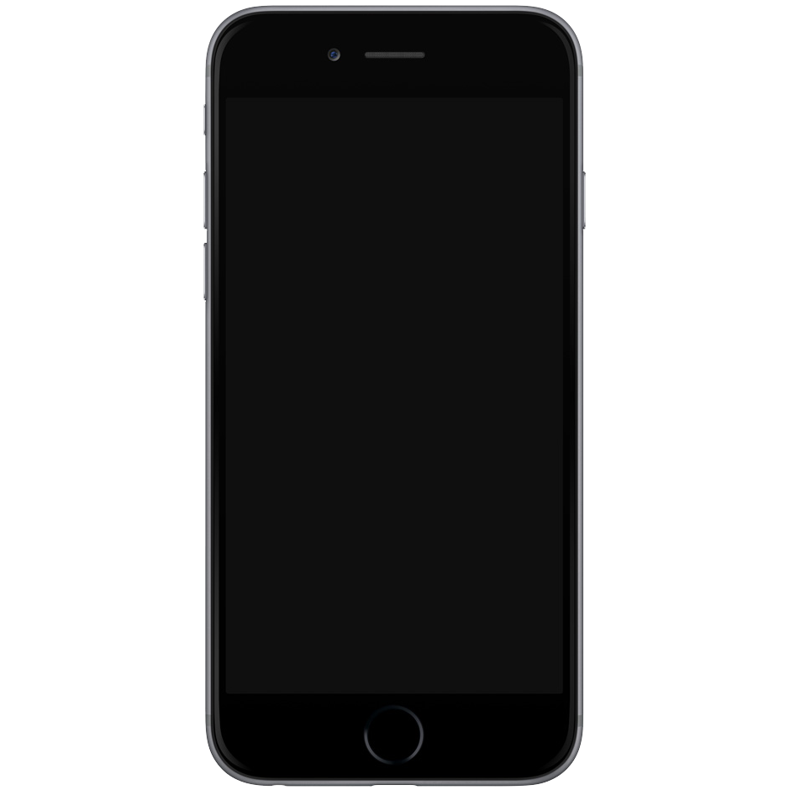

HOW TO TAKE
CARE OF YOUR
CELL PHONE.

Slide 2

TIRED OF REPAIRING or buying PHONEs?

Slide 3
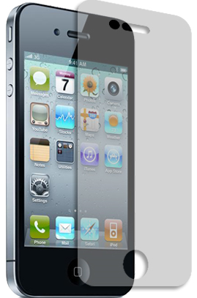
7WAYS TO TAKE PROPER CARE OF YOUR CELL PHONE

Slide 4
1
BUY A CASE AND SCREEN PROTECTOR

Slide 5


1
BUY A CASE AND SCREEN PROTECTOR

Slide 6
2
KEEP YOUR PHONE IN A SAFE PLACE WHEN NOT IN USE

Slide 7




2
KEEP YOUR PHONE IN A SAFE PLACE WHEN NOT IN USE

Slide 8
3
KEEP YOUR PHONE DRY

Slide 9

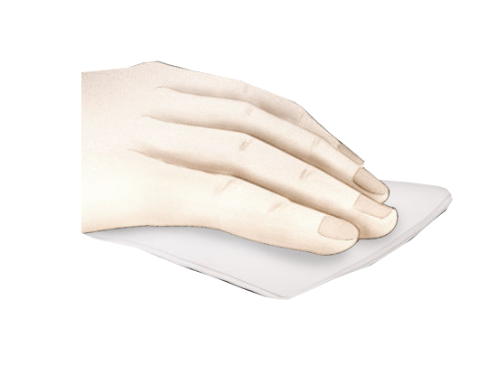

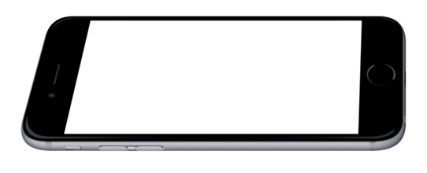
3
KEEP YOUR PHONE DRY
Don’t talk on your cell phone while it’s raining, do not eat near the phone, and avoid carrying it near the pound, swimming pool or toilets.

Slide 10
4
CLEAN YOUR PHONE REGULARLY

Slide 11







4
CLEAN YOUR PHONE REGULARLY

Slide 12
RECHARGE YOUR CELL PHONE ON A REGULAR SCHEDULE
5

Slide 13
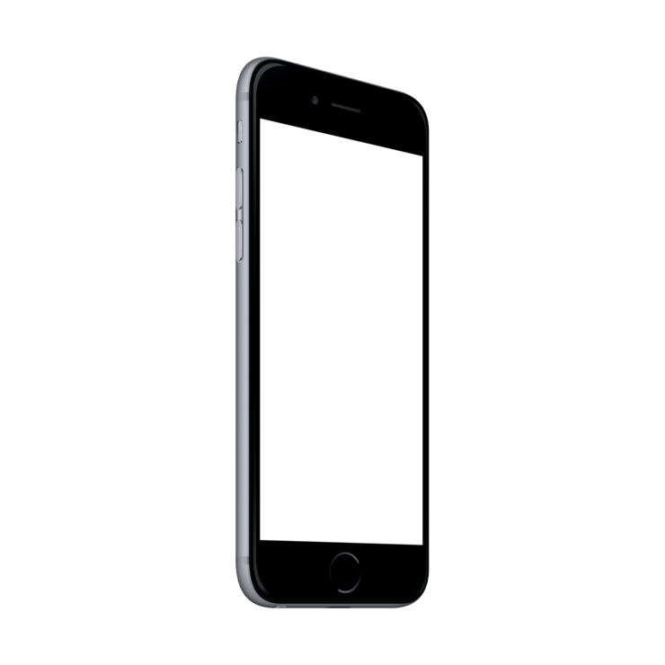


5
RECHARGE YOUR PHONE ON A REGULAR SCHEDULE
NOTE
Keep Your percentage between 40% - 80 % for longer battery life.
It is also advisable to drain your phone battery to 0% once a while, and charge to 100%.

Slide 14
AVOID HAVING YOUR PHONES IN YOUR POCKET WHILE BENDING OR LIFTING THINGS.
6

Slide 15
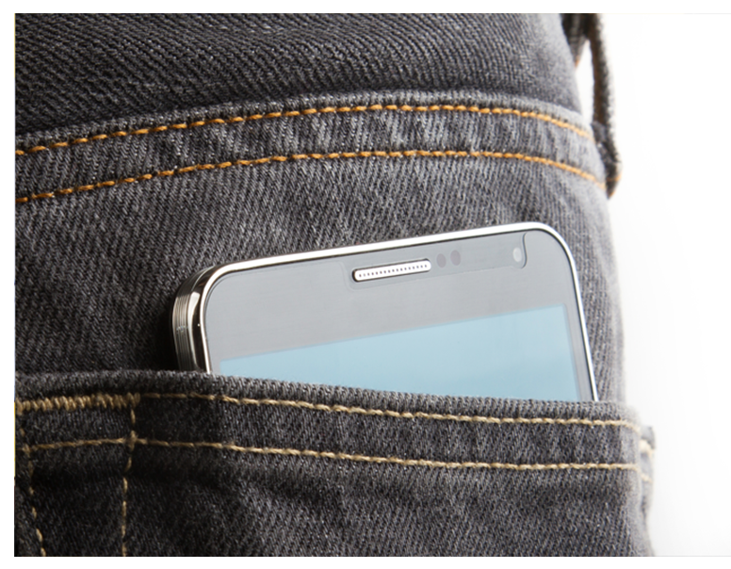
AVOID HAVING YOUR PHONE IN YOUR POCKET WHILE BENDIN OR LIFTING THINGS
6

Slide 16
7
AVOID CHARGING YOUR PHONE WITH THE WRONG CHARGER

Slide 17


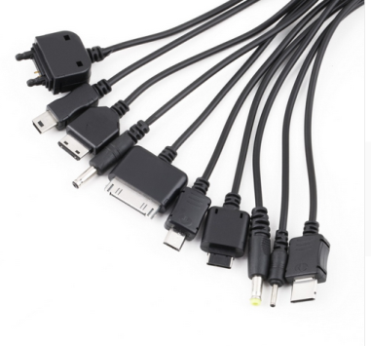
7
AVOID CHARGING YOUR PHONE WITH THE WRONG CHARGER

Slide 18

Thank you for watching
Computer department

