Slide 1
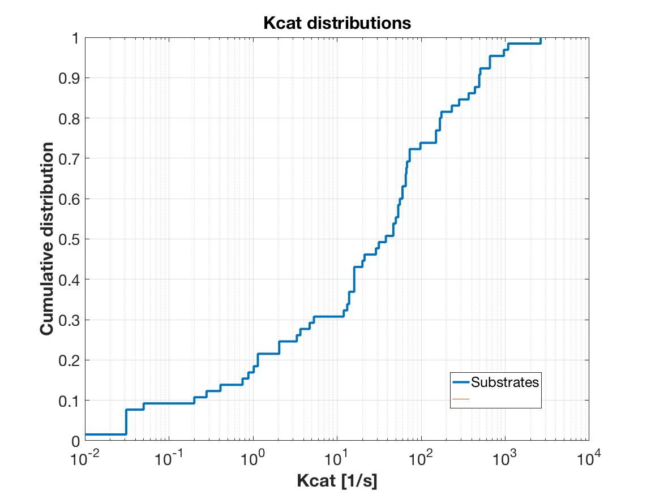
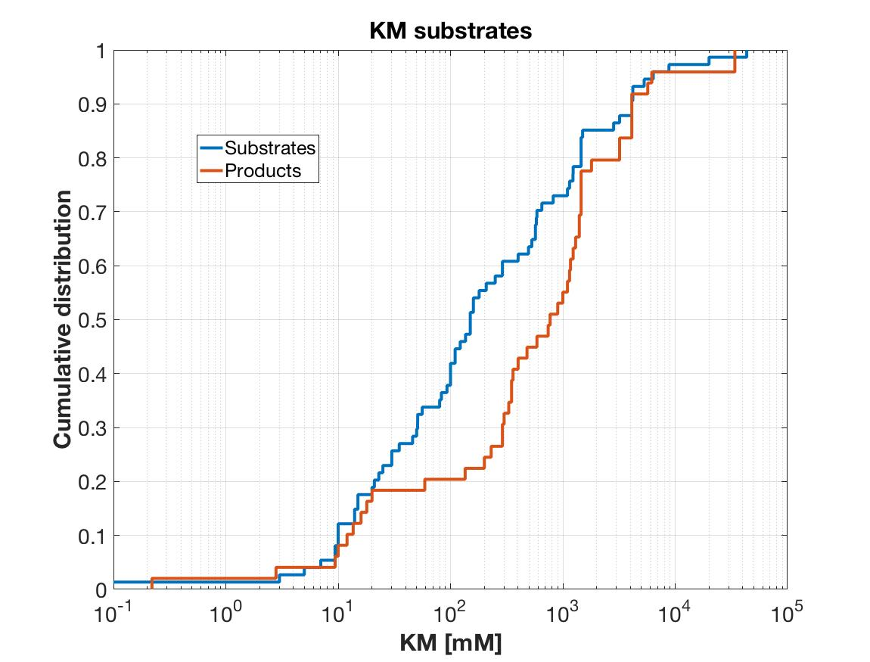
Data availability for the Sce reduced model
AN-52
Rxn´s | 87
Metabolites | 78
Genes | 119
Enzymatic Rxn´s | 53
Reversible Rxn´s | 22
Kinetic parameters requeriments
Kcat + | 30/53
KS | 46/104
KP | 29/109
Keq | 22
Total | 288
2018-02-09

