Slide 2
Reconstruction of Halo-GEM

Slide 3
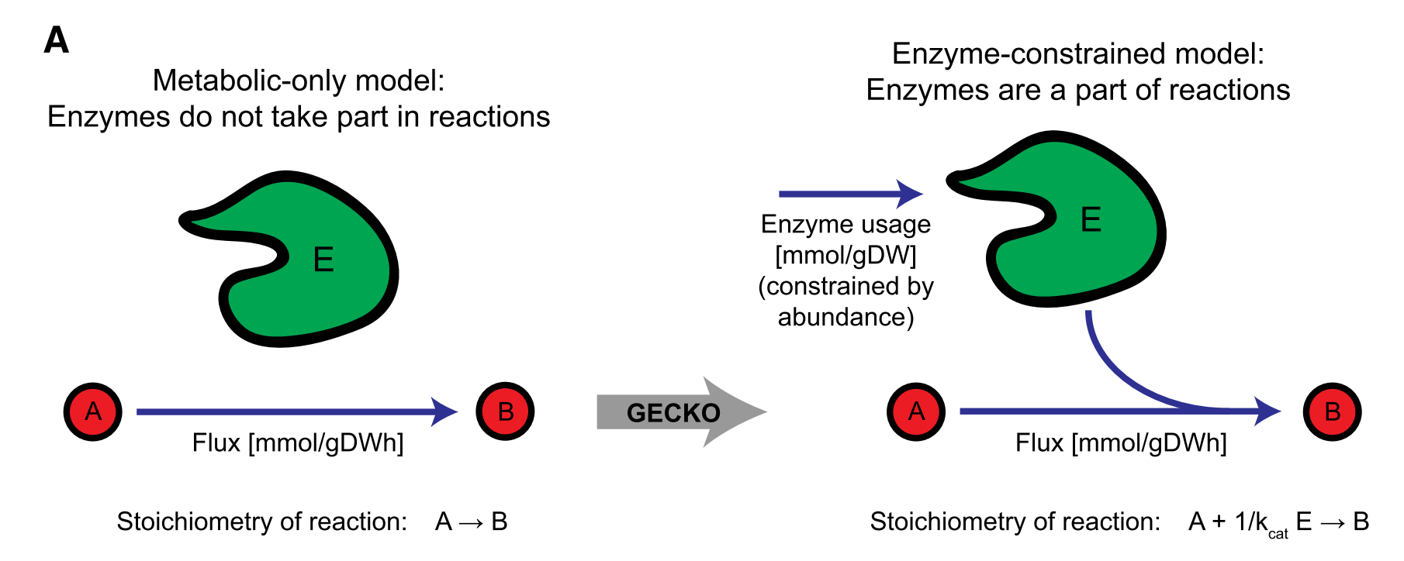
Reconstruction of Halo-ecGEM
Sánchez, B. J., et al. (2017). Molecular Systems Biology, 13(8), 935.

Slide 4
Reconstruction of Halo-ecGEM
Search kcat from BRENDA, only records for bacteria were considered.
Matched digits in EC number | Substrate? | Number of reactions
4 (e.g. EC1.1.1.1) | Yes | 392
4 (e.g. EC1.1.1.1) | No | 679
3 (e.g. EC1.1.1.X) | Yes | 144
3 (e.g. EC1.1.1.X) | No | 587
2 (e.g. EC1.1.X.X) | Yes | 2
2 (e.g. EC1.1.X.X) | No | 9
1 (e.g. EC1.X.X.X) | No | 4
0 (e.g. ECX.X.X.X) | Yes | 2
0 (e.g. ECX.X.X.X) | No | 31

Slide 5
A
B

Slide 6
Improve Halo-ecGEM with Bayesian statistical learning
Li G., et. al. (2020). bioRxiv. (Under Revision, Nature Communications)
https://www.biorxiv.org/content/10.1101/2020.04.01.019620v1.full

Slide 7
Improve Halo-ecGEM with Bayesian statistical learning
GEM
dFBA
Batch
Fed-batch
ecGEM
Simulations
Proteomics
Calibrate: k_{cat}, etc
Bayesian Approach

Slide 8
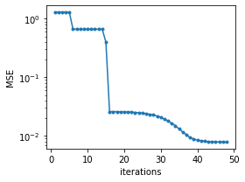
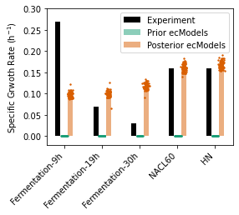
Improve Halo-ecGEM with Bayesian statistical learning
Step 1: constrain total enzyme amount

Slide 11
A
B
C
D

Slide 12
A
B
C

Slide 13
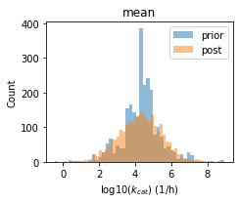
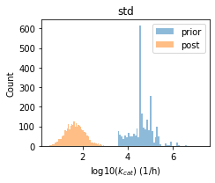
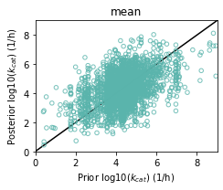
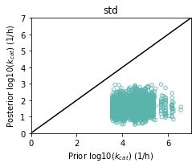
Improve Halo-ecGEM with Bayesian statistical learning
Step 1: constrain total enzyme amount

Slide 14
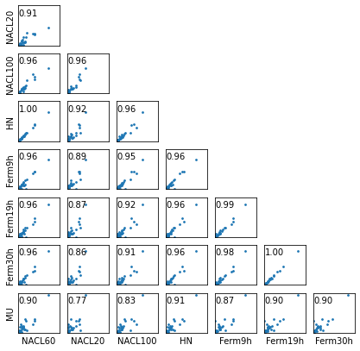
Improve Halo-ecGEM with Bayesian statistical learning
Step2: constrain enzyme pools according go-slim groups
Mass fraction of genes belonging to each go-slim term
Inset number: Pearson's correlation coefficient

Slide 15
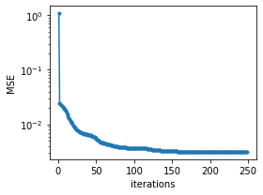
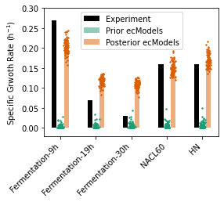
Improve Halo-ecGEM with Bayesian statistical learning
Step2: constrain enzyme pools according go-slim groups

Slide 16
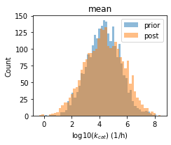
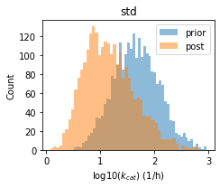
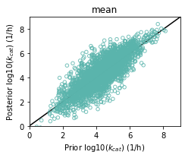
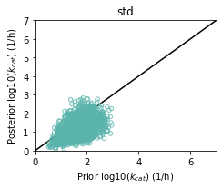
Improve Halo-ecGEM with Bayesian statistical learning
Step2: constrain enzyme pools according go-slim groups

Slide 17
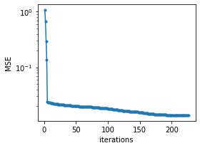
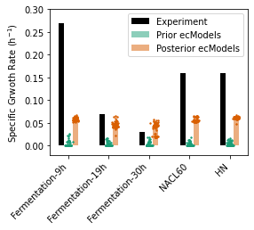
Improve Halo-ecGEM with Bayesian statistical learning
Step3: constrain individual enzyme abundances

Slide 18
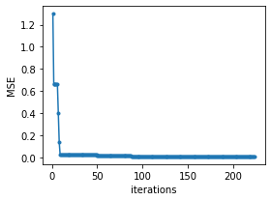
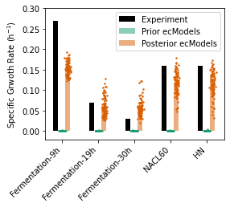
Improve Halo-ecGEM with Bayesian statistical learning
Step13:

Slide 19
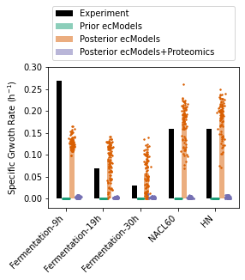
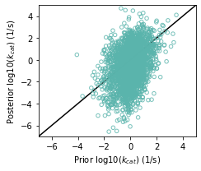
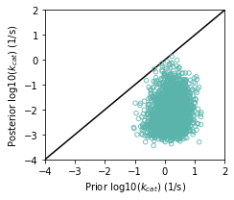
a
b
c
d
Posterior model parameter validation
Other simulations for ecModel validation/application
Notes:
Figure X Using proteomics to calibrate ecModel. (a) An illustration of calibration approach. (b) Simulated specific growth rate at various conditions. (cd) Parity plots of updated (c) mean and (d) standard variance of kcat values.

Slide 21
a
b
GEM
ecGEM
Calibrated
ecGEM
Phenome
Proteomics
Calibrate: k_{cat} Bayesian Approach
c

