Slide 1
Exercise 2
Eduard Kerkhoven
Christoph Börlin; Ivan Domenzain
KMG060 – 2019-09-27

Slide 2
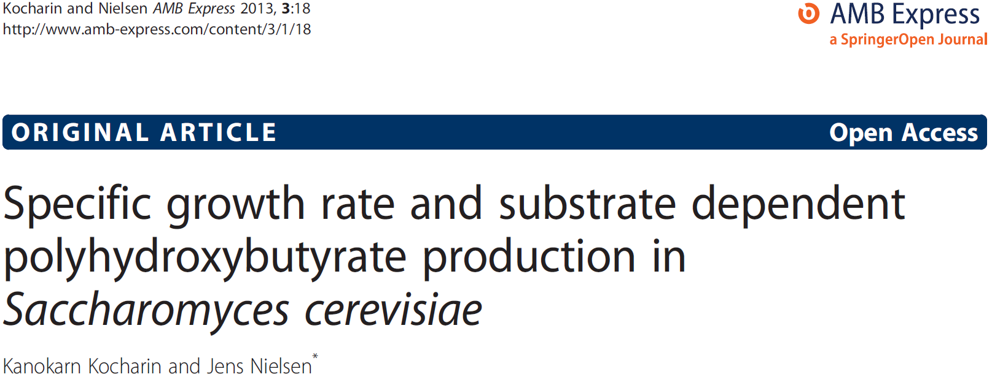
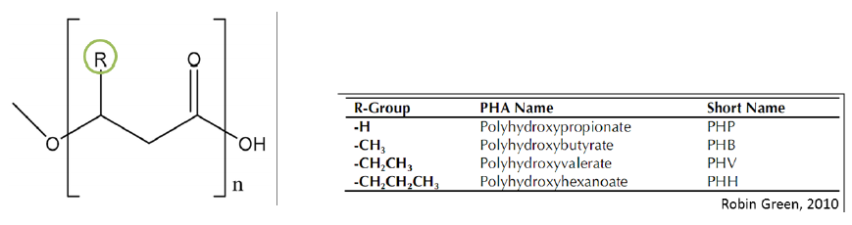
Polyhydroxybutarate production

Slide 3
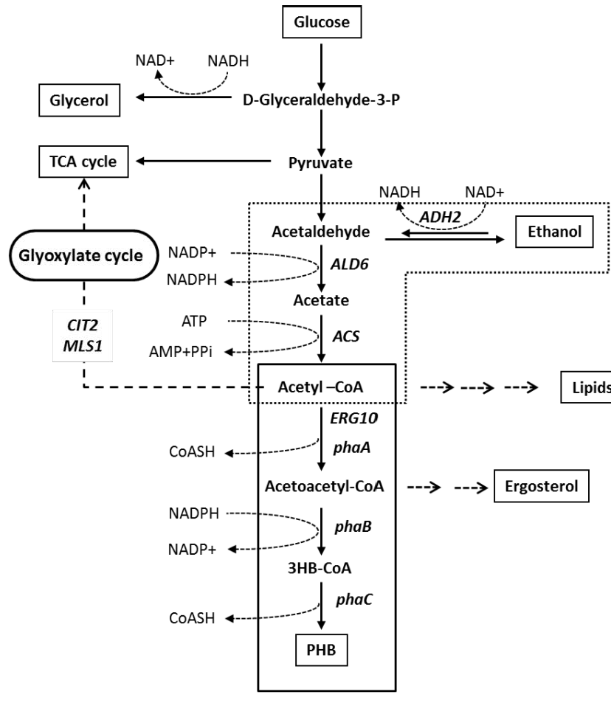
Divert flux towards PHB
Effect of growth rate and substrates on PHB production

Slide 4

Question 1
Simplified schematic of glycolysis, TCA cycle, PHB production and:
NuclSyn: biosynthesis of nucleotides from ribose 5-phosphate
AAsyn: biosynthesis of amino acids from pyruvate
ATPsyn: mitochondrial ATP synthase
Growth: biomass production
ATPM: ATP hydrolysis required for maintenance
Transport reactions
Further reduce the complexity of this model:
By lumping linear reactions (GlcTr + Hxk)
Question 1: Are there other ways to reduce
the model size?
http://etc.ch/gQLF

Slide 5
Reduced model
Glucose_{out}
v₁₄
2 NADH + O₂
5 ATP + CO2
ATP
v₁
v₁₅
2 NADPH + CO₂
ATP
Glc6P
Nucleotides
O₂
v₁₆
O_{2,out}
v₅
v₁₇
v₂
v₈
CO₂
CO_{2out}
Fru6P
Ribu5P
Rib5P
v₇
ATP
v₃
4.3 amino acids +
0.4 nucleotides +
25 ATP + 2 NADPH
v₁₈
biomass
GA3P
v₆
v₄
2 ATP + NADH
CO₂
2 ATP + NADPH
v₉
Pyruvate
Acetaldehyde
PHB_{out}
Amino
acids
v₁₁
v₁₃
v₁₀
NADH
v₁₂
3 CO₂ + ATP
+ 5 NADH
EtOH_{out}

Slide 6
Matrix permutations in Matlab
Split S-matrix in S_{in} and S_{ex}
Split S_{in} in S_{in,cal} and S_{in,meas}
In MATLAB, multiple rows and columns are selected as:
S(firstRow : lastRow, firstColumn : lastColumn)
Example: S(2:3, 2:6) selects row 2 to 3 and columns 2 to 6
To select all rows or columns, writing only ‘:’ is sufficient:
Example: S(:, 6) selects the whole column 6 (all rows)
To select a subset of rows or columns, use square brackets:
Example: S([2,5,8], :) selects the complete rows 2, 5 and 8 (all columns)
To select until the last rows or columns, use ‘end’:
Example: S(2:3, 2:end) selects row 2:3 and all columns except column 1
To make a new matrix with selected rows and columns:
Example: Sincal = Sin(:, [1,5,6]) selects columns 1, 5 and 6 from S_{in} to generate S_{in,cal} (note that S_{in} remains unchanged)

Slide 7


Something about units of rates
Experimentally metabolites are measured as concentrations, i.e. with units:
moles/L (or mmoles/L)
g/L (or Kg/m³)
Over time we measure substrate uptake rates, e.g. glucose uptake rate, as volumetric rates, i.e. with units:
moles/L/h (or mmoles/L/h)
g/L/h (or Kg/m³/h)
biomass
(=yeast cells)
glucose
ethanol
O₂
CO₂

Slide 8
Specific rates
Often we normalize rates with the amount of biomass
These are called specific rates, e.g. specific glucose uptake rate, i.e. with units:
moles/g DW/h (or mmoles/g DW/h)
g/g DW/h (or Kg/g DW/h)
biomass
(=yeast cells)
glucose
ethanol
O₂
CO₂

Slide 9
Question 6
Assume that we performed a cultivation and measured:
Extracellular glucose and ethanol using HPLC, allowing to determine v₁ and v₁₂
O₂ consumption by online gas-analyser, giving v₁₆
Growth rate: v₁₈
v₁ = 1; v₁₂ = 0; v₁₆ = -5; v₁₈ = 0.05
What is the rate of PHB production?
solveMFA(Sin, [1, 12, 16, 18], [1, 0, -5, 0.05]);
http://etc.ch/gQLF

Slide 10
Question 7
Reorganize some of the rows of the S_{in}-matrix, and recalculate the PHB production

Slide 11
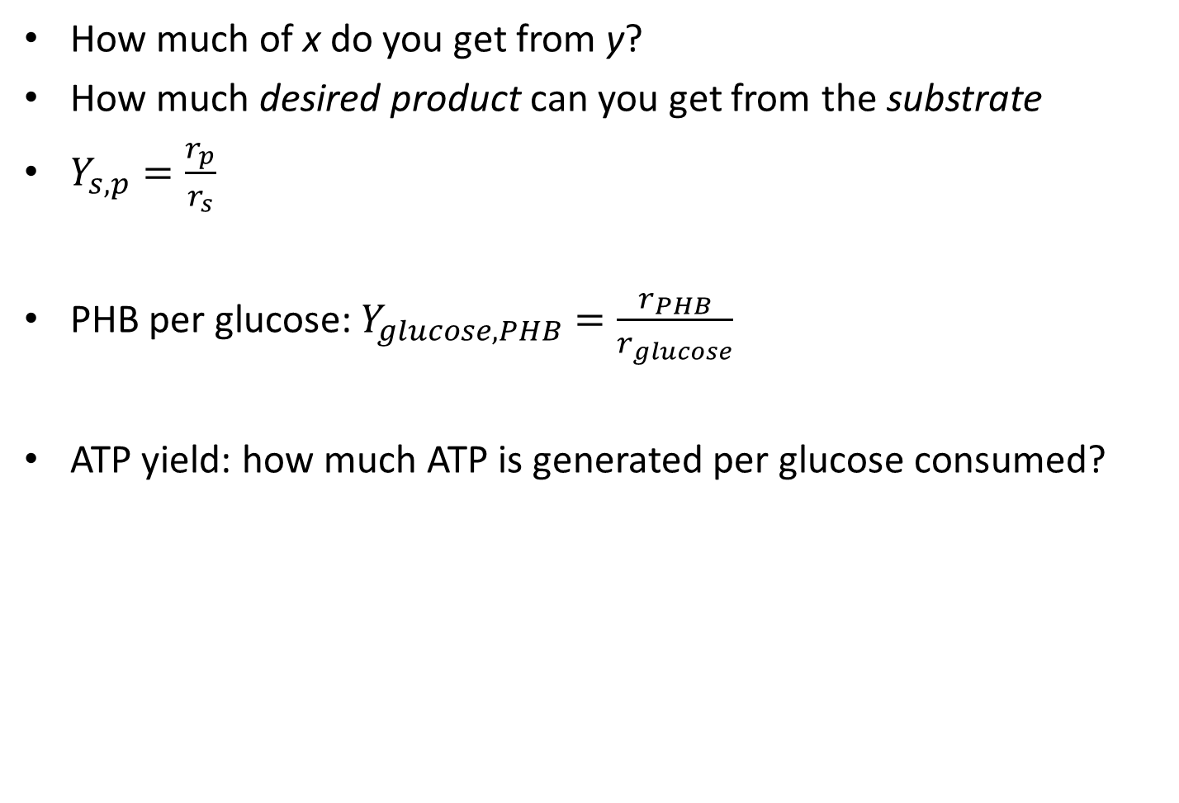
Yield coefficient
How much of x do you get from y?
How much desired product can you get from the substrate
$Y_{s,p}=\frac{r_{p}}{r_{s}}$
PHB per glucose: $Y_{glucose,PHB}=\frac{r_{PHB}}{r_{glucose}}$
ATP yield: how much ATP is generated per glucose consumed?

Slide 12
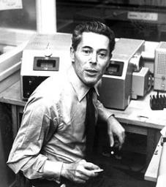
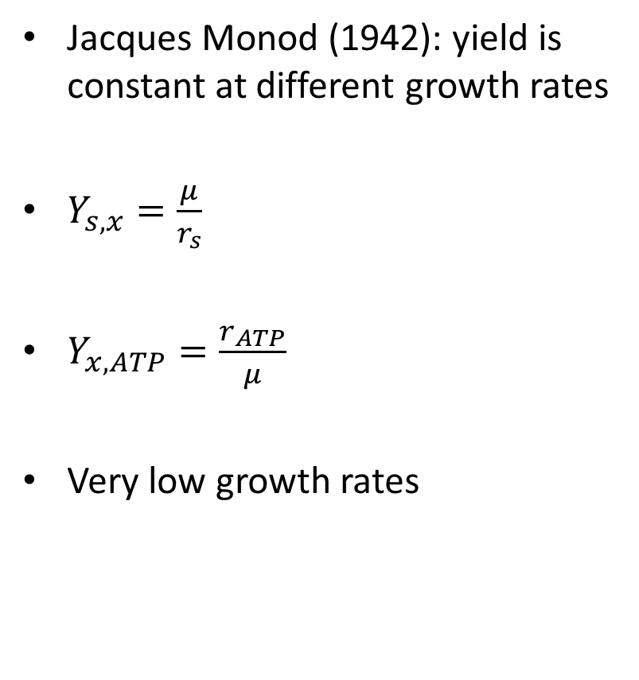
Monod: constant yield
Jacques Monod (1942): yield is constant at different growth rates
$Y_{s,x}=\frac{μ}{r_{s}}$
$Y_{x,ATP}=\frac{r_{ATP}}{μ}$
Very low growth rates
r_{s} or r_{ATP}
Growth rate μ

Slide 13
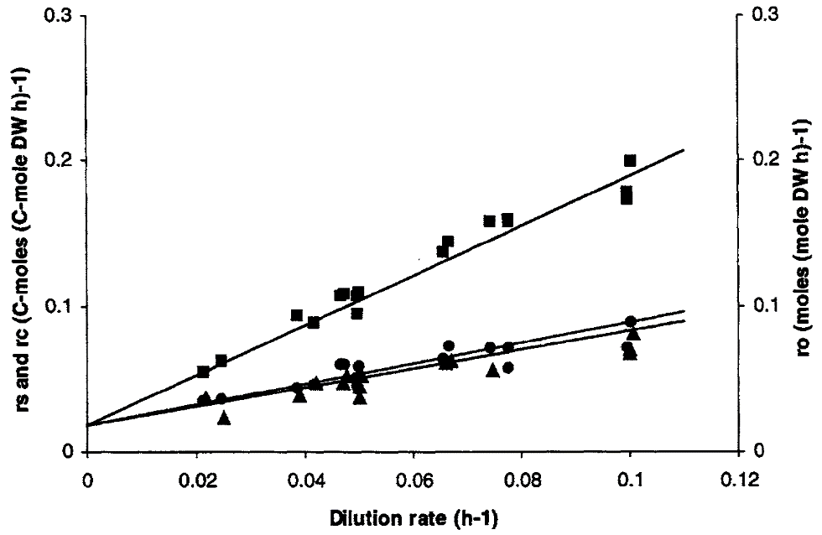
At no growth: still maintenance
Herbert and Luedeking-Pirt (1959): maintenance

Slide 14
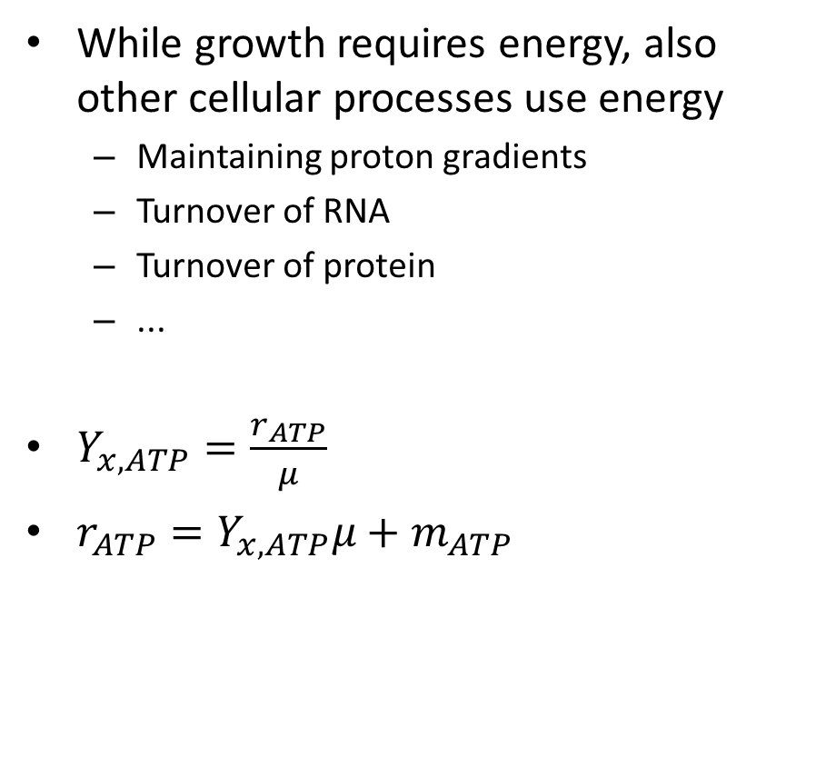
Maintenance energy
While growth requires energy, also other cellular processes use energy
Maintaining proton gradients
Turnover of RNA
Turnover of protein
...
$Y_{x,ATP}=\frac{r_{ATP}}{μ}$
$r_{ATP}=Y_{x,ATP}μ+m_{ATP}$

Slide 15
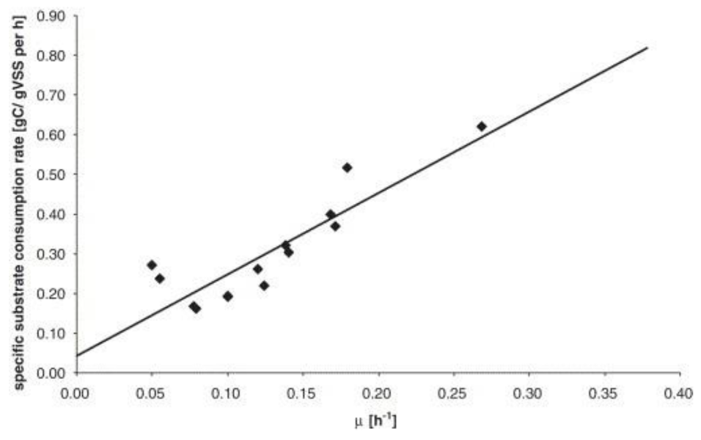

Calculate Y_{x,ATP} and m_{ATP}
$r_{ATP}=Y_{x,ATP}μ+m_{ATP}$
Difficult to measure r_{ATP} but is linked to r_{s}
Each glucose molecule can produce max 36 ATP
If you know glucose uptake (r_{s}) and efficiency of ATP production, you can calculate r_{ATP}.
r_{ATP} (mmol gDCW⁻¹ h⁻¹)
Notes:
Diffeerence between r ATP and r S.

Slide 16
Reduced model
Glucose_{out}
v₁₄
2 NADH + O₂
5 ATP + CO2
ATP
v₁
v₁₅
2 NADPH + CO₂
ATP
Glc6P
Nucleotides
O₂
v₁₆
O_{2,out}
v₅
v₁₇
v₂
v₈
CO₂
CO_{2out}
Fru6P
Ribu5P
Rib5P
v₇
ATP
v₃
4.3 amino acids +
0.4 nucleotides +
25 ATP + 2 NADPH
v₁₈
biomass
GA3P
v₆
v₄
2 ATP + NADH
CO₂
2 ATP + NADPH
v₉
Pyruvate
Acetaldehyde
PHB_{out}
Amino
acids
v₁₁
v₁₃
v₁₀
NADH
v₁₂
3 CO₂ + ATP
+ 5 NADH
EtOH_{out}
http://etc.ch/gQLF

Slide 17
Question 8
We want to determine non-growth associated maintenance requirement from the wild-type strain (= no PHB production). Glucose uptake is measured at 0.275, while growth is 0.05 and CO₂ excretion is 5. What is the rate of the non-growth associated maintenance (NGAM)?

Slide 18
Question 9
Another cultivation of the same strain, now in anaerobic conditions. To reach the same growth rate (0.05), do you think that the glucose uptake rate will be changed?

Slide 19
Question 10
The glucose uptake rate in the anaerobic culture is 0.556. This is still the wild-type strain (= no PHB production). What is the NGAM?

Slide 20
Question 11
Now back to the engineered strain. Looking at the metabolic network, you can imagine that the PHB production will be highest when there is no growth and no ethanol secretion, this way you are not wasting any carbons! Assume the ATP maintenance (NGAM) you calculated in question 7, what is the PHB production if the glucose uptake is 10?
Can you identify a problem with one of the reactions?
Question 12

