Slide 1

Automated Feature engineering
Xiaoyang Wang
University of Illinois at Urbana-Champaign
Notes:
NOTE:
To change the image on this slide, select the picture and delete it. Then click the Pictures icon in the placeholder to insert your own image.

Slide 2
Basic Knowledge
Feature engineering for a single feature: transformation,
Feature crossing: Combine multiple feature.
Example: Use feature [education, job, company, years of experience] or [job, company, level] to predict employees’ salary in CA.
Automated feature engineering(crossing):
Feature generation: Graph traversal.
Feature evaluation:
Filter: Use some metrics like information gain to filter out features individually without model.
Wrapper: Evaluate subsets of features with model.
Embedding: LASSO, learn a sparse weight vector.
Feature selection: Use some metrics to decide which features to discard, since the evaluation might be inaccurate.

Slide 3
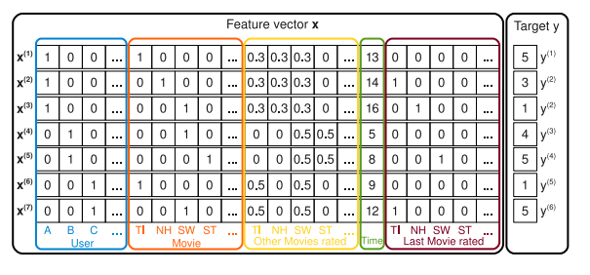

Factorization Machine
Learns second level feature interaction(categorical features)
Problem definition.
A stronger regression model considering the second order interaction between features.

Slide 4
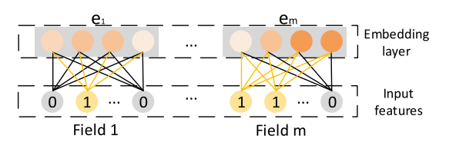

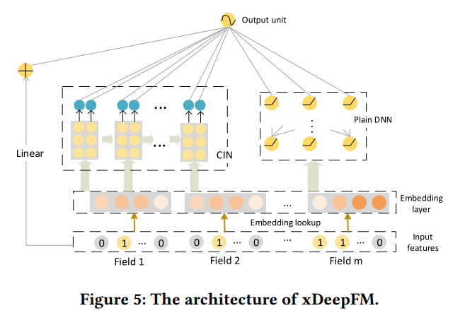
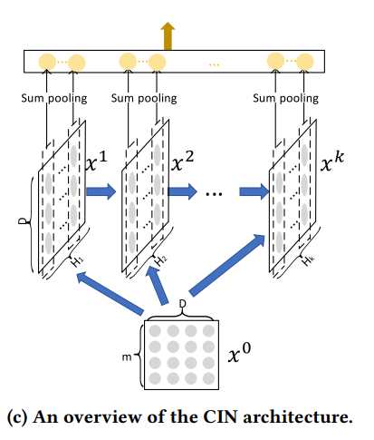
xDeepFM: Combining Explicit and Implicit Feature Interactions for Recommender Systems
Construct mixed feature embedding and feed them to DL
Feature embedding: map a one-hot feature vector to an embedding vector.

Slide 5
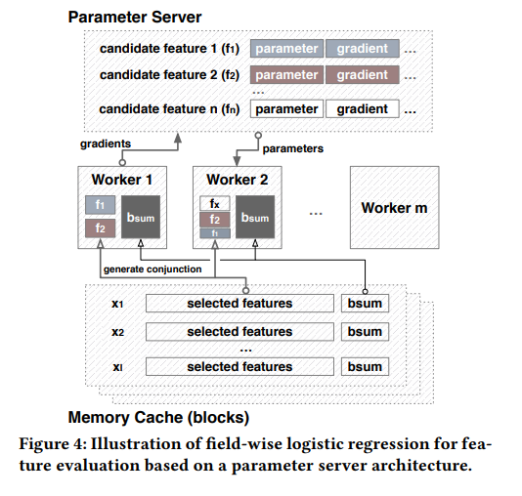
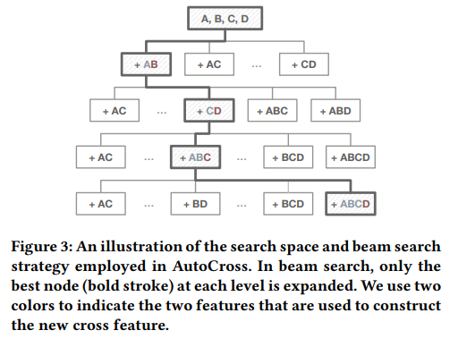
AutoCross: Automatic Feature Crossing for Tabular Data in Real-World Applications
Use beam search to traverse a tree-structure space.
Field-wise logistic regression.
Successive mini-batch GD
Notes:
Generate child node and use logistic regression to approximate real model.
Fix the weights for learned features.

Slide 6
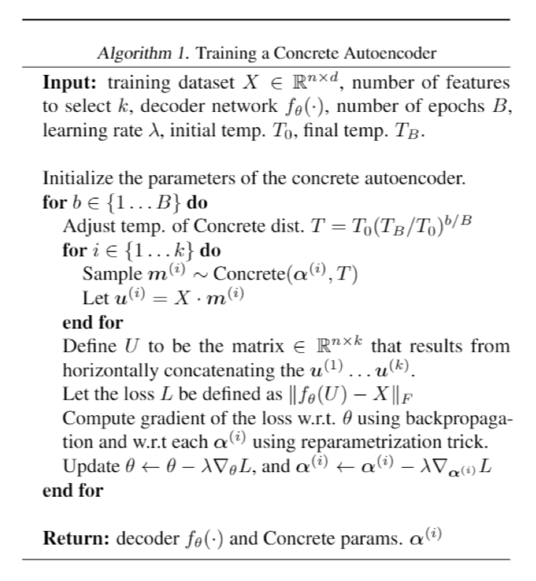
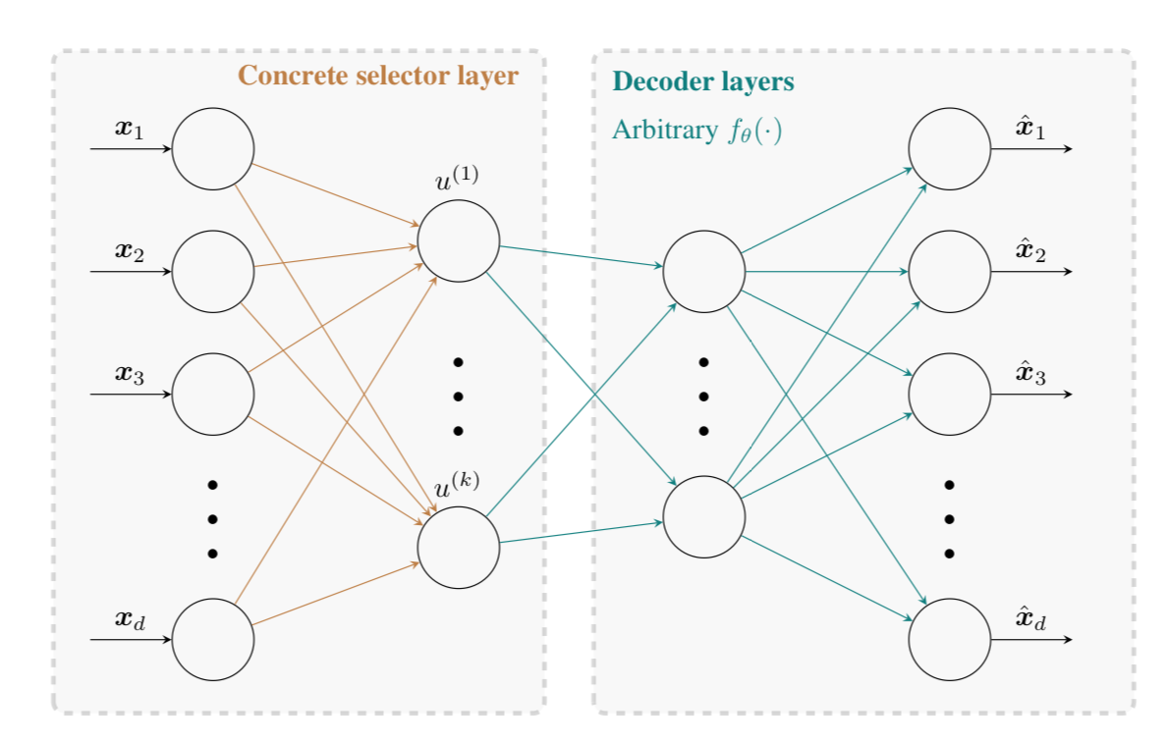
Concrete Autoencoders: Differentiable Feature Selection and Reconstruction
Model discrete variable with Concrete/Gumbel-Softmax distribution to directly optimize feature selection

Slide 7
ExploreKit: Automatic Feature Generation and Selection
Learning to predict the usefulness of features

Slide 8
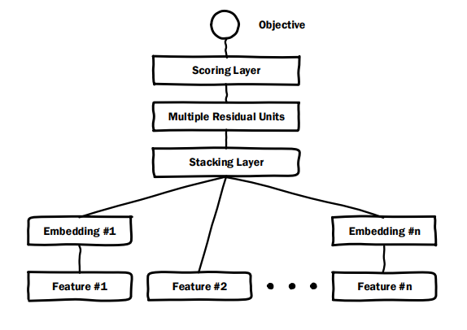
Deep Crossing: Web-Scale Modeling without Manually Crafted Combinatorial Features
Just another kind of feature embeddings(categorical features)

Slide 9
AutoLearn – Automated Feature Generation and Selection
Mining correlated features and select useful ones

Slide 10
Learning Feature Engineering for Classification
Use recommendation systems to recommend features

Slide 11
Feature Engineering for Predictive Modeling Using Reinforcement Learning
Define a transformation graph and use RL to explore

Slide 12
Improving Robustness of ML Classifiers against Realizable Evasion Attack Using Conserved Features
Leverage sandbox check to select features which will disable the malware once manipulated.

Slide 13
DiFacto - Distributed Factorization Machines
Asynchronous Stochastic Gradient Descent
Adaptive memory
Don’t allocate memory for zeros.

Slide 14
Research Opportunities
1. Robust automatic feature engineering against adversarial example.
The major problem is how to evaluate the robustness of features.
1.1 Using domain knowledge – KDD/CVPR/Security&Pravicy paper
1.2 Study the general relationship between feature and model like decision boundary maximization – ICML/NIPS/ICLR paper
1.3 Train the VAE to drop the features or pixels(harder) sensitive to adversarial examples. (We can also let the latent vector stay the same, but it’s like traditional adversarial training as data augmentation) – might get no paper
2. Explainable machine learning using AFE. Train a DL model, distill an AutoCross model for deployment. Some DL model is more like AFE instead of tree-based model.

Slide 15
Berkeley RISE Lab
https://rise.cs.berkeley.edu

Slide 16
Databricks
https://databricks.com

