Slide 1

Distributed Machine learning computing
Xiaoyang Wang
UIUC
Notes:
NOTE:
To change the image on this slide, select the picture and delete it. Then click the Pictures icon in the placeholder to insert your own image.

Slide 2
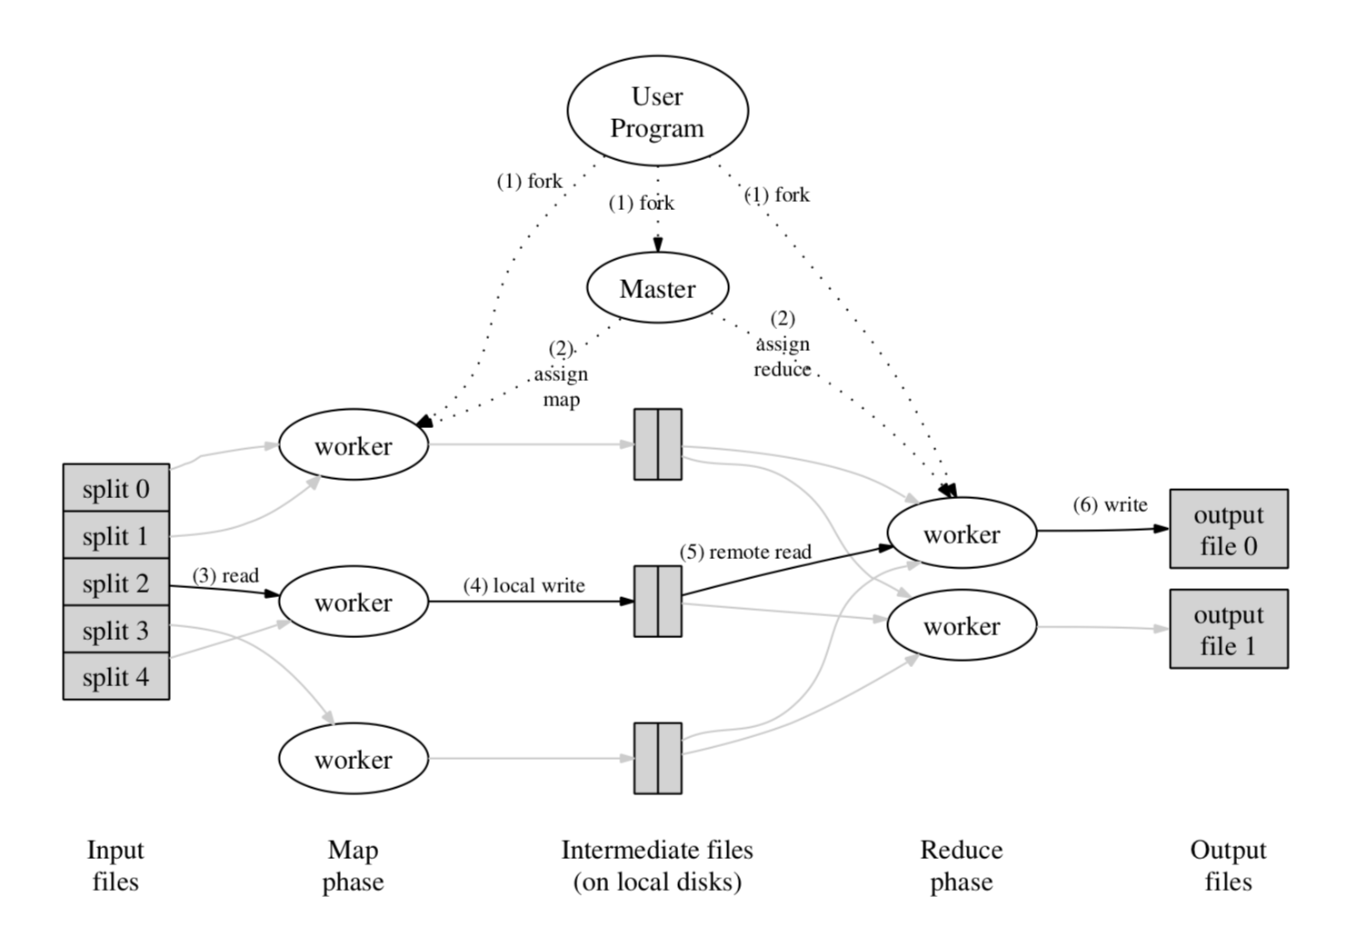
MapReduce: Simplified Data Processing on Large Clusters (OSDI 2004)
Map and Reduce operations.
Process large scale data with clusters.

Slide 3
Distributed GraphLab: A Framework for Machine Learning and Data Mining in the Cloud(VLDB 2012)
MapReduce APIs are inefficient with graph processing applications.
GraphLab proposed new abstractions for graph processing.
1-2 order of magnitude speed up over Hadoop-based implementation.
New abstraction: data graph, update function, sync operation.
Asynchronous algorithms.
Dynamic computing/task scheduling.
Pipeline locking.
Notes:
Bulk message passing and shared memory implementation. Dependency via message pass or mem read&write.
Pipeline locking: async lock via callback, no spin lock.

Slide 4
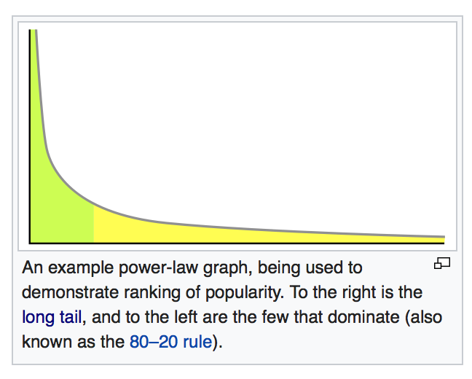
PowerGraph: Distributed Graph-Parallel Computation on Natural Graphs
The power law distribution of natural graphs is a bottle neck for scalability.
Essentially a few vertices connect a large portion of vertices.
Proposed new methods for power-law graph computing.
Delta caching.
Vertex-cut/Edge-cut.
Notes:
Ins as an example.

Slide 5
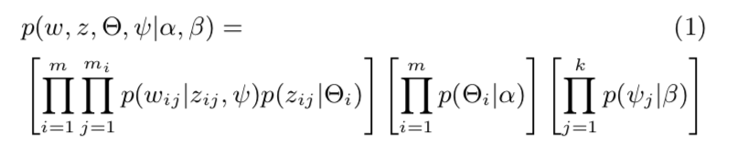
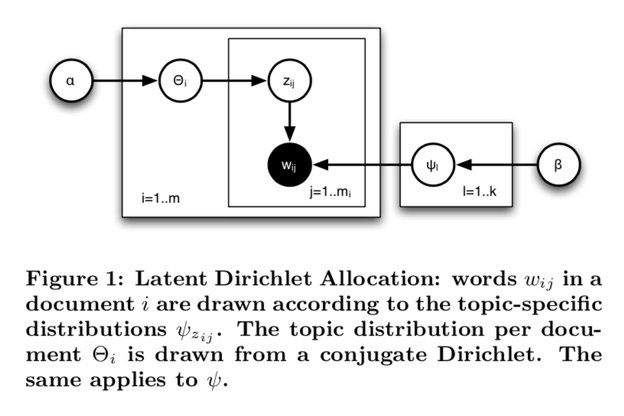
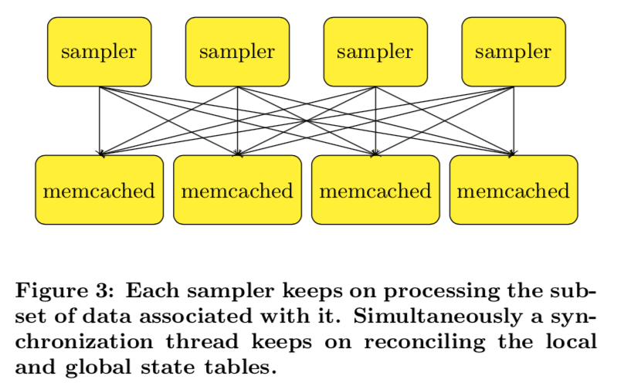
An Architecture for Parallel Topic Models (VLDB 2010)
Distributed sampling architecture using KV-store system.

Slide 6
Scalable Inference in Latent Variable Models (WSDM 2012)
Handles steaming data.
Focus on synchronization.

Slide 7
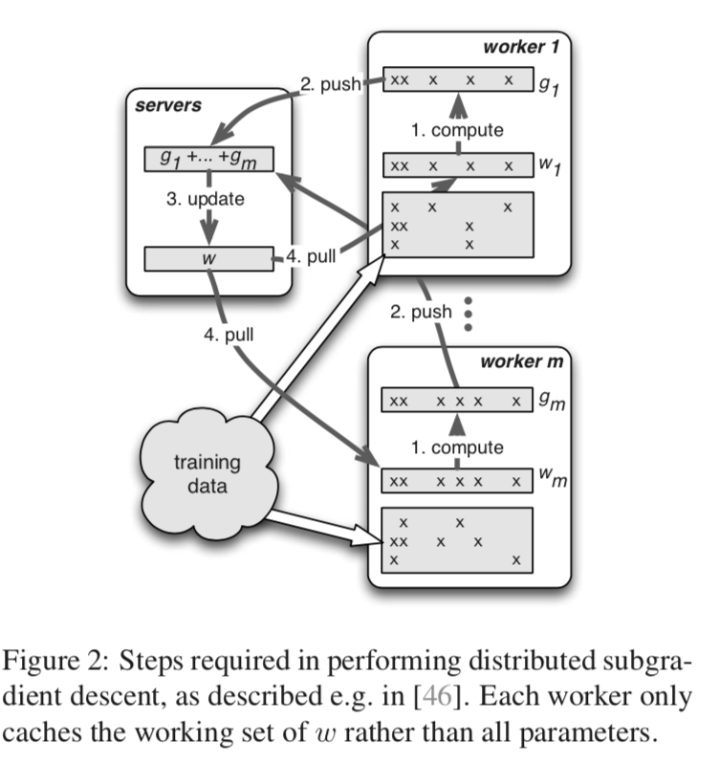
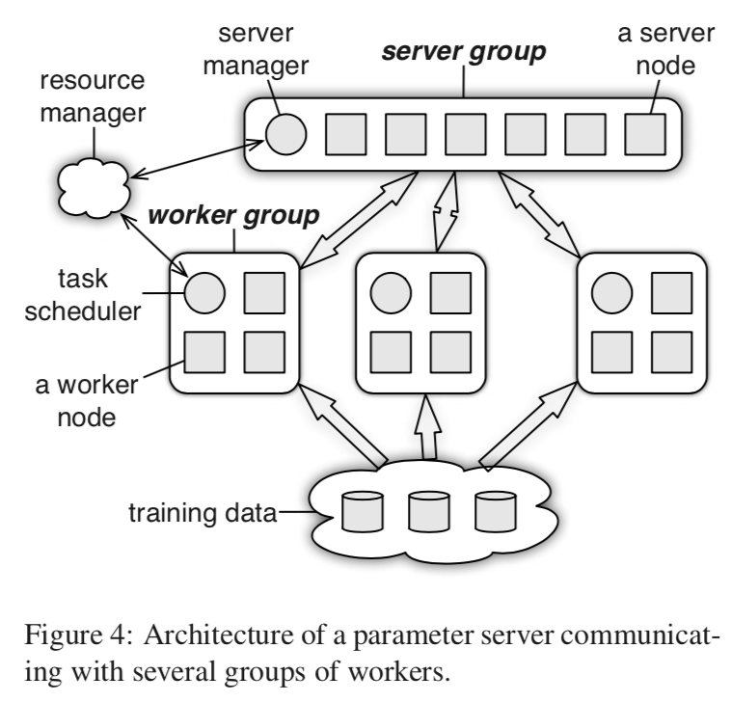
Scaling Distributed Machine Learning with the Parameter Server (OSDI 2014)
A general framework for machine learning applications, both discrimitive and generative model.
Ranged Push and Pull
Asynchronous algorithm.
Flexible consistency.
User-defined function and
filter

Slide 8
Communication Efficient Distributed Machine Learning with the Parameter Server (NIPS 2014)
Optimization algorithms used in parameter server.
Especially asynchronous distributed optimization.

Slide 9
Graph Partitioning via Parallel Submodular Approximation to Accelerate Distributed Machine Learning
Data partition algorithm for machine learning acceleration.

Slide 10
Open problems
Second order optimization.
Exchange knowledge instead of gradients. (AutoML)
Provable quantized training.

Slide 11
Stanford DAWN
Big data system
https://dawn.cs.stanford.edu

Slide 12
Octoml
https://octoml.ai

