Slide 1
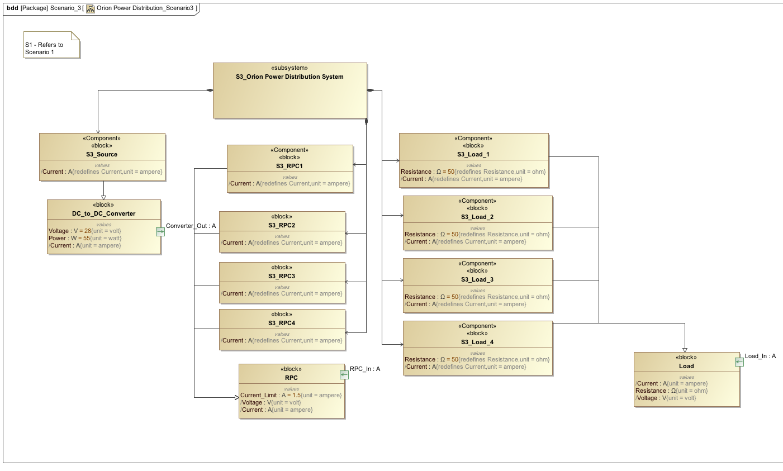

Slide 2
Constraint engine computes power as Σ_{RPC} (current limit * voltage) = 168W
This violates the dc_to_dc_converter constraint of 55W.
Violation is passed to the reasoner.

Slide 3
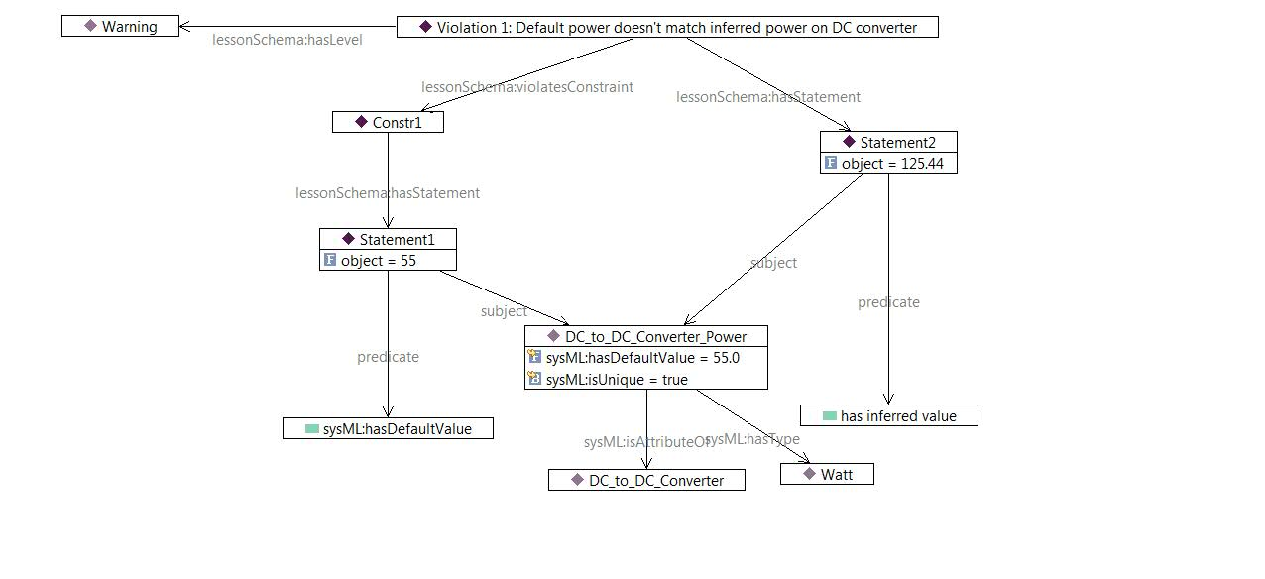
Constraint Violation as expressed in the Ontology
Violation 1 says, “Warning! The statement, “The DC to DC Converter power has inferred value of 168 Watts (as opposed to its default value of 55 Watts) violates Constraint #1”

Slide 4
Warning
The DC to DC Converter power has inferred value of 168 Watts (as opposed to its default value of 55 Watts).
Fix
Override

Slide 5
Enter Rationale
What is your rationale for overriding this constraint?
Actual values will be different
Constraint not relevant to this case
Defer resolution to later
Other…

Slide 6
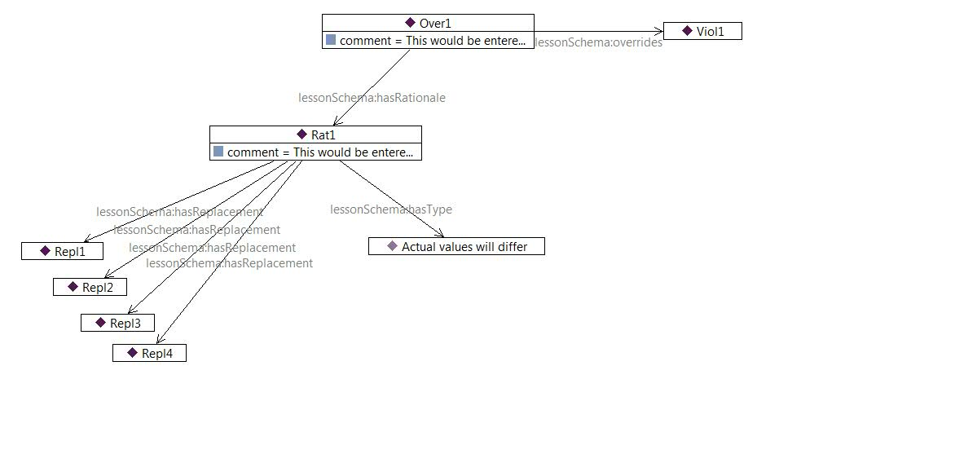
Constraint Violation as expressed in the Ontology
I chose to override the violation report because actual values will differ from reported defaults.

Slide 7
Define Alternative Computation
Please define the way in which the actual values will determine the power.
Replace this:
With:
Attribute set
Attribute set…
DC_to_DC_Converter.Voltage
DC_to_DC_Converter.Voltage
RPC_1.Current_Limit
Load_1.Resistance
+ Add another attribute …
+ Add another attribute …
Attribute set
Attribute set…
DC_to_DC_Converter.Voltage
DC_to_DC_Converter.Voltage
RPC_2.Current_Limit
Load_2.Resistance
+ Add another attribute …
+ Add another attribute …
+ Add another attribute set…

Slide 8
I chose to override the violation report because actual values will differ from reported defaults. In particular, the four replacements listed above will hold.

Slide 9
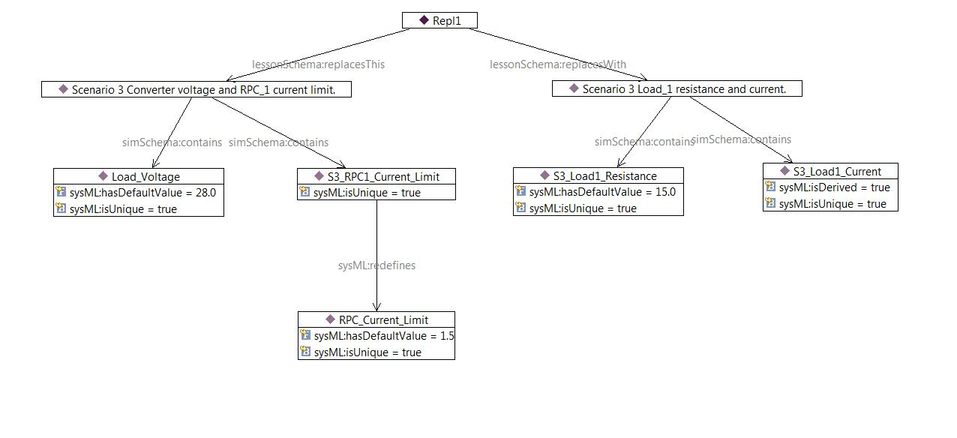
Replace the current limit of RPC 1 at default voltage 28V (in the power computation) with the derived current, based on the resistance of the first load (default 15Ω).

Slide 10
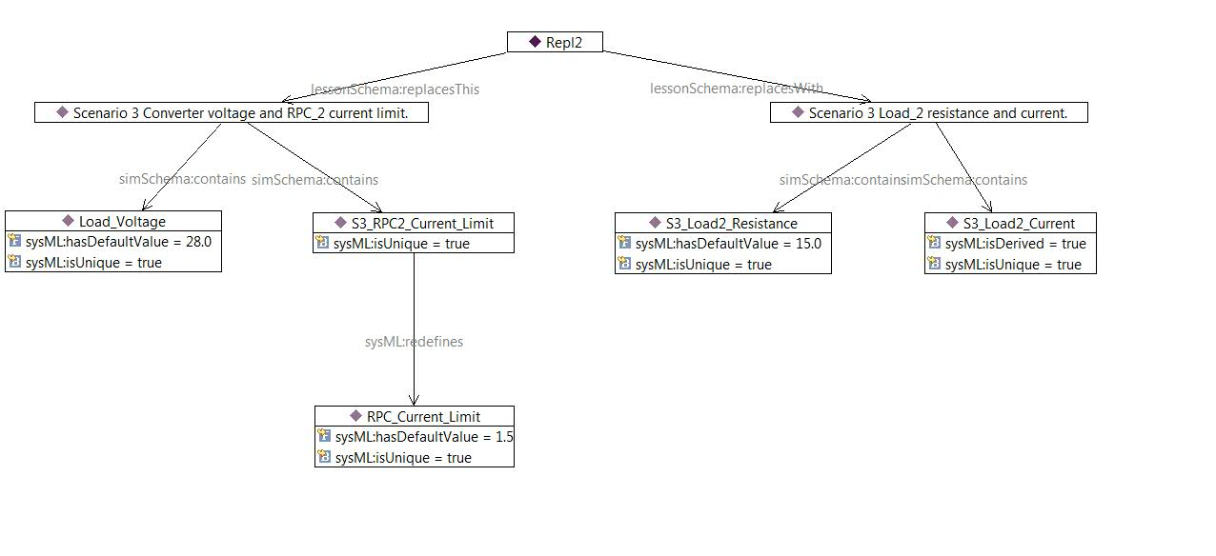
Replace the current limit of RPC 2 at default voltage 28V (in the power computation) with the derived current, based on the resistance of the first load (default 15Ω).

Slide 11
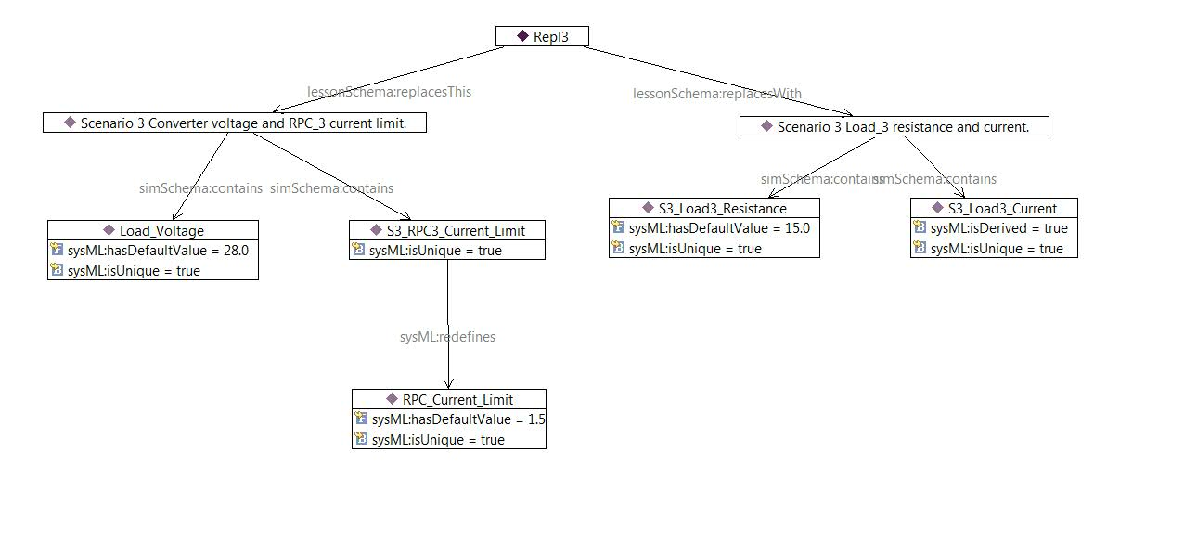
Replace the current limit of RPC 3 at default voltage 28V (in the power computation) with the derived current, based on the resistance of the first load (default 15Ω).

Slide 12
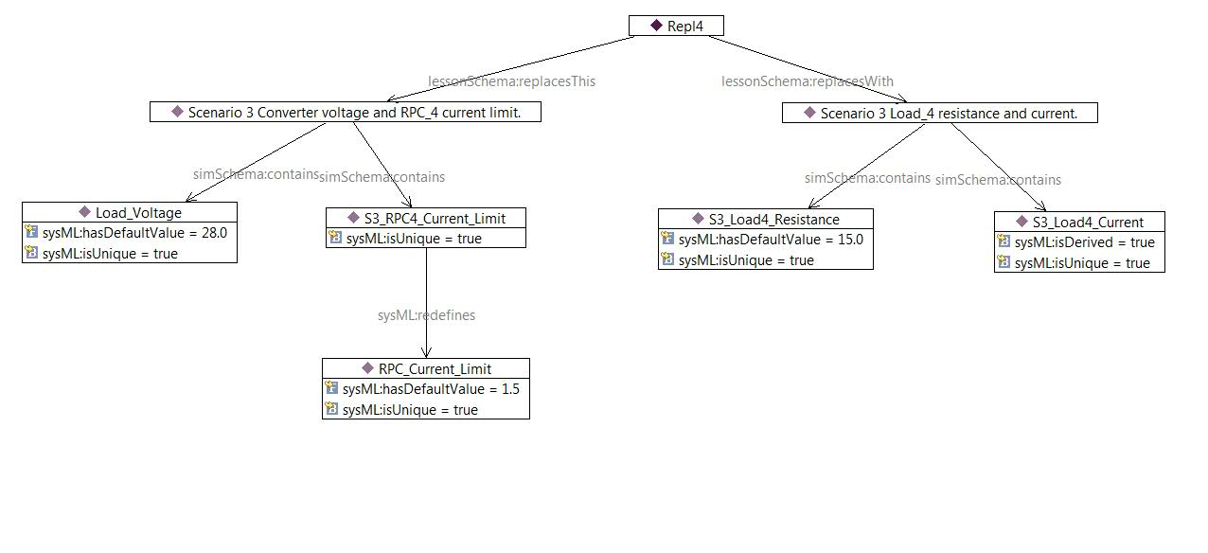
Replace the current limit of RPC 4 at default voltage 28V (in the power computation) with the derived current, based on the resistance of the first load (default 15Ω).

Slide 13
Info
A new constraint has been added to the model.
It will take precedence over the previously violated constraint if the required attribute values are available to compute it.
Okay

Slide 14
Later in the design process
New loads have been added…

Slide 15
Warning
The DC to DC Converter power, computed using Load.Resistance, has inferred value of 90 Watts (as opposed to its default value of 55 Watts).
Fix
Override

