Slide 1
编译原理第二次答辩
魏帅
成员：
邢亚北
马仕青
刘海波
2011年12月16日

Slide 2
Requirements
1、Each attendee/group has at most 10 minutes
2、Bring with your PC
3、Demonstrate your tool
4、Explain the technique used and other important issues
5、Explain the responsibility of each member

Slide 3
Tools and Techniques
Development Platform：Eclipse
Plugin：
JavaCC
WindowBulider(GUI)

Slide 4
Responsibility of each member
GUI Development: 魏帅
Lexical and Syntax Analyzer: 马仕青
Symbol Table and Type Check: 刘海波
Test Case: 邢亚北

Slide 5
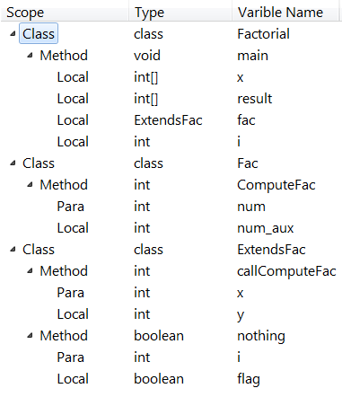
Symbol Table
Overview:

Slide 6
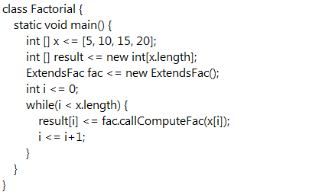
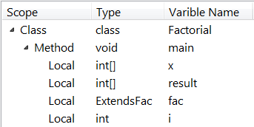
Symbol Table
Detail (one class for example) :

Slide 7
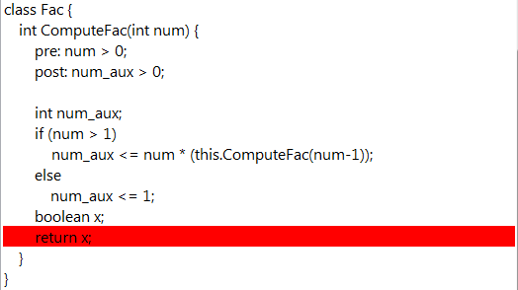
Type Check
Test Example:
Return Instructions:
– If the return type matches the expression?
Error Message:

Slide 8
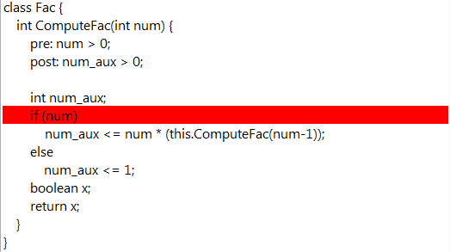
Type Check
Test Example:
Conditional Instructions:
– If the conditional expression producing a Boolean value?
Error Message:

Slide 9
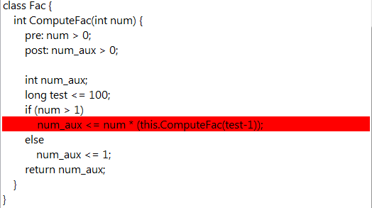
Type Check
Test Example:
Method Invocations:
– If the types of actual parameters match types of formal parameters?
Error Message:

Slide 10
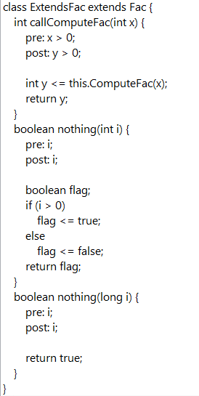

Type Check
Duplicate Methods:

Slide 11
Summary
Symbol Table
Type Check
Friendly GUI
Appropriate Error Messages

Slide 12
Thank you!

