Slide 1
Securing your Dancer app
Keeping out the bad guys
Peter Mottram (SysPete) <peter@sysnix.com>
Perl Dancer Conference 2014

Slide 2
Who's this Pete guy?
Lived and worked in UK, NL and Malta
24 years UNIX & Linux systems
Nokia, Orange, BT, IBM
Linux, network security, Perl, e-commerce
Interchange6 development team member
whacks small balls with sticks & drink beer

Slide 3
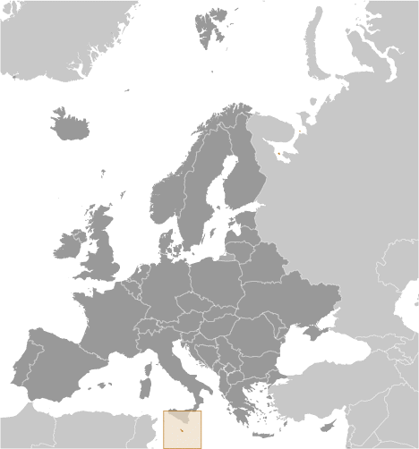
Malta
"slightly less than twice the size of Washington, DC"
© CIA World Fact Book

Slide 4
Attackers are Winning
On the internet right now, the attacker has the advantage and will for the foreseeable future.
Bruce Schneier, AppSec USA, 18th September 2014

Slide 5
Network Security
Where did it all go wrong?

Slide 6
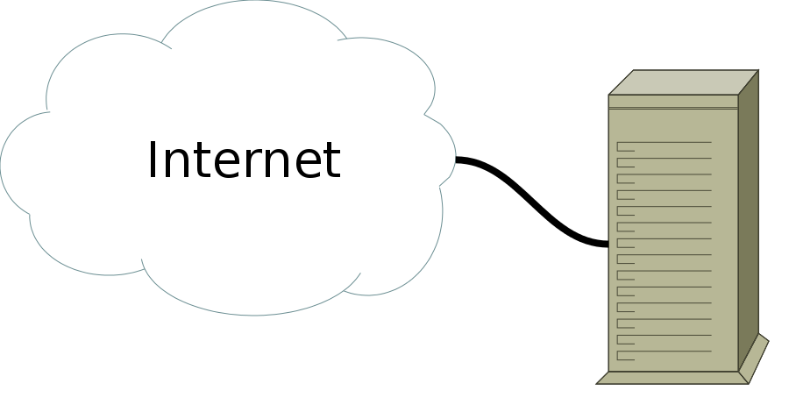
The Wild West

Slide 7
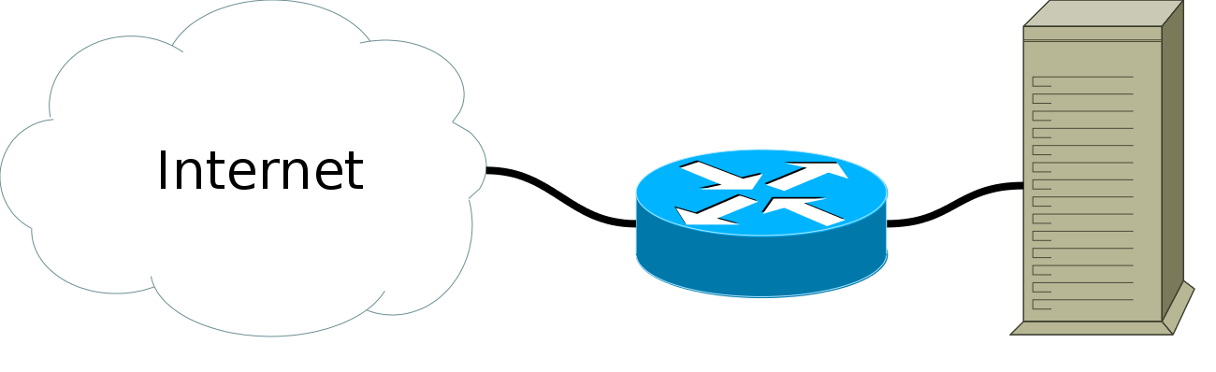
Stateless filtering

Slide 8
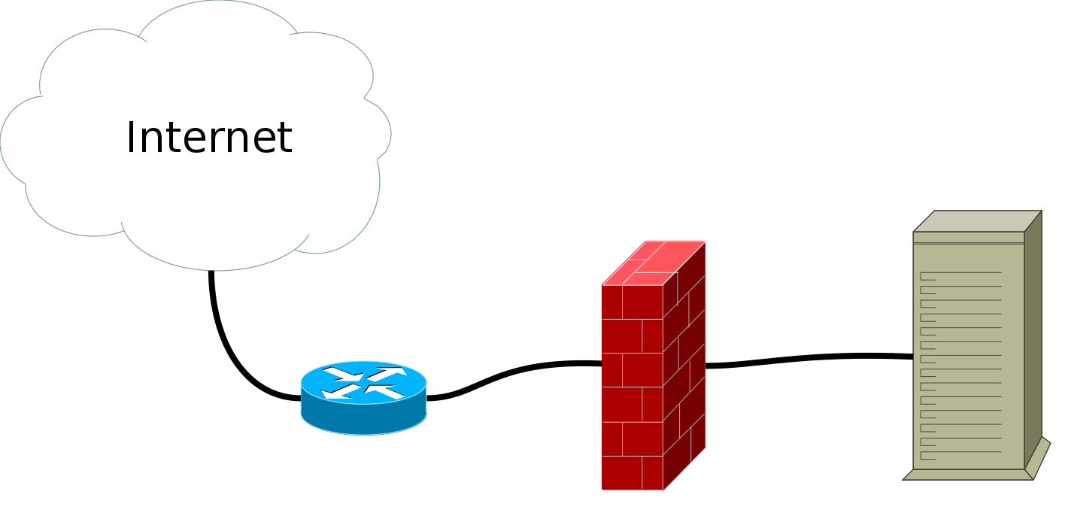
Stateful filtering

Slide 9
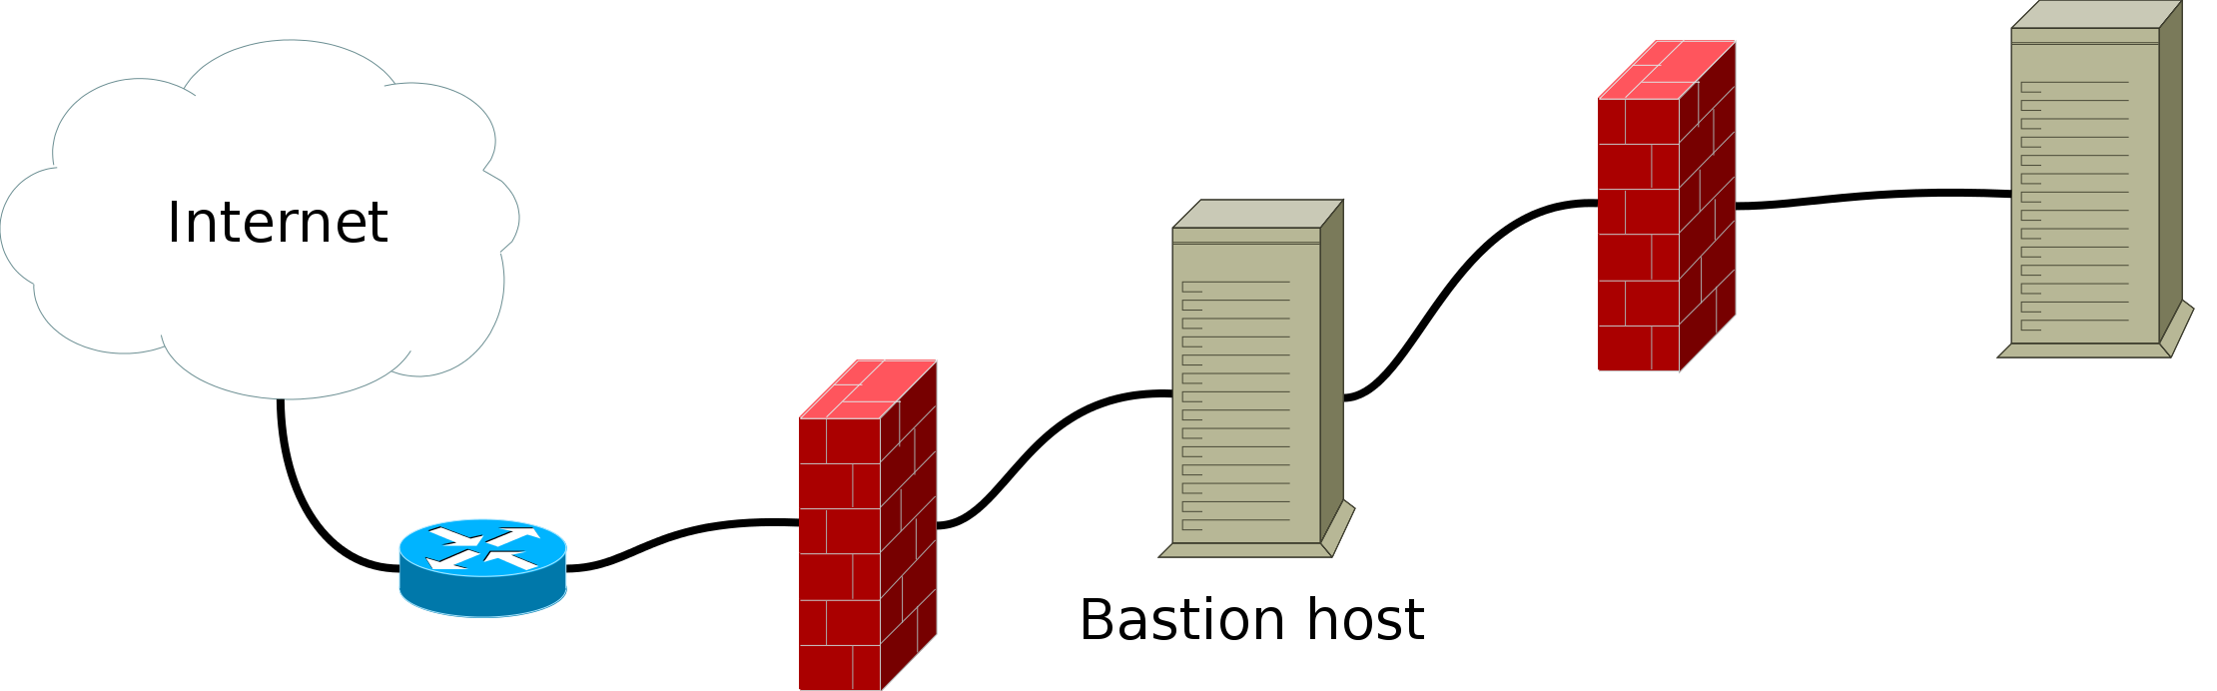
DMZ

Slide 10
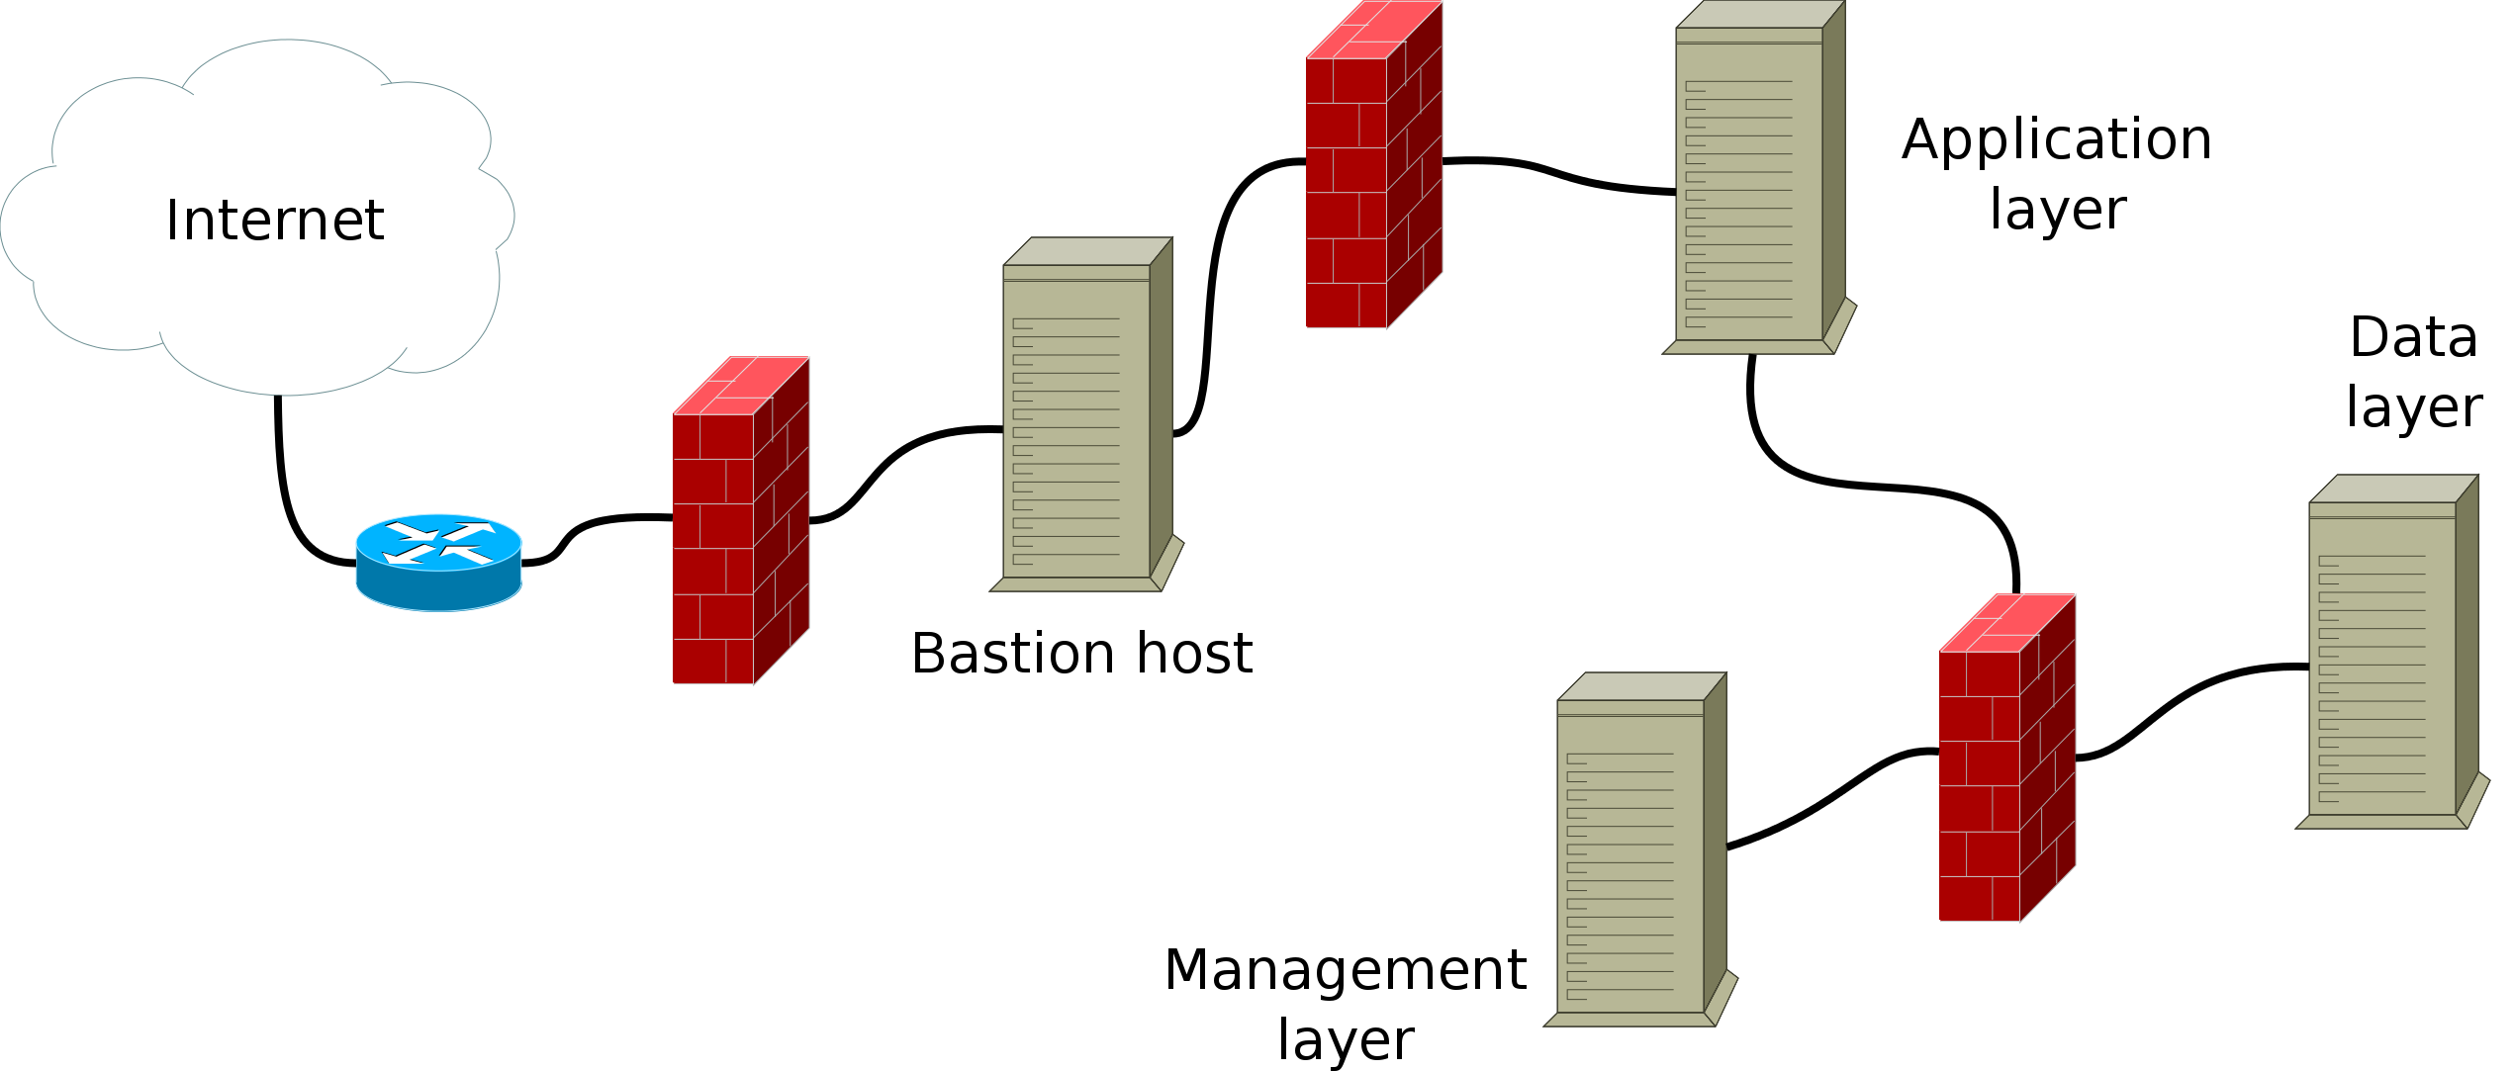
Multiple layers

Slide 11
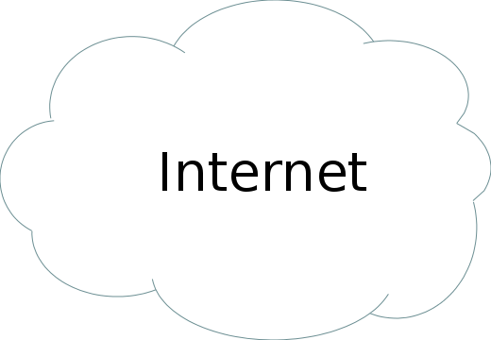
The Cloud

Slide 12
Three Trends
Bruce Schneier, AppSec USA, 18th September 2014
losing control of our infrastructure
attacks are getting more sophisticated
increasing government involvement in cyberspace
Notes:
Three trends that are currently important to the security industry.
- rise of cloud: we no longer have control of our data, devices that we have less control over: locked down devices
- e.g.: Target. Since Target was not as well-secured as its "neighbors", it was attacked. APT...
- gov involvement goes beyond NSA & other secret services. Businesses and other organizations tend to be collateral damage when governments act on the internet—to censor it, conduct espionage on it, or attack adversaries using it.

Slide 13
Security
Finding the right balance
Security requirements
Cost
Impact on users
Motiviations of attacker

Slide 14
Attackers
Source: OWASP
Disgruntled staff or developers
"Drive by" attacks: viruses, worms, trojans
Motivated criminal attackers: organised crime
Criminal attackers without motive against you
Script kiddies

Slide 15
Security Principles
OWASP CLASP Project
Ethics in Secure Software Development
Insider Threats as the Weak Link
Assume the Network is Compromised
Minimize Attack Surface
Secure by Default
Defense in Depth
Principles for Reducing Exposure
The Insecure Bootstrapping Principle
Input Validation

Slide 16
Ethics in Secure Software Development
software development organisations should behave ethically as a whole
do not expect all people on the dev team will be ethical
do not expose a user to security risks that are known but not obvoius to user
privacy policy - personal information
inform users in case of breach
Notes:
- do not expose... without clearly informing them of the risks + mitigation strategies
- on policy change the user should be given the choice to accept change or have data expunged

Slide 17
Ethics - SSL
https only - disable all http
2048+ bit keys only
EV is for a warm feeling only

Slide 18
Ethics - HTTP headers
Strict-Transport-Security: max-age=16070400; includeSubDomains | Enforces secure (HTTP over SSL/TLS) connections to server.
X-Frame-Options: deny | Provides Clickjacking protection. May need tuning if frames/iframes are in use.
X-XSS-Protection: 1; mode=block | XSS filtering by most modern browsers
X-Content-Type-Options: nosniff | Reduces exposure to drive-by download attacks on IE & Chrome
Content-Security-Policy: default-src 'self' | Helps protect against XSS and content injection. Needs very careful tuning.
Content-Security-Policy-Report-Only: default-src 'self'; report-uri http://loghost.example.com/reports.jsp | Like Content-Security-Policy, but only reports - useful for dev and testing.

Slide 19
Adding HTTP headers
nginx
add_header Strict-Transport-Security "max-age=16070400; includeSubDomains";
Apache
Header add Strict-Transport-Security "max-age=16070400;includeSubDomains"
Dancer/Plack/Plack::Middleware::Headers
plack_middlewares:
-
- Headers
- set
-
- Strict-Transport-Security
- "max-age=16070400;includeSubDomains"

Slide 20
Ethics - XSRF
Plack::Middleware::XSRFBlock
plack_middlewares:
-
- XSRFBlock
- cookie_name
- MY-XSRF-Token
- cookie_options
-
httponly: 1
See also Plack::Middleware::CSRFBlock
Notes:
Beware of the extra param received named 'xsrf_token' by default.

Slide 21
Ethics - escape HTML
protect against XSS
Dancer::Plugin::EscapeHTML
plugins:
EscapeHTML:
automatic_escaping: 1
exclude_pattern: '_html$'

Slide 22
Insider Threats
users with inside access to the application
the guy in the next cube, secretaries, janitors
staff who recently quit or have been fired
social engineering
Notes:
- users

Slide 23
Don't Trust the Network!
Eavesdropping
Tampering
Spoofing
Hijacking
Observing
Notes:
- Eavesdropping: even with crypto may be possible when not performing proper auth using MITM
- Tampering: change data on the wire even if encrypted. Thwarted by ongoing message authentication (MACing) using TLS/SSL.
- Spoofing: traffic can be forged so that it appears to come from a different source address. Do NOT rely on source IP/DNS for auth.
- Hijacking: established connections are taken over, allowing attacker to enter an established session without having to authenticate.Thwart partly with MACing (TLS/SSL).
- Observing: can give away security-critical info even when a network connection is encrypted. e.g. 2 particular hosts are talking may give away significant information, as can the timing of traffic. AKA covert channels - the most difficult problem in the security space.

Slide 24
Minimize Attack Surface
measure the number of input points that the application has
consider accessibility of input point
files, registry keys, user input, database content, etc
collapsing multiple input points into a single input point does not necessarily reduce the attack surface

Slide 25
Secure by Default
A system's default setting should not expose users to unnecessary risks and should be as secure as possible
Failure in the system should not cause the system to behave in an insecure manner
Does not interact well with usability

Slide 26
Secure by Default -
Obfuscate server headers
nginx
server_tokens off;
more_set_headers 'Server: Teapot v8.12';
Apache
ServerSignature Off
ServerTokens Prod
Dancer
session_name: session

Slide 27
Secure by Default -
Protect the server
Keep up to date with security fixes
Monitor everything
Disable unused services/daemons
Never run web servers or applications as superuser

Slide 28
Defense in Depth
Redundant security mechanisms increase security
If one mechanism fails perhaps another will still provide the necessary security
Increases in complexity run counter to the “KISS” principle
Risk from increased complexity usually minimal compared to risk to be mitigated

Slide 29
Defense in Depth -
Possible strategies
Hardware Firewalls
HIDS / NIDS / IDPS
Multi-layer infrastructure
Application proxy
mod_security
software firewall on server

Slide 30
Principles for Reducing Exposure
Compartmentalisation
Least privilege
Minimise windows of vulnerability
Minimise windows of privilege
Privilege separation
Notes:
- contain damage if something does go wrong - submarine example
- only grant those privs necessary to get the job done
- when risks must be introduced it should be for as short a time as possible
- only allow priv escalation for restricted time window
- break application into 2 parts: one small with privs than can be audited and the rest with low privs

Slide 31
Reducing Exposure -
Compartmentalisation
One plack server for each Dancer app
Multiple VMs
Containers

Slide 32
Reducing Exposure -
Least Privilege
Different unpriviliged accounts for each Dancer app
Application should never use superuser account to connect to databases

Slide 33
Reducing Exposure -
Minimise Windows
Automatic session expiration
Manual session expiration on logout
Renew session ID on privilege level change ***

Slide 34
The Insecure Bootstrapping Principle
If you need to use an insecure communication channel for anything - you should use it to bootstrap a secure communication channel so that you do not need to use an insecure channel again.
Much better to NEVER use an insecure channel.

Slide 35
Input Validation
Where to perform input validation
Ways in which data can be invalid
How to determine input validity
Actions to perform when invalid data is found

Slide 36
Where to perform input validation
Use
Unit boundaries
Trust boundaries
Protocol parsing
Application entry points
Network
Notes:
- Use: all places in the code where data (particularly of external origin) gets used.
- Unit boundaries: individual components, modules, or functions.
- Trust boundaries: on a per-executable basis.
- Protocol parsing: when the network protocol gets interpreted.
- Application entry points: just before or just after passing data to an application, such as a validation engine in a web server for a web service.
- Network: a traditional intrusion detection system (IDS).

Slide 37
Ways in which data can be invalid
Invalid data is anything that does not meet the strictest possible definition of valid.
Four different contexts in which data can be invalid:
Sender
Tokens
Syntax
Semantics

Slide 38
How to determine input validity
High-level approaches:
Black-listing
White-listing
Cryptographic validation

Slide 39
Actions to perform when invalid data is found
Three classes of action one can take:
Error
Record
Modify
Notes:
- Error: This includes fatal errors and non-fatal errors.
- Record: This includes logging errors and sending notifications of errors to interested parties.
- Modify: This includes filtering data or replacing data with default values. e.g. remove spaces from email addresses

