Slide 1
Testing with Roles
Peter Mottram (SysPete) <peter@sysnix.com>
Perl::Dancer Conference 2014

Slide 2
Who's this Pete guy?
Lived and worked in UK, NL and Malta
24 years UNIX & Linux systems
Nokia, Orange, BT, IBM
Linux, network security, Perl, e-commerce
Interchange6 development team member
whacks small balls with sticks & drink beer

Slide 3
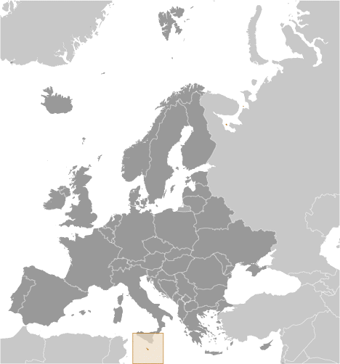
Malta
"slightly less than twice the size of Washington, DC"
© CIA World Fact Book

Slide 4
Test::Roo
Testing with Roles
Author: David Golden
First release: 25th February 2013
Latest release: 5th August 2014
Based on Moo
See also: Test::Routine (Moose)

Slide 5
What is a Role?
Encapsulates some piece of behavior or state that can be shared between classes
Something that classes do
Roles are not classes
Composed into a class
Notes:
- Behavoir: attributes, methods, method modifiers.
- We often say that roles are consumed, either by classes or other roles.

Slide 6
Why?
DRY
Test similar behaviours in different *.t
Fixtures
State initialisation
The tests themselves

Slide 7
Why Not?
Adds complexity
Extra dependencies (Moo++)
Most testing just doesn't need it

Slide 8
Demo - Camels and Spiders
Role::Animal
Camel
Spider

Slide 9
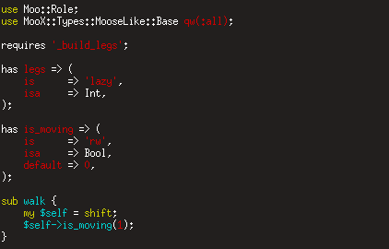
Role::Animal

Slide 10
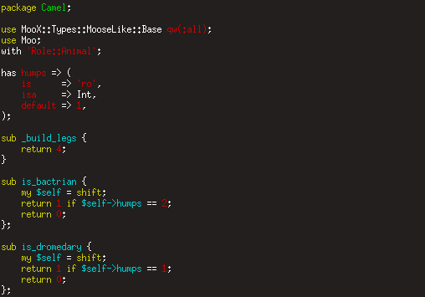
Camel

Slide 11
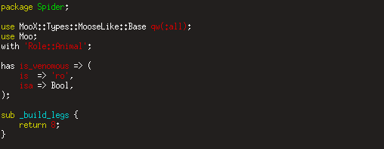
Spider

Slide 12
Demo

Slide 13
Questions?
Peter Mottram (SysPete) <peter@sysnix.com>

