Slide 1
A New Versioned Schema for DBIx::Class
Peter Mottram (SysPete) <peter@sysnix.com>
Perl Dancer Conference 2014

Slide 2
Who's this Pete guy?
Lived and worked in UK, NL and Malta
24 years UNIX & Linux systems
Nokia, Orange, BT, IBM
Linux, network security, Perl, e-commerce
Interchange6 development team member
whacks small balls with sticks & drink beer

Slide 3
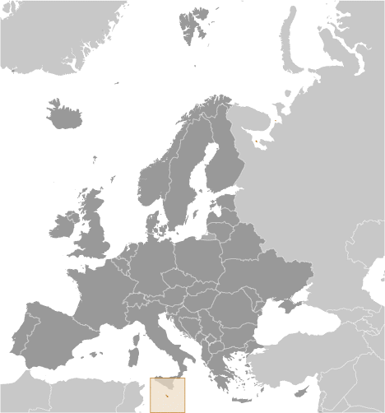
Malta
"slightly less than twice the size of Washington, DC"
© CIA World Fact Book

Slide 4
Why version the schema?
Deploy specific version
Upgrades
Downgrades
Validation
Notes:
- Deploy: easily deploy a specific schema version
- Upgrades: new tables, renamed columns, type changes, etc
- Downgrades: backout change
- Validation: does our schema match what we are expecting?

Slide 5
Existing Solutions
DBIx::Class::Schema::Versioned
DBIx::Class::DeploymentHandler
DBIx::Class::Migration
Notes:
Non-DBIC solutions exist but we're only interested in DBIC

Slide 6
DBIx::Class::Schema::Versioned
Part of DBIx::Class distro
Uses DDL diff files
One sql file per upgrade/db engine
No downgrades
No Perl scripts allowed
“Use DeploymentHandler instead”
Notes:
- 1 sql file per upgrade per database engine
- only sql so can't use power of Perl & DBIC
- 'use DH' - the response I received when I 1st mentioned it on IRC

Slide 7
DBIx::Class::DeploymentHandler
Not part of DBIx::Class distro
Much more powerful than ::Schema::Versioned
Downgrades in addition to upgrades
Multiple sql files files per upgrade/downgrade/install
Perl scripts allowed for upgrade/downgrade/install
Logging
Population
Large footprint (Moose!)
Notes:
- script can log fatal, error, warn, info, debug, trace set via ENV
- population at any version

Slide 8
DBIx::Class::Migration
Not part of DBIx::Class distro
Extends ::DeploymentHandler
Downgrades in addition to upgrades
Multiple sql files files per upgrade/downgrade/install
Perl scripts allowed for upgrade/downgrade/install
DBIx::Class::Fixtures
Testing (Test::DBIx::Class)
Standard workflows with supplied scripts
Extensive documentation
Larger footprint that DH
Possibly more rigid than DH
Notes:
- integrates with testing tools like Test::DBIx::Class
- Might be difficult to introduce into existing large & complex project

Slide 9
A new versioned schema for DBIx::Class
DBIx::Class::Schema::Versioned::Inline

Slide 10
Why?
I'm a Perl hacker - I don't want to mess with SQL
I want to see my version info within the schema definition
I don't want to have to carry around piles of schema diffs
Seemed like a good idea at the time

Slide 11
Features
Extends DBIx::Class::Schema::Versioned
Extensive use of SQL::Translator
Version information stored in schema definition
No DDL diff files
Perl scripts
One file stores all upgrade data changes
Candy
No downgrades (yet)
No validation (yet)

Slide 12
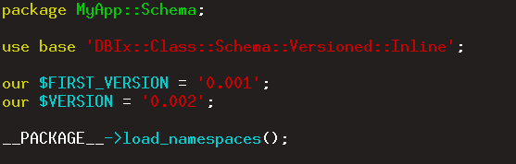
MyApp::Schema

Slide 13
Schema definition
versioned
since
until (till)
renamed_from
changes

Slide 14
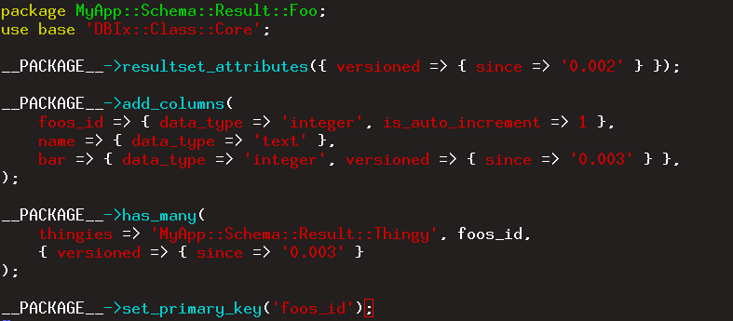
since
Specifies the first version at which a table, column or relationship exists

Slide 15
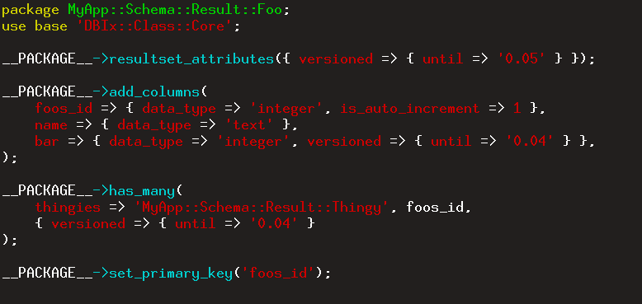
until
Specifies the first version at which a table, column or relationship no longer exists

Slide 16
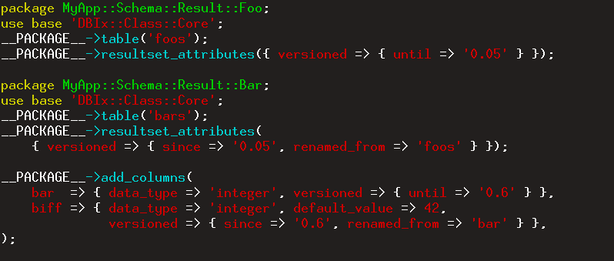
renamed_from
tables and columns only - NOT relationships

Slide 17
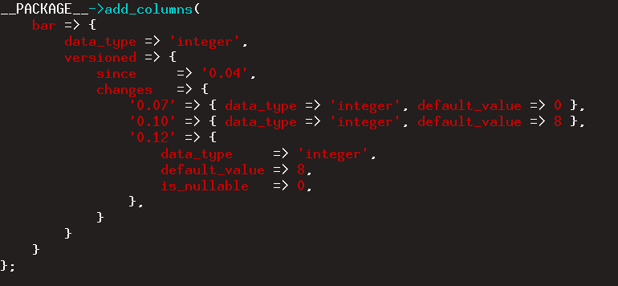
changes
columns only

Slide 18
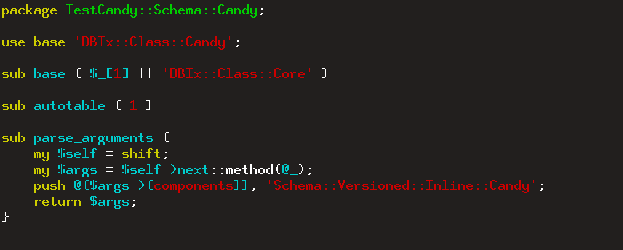
Candy
Mix in some DBIx::Class::Candy goodness with some ::Versioned::Inline::Candy

Slide 19
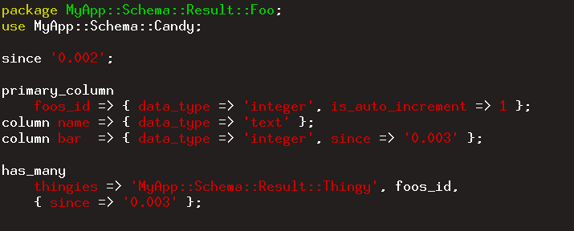
since with Candy

Slide 20
since

Slide 21
since with Candy

Slide 22
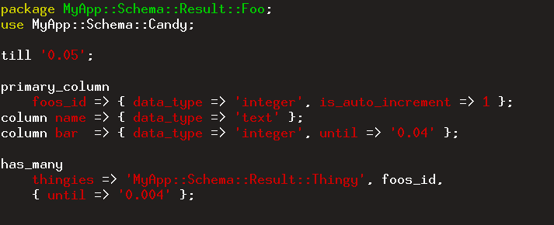
until with Candy
Note: until candy for class is named till
Notes:
Note: till instead of until for class.

Slide 23
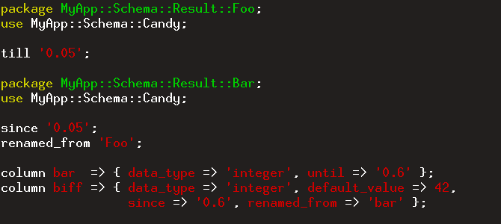
renamed_from with Candy

Slide 24
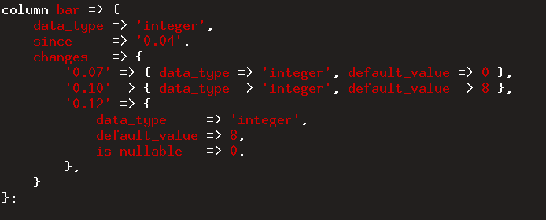
changes with Candy

Slide 25
Upgrades
DBIx::Class::Schema::Versioned::Inline::Upgrade
Exports:
before
after

Slide 26
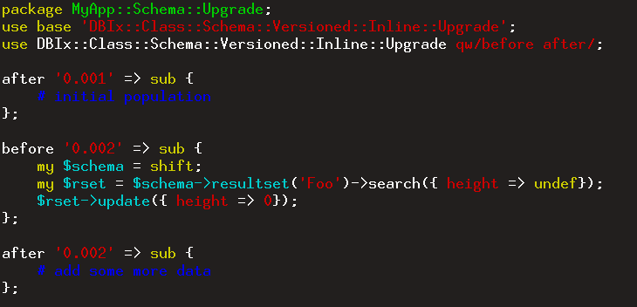
Upgrade

Slide 27
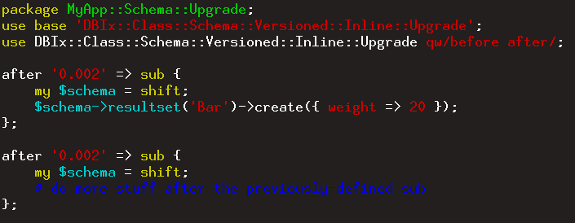
Upgrade
Multiple subroutines for one version

Slide 28
Questions?
Peter Mottram (SysPete) <peter@sysnix.com>

