Slide 1

Plack::Debugger meets Dancer2
Peter Mottram (SysPete) <peter@sysnix.com>
Perl Dancer Conference, Vienna, Austria
21st September 2016

Slide 2
About me
UK -> NL -> Malta
Interchange6 and Dancer2 core developer
> 25 years UNIX & Linux
Network security, Perl, e-commerce

Slide 3
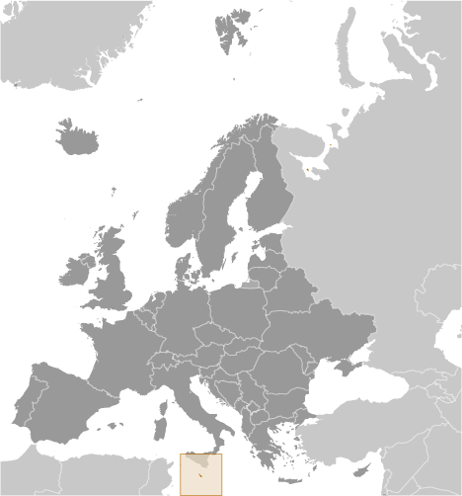
ⓒCIA World Fact Book

Slide 4
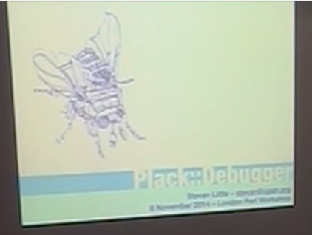
LPW 2014
Notes:
Where did this start?
London Perl Workshop 2014
a presentation by...

Slide 5

STEVAN
Notes:
Decided I needed to play with this toy.
Today.
...18 months later finally had an itch to scratch.
But first...

Slide 6
History of Debugging on the WWW
Notes:
A brief personal history
inspired by/stolen from Stevan's LPW talk

Slide 7
1994

Slide 8
Perl 5

Slide 9
#!/usr/local/bin/perl
print "Content-type: text/html\n\n";
print "<html>\n";
print "<body>\n";
print "<h1>HELLO WORLD!</h1>\n";
print "</body>\n";
print "</html>\n";

Slide 10
warn(“WTF is going on !!!!!! $x”);
Notes:
start of the art in debugging

Slide 11
1996

Slide 12
CGI.pm

Slide 13
#!/usr/local/bin/perl
use CGI qw(:all);
print
header,
start_html,
h1(“HELLO WORLD!”),
end_html;

Slide 14
warn(“WTF is going on !!!!!! $x”);
Notes:
start of the art in debugging

Slide 15
1999

Slide 16
HTML::Mason

Slide 17
<html>
<head>
<title><% $title %></title>
</head>
<body>
<h1><% $title %></h1>
% $m->call_next;
</body>
</html>

Slide 18
<%init>
my $title = “HELLO WORLD!”;
</%init>

Slide 19
warn(“WTF is going on !!!!!! $x”);
Notes:
start of the art in debugging

Slide 20
2002

Slide 21
HTML::Mason::Exceptions

Slide 22
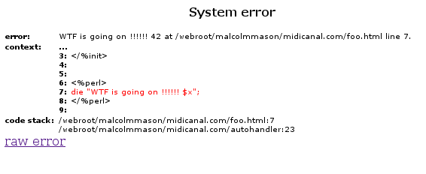

Slide 23
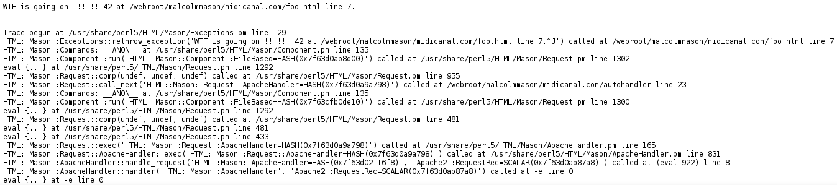

Slide 24
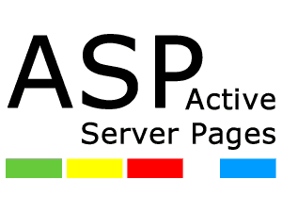
Notes:
Of course those working outside Perl had other toys.

Slide 25
Response.Write(“WTF is going on !!!!!!”);
Response.Write(x);
Notes:
State of the art in debugging

Slide 26
Response.Write(“<!--”);
Response.Write(“WTF is going on !!!!!!”);
Response.Write(x);
Response.Write(“-->”);

Slide 27
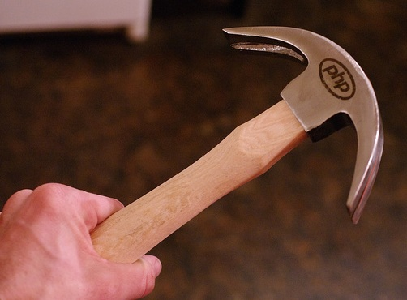

Slide 28
<?php
echo(“WTF is going on !!!!!!”);
echo($x);
?>

Slide 29
2005

Slide 30

Notes:
Ruby on Rails revolutionised web programming

Slide 31
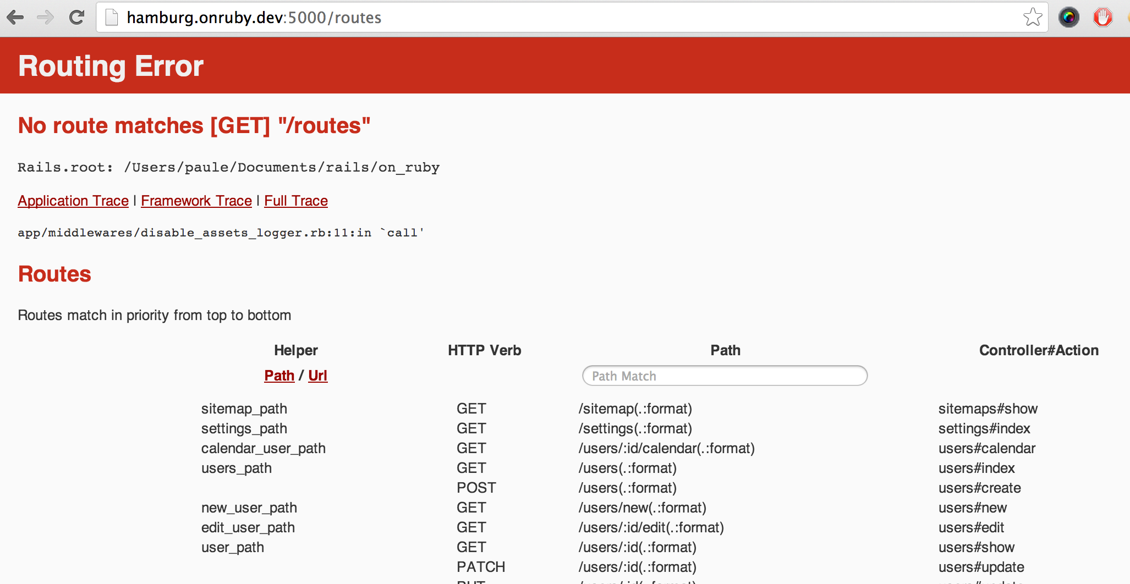
Notes:
Ruby on Rails revolutionised web programming

Slide 32
2006

Slide 33

Notes:
Someone came up with the great idea to mix up php and Javascript together in your browser.

Slide 34
2008

Slide 35
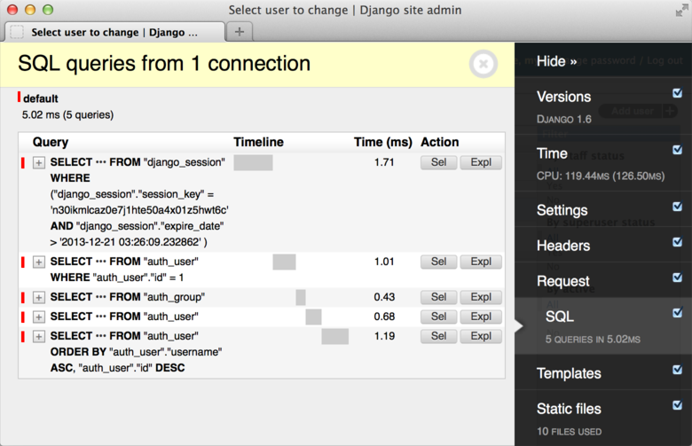
Notes:
Django Debug Toolbar
No error on this page - just information.

Slide 36
2009

Slide 37

Notes:
Miyagawa

Slide 38
PSGI
(Perl Server Gateway Interface)

Slide 39
PSGI Middleware

Slide 40
(later in) 2009

Slide 41
Plack::Middleware::Debug
Marcel Grünauer

Slide 42
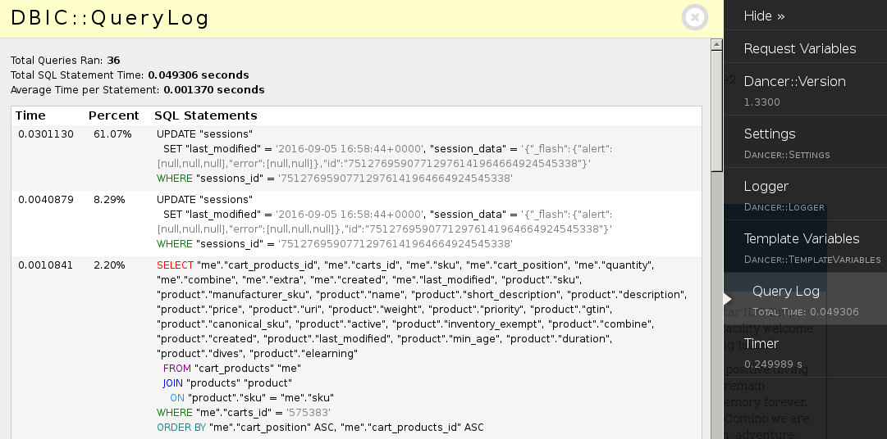

Slide 43
2014

Slide 44
STEVAN

Slide 45

Notes:
Joined booking.com

Slide 46
Plack::Middleware::Debug

Slide 47
AJAX
Plack::Middleware::Debug::AJAX

Slide 48
Plack::Middleware::Debug++

Slide 49
Plack::Debugger
Notes:
booking were using Plack::Middleware::Debug with local customisations and Stevan was looking at adding AJAX support.
tldr; way too complex so he decided to write Plack::Debugger

Slide 50
Goals
Most visibility
Least intrusion
Most flexibility
Useful for 600+ devs

Slide 51
Plack::Middleware::Debug
P::M::D::Panel
P::M::D::Panel
P::M::D::Panel
P::M::D::Panel
$app
Notes:
Review of Plack::Middleware::Debug design.
Each panel is a piece of middleware.
Each collects its data and injects html at the end of the response page. HTML can get really big.
Can screw up page layouts especially on phones and tablets.

Slide 52
Plack::Debugger
Debugger
Collector
Storage
HTTP API
[ Panel, … ]
Injector
Javascript UI
Notes:
Collector: during request collects data and passes it to the debugger. No other responsibilities. You don't even need the UI.
Injector just adds a single script tag into end of appropriate reqs. PMD also only collected for text/html requests since it added results to the page.

