Slide 1



KONGU ENGINEERING COLLEGE
PERUNDURAI ERODE-638060
DEPARTMENT OF COMPUTER APPLICATIONS
UNIT – 5
TITLE : Neural Style Transfer in Deep Learning

Slide 2
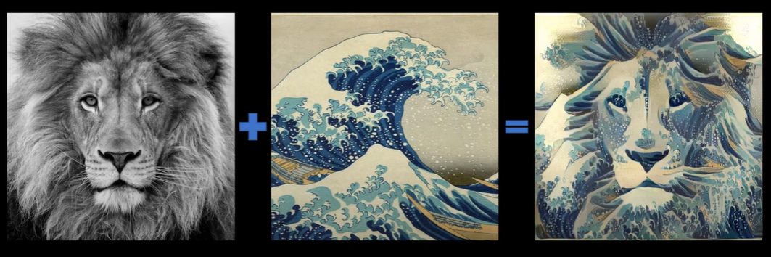
Introduction
Definition: Neural Style Transfer (NST) is a computer vision technique that combines the content of one image with the style of another using deep learning.
Origin: Proposed by Gatys et al. (2015).
Applications: Art generation, photo editing, AR/VR, creative industries.

Slide 3
Key Concept & Core Idea
Content Image: The base image whose structure we want to preserve.
Style Image: The artistic image whose style we want to apply.
Output Image: A blend of content + style.
Use a pre-trained CNN (VGG19) as a feature extractor.
Content Representation: Captured from higher layers (object structure).
Style Representation: Captured using Gram matrices of feature activations (texture, color, brush strokes).

Slide 4
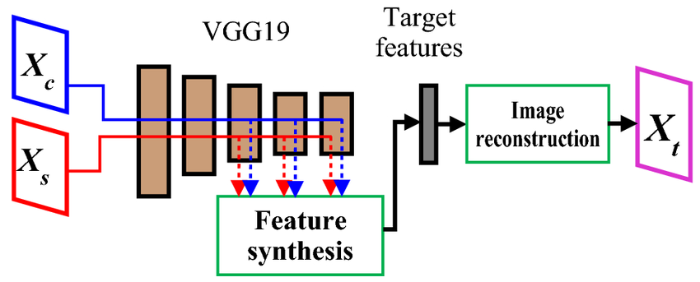

Slide 5
Loss Functions
Content Loss: MSE between content image and output features.
Style Loss: MSE between Gram matrices of style image and output.
Total Loss = Content Loss * α + Style Loss * β
α and β control the trade-off.

Slide 6
Optimization Process
Initialize output image (copy of content or random noise).
Forward pass through CNN.
Compute Content & Style Loss.
Backpropagate gradients.
Update output image pixels (not CNN weights).

Slide 7
Advantages & Challenges
Advantages:
Produces visually appealing results.
Leverages pre-trained networks.
Challenges:
Computationally expensive.
Slow for high-resolution images.
Trade-off between style & content balance.

Slide 8
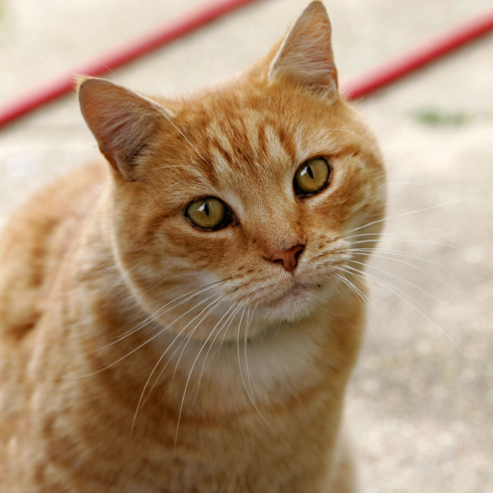
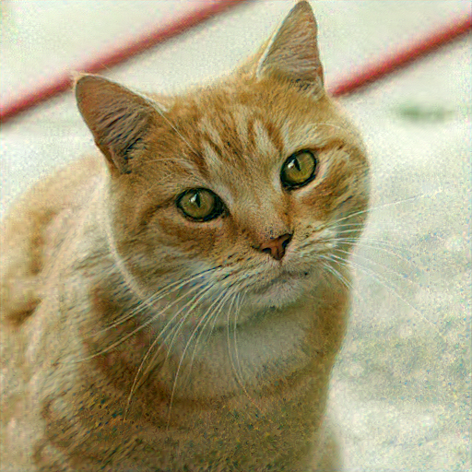
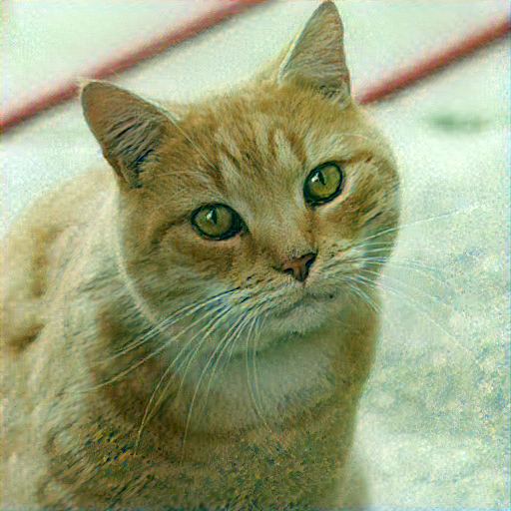
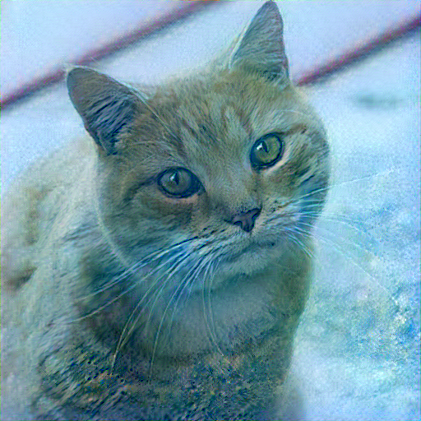
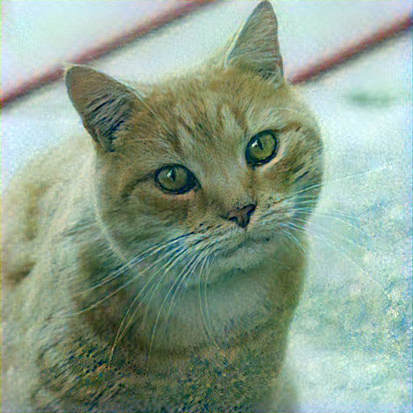
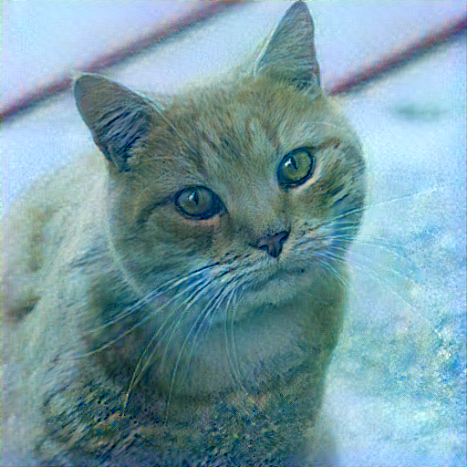


Slide 9
Conclusion
Neural Style Transfer blends art and AI.
Opens new possibilities in creativity & design.
Future: Faster, higher-quality, real-time NST.
https://shafeentejani.github.io/2017-01-03/fast-style-transfer/

Slide 10
THANK YOU

