Slide 1

HCI - Assignment n.2 Design and prototyping of an application using a human-centered approach Deliverable n. 1: Requirement Analysis
Carteira Virtual Urbanos do Porto
Gonçalo Abrantes 104152
Guilherme Antunes 103600
P5

Slide 2
Introduction Carteira Virtual Urbanos do Porto
Motivation:
Reducing dependence on the physical wallet as well as reducing the number of cards in it
Making the ticketing system accessible via mobile anywhere
Completely digitalize the ticket vending system
Personal Interests:
Not having to carry cards for everything
Being able to buy the tickets at home if you are not able to arrive on time to buy them before departure

Slide 3
Project Objectives Carteira Virtual Urbanos do Porto
High-level goals:
Show the timetable of the trains that make the desired route
Make travel statistics available
Replace physical cards with virtual wallet
Allow customers to buy tickets anywhere
Benefits:
Save time in queues
Take up less space with cards
Increases accessibility
Reduce resource consumption

Slide 4

Persona Carteira Virtual Urbanos do Porto
Name: Peter Griffin
Gender: Male
Age: 45
Profession: University professor
Background: Married and father of three, they live in Ovar
Main motivations: Likes to travel, takes the kids to school every day
Goals and needs: Fulfill family duties, enjoy traveling hassle free

Slide 5
Scenarios Carteira Virtual Urbanos do Porto
Peter is tired of carrying his wallet full of cards
He discovers the new virtual wallet for Porto's urban trains
Peter registers his usual card in the wallet associated with his new profile
Peter decides to take the family out for the weekend
He needs to buy a new card for his wife with 2 trips to his destination
He buys a new card automatically associated with his profile through the application
He buys two trips and associates them with the card he just purchased
Peter arrives at the station with his family to catch the next train
He sees in the app when the next train to their destination is
The train arrives on time and Peter validates the tickets for the whole family with the NFC of his cell phone one by one

Slide 6
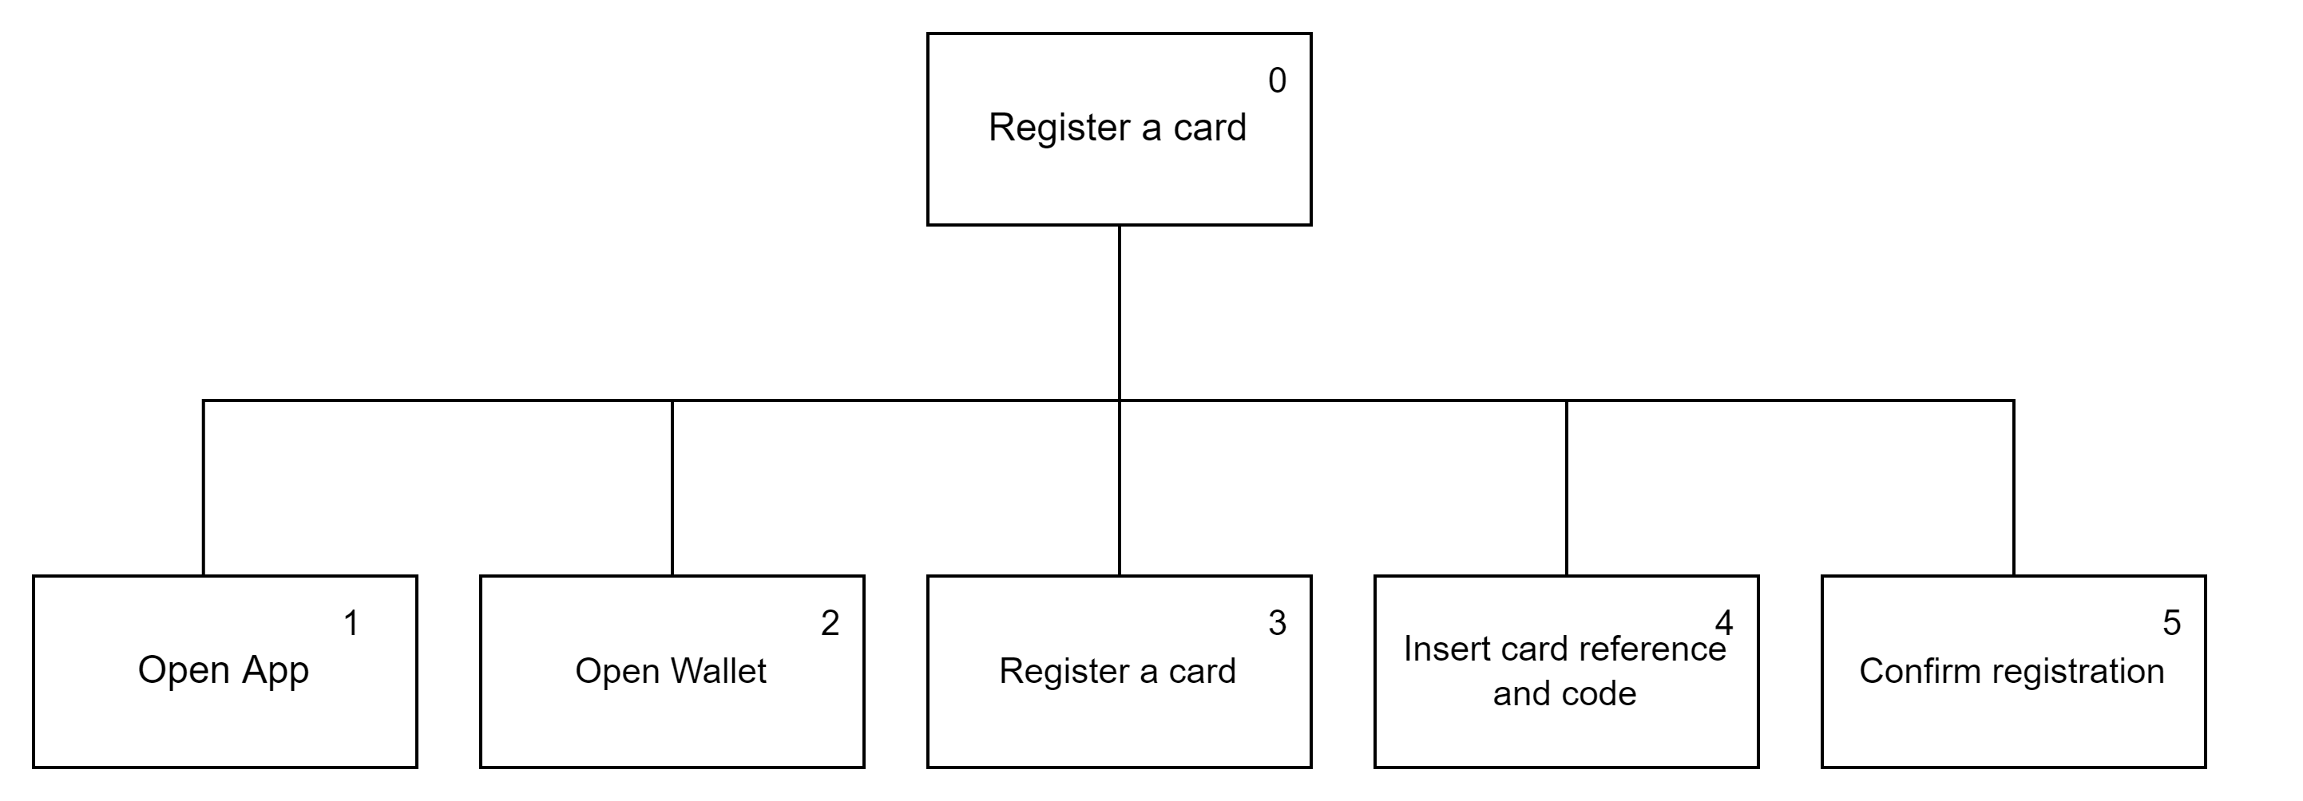

Tasks Carteira Virtual Urbanos do Porto
Plan 0: 1-2-3-4-5
Plan 0: 1-5-6-7-8-9
If there are no cards in your wallet: 1-2-3-4-5-6-7-8-9

Slide 7

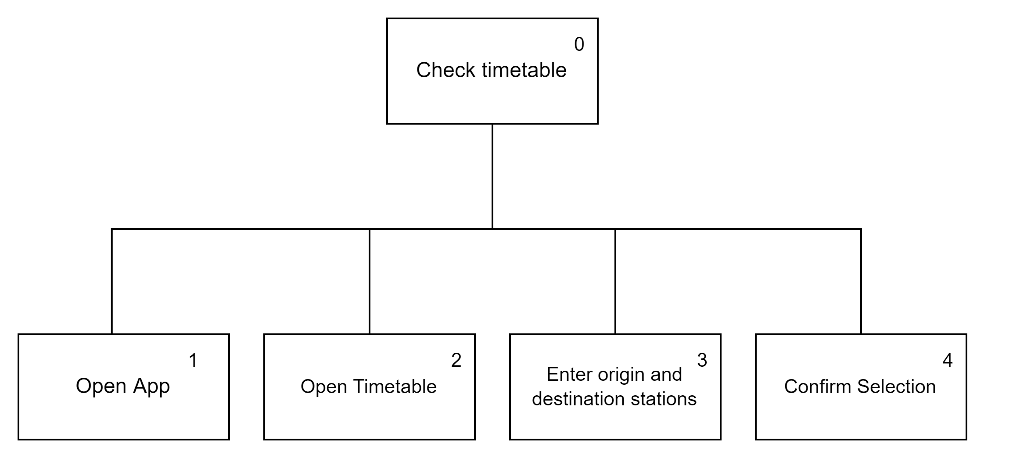
Tasks Carteira Virtual Urbanos do Porto
Plan 0: 1-2-3-4-5
Plan 0: 1-2-3-4

Slide 8
Requirements Carteira Virtual Urbanos do Porto
Functional Requirements
have multiple cards and each card hold only one trip
create multiple cards
register an existing physical card
buy tickets through digital payment methods
validate tickets by nfc
Non-functional Requirements
available anytime
easy to learn and use
store data
data security

Slide 9
Next Steps Carteira Virtual Urbanos do Porto
What type of prototype are you considering? (Paper or digital prototype?)
How will you test it?

