Slide 1
Chapter 15: Message Transactions
Computer Networks: A Systems Approach

Slide 2
Overview
TCP’s reliable byte-stream abstraction is not the only option for process-to-process communication. Message transactions—involving a request/response message exchange between a pair of processes—is another. This chapter looks at two examples: Remote Procedure Call (RPC) and Remote Dynamic Memory Access (RDMA).

Slide 3
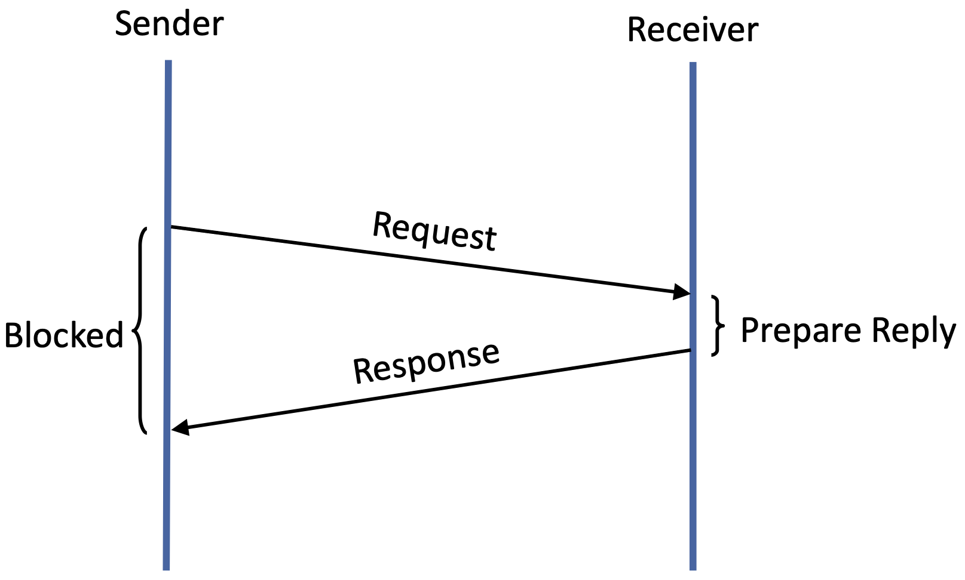
Request/Response Transaction
Common usage pattern
  Sender transmits request message and blocks waiting for a reply
  Receiver responds with a reply message, which unblocks the sender
Variants for multi-threaded workloads
  Reply simply acknowledges receipt
  Multiple request/response pairs in parallel
  Asynchronous send
Extends local abstractions over the network
  Remote Procedure Call (RPC)
  Remote DMA (RDMA)
Could build on TCP, but it’s a poor match
  excessive connection setup overhead

Slide 4
Design Issues
Identity
  Target ID: Procedure Identifier (RPC) or Memory Address (RDMA)
  Transaction ID: pairs the reply with the corresponding request
Reliability Semantics
  At-most-once
  At-least-once (assumes idempotency)
Message Size
  Either cap message size or fragment and reassemble (like TCP)
Concurrency
  Blocking calls vs Asynchronous signals
  Support for multiple outstanding request/response pairs (like HTTP/2)
Data Format
  Payload is a serialized data structure (or not)

Slide 5
Remote Procedure Call

Slide 6
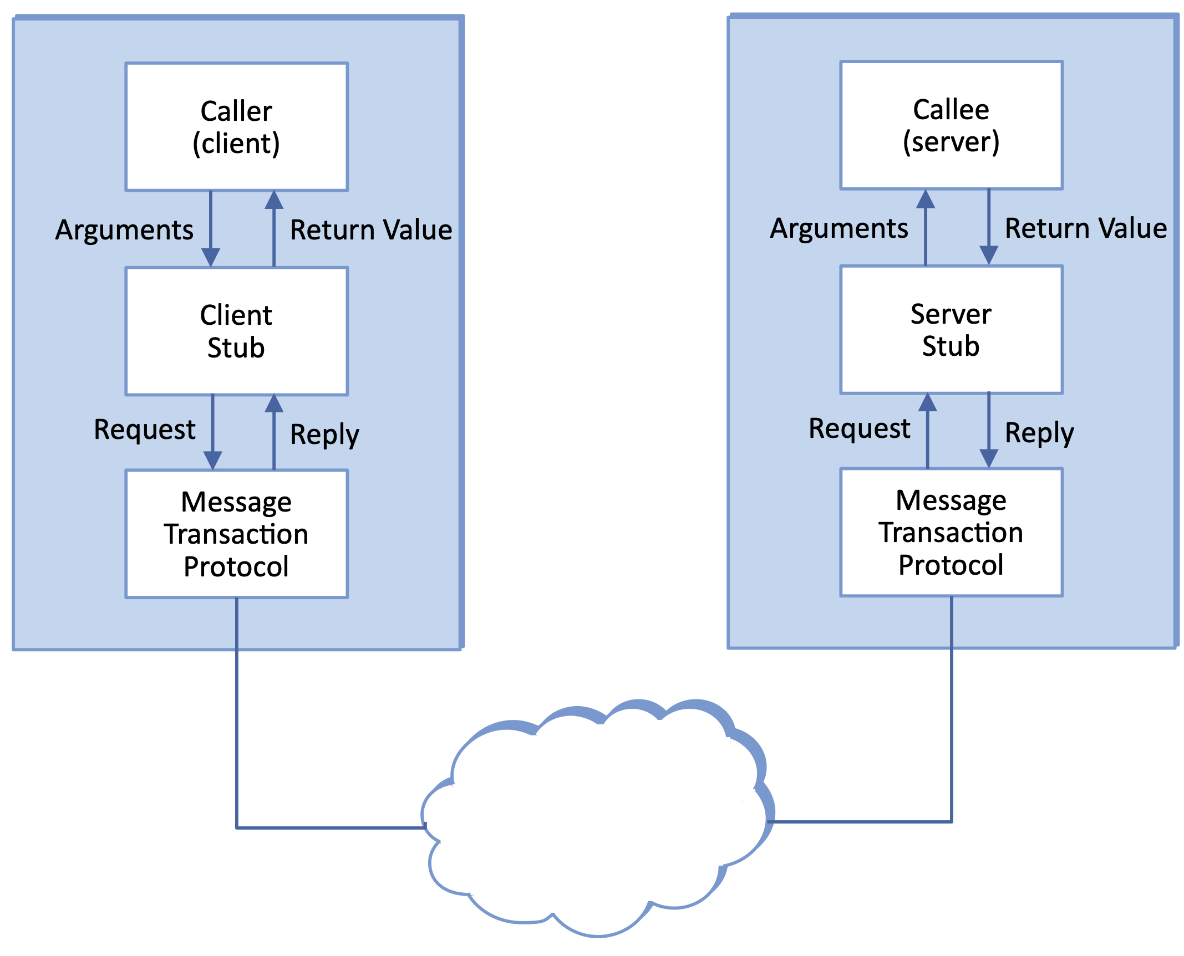
Overview
Two Components
  Message transaction protocol
  Stub compiler
Old idea whose time has come
  Birrell & Nelson built RPC at PARC in 1984
  Sun built SunRPC to support NFS
  Google built gRPC for datacenter workloads
  Today QUIC is quickly gaining ground on TCP

Slide 7
RPC vs. REST
Both sit on a message transaction protocol (HTTP, gRPC, QUIC)
REST: just 4 operations (GET/POST/PUT/DELETE) on resources
RPC: arbitrarily many named procedures (e.g., SendEmail())
Duals of each other—a matter of API taste, not capability

Slide 8
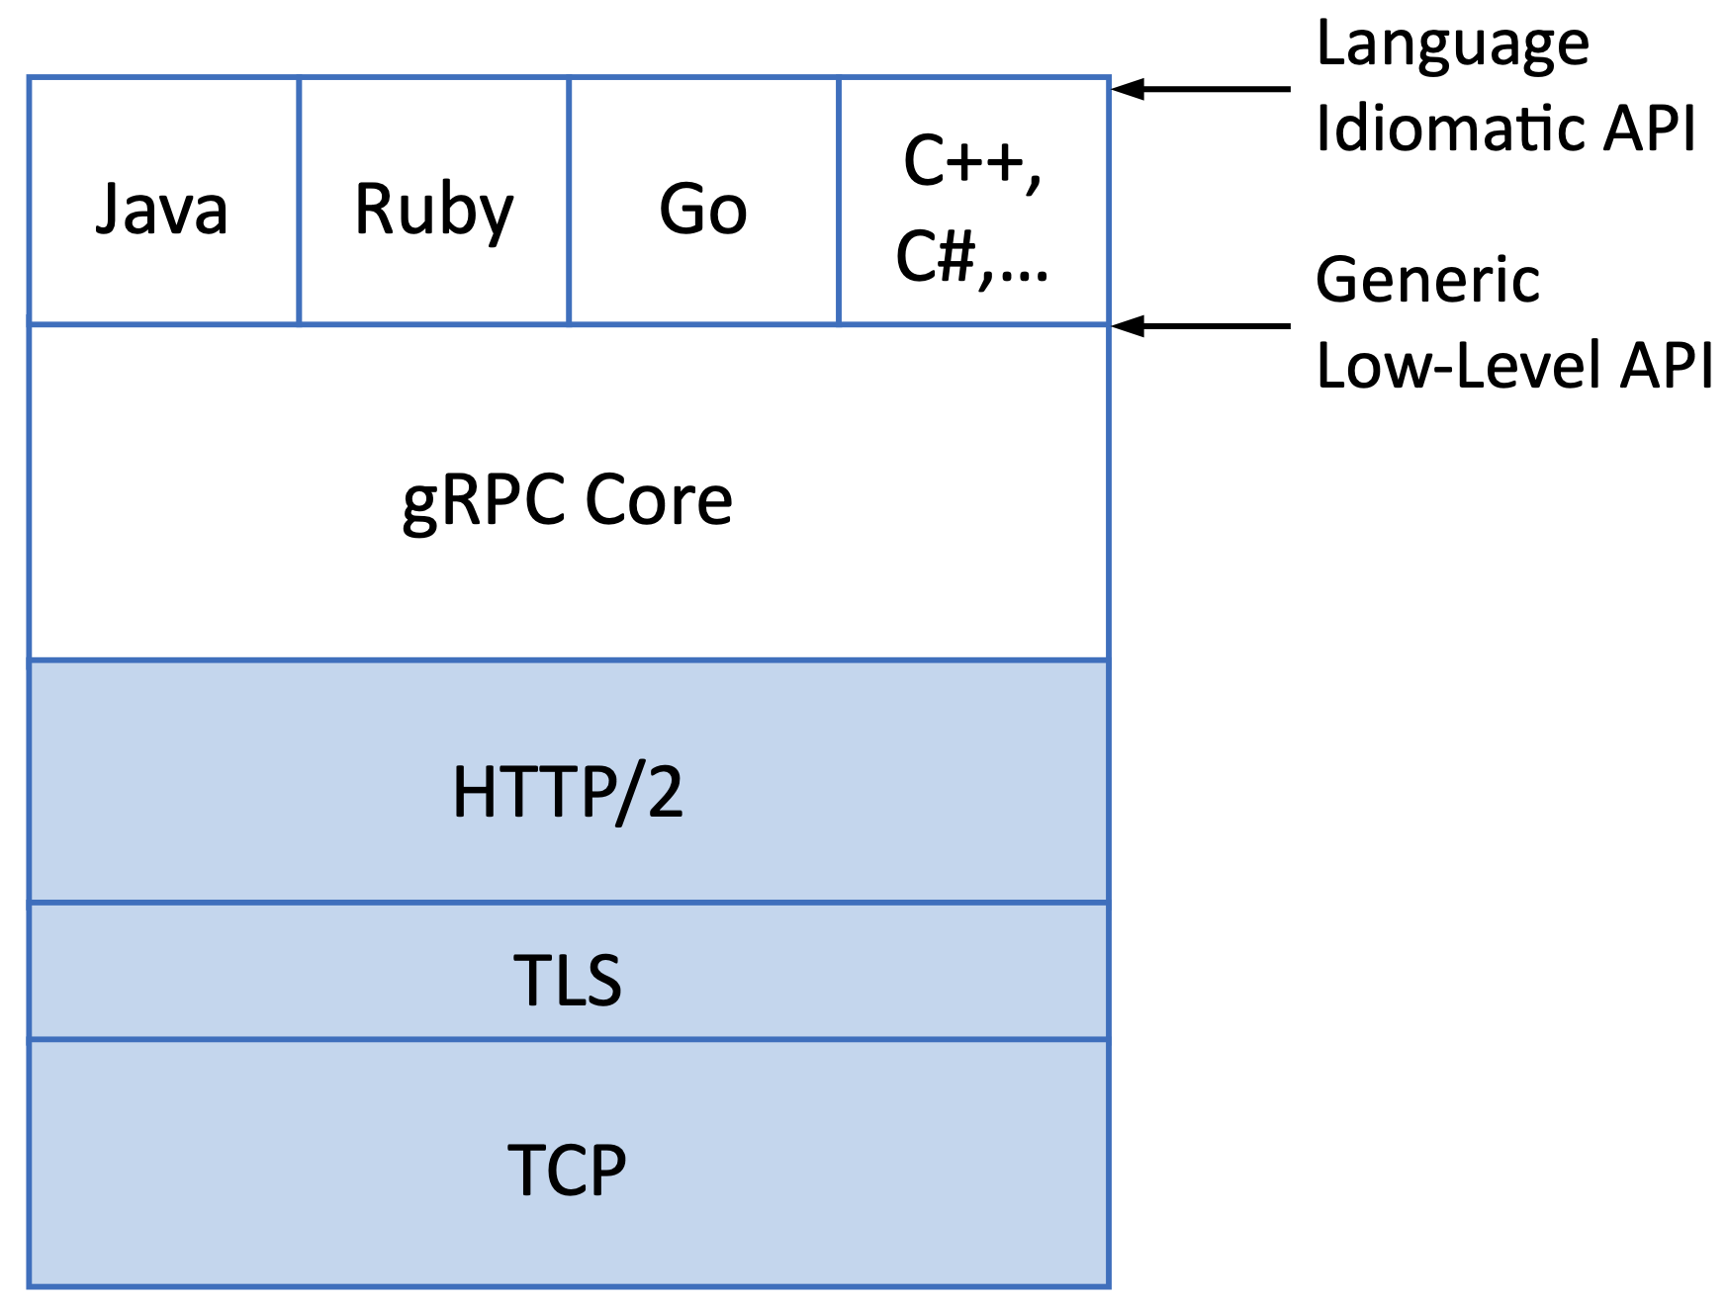
gRPC Stack
Designed for cloud services
  Netflix, Uber,…
Outsources many problems
  Request/Response pairing (HTTP/2)
  Secure communication (TLS)
  Reliable message delivery (TCP)
Method identified as a URI
  Parameters & return value in the HTTP body
Four streaming patterns
  Simple: one request / one reply
  Server streaming: one request / many replies
  Client streaming: many requests / one reply
  Bidirectional: independent streams in either direction

Slide 9
gRPC Over HTTP/2
HEADERS (flags = END_HEADERS)
:method = POST
:path = /google.pubsub.v2.PublisherService/CreateTopic
content-type = application/grpc+proto
DATA (flags = END_STREAM)
<Length-Prefixed Message>
HEADERS (flags = END_HEADERS)
:status = 200
content-type = application/grpc+proto
DATA
<Length-Prefixed Message>
HEADERS (flags = END_STREAM)
grpc-status = 0
Colon-prefixed fields: standard HTTP; others: gRPC-specific
content-type: application/grpc+proto -> parsed via Protocol Buffers

Slide 10
Optimizing RPC

Slide 11
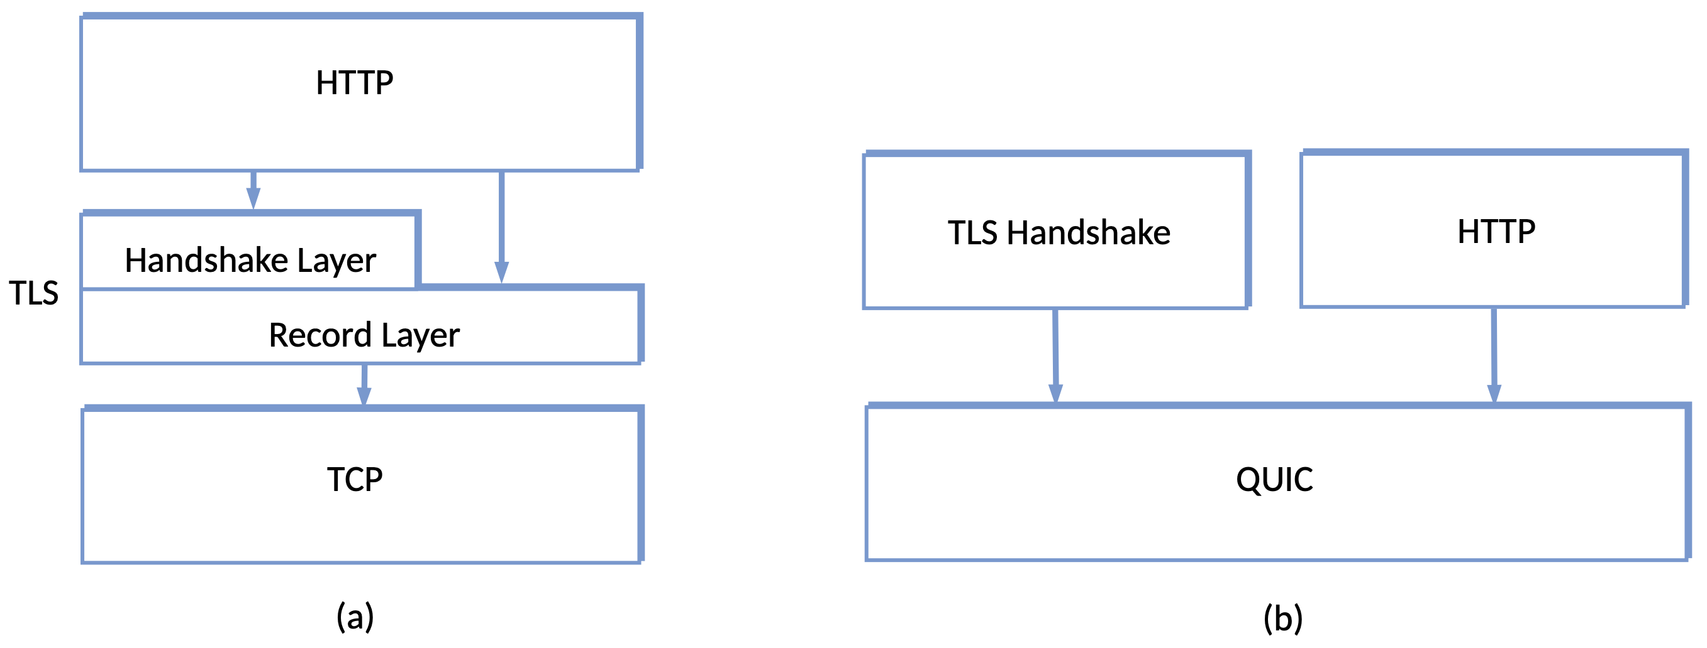
Overview
gRPC made a tradeoff
  Convenience of RPC at the expense of known performance limits
  TCP + TLS handshakes can cost 3 RTTs before the first byte
QUIC addresses performance by rethinking layering
  Folds TLS handshake into the transport

Slide 12
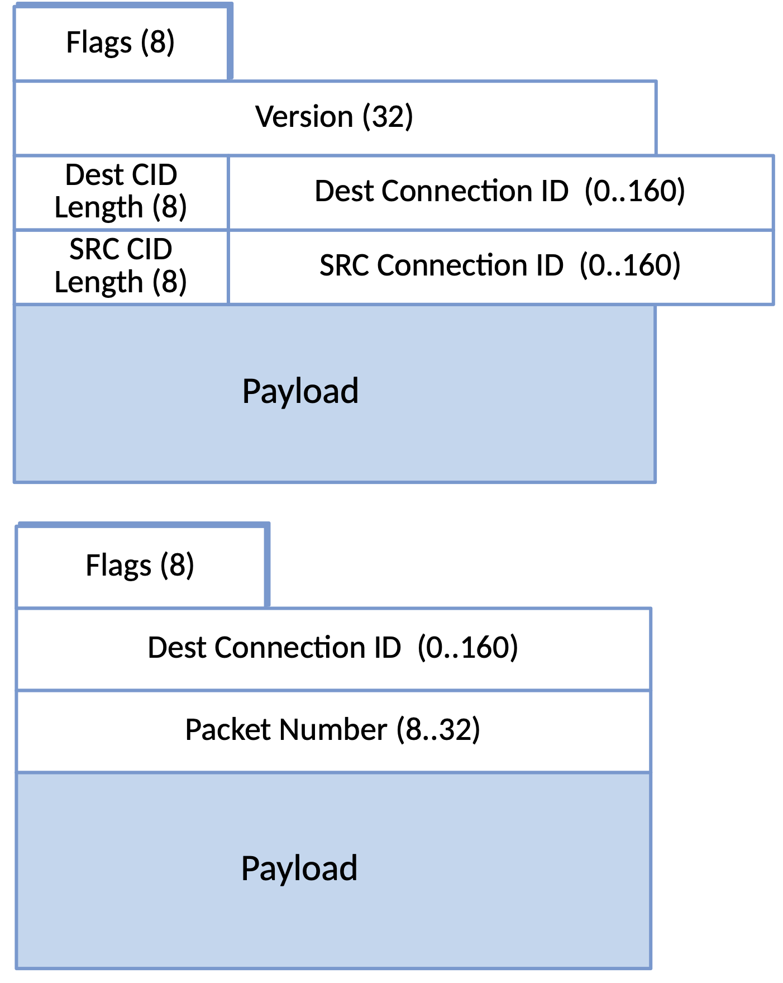
QUIC Packet Headers
Connection ID fully identifies the connection
  Like a port, but not tied to IP addr
  Simplifies connection migration
Packet numbers increase monotonically
  Unlikely to reuse (up to 2⁶² – 1)
  Optimized to transmit just necessary bits
Payload carries one or more QUIC frames
  20 different types (e.g., PING, ACK, STREAM)
  Frames may be part of different streams

Slide 13
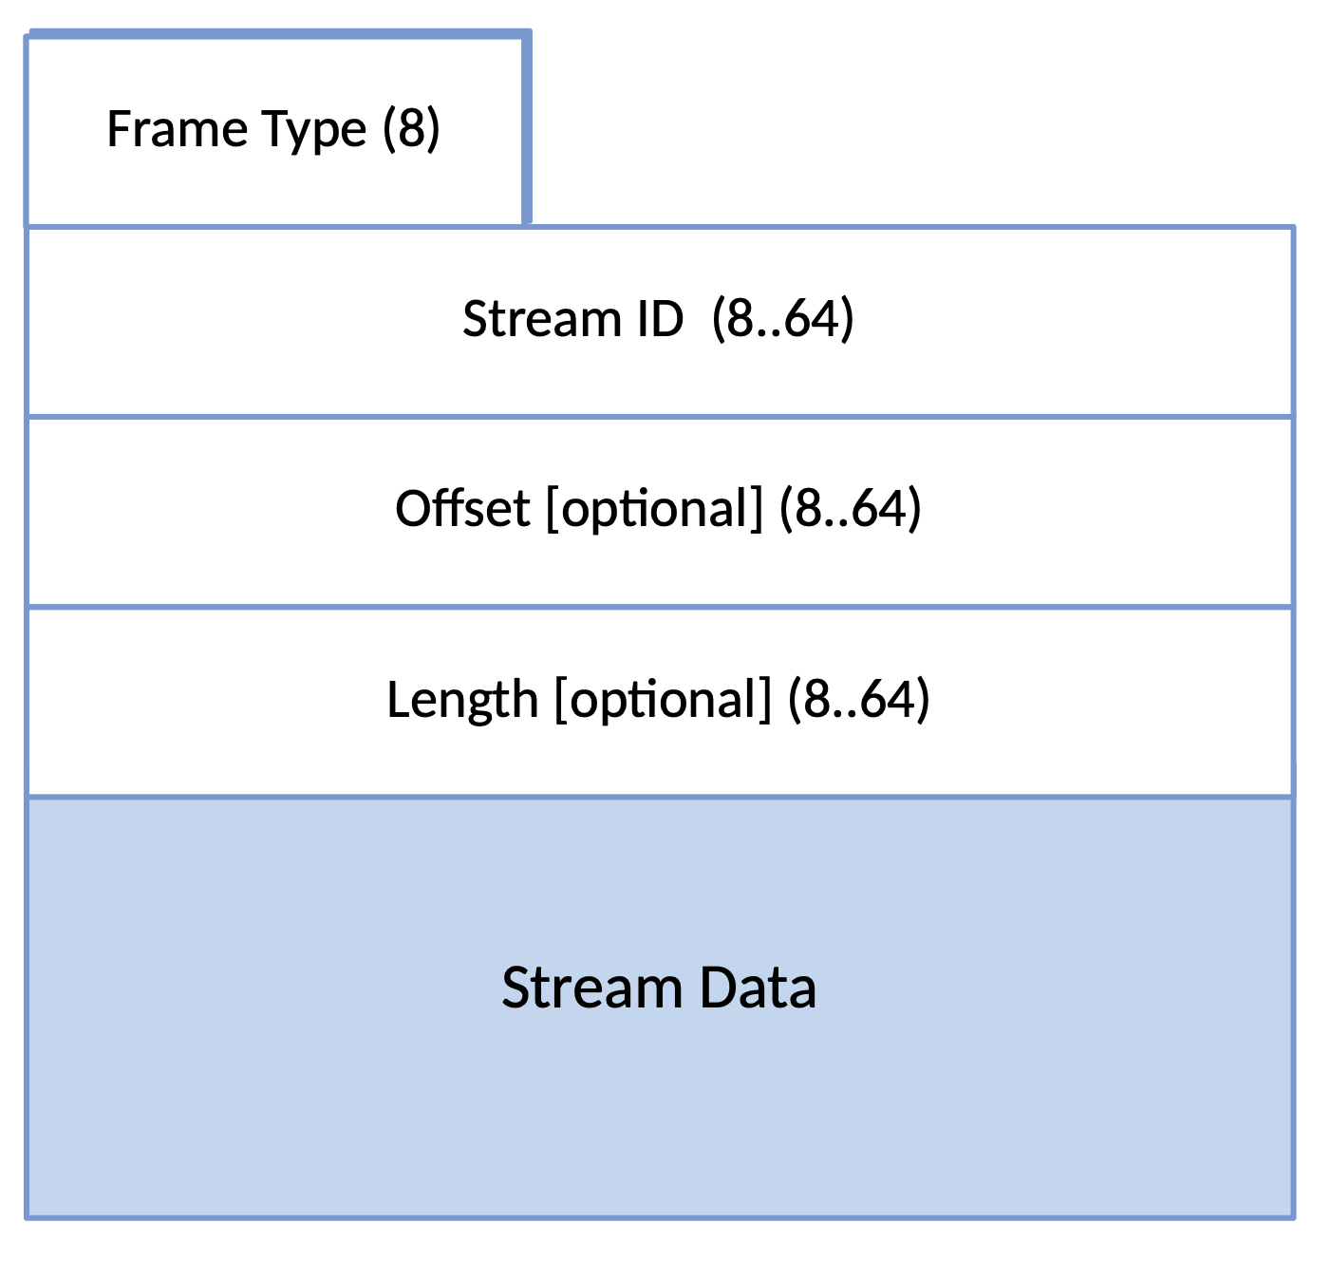
STREAM Frames
Connection multiplexes streams
  Each stream has a unique ID
  Streams have minimal overhead
  e.g., stream per request/response pair
Type field spells out formatting
  High-order 5 bits: 00001 = STREAM
  Low-order 3 bits indicate whether…
    Offset is present (not => 1st frame)
    Length is present (not => last frame)

Slide 14
Variable-Length Integers
Top 2 bits encode the length
  Rest carries the value
Small fields efficient
  But leaving room to grow
2MSB | Length | Usable Bits | Range
00 | 1 byte | 6 | 0-63
01 | 2 bytes | 14 | 0 to 2^14-1
10 | 4 bytes | 30 | 0 to 2^30-1
11 | 8 bytes | 62 | 0 to 2^62-1

Slide 15
Loss Detection
QUIC never reuses packet numbers
  Retransmissions are unambiguous
  Simplifies process of estimating RTT
ACK Frame
  Reports ranges (similar to SACK in TCP)
  Explicitly indicates "ACK Delay” (impacts RTT estimate)
  Treat 3+ ACKed packets ahead of an unacked packet as a loss
When packet loss is detected…
  Triggers Congestion Control (behavior is similar to TCP NewReno)
  Retransmit all unacked data

Slide 16
Loss Timeout Calculation
max(kTimeThreshold max(smoothed_rtt, latest_rtt), kGranularity)
kGranularity is the local timer granularity (1ms recommended)
  Sets lower bound
kTimeThreshold is an empirically determined constant (9/8 recommended)
  Means sender waits slightly more than the estimated RTT before declaring a packet lost
max(smoothed_rtt, latest_rtt)
  Means a sudden drop in RTT measurement will be ignored
  Means a sudden rise in RTT causes sender to wait longer before declaring a packet loss

Slide 17
Probe Timeout Calculation
smoothed_rtt + max(4 x rttvar, kGranularity) + max_ack_delay
rttvar is the variance in observed RTT
max_ack_delay is maximum time receiver might delay an ACK
Send a “Probe” to receiver
  New Data, Retransmission, or PING
  Purpose is to restart ACKs

Slide 18
Connection Migration
Connection ID identifies the connection
  In contrast to TCP, which uses IP address as part of the “connection key”
Makes it possible to migrate from one network to another
  Example: 5G to Wi-Fi
Problem: there are spoofing and amplification risks
Solution: QUIC requires “path validation” upon migration
  Client simply starts using new IP address with existing Connection ID
  Server sends a PATH_CHALLENGE frame to client
  Includes random data (which is always encrypted in QUIC)
  Expects client to respond with that random data before trusting it

Slide 19
Remote DMA

Slide 20
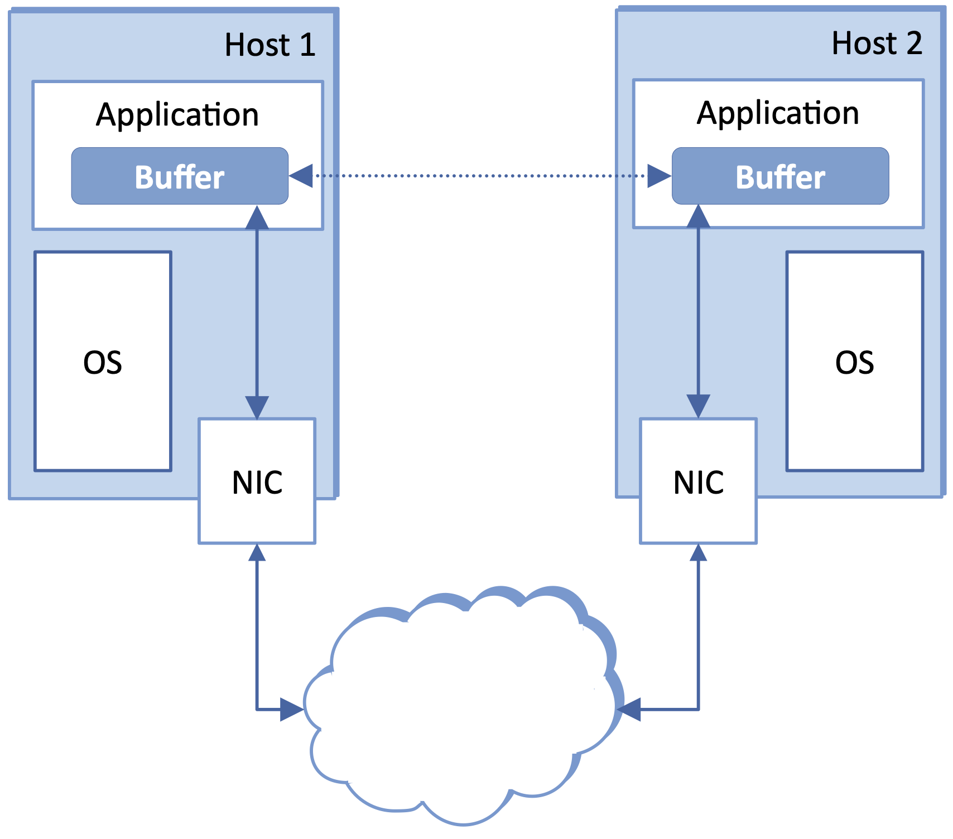
Overview
Extends DMA over the network
  Read/Write a remote process's memory
Roots in High-Performance Computing
  Originally ran on supercomputers with purpose-built interconnects
  Today runs on commodity servers connected by a datacenter fabric
InfiniBandTM is the canonical technology
  Avoids TCP complexity
  Avoids OS overheads
  Avoids Ethernet switch congestion

Slide 21
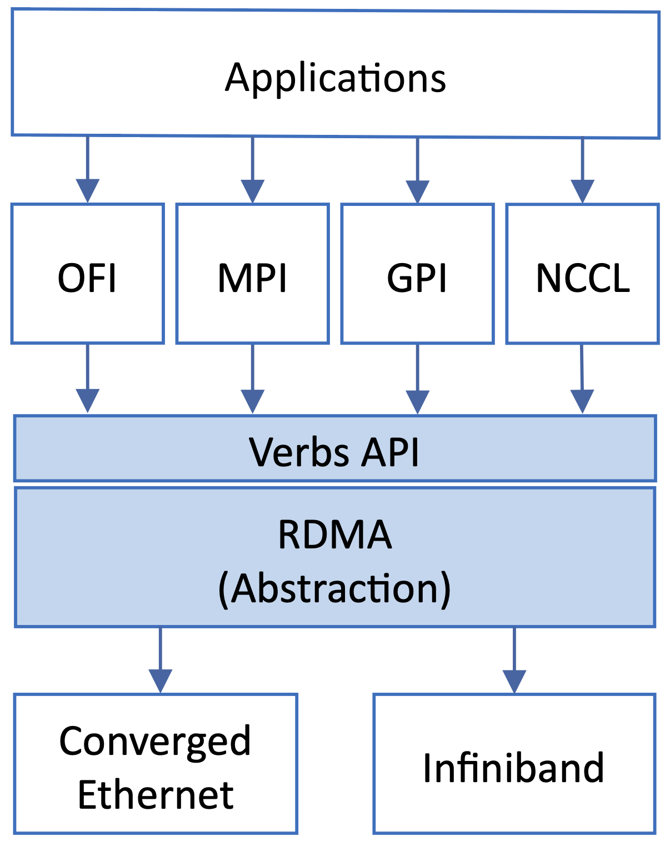
Verbs API
De facto standard, low-level RDMA interface
Higher-level libraries sit on top
  e.g., MPI, GPI, OFI, NCCL
  e.g., Scatter / Shuffle / Gather behavior
Converged Ethernet aims to decouple Verbs from InfiniBand

Slide 22
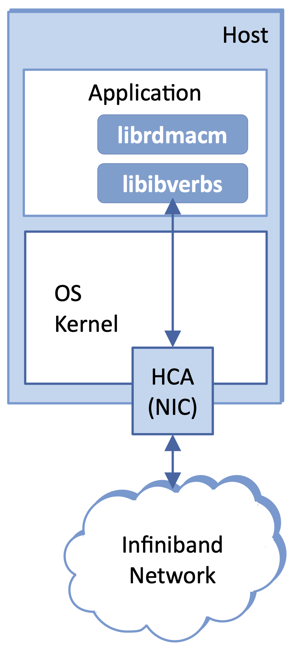
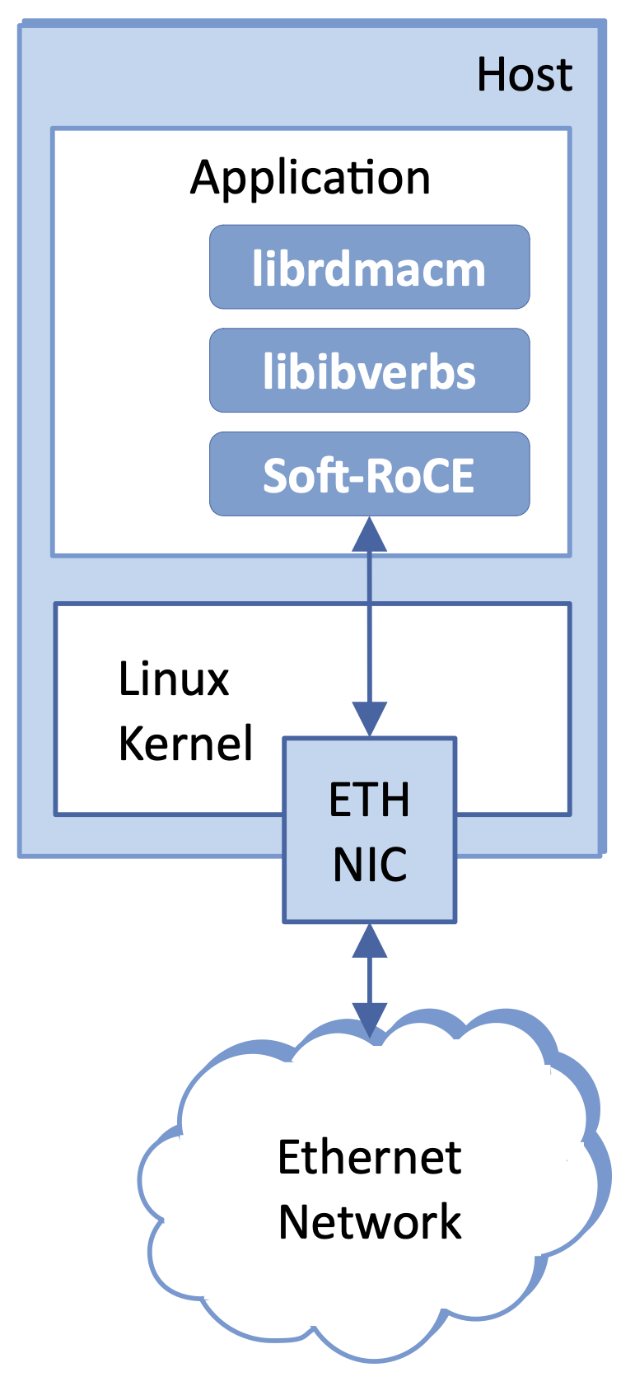
RDMA Software Stack
libibverbs
  Device-like interface
  Talks directly to the NIC
  Bypasses the OS
librdmacm
  Connection management wrapper
  Significant complexity / overhead
HCA: Host Channel Adaptor
  Implements “transport protocol”
  Soft-RoCE is a software option

Slide 23
Connection Setup
Queue Pair (QP): local handle for the endpoint, like a socket
Completion Queue: notified when a send or receive finishes
Register memory buffers that peers are allowed to access
One-time setup cost — fine for a long-running job, not a browser
One-Sided Operations
  Read: copy a remote block into a local buffer, no notice to the remote host
  Write / Write-with-Immediate: write remote memory, optional notification
  Fetch-and-Add / Compare-and-Swap: atomic operations for synchronization

Slide 24
RDMA Write Example
// Register buf with the NIC, then post the write in four steps
char buf[] = "Hello World";
struct ibv_mr *mr = ibv_reg_mr(pd, buf, sizeof(buf), 0);
ibv_wr_start(qpx);
ibv_wr_set_flags(qpx, IBV_SEND_SIGNALED); // Optional Request notification
ibv_wr_rdma_write(qpx, remote_rkey, remote_addr);
ibv_wr_set_sge(qpx, mr->lkey, (uintptr_t)buf, sizeof(buf));
ibv_wr_complete(qpx); // NIC has accepted it for sending
// Threads typically spin-poll rather than block
struct ibv_wc wc;
int n;
do {
n = ibv_poll_cq(cq, 1, &wc);
} while (n == 0);

Slide 25
Protocol Details (HCA)
Sliding window with a 24-bit sequence number
  Numbers are per-packet (rather than per-byte)
  Packets carry both complete messages and message fragments
24-bit QP field identifies the local endpoint
  Like a socket
  Used to locate local QP data structure
RDMA Extension Header
  64-bit memory address
  32-bit remote key
  32-bit message length (role in reassembly)

Slide 26
Optimizing Ethernet for RDMA

Slide 27
InfiniBand Network
Traffic assigned to one of 16 “virtual lanes”
Each virtual lane is assigned a priority
  Switches associate a priority queue with each lane
Per-hop flow control on each priority queue
  Per-hop implies host-to-switch, switch-to-switch, and switch-to-host
  In contrast to TCP, where “advertised window” is end-to-end
Limitations
  Scales to modest sized datacenters
  Proprietary solution (with associated cost)

Slide 28
RoCE: RDMA over Converged Ethernet
RoCE v1: InfiniBand packets in raw Ethernet frames
  Implies L2 connectivity
RoCE v2: InfiniBand packets in UDP/IP
  Routable across a datacenter fabric
Only InfiniBand transport header and payload neare encapsulated

Slide 29
Emulating InfiniBand Congestion Control
Priority Flow Control (802.1Qbb)
  Replicates per-hop flow control
  Fall-back only; not the primary mechanism
ECN
  Reuses the congestion signal already used for TCP
  Except there is no TCP to respond for RDMA traffic
DCQCN: Datacenter Quantized Congestion Control
  Applies TPC’s Additive-Increase/Multiplicative-Decrease (AIMD)
  Receiver replies with CNP (Congestion Notice Packet)
    In place of TCP's ECE/CWR
  Receiver throttles feedback
    One CNP (recommended) every 50 microseconds
    Explains why “Quantize” is in its name

Slide 30
Argument Marshalling

Slide 31
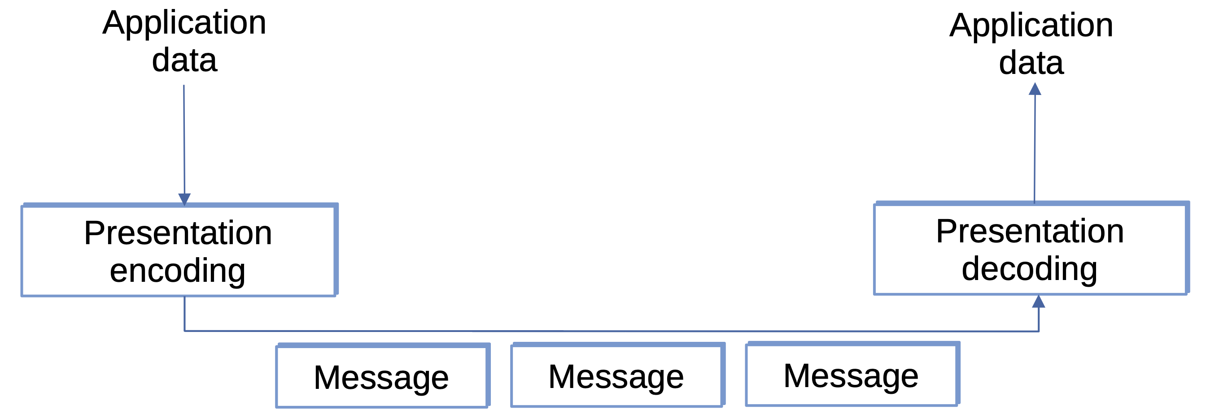
Overview
Marshalling (serialization): converting data to and from wire format
Central to RPC (varied clients/servers)
  Largely skipped by RDMA
  RDMA assumes one team, one architecture, one compiler

Slide 32
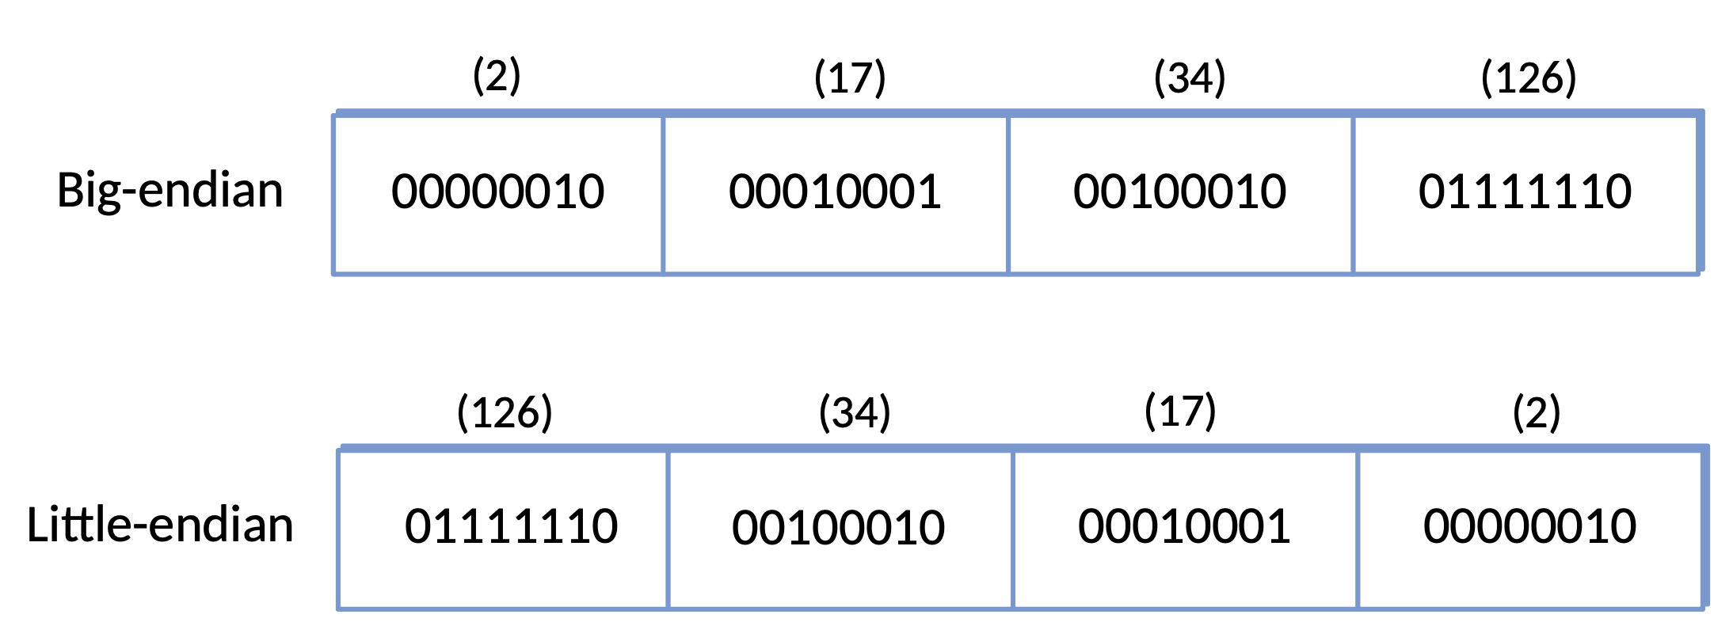
Byte Order
Machines disagree on integer size and byte order
  16 vs 3 vs 64 bits long
  Big-endian vs Little-endian (e.g., 34,677,374)
Risky to assume your peer uses the same conventions

Slide 33
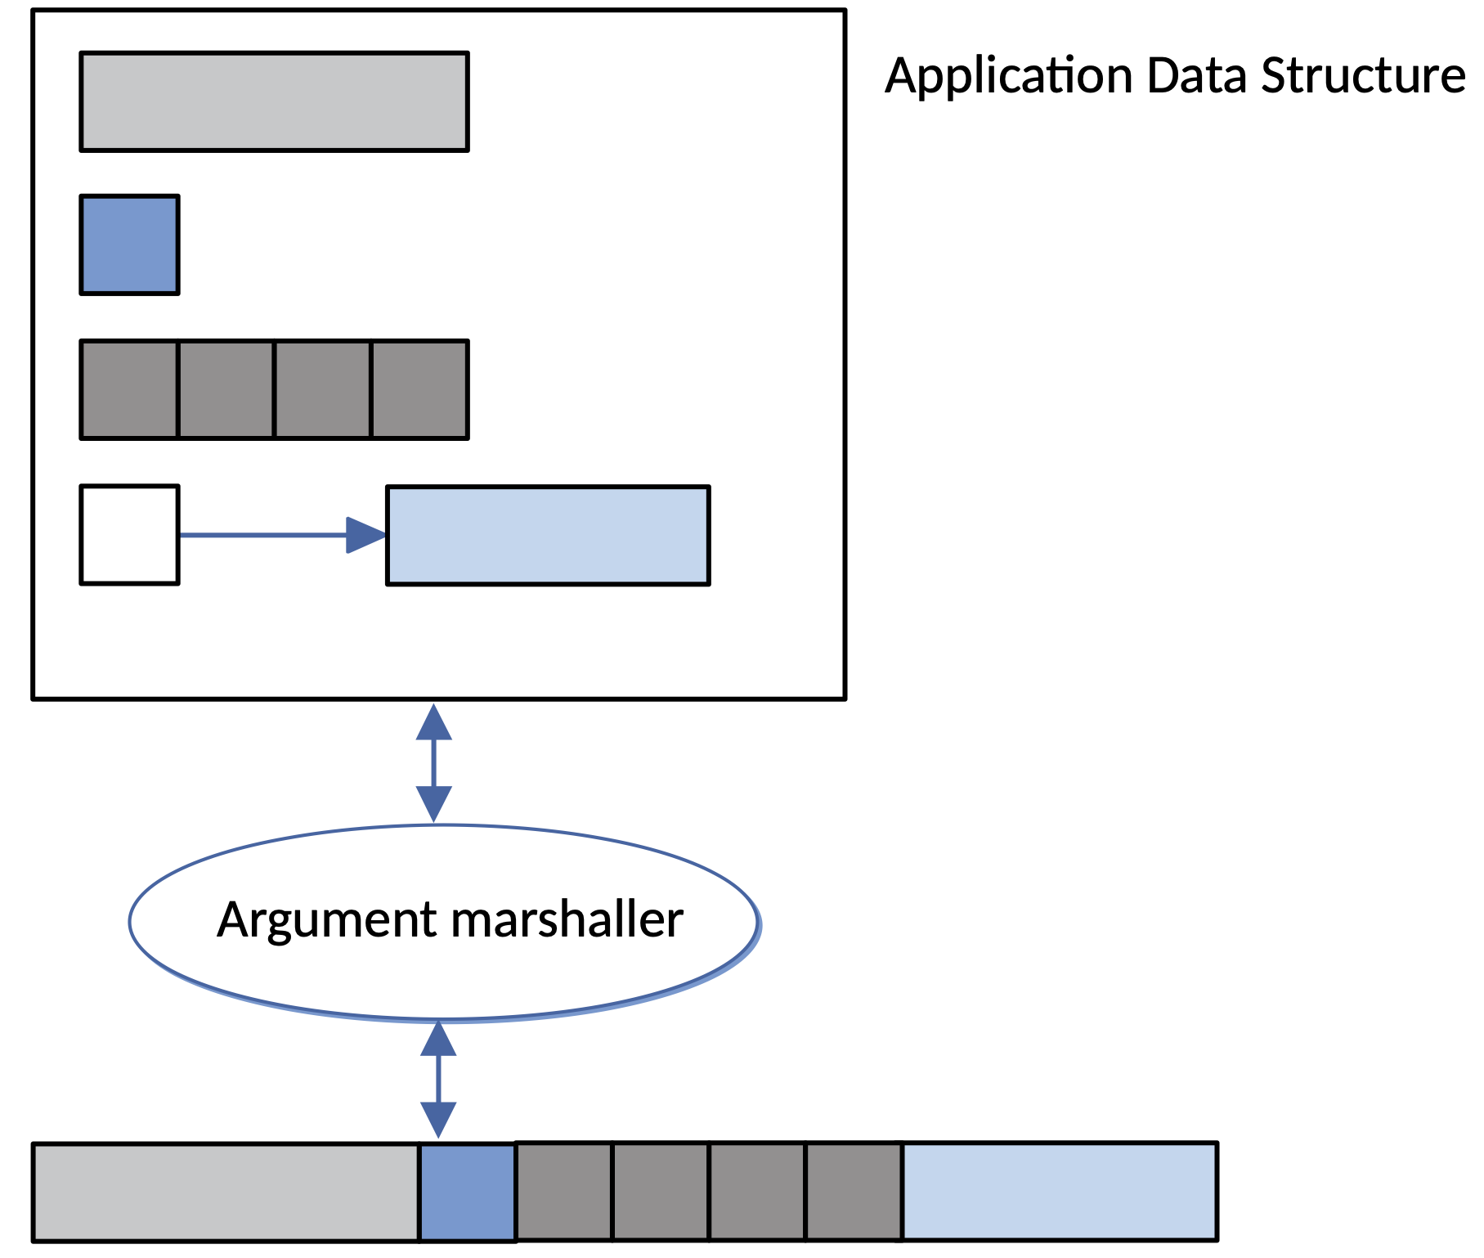
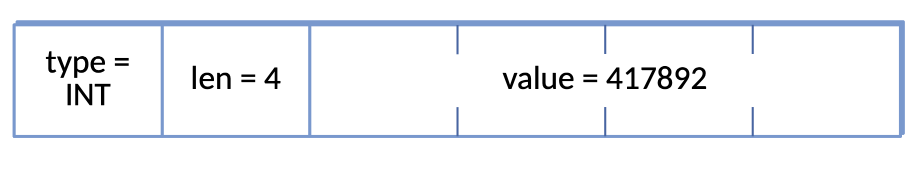
Data Types, Conversion, and Tags
Data types
  Base Types: integers, floats, characters
  Flat: structs and arrays
  Complex: pointer-based structures
Conversion strategy
  Canonical form: translate to/from one agreed external format
  Receiver-makes-right: N-by-N problem
  Same-architecture case favors receiver-makes-right
Tags
  Tagged: include type/length info with the data
  Untagged: receiver already knows the expected types
  Variable-length data needs a length tag either way

Slide 34
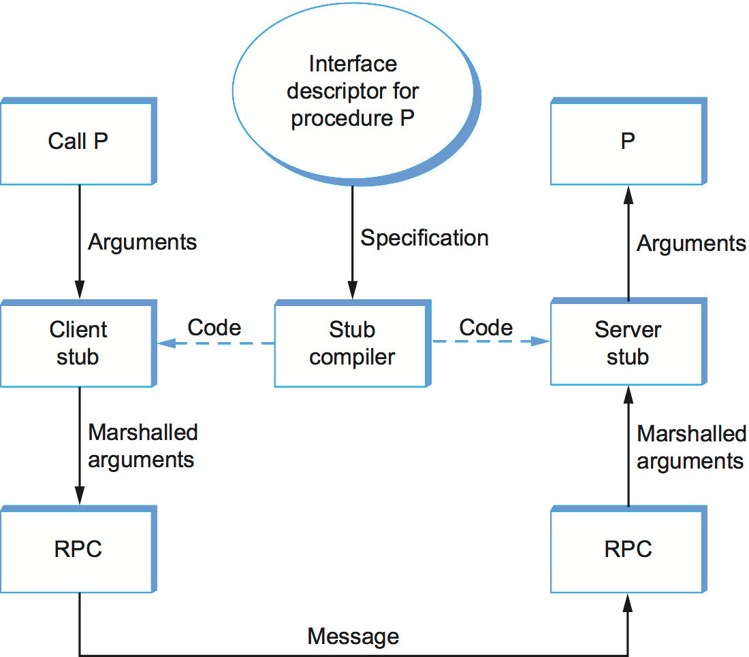
Stubs
Stub
  Code that actually does marshalling
Compiled stubs
  Write for each procedure
  Code generated by a compiler
  Generally fast
Interpreted stubs
  Auto-generated from interface spec
  Often slower

Slide 35
Protobuf Message Exampel
Tagged / Canonical Strategy
Both client and server share the .proto file
message Person {
required string name = 1;
required int32 id = 2;
optional string email = 3;
enum PhoneType {
MOBILE = 0;
HOME = 1;
WORK = 2;
}
message PhoneNumber {
required string number = 1;
optional PhoneType type = 2 [default = HOME];
}
required PhoneNumber phone = 4;
}

Slide 36
Encoding Integers (varint)
Each byte: top bit = "more bytes follow", low 7 bits = value
Small integers (< 128) fit in a single byte
  e.g., 2 encodes as 0000 0010
Decoding 1110 1101 0000 0010 to recover 365
1110 1101 0000 0010
→ 110 1101 000 0010
Drop “continuation” bit from each byte
000 0010 110 1101
→ 000 0010 || 110 1101
→ 101101101
→ 256 + 64 + 32 + 8 + 4 + 1 = 365
Least significant bits first (so swap)

