Slide 1
10⁰ Hz
10⁴
10⁸
10¹²
10¹⁶
10²⁰
10²⁴
Radio
Microwave
Microwave
Infrared
UV
X-Ray
Gamma Ray
10⁷
|
10⁸
|
10⁹
|
10¹⁰
|
10¹¹
|
10¹²
|
10⁵
|
10⁶
|
10⁸
|
10¹³
|
10¹⁴
|
10⁴
|
10¹⁴
|
10¹⁵
|
10¹⁶
|
Satellite
Fiber
Optics
Coax
Microwave
AM
FM
Mobile
Cellular

Slide 2

1010
Binary Data. Encoded in digital symbols.
Digital signal representing a discrete set of
symbols. Modulated onto analog signal.
Analog signal transmitted over some physical
medium. Modeled by a sine wave.

Slide 3
Control Plane
Routing
Algorithm
RIB
Interface for installing
forwarding rules
Data Plane
Forwarding
Logic
FIB

Slide 4
CPU
Main Memory (DRAM)
PCIe
NIC 1
NIC 2
NIC 3
NIC 4

Slide 5
Network Processing Unit
TCAM (Patterns to Match)
CPU
(Control)
Forwarding Pipeline
PCIe
SRAM (Packet Buffers)
SFI
48x40G SFP+
(Ports 1~48)
. . .

Slide 6
IP Header
Payload
Provider Path Label
VPN Label

Slide 7

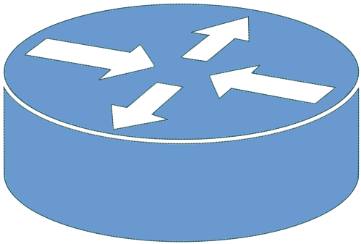

Provider
Edge
Customer
Edge
Provider Backbone

Slide 8
Internetwork
Network
192.168.1/24
Network
192.168.2/24
R1
R2
18.5.0.1
IP Header,
Dst = 192.168.2.x
IP Header,
Dst = 18.5.0.1
IP Header,
Dst = 192.168.2.x
IP Payload
IP Header,
Dst = 192.168.2.x
IP Payload
IP Payload

Slide 9


Host W
Host X
VLAN 100
VLAN 100
VLAN 200
VLAN 200
Host Z
Host Y
Host Z

Slide 10
Outer
Ethernet
Header
Outer
IP
Header
Outer
UDP
Header
VXLAN
Header
Inner Ethernet
Header
… Body …
DestPort=4789
8
24
24
8
Flags
Reserved
VNI
Reserved

Slide 11
64
48
48
16
16
Preamble
DestAddr
SrcAddr
Type
… Body …
CRC
802.1
802.1Q
Hdr
Preamble
DestAddr
SrcAddr
Type
… Body …
CRC
802.1Q
16:
4:
12:
Type
Control
Tag
32 =

Slide 12

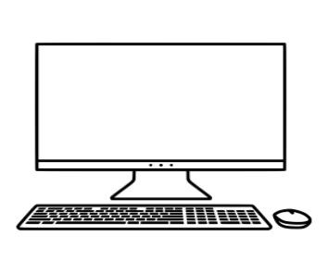
Tunnel
Remote User
Remote User
Internet
Corporate Office

Slide 13
Tunnel
Branch
Office
Internet
Corporate Office
Tunnel
Tunnel
Datacenter

Slide 14

Network Policies
SD-WAN Controller
Cloud Services
Corporate
Datacenter
Branch
Overlay Tunnel
Main Office
SD-WAN Edge

Slide 15
VMA
VM B
VM C
VM D
vS
vS
NIC
NIC

Slide 16
VMA
VM B
VM C
VM D
vS
vS
NIC
NIC

Slide 17
API
(Used by Cloud Management System)
Network Virtualization Application
Management Plane
Desired State
SDN Controller
Control Plane
Discovered State
Control Directives
vSwitch
vSwitch
vSwitch
Data
Plane
Notes:
The Management Plane / Control Plane annotations (on the right side) may be extraneous, but I included them here to show how those specific labels could be retained if necessary.
Also, “SDN Controller” in this and the next slide could be just “Controller”.

Slide 18
API
Network Virtualization
Controller
VM
…
VM
VM
…
VM
vS
vS
NIC
NIC
End Host
End Host
Underlay Network

Slide 19
Outer
MAC
Header
Outer
IP
Header
Outer
UDP
Header
VXLAN
Header
Inner
MAC
Header
Inner
IP
Header
… Payload …
VM
VM
vS
vS
NIC
NIC
End Host
End Host
Underlay Network

Slide 20
Outer
MAC
Header
Outer
IP
Header
Outer
UDP
Header
GENEVE
Header
Options
Inner
MAC
Header
Inner
IP
Header
… Payload …

Slide 21
SDN Controller
OVSDB
OpenFlow
OVS (Data Plane)
ovsdb-server
ovs-vswitchd
First Packet
Kernel Datapath
Subsequent Packets

Slide 22
Cloud Management System
OVN/CMS Plugin
Desired State
Northbound DB
OVN-northd
Southbound DB
Hypervisor
Hypervisor
OVN controller
OVN controller
OVS
…
OVS
Notes:
The Management Plane / Control Plane annotations (on the right side) may be extraneous, but I included them here to show how those specific labels could be retained if necessary.
Also, “SDN Controller” in this and the next slide could be just “Controller”.

Slide 23
Logical_Switch
Chassis (Physical Network)
Name | Ports
LS1 | LP1,LP2
Name | Encap | IP
HV1 | Geneve | 10.0.0.10
HV2 | Geneve | 10.0.0.11
Logical_Port
Port_Binding
Name | MAC
LP1 | AA
LP2 | BB
Name | Chassis
LP1 | HV1
LP2 | HV2
Logical_Flows
Datapath | Match | Action
LS1 | eth.dst = AA | LP1
LS1 | eth.dst = BB | LP2
LS1 | eth.dst = <broadcast> | LP1,LP2
Tables in ovn-sb
Physical Flows
Match | Encap | Dest
eth.dst = AA | Geneve | 10.0.0.10
eth.dst = BB | Geneve | 10.0.0.11
Flows computed
on individual hypervisors

Slide 24
Corporate Office
Internet
Remote User

