Slide 1
Chapter 6: Federating Networks
Computer Networks: A Systems Approach

Slide 2
Overview
It’s not practical to mandate a single network technology, so providing universal connectivity implies we need to federate independently owned an operated networks. This chapter looks at the two big challenges of federation: accommodating heterogeneity, and scaling to support thousands of autonomous networks.

Slide 3
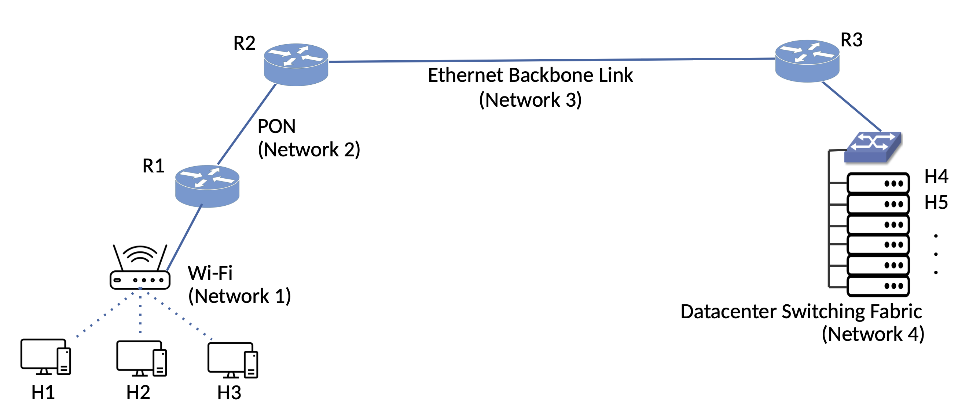
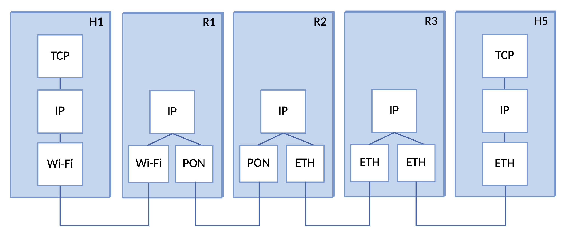
Internetwork as a Logical Overlay
IP implements router data plane
Networks Connected by Routers

Slide 4
Design Goals
Continue operating despite loss of networks or routers
Support multiple end-to-end communication services
Accommodate a variety of network technologies
Accommodate autonomous management of network resources
Make host attachment easy
Resources should be accountable
  Notably, still not achieved today
Scale was not on the original list of design goals
  Became a dominant requirement over time

Slide 5
Heterogeneity

Slide 6
Overview
Need a service model that works over any network technology
  Runs over anything (including, famously, carrier pigeons – RFC 1149)
IP adopts a “Best Effort” service model
  Defines a global/universal address for every host
  Adopt a connectionless datagram packet delivery service

Slide 7
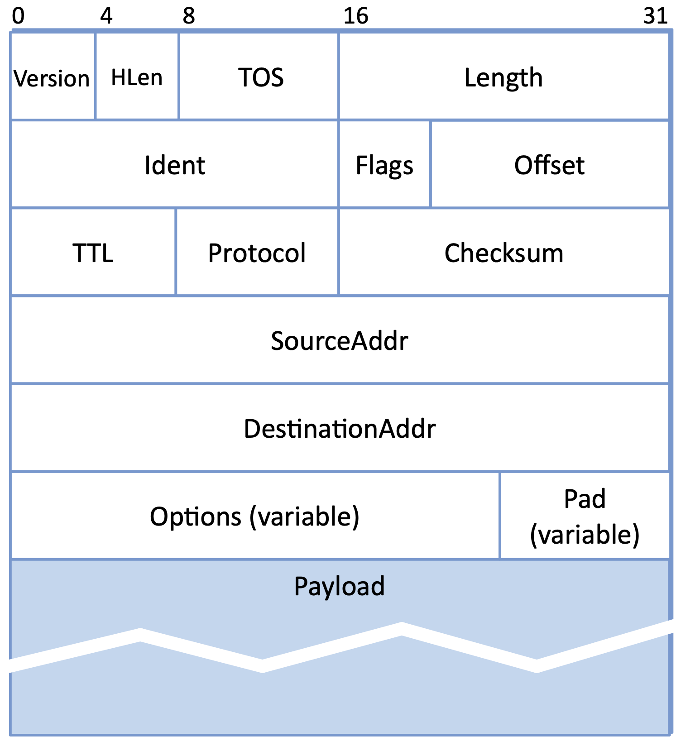
IPv4 Header
Version v4 (and later v6)
TOS anticipates differentiated service
16-bit Length field implies 65,535-byte max
Ident + Flags + Offset used for fragmentation
TTL (hop count) limits routing loops
Protocol is the demux key (TCP, UDP,… )
Checksum catches (some) corrupted headers
32-bit Source/Destination addresses
Options rarely included in practice

Slide 8
Fragmentation and MTU
Every network has a Maximum Transmission Unit (MTU)
IPv4 fragments packets "in flight" (when longer than next hop MTU)
IPv4 reassembles all the fragments at the destination host
Fragmentation is best avoided
  One lost fragment loses the whole datagram
IP instead relies on Path MTU Discovery
  Router signals back when a packet is too large (set “do not fragment” flag)
  Is a standard part of IPv6

Slide 9
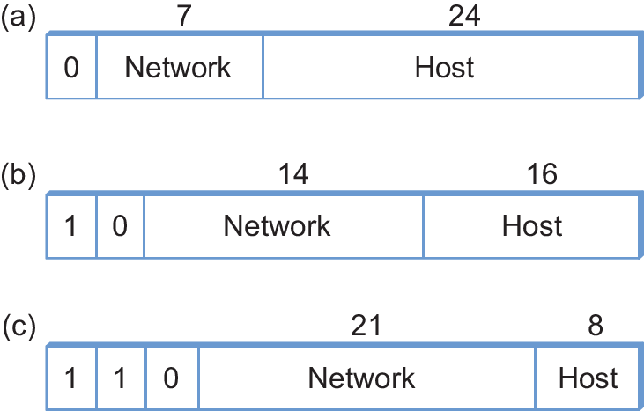
Global Addresses
Ethernet addresses are flat
  No routing structure
IP addresses are hierarchical
  (Network part / host part)
Originally divided into class A, B, and C
  Fixed split points
Address belongs to an interface, not a host

Slide 10
Packet Forwarding
Do a lookup on the network part of the destination address
Forwarding table
  Set of (NetworkNum, NextHop) pairs
  “NextHop” is a local interface implies directly connected
  “NextHop” is a router address, then forward to that address
  When nothing matches, forward to a Default Router
NetworkNum | NextHop
1 | R1
2 | Interface 0
3 | Interface 1
4 | R3

Slide 11
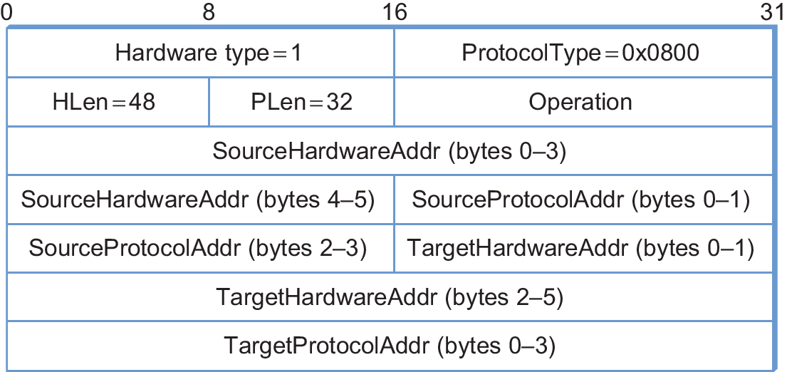
Address Resolution (ARP)
Used to map IP addresses to link-layer addresses
Sender broadcasts a query for the target's IP address
Target replies with its link-layer address
Entries cached and periodically timed out

Slide 12
Scale

Slide 13
Overview
Classful addressing put the Internet's address space under stress
Two issues
  Address assignment: wasted addresses in each class
  Routing: bigger forwarding tables as the number of networks grew

Slide 14
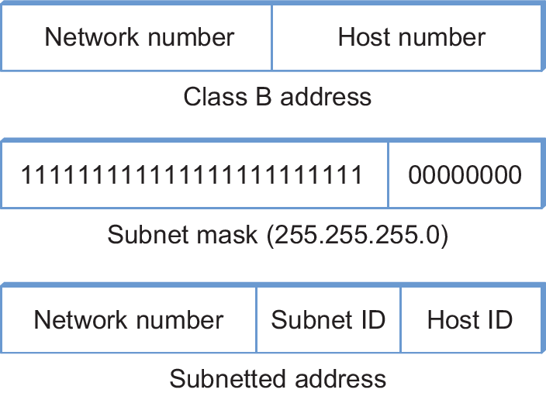
Subnetting
One network number shared across several physical networks (subnets)
Each host configured with an address and a subnet mask
AND address with mask to get the subnet number

Slide 15
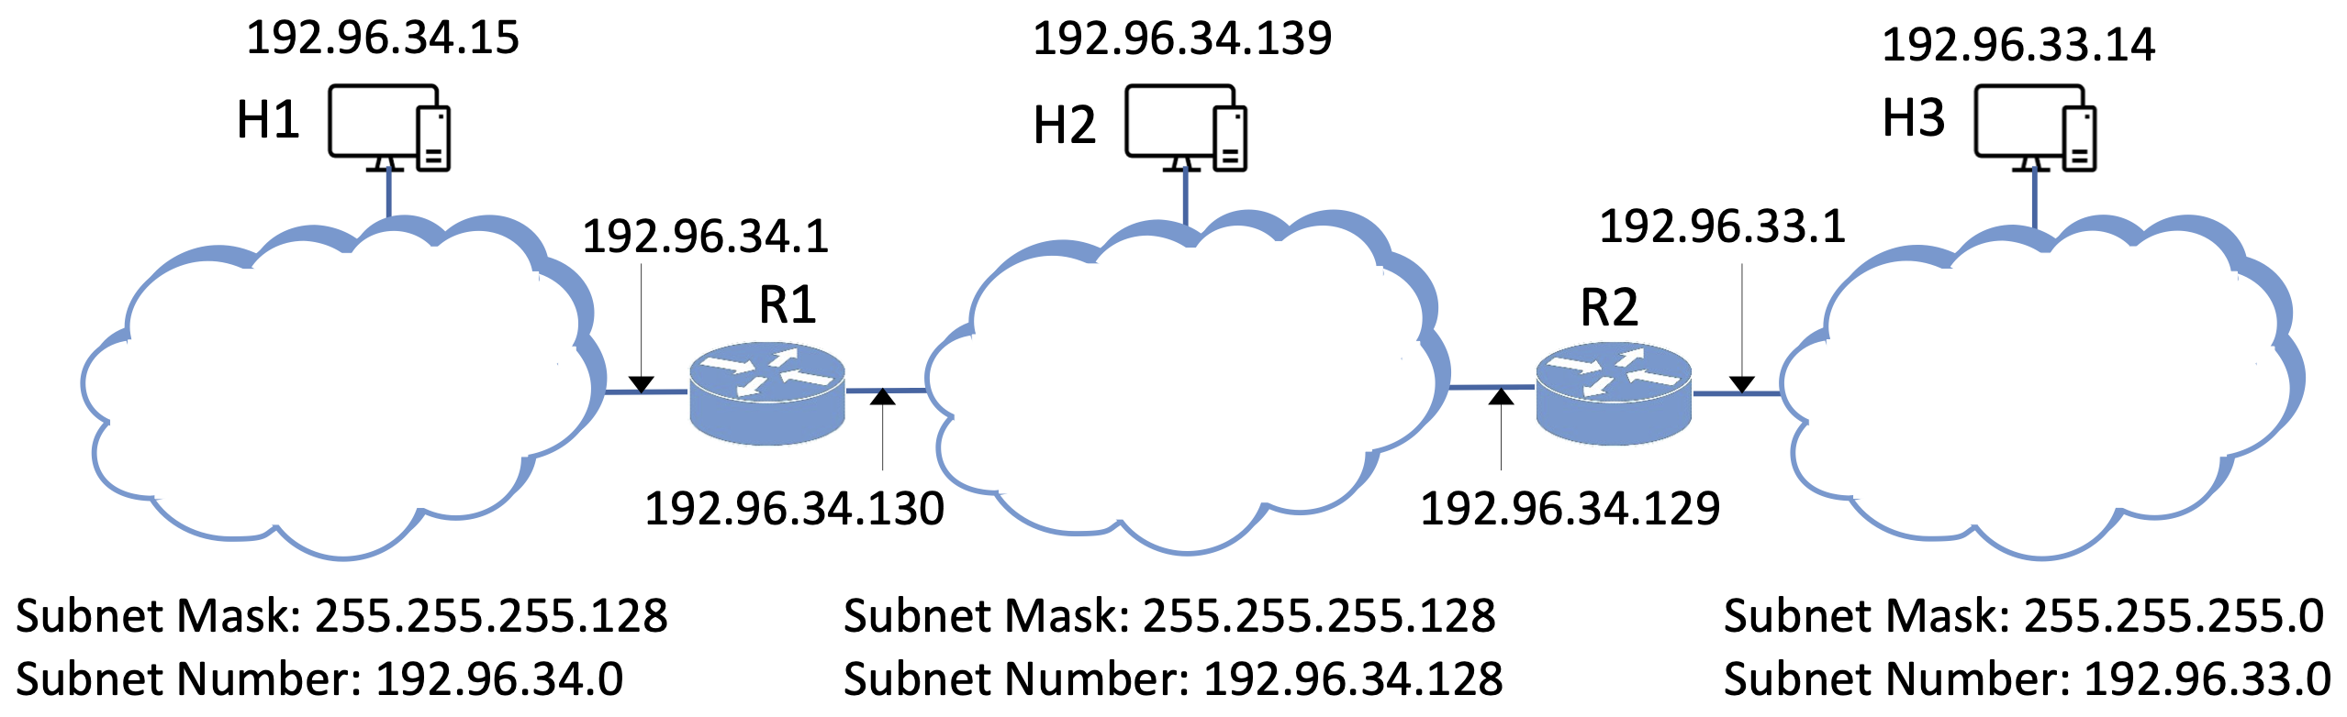
Subnetting Example

Slide 16
Subnet Forwarding Table
Router ANDs the destination address with each subnet mask
First matching subnet selected
SubnetNumber | SubnetMask | NextHop
128.96.34.0 | 255.255.255.128 | Interface 0
128.96.34.128 | 255.255.255.128 | Interface 1
128.96.33.0 | 255.255.255.0 | R2

Slide 17
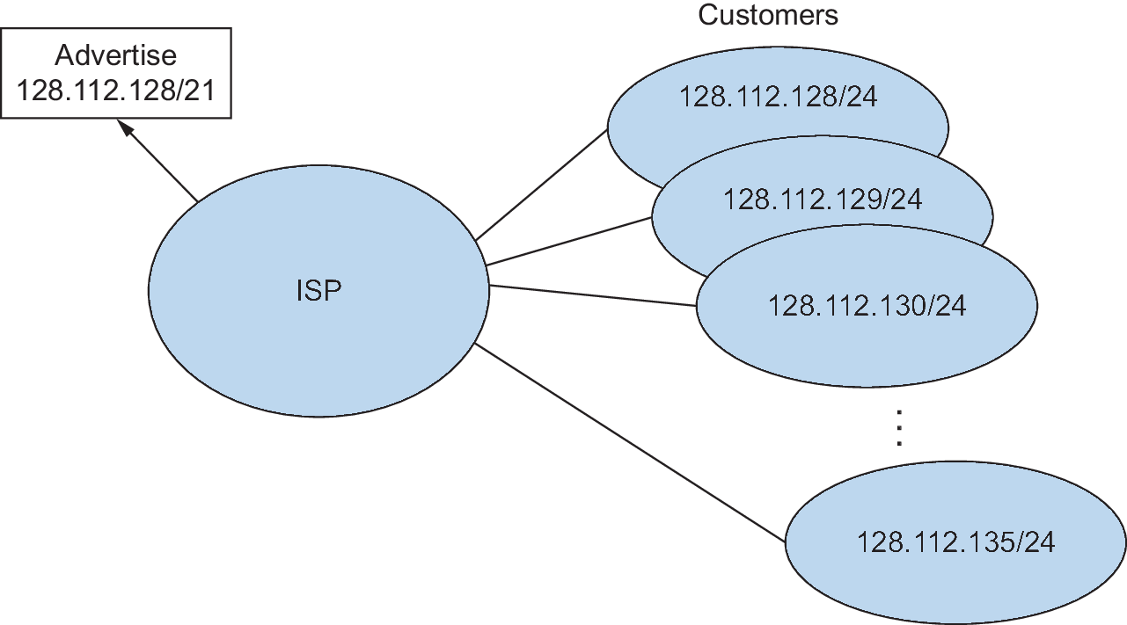
Classless Addressing (CIDR)
Subnets make more efficient use of classful addresses, but routing tables still exploding
Supernets coalesce multiple classful addresses into one table entry
Prefix notation gives the prefix length in bits (e.g., 128.112.135.0/24)
One advertised prefix can cover many customer networks
Forwarding decision based on longest-prefix match

Slide 18
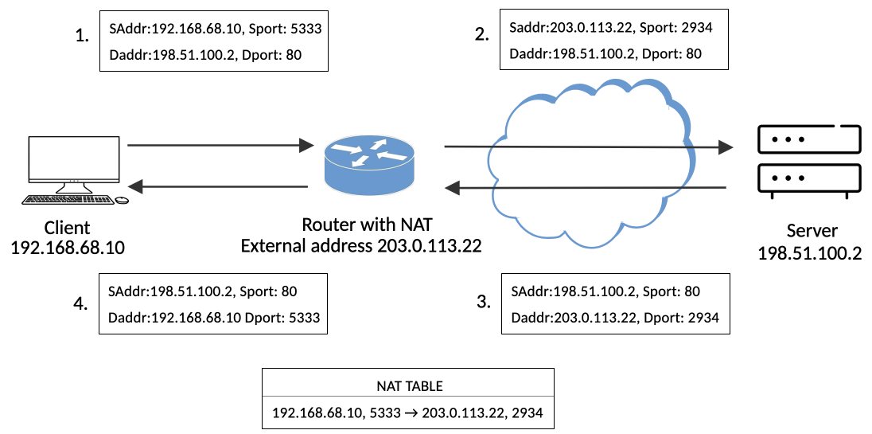
Network Address Translation (NAT)
Private addresses reused across many separate networks
  e.g., 192.168.0.0/16
NAT device rewrites source address (and port) at the border
Table of local (address, port) to global (address, port) mappings
Makes it hard to initiate connections into a NAT'd network (used by clients, but not servers)

Slide 19
IPv6 Motivation
Driven by IPv4 address exhaustion
Also a chance to add other wishlist features
  Real-time service support
  Security support
  Autoconfiguration
  Better mobile routing support
Required a gradual transition plan from IPv4
  No flag day
  Reality is that it may never terminate

Slide 20
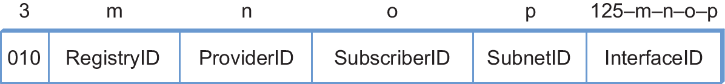
IPv6 Address Space
128-bit addresses: 3.4 x 10³⁸ possible nodes
Over 99% of the space is Global Unicast
Supports provider-based hierarchy
Written as eight groups of hex digits
  x:x:x:x:x:x:x:x
  :: compresses run of contiguous zero groups
Embedded IPv4 addresses get their own shorthand
  ::FFFF:a.b.c.d
Prefix | Use
00...0 (128 bits) | Unspecified
00...1 (128 bits) | Loopback
1111 1111 | Multicast
1111 1110 10 | Link-local unicast
Everything else | Global unicast

Slide 21
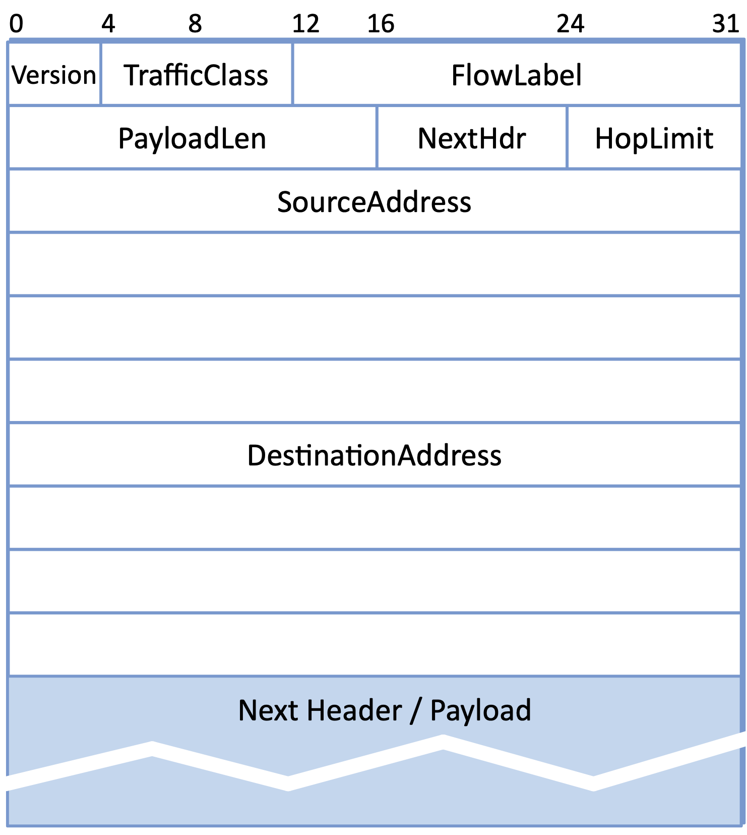
IPv6 Header
Simpler than IPv4
Fragmentation fields removed
HopLimit renames IPv4's TTL
NextHdr gives “type” of next header
  Replaces Protocol field in IPv4
  Replaces IPv4 options
    Referred to as extension headers
    e.g., SRv6 (Chapter 4)
  Results in a “header chain”

