Slide 1
Chapter 1: Introduction
Computer Networks: A Systems Approach

Slide 2
Overview
Today’s Internet connects over 22 billion devices. The network itself is a massively distributed system, built from hundreds of millions of switching devices. All of this is in the service of applications as diverse as video conferencing, live and on-demand streaming, e-commerce, social media, automated manufacturing.
This book imagines that we’re setting out to build just such a network. What available technologies would serve as the underlying building blocks, and what kind of software architecture would you design to integrate these building blocks into an effective communication service? Answering this question is the overriding goal of this book. This chapter lays the foundation for doing just that.

Slide 3
Requirements
Scalable
  Grow without arbitrary limits
General-Purpose
  Support any application
Cost-Effective
  Efficiently share resources
High Performance
  High Throughput / Low Latency
Other Common Requirements
  Secure
  Manageable
  Reliable (Available)
  Evolvable
Tradeoffs Inevitable
  Priorities change

Slide 4
Network Architecture
Blueprint for modularizing a network
  Same challenge as modularizing any complex system
  Added challenge of reaching agreement about interoperating
An architecture is both descriptive and prescriptive
  Describes what exists so others can understand it (and build upon it)
  Prescribes how to extend and evolve what’s already there
Balancing Act
  An architecture is “anchored” by a set of invariants (require agreement)
  An architecture is flexible enough to evolve (encourage innovation)

Slide 5
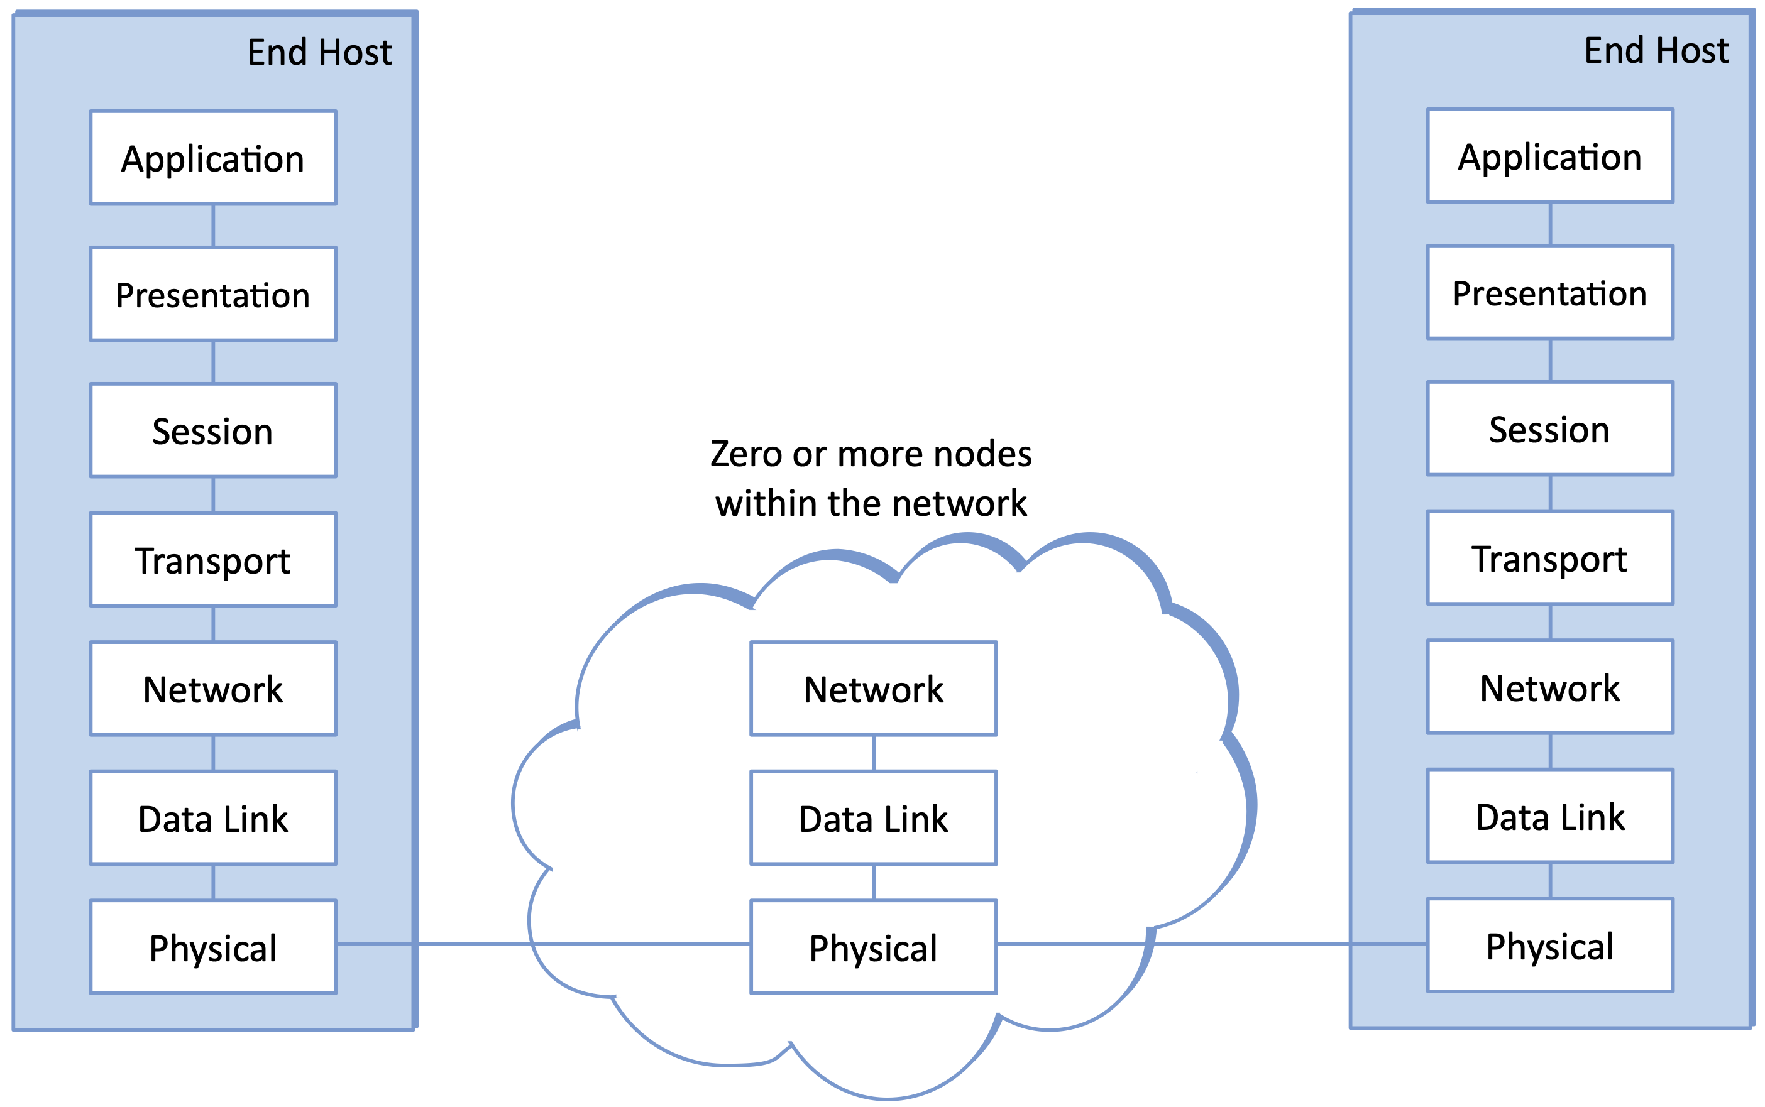
OSI Architecture
Prescribes 7 layers of abstract functionality
  Networking through the Telco lens

Slide 6
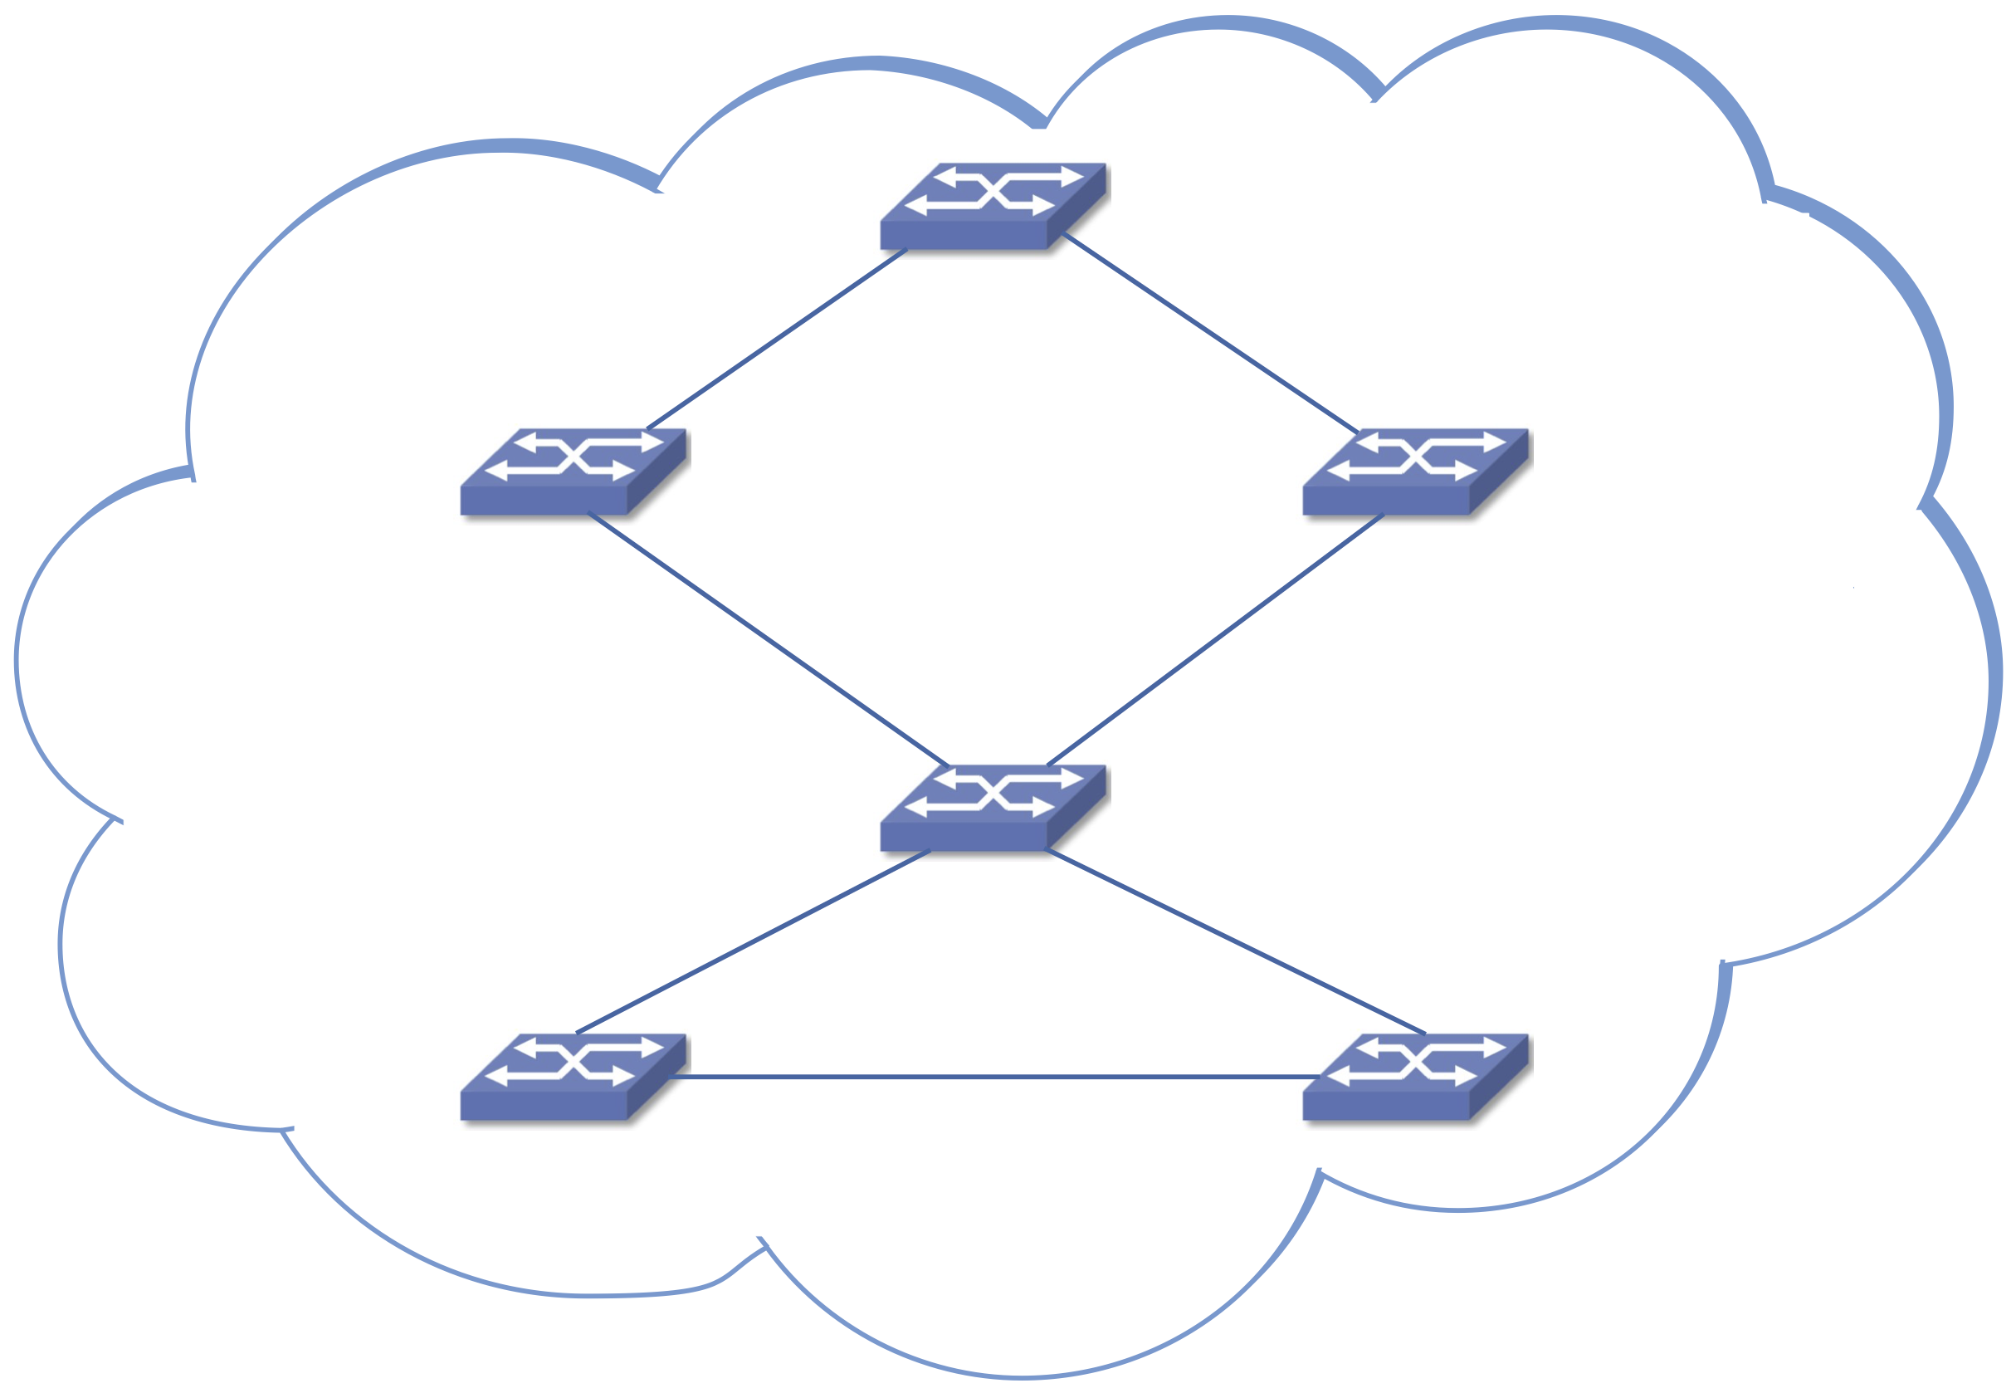
OSI Architecture
Prescribes 7 layers of abstract functionality
  Networking through the Telco lens
  Outlines role of switching

Slide 7
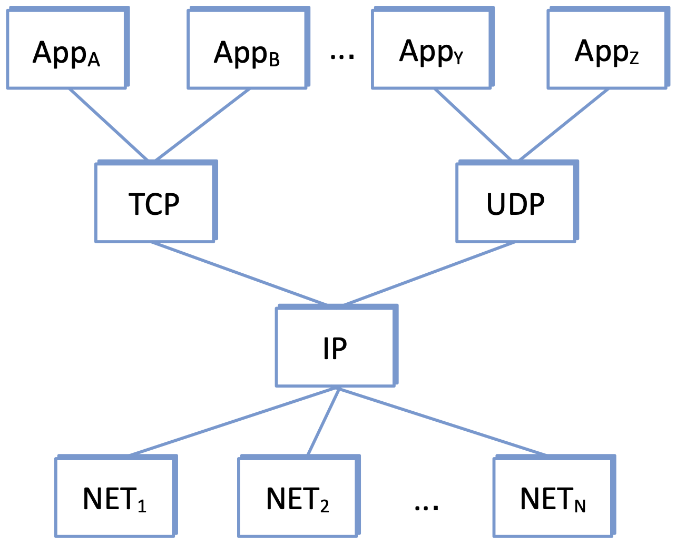
Internet Architecture
Organized around core protocols
Hourglass Shape
  Many apps on top
  Many link technologies below
  IP defines the narrow waist
    Universal Connectivity
    Best-Effort Packet Delivery

Slide 8
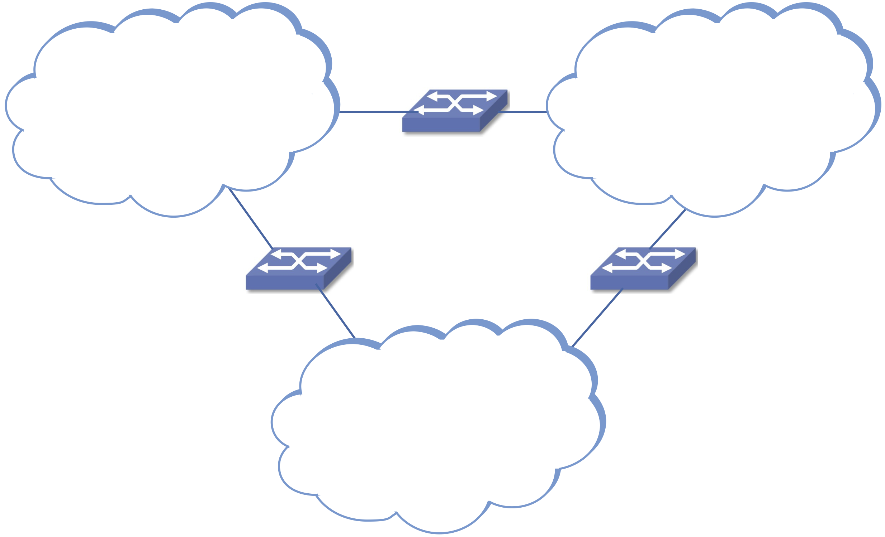
Internet Architecture (cont)
IP is a logical network
Overlayed on physical networks
Powerful idea → Recursive Networks
  You can build a network by…
    connecting two or more nodes with a link
    connecting two more networks with a node

Slide 9
Design Principles
Separation of Concerns
  Don’t try to solve all problems (satisfy all requirements) at once
  Internet Example
    Focus on universal connectivity
    Remain agnostic about apps (top) and technologies (bottom)
End-to-End Arguments
  Don’t try to solve problems at low levels (inside the network) that can only be fully addressed at high levels (with application knowledge)
  Internet Example
    Reliable delivery can only be verified end-to-end
    Detect (and optionally “fix”) errors inside the network as an optimization

Slide 10
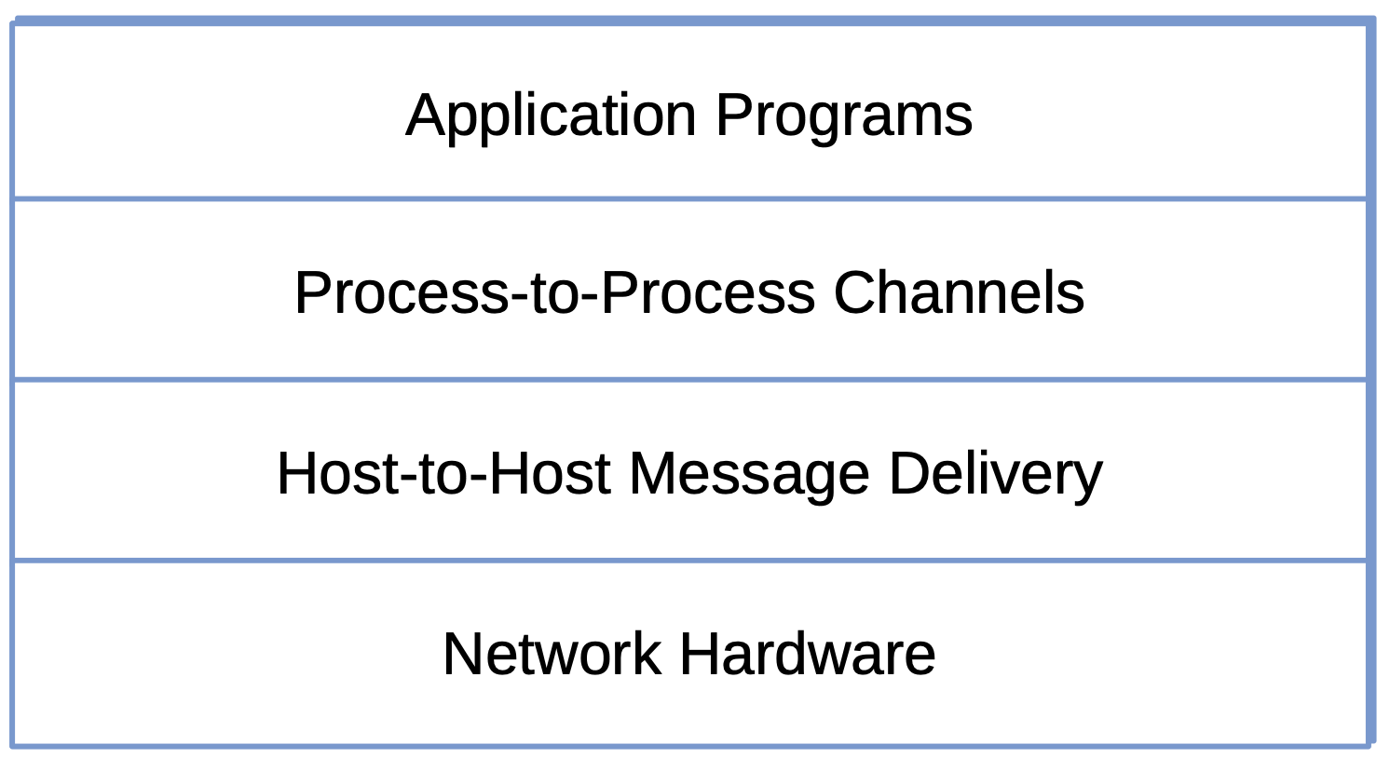
Layering
Approach to modularity
Stack of abstractions
  Hardware at the base
  Each layer builds on lower-level services
  Layers independently replaceable
Internet Example
  IP → host-to-host packet delivery
  TCP → process-to-process communication channel

Slide 11
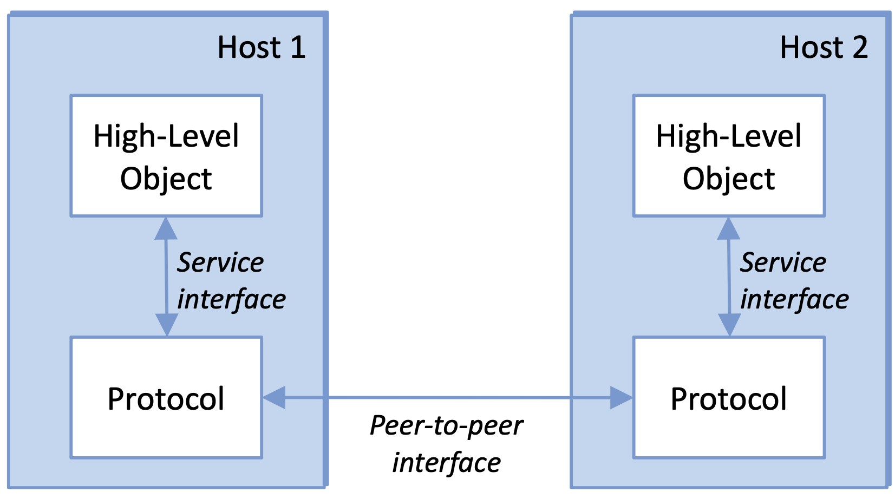
Protocols
Network module
Defines two interfaces
  Service interface: operations exposed to layer above
  Peer interface: message format exchanged with remote peer

Slide 12
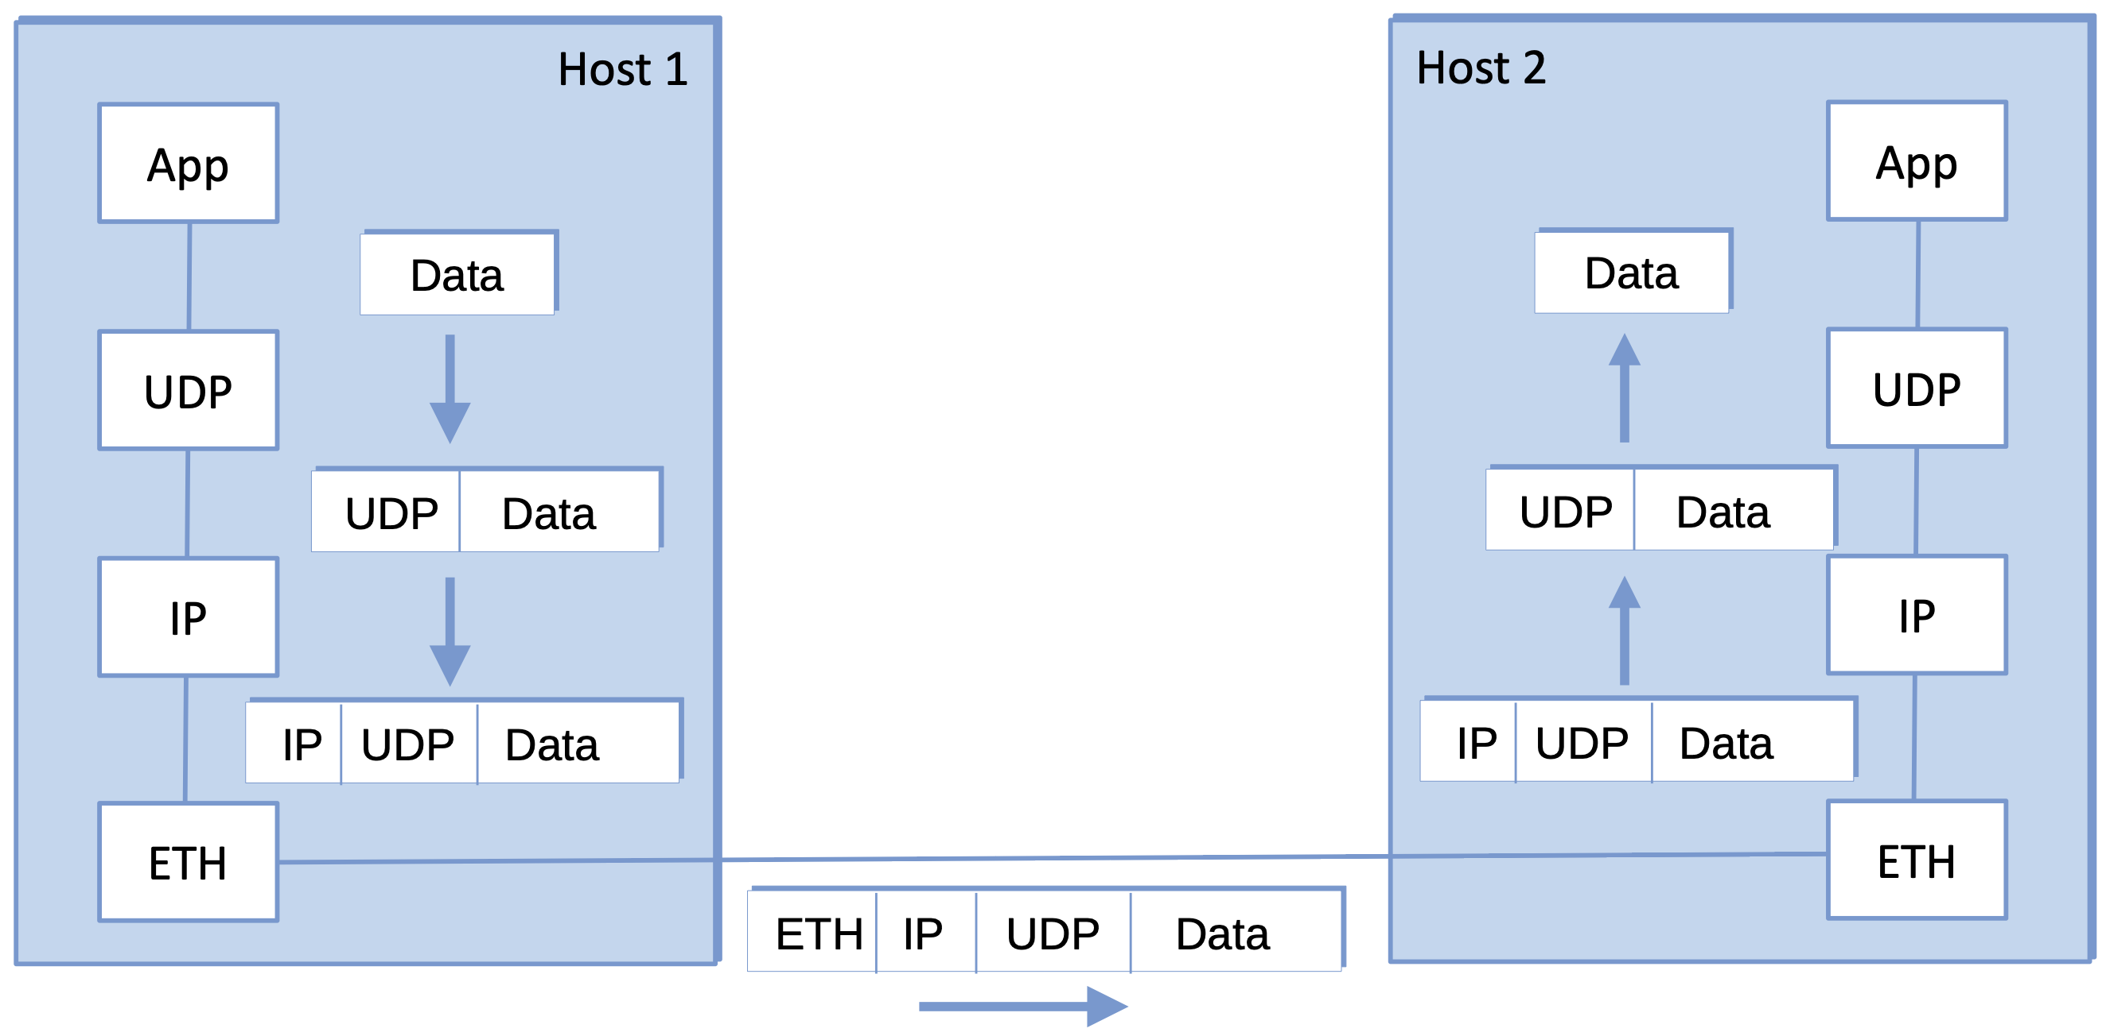
Encapsulation
Each layer prepends a header (control info for its peer)
  Payload untouched by intermediate nodes
Destination strips headers in reverse order

Slide 13
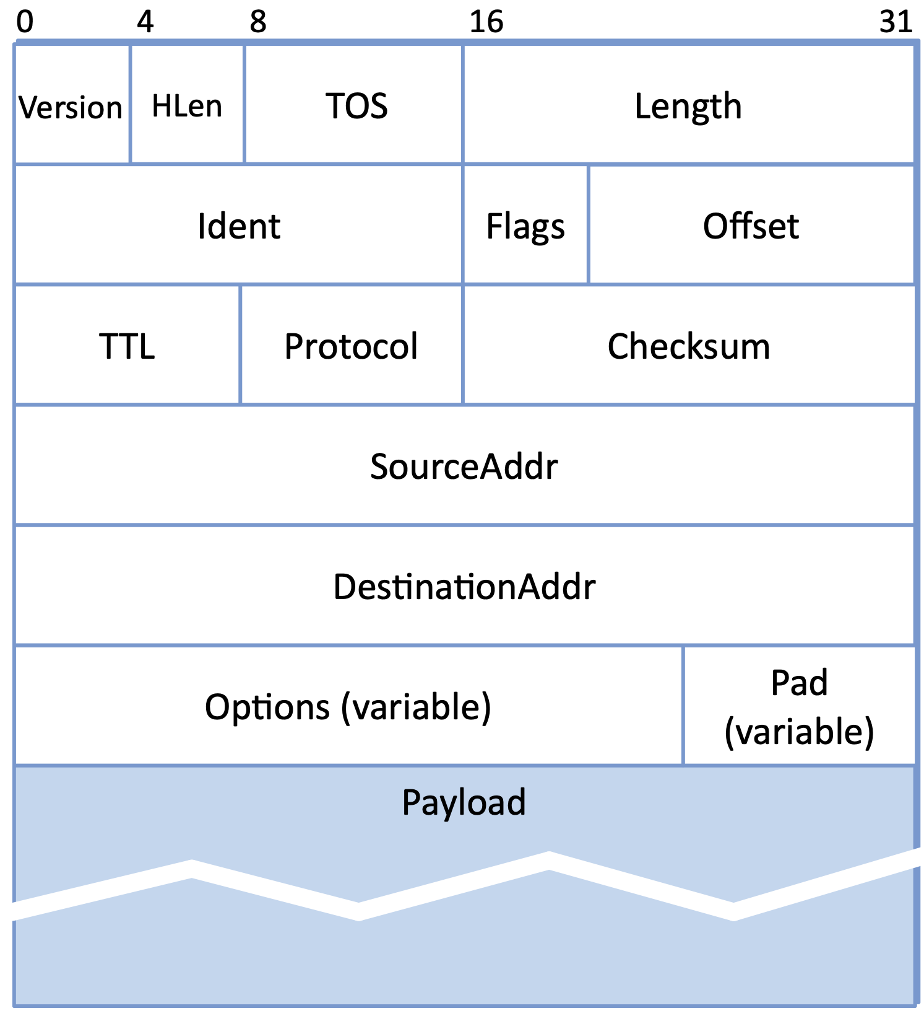
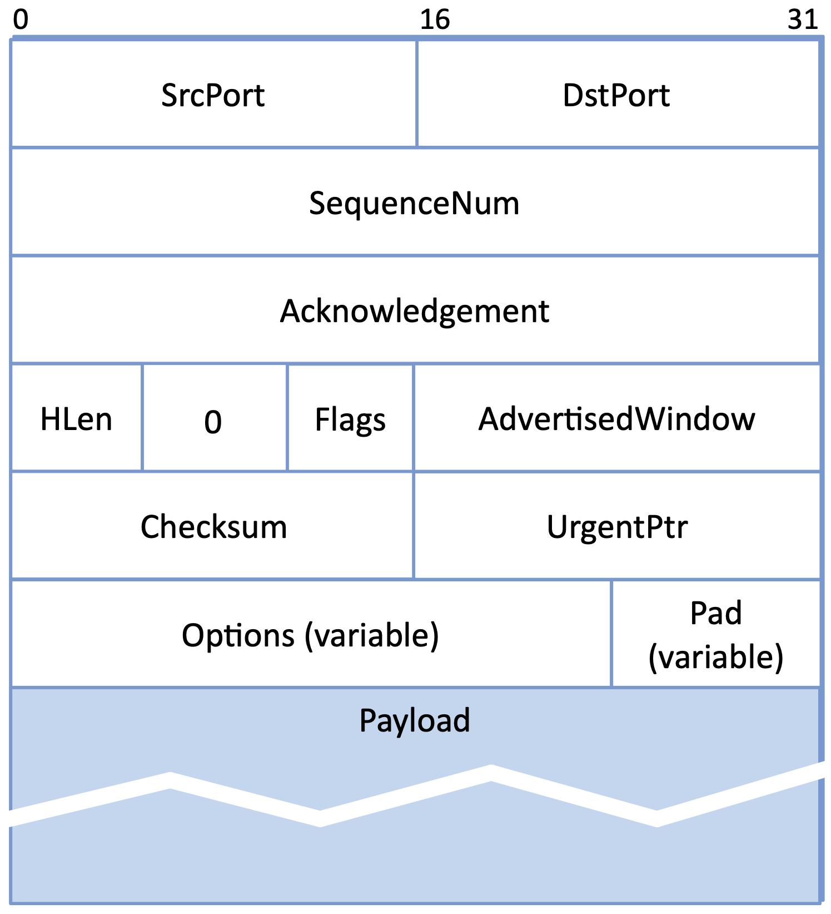
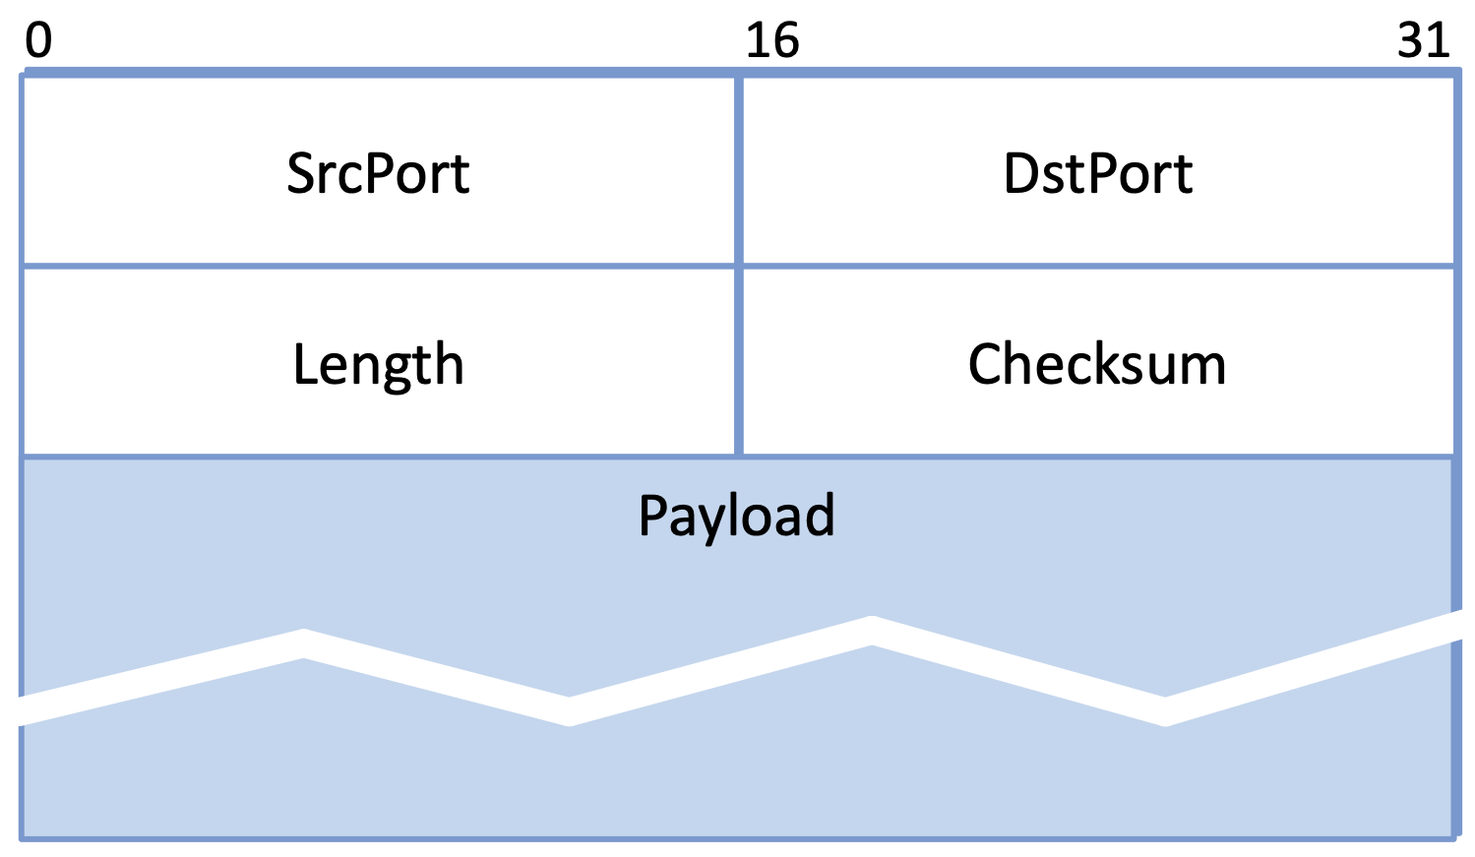
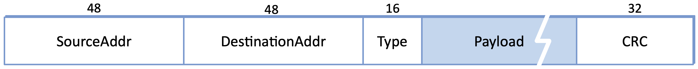
Example Headers
UDP
Host Addresses
  How we write them (for now)
  More details later
Ethernet (48 bits)
  6e:86:88:18:7d:39
IP (32 bits)
  128.112.155.172
  128.112.155.0/24
IP
TCP
ETH

Slide 14
Protocol Specifications
Abstract definition
  Prose, pseudocode, state diagrams, packet header diagrams
  RFCs give examples for Internet protocols
Key requirement: different implementations must interoperate
  Focus typically on the peer-to-peer interface
  Common service interface lowers barrier to use, but not required

Slide 15
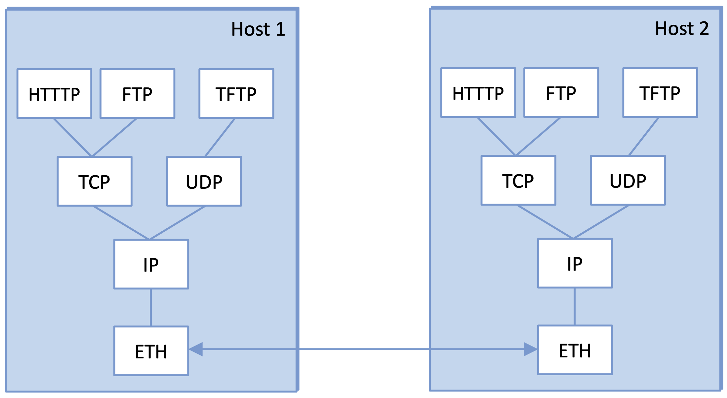
Multiplexing and Demultiplexing
Common for multiple users (apps or protocols) to share a protocol
Demux key in header identifies the intended recipient
  No universal format
  ETH: 16-bit Type field
  IP: 8-bit Protocol field
  TCP/UDP: pair of 16-bit Port fields

Slide 16
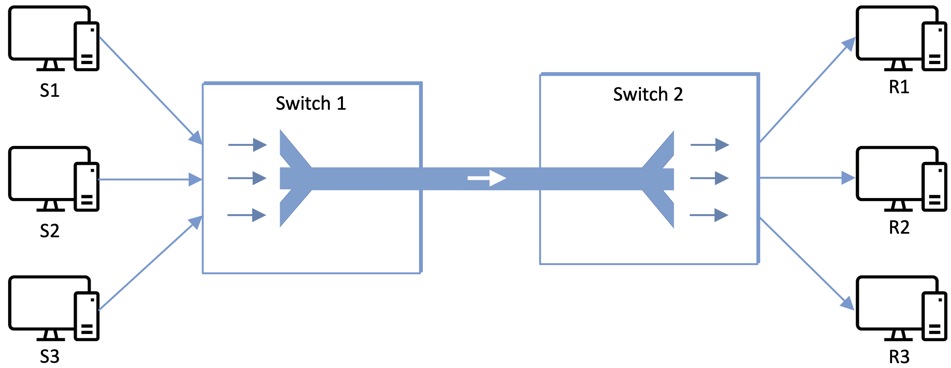
Multiplexing (More Generally)
About how to share resources
Synchronous TDM (STDM)
  Fixed time slots per flow
Frequency Division (FDM)
  Fixed frequency band per flow
Limitation
  Idle slots waste capacity
  Fixed number of flows

Slide 17
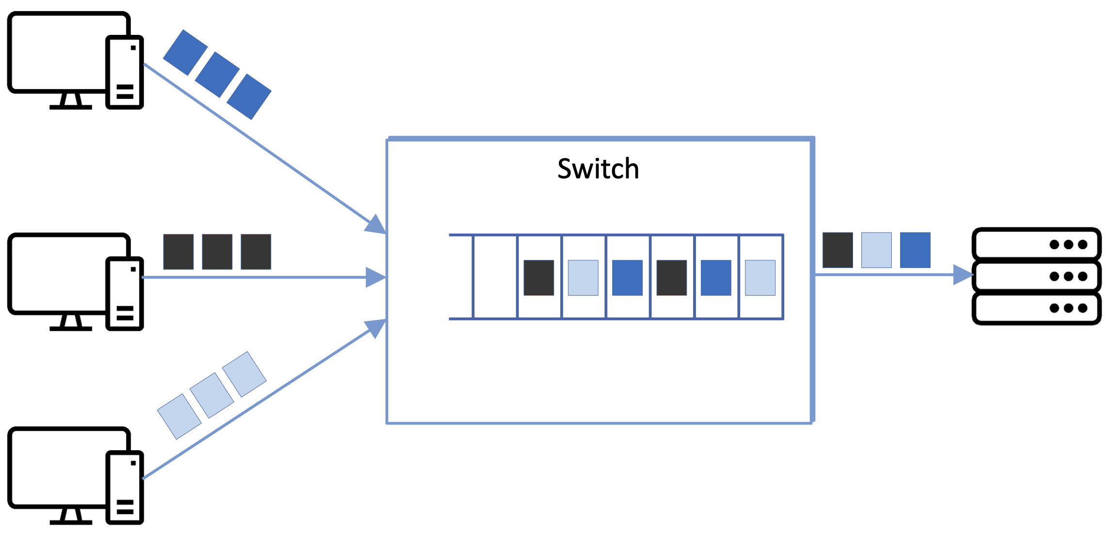
Statistical Multiplexing
Transmit on demand
  Packets define “scheduling interval”
  Queue packets waiting service
    e.g., FIFO
Congestion
  Input rate exceeds output rate
  Packet buffer overflows
  No choice but to drop some packet

Slide 18
Performance Metrics
Bandwidth / Throughput
  Measured in bits-per-second (bps)
  Limited by spectrum “bandwidth” (e.g., 10 MHz implies 10 Mbps)
Latency / Response Time / Delay
  Measured in seconds (ms, µs)
  One way: Propagation + Transmission + Queuing
    Transmission = TransferSize / Bandwidth
  Round-trip (RTT)
Intuition
  Small transfers: RTT-dominated
  Large transfers: bandwidth-dominated

Slide 19
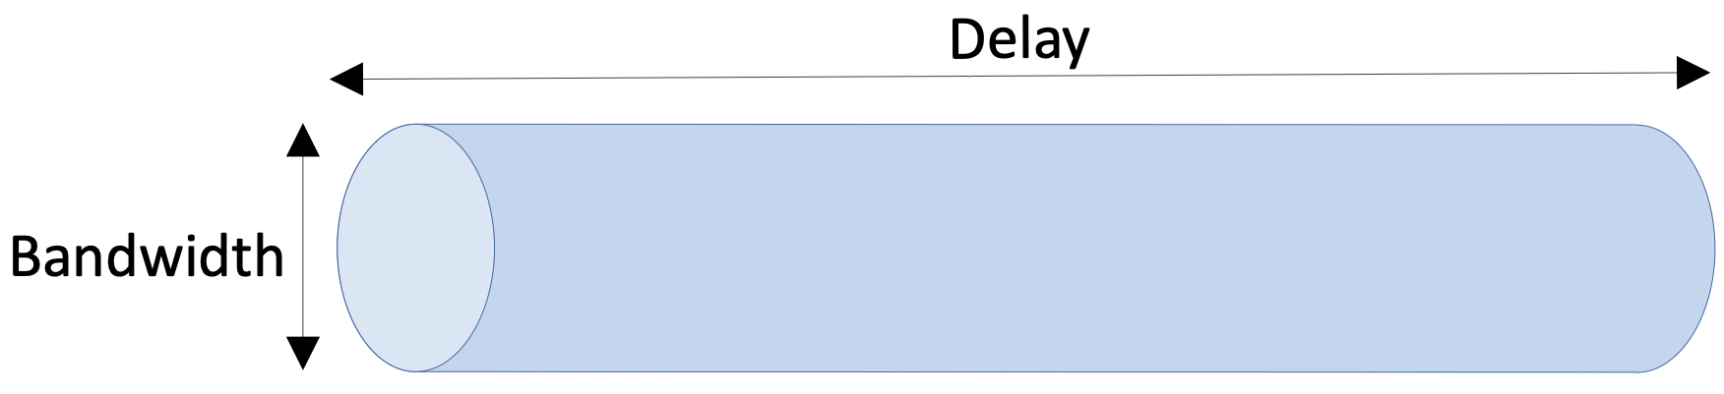
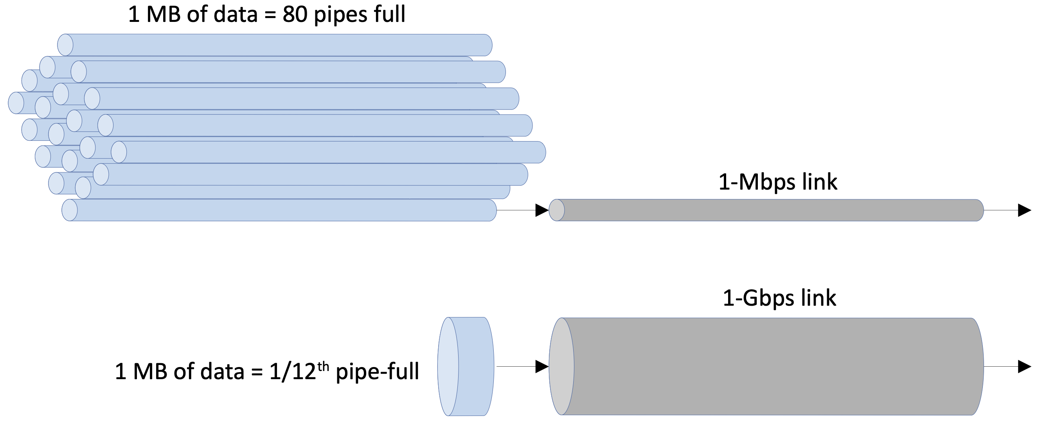
Delay × Bandwidth Product
Bits "in flight"
  Typically RTT × Bandwidth
Goal is to ”keep the pipe full"
  Otherwise measured xput suffers
As bandwidth → ∞
  Latency becomes the bottleneck
  Physics (speed of light)

Slide 20
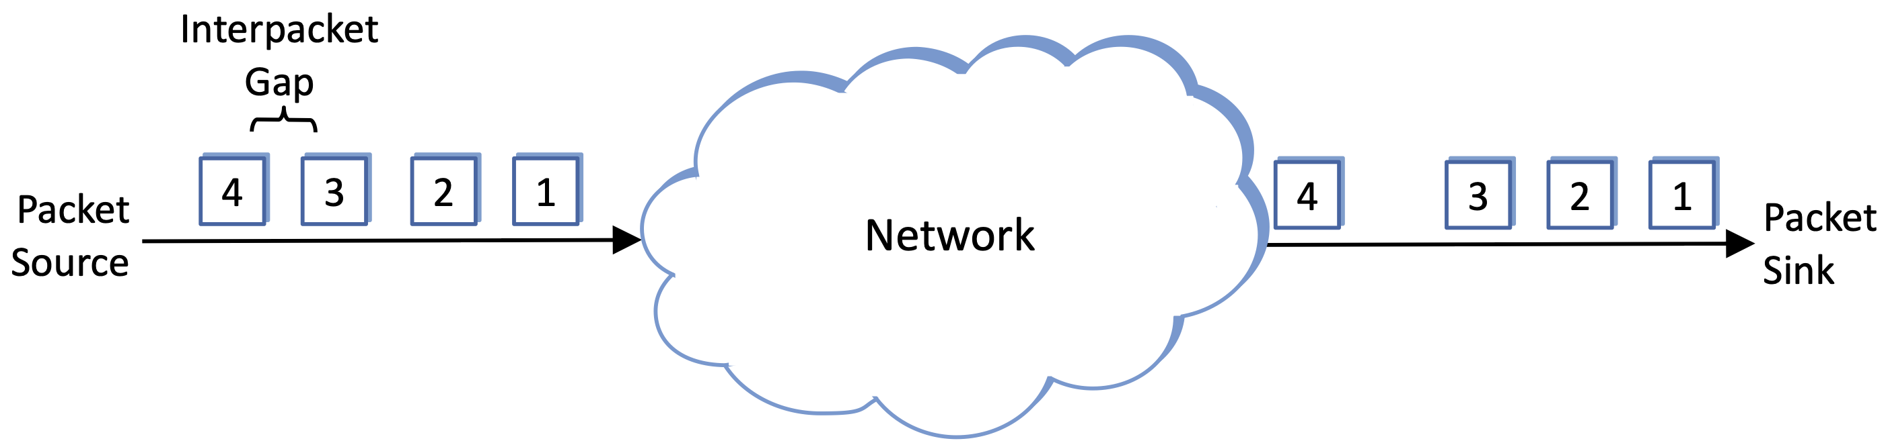
Application Requirements
Some applications can use as much bandwidth as the network can deliver
  shorter downloads
Some applications care about delay
  faster response times
Some applications care about jitter: minimize variation in delay
  predictable arrival rate

