Slide 1
Chapter 3: Packet Switching
Computer Networks: A Systems Approach

Slide 2
Overview
For any system you set out to build, you first have to identify the available building blocks. Throughout its history, many network technologies have come and gone, but Ethernet has survived and adapted to become a ubiquitous building block. This chapter describes Ethernet (both as a link technology and a switching technology), which then serves as the foundation for everything else that makes up the Internet.*
*Of course wireless networks are important (and we cover them in Chapter 5), but as a foundational chapter, we need to start with switches.

Slide 3
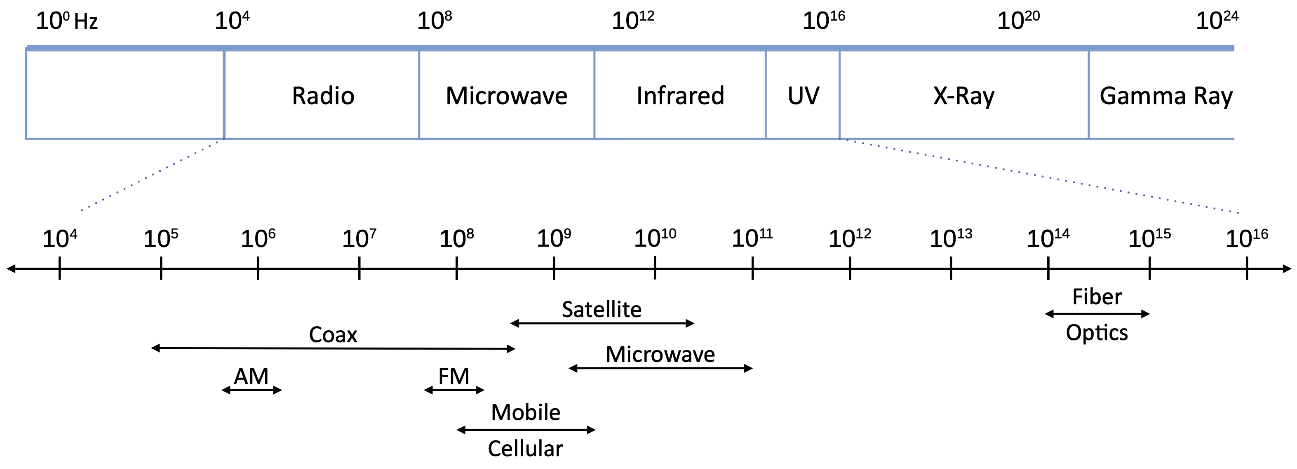
Spectrum
Networks carry information as electromagnetic waves
Networks run over a range of frequency bands

Slide 4
Link Technology

Slide 5
Link Layer
Directly connects nodes sharing a physical medium
  Sometimes called “Media Access Control” (MAC)
IP runs on top of whatever link technology is available
  Ethernet, WiFi, 4G/5G, SONET…
Three key problems to address
  How to encode bits on signals sent over the physical medium
  How to group bits into frames
  How to detect if there are any bit errors in a delivered frame

Slide 6
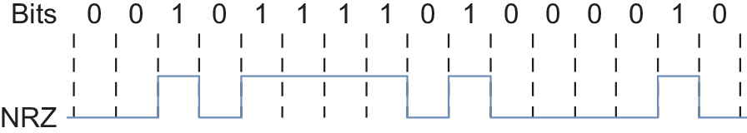
Encoding
NRZ: Non-Return to Zero
  Simplest mapping: 1 = high voltage, 0 = low voltage
Problems
  Clock drift means that long runs of same value are hard to dissect
  Signal is sampled to detect above/below average → average drifts

Slide 7
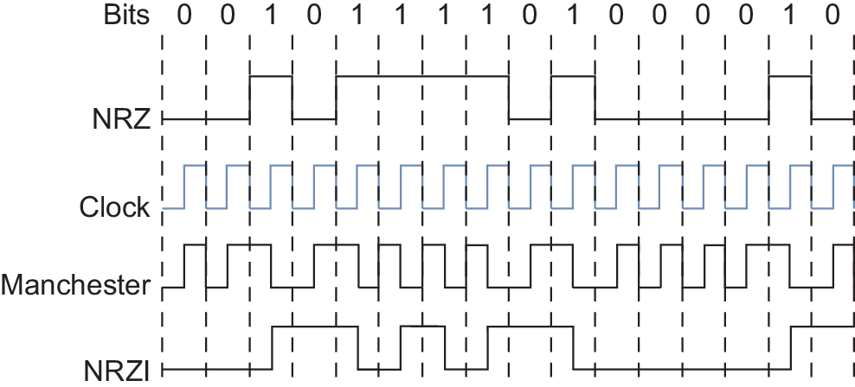
Encoding (cont)
NRZI
  Transition to encode a 1
  No change to encode a 0
  Fixes long runs of 1s
  Suitable if long runs of 0 are rare
Manchester
  Transmit XOR of NRZ and clock
  50% overhead
4B/5B (8B/10B)
  Map every 4 data bits to a 5-bit code
  Only 16 of 32 code words used for data
  No code has more than one leading 0
  Encode code words with NRZI
  25% overhead

Slide 8
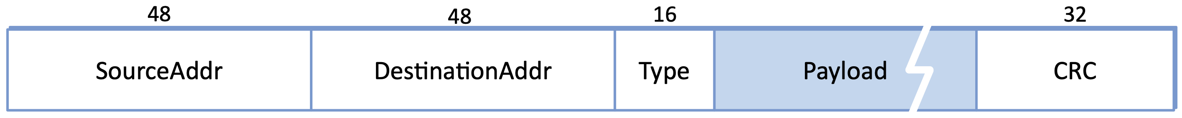
Framing
Raw bit stream must be grouped into frames for processing
  Frames are passed between host and network adaptor (NIC)
Techniques
  Sentinel-based: special pattern marks frame boundaries
  Length-based: header field declares number of bytes in frame
  Clock-based: fixed-size frames tied to a master clock
Every link-layer protocol defines its own frame format
  e.g., Ethernet has a 64-bit preamble (alternating 0s and 1s), followed by…

Slide 9
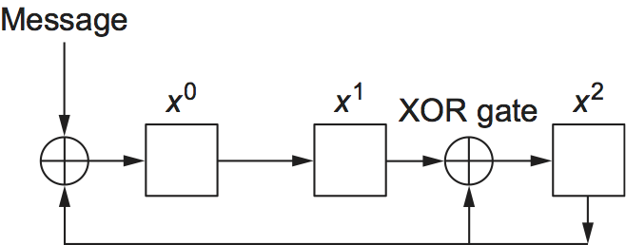
Error Detection
Corruption on the wire is inevitable
  Receiver must detect it
Cyclic Redundancy Code (CRC)
  Treat frame as a polynomial M(x)
  Divide M(x) by generator C(x)
  Attach “remainder” as error code
Receiver redivides by same C(x)
  Nonzero remainder implies corruption
CRC-32 specifies a specific C(x)
  Catches all 1-bit and 2-bit errors
  Catches all odd-bit errors
  Catches all burst errors ≤ 32 bits
Computed in hardware at line speed

Slide 10
Evolution of Ethernet
Invented at Xerox PARC in 1973
  10 Mbps over shared coaxial cable
  Inspired by ALOHA wireless network
CSMA/CD – Carrier Sense Multiple Access with Collision Detection
  Listen for idle channel before transmitting
  Backoff exponentially if a collision is detected
Adapted Over Time
  10M → 100M → 1G → 10G → 100G → 400G
    Improved encoding
    Improved signaling
    New media (e.g., fiber)
  Multi-Access → Point-to-Point (became a switched network)
  Always backwards compatible (frame format, 48-bit addresses)

Slide 11
Switch Technology

Slide 12
Packet Switches
Building block of the Internet
  Switches are to Networking as Servers are to Computing
  Where functionality described in Part II is implemented
Common Platform
  Receive frames on input ports
  Make a forwarding decision
  Transmit frames on output ports
Configured (programmed) for varied deployments
  IP packets (L3 Switch, Router)
  Ethernet packets (L2 Switch, Bridge)
  Both (L2/L3 Switch)

Slide 13
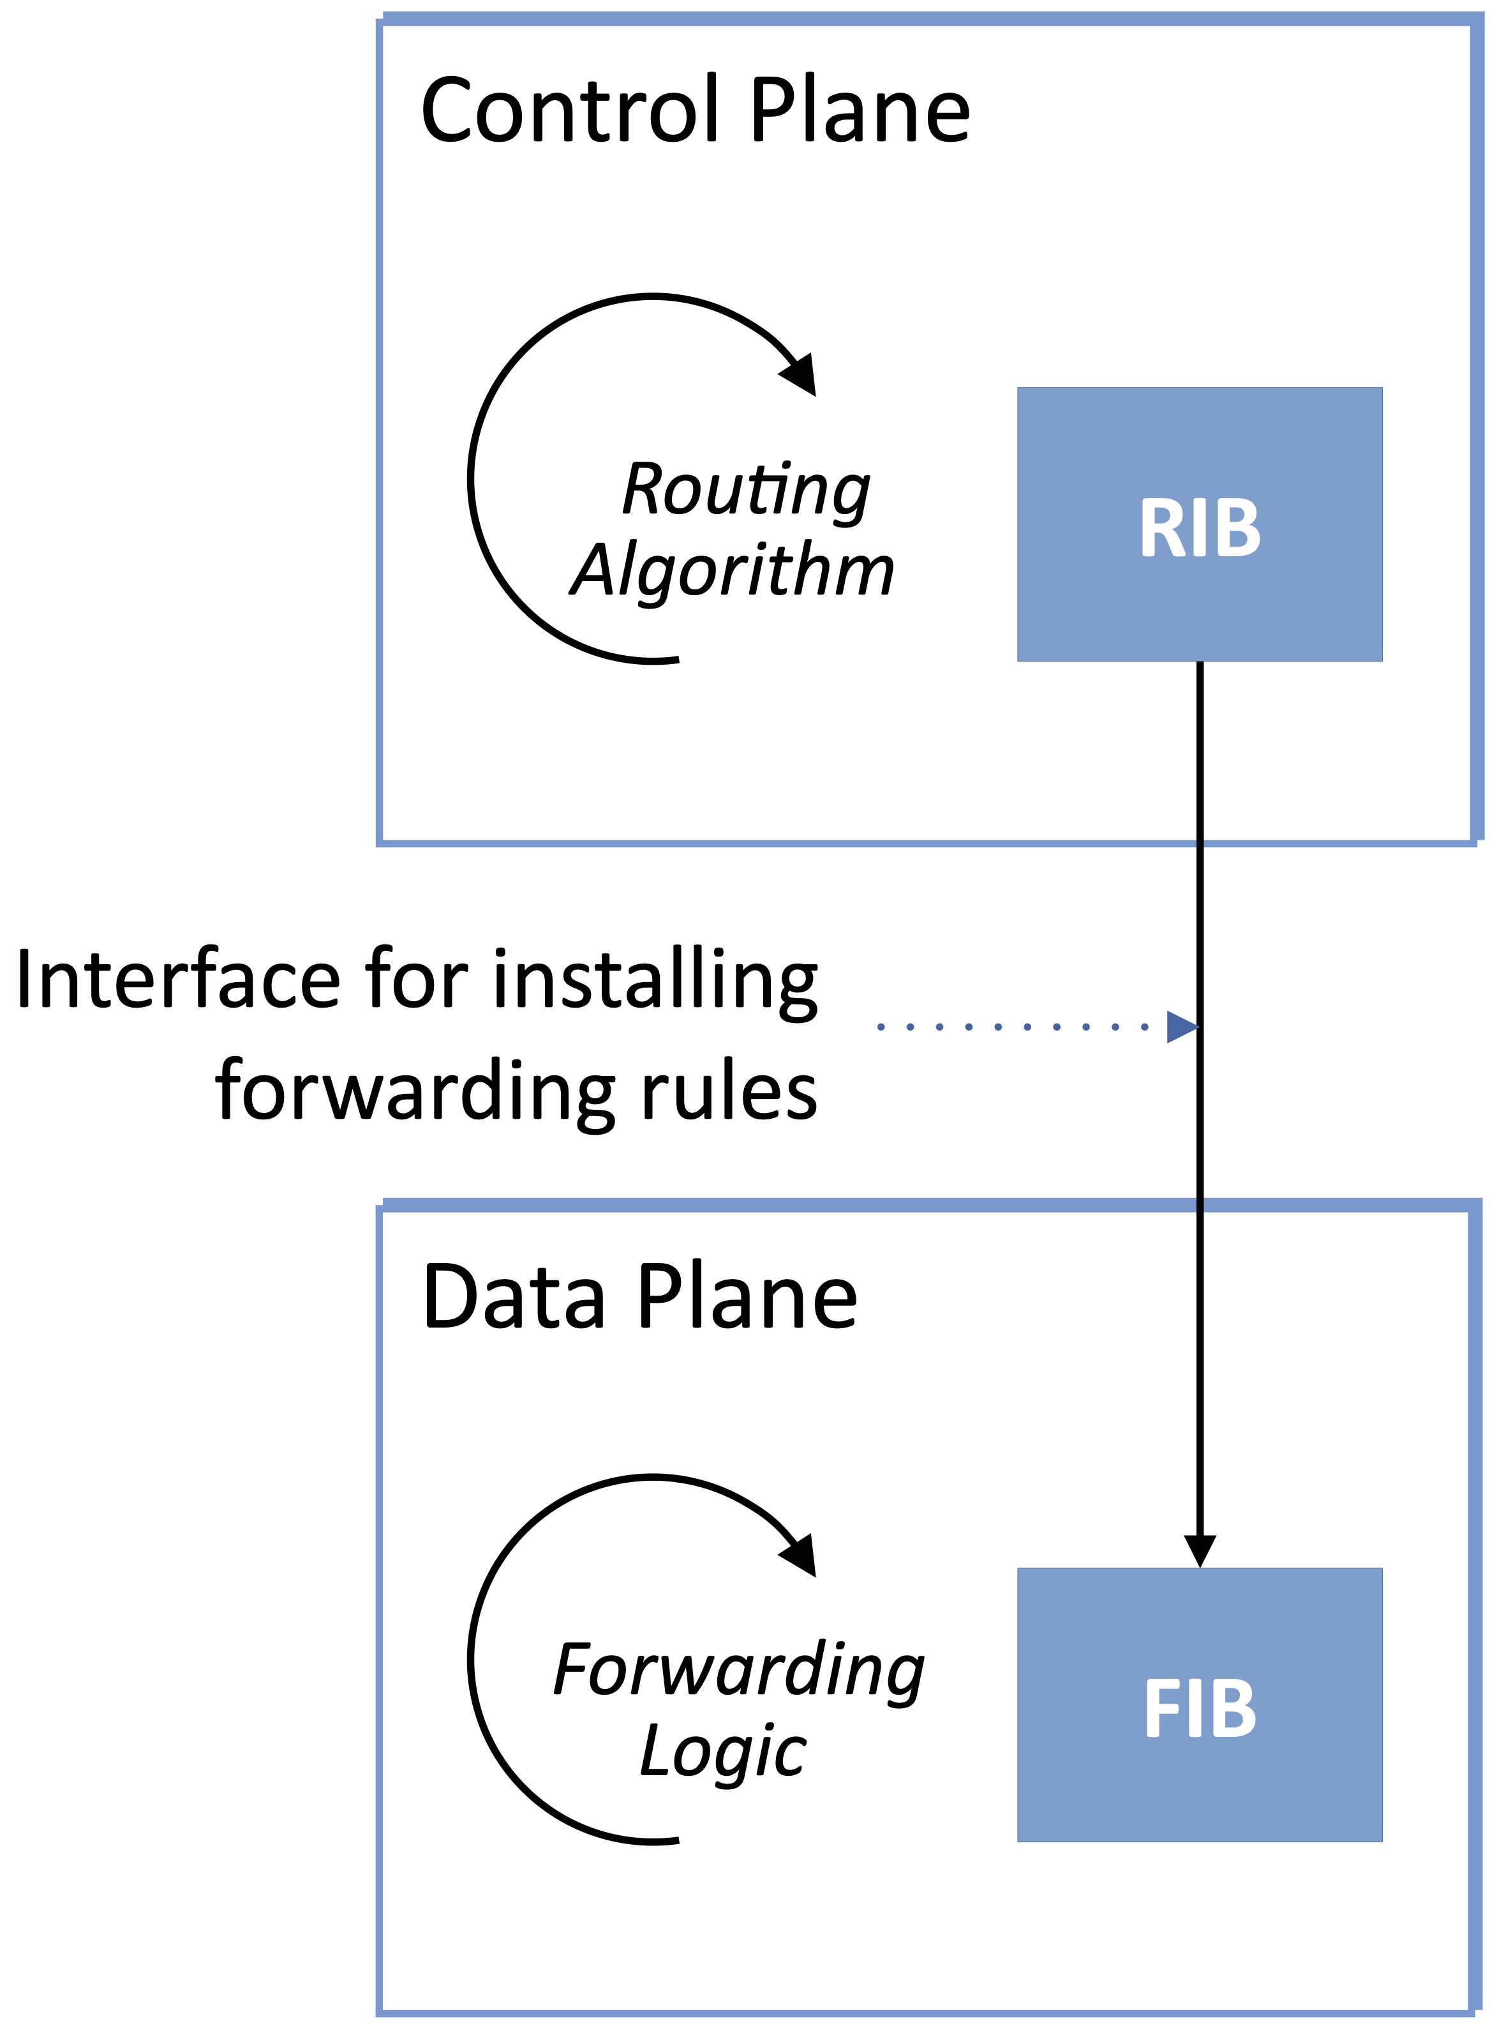
Control and Data Planes
Control Plane
  RIB (Routing Information Base)
  Routing algorithms learn routes
  e.g., BGP, OSPF
Data Plane
  FIB (Forwarding Information Base)
  Optimized for forwarding decisions
Driving towards an open API
  OpenFlow (1st generation)
  P4 (2nd generation)

Slide 14
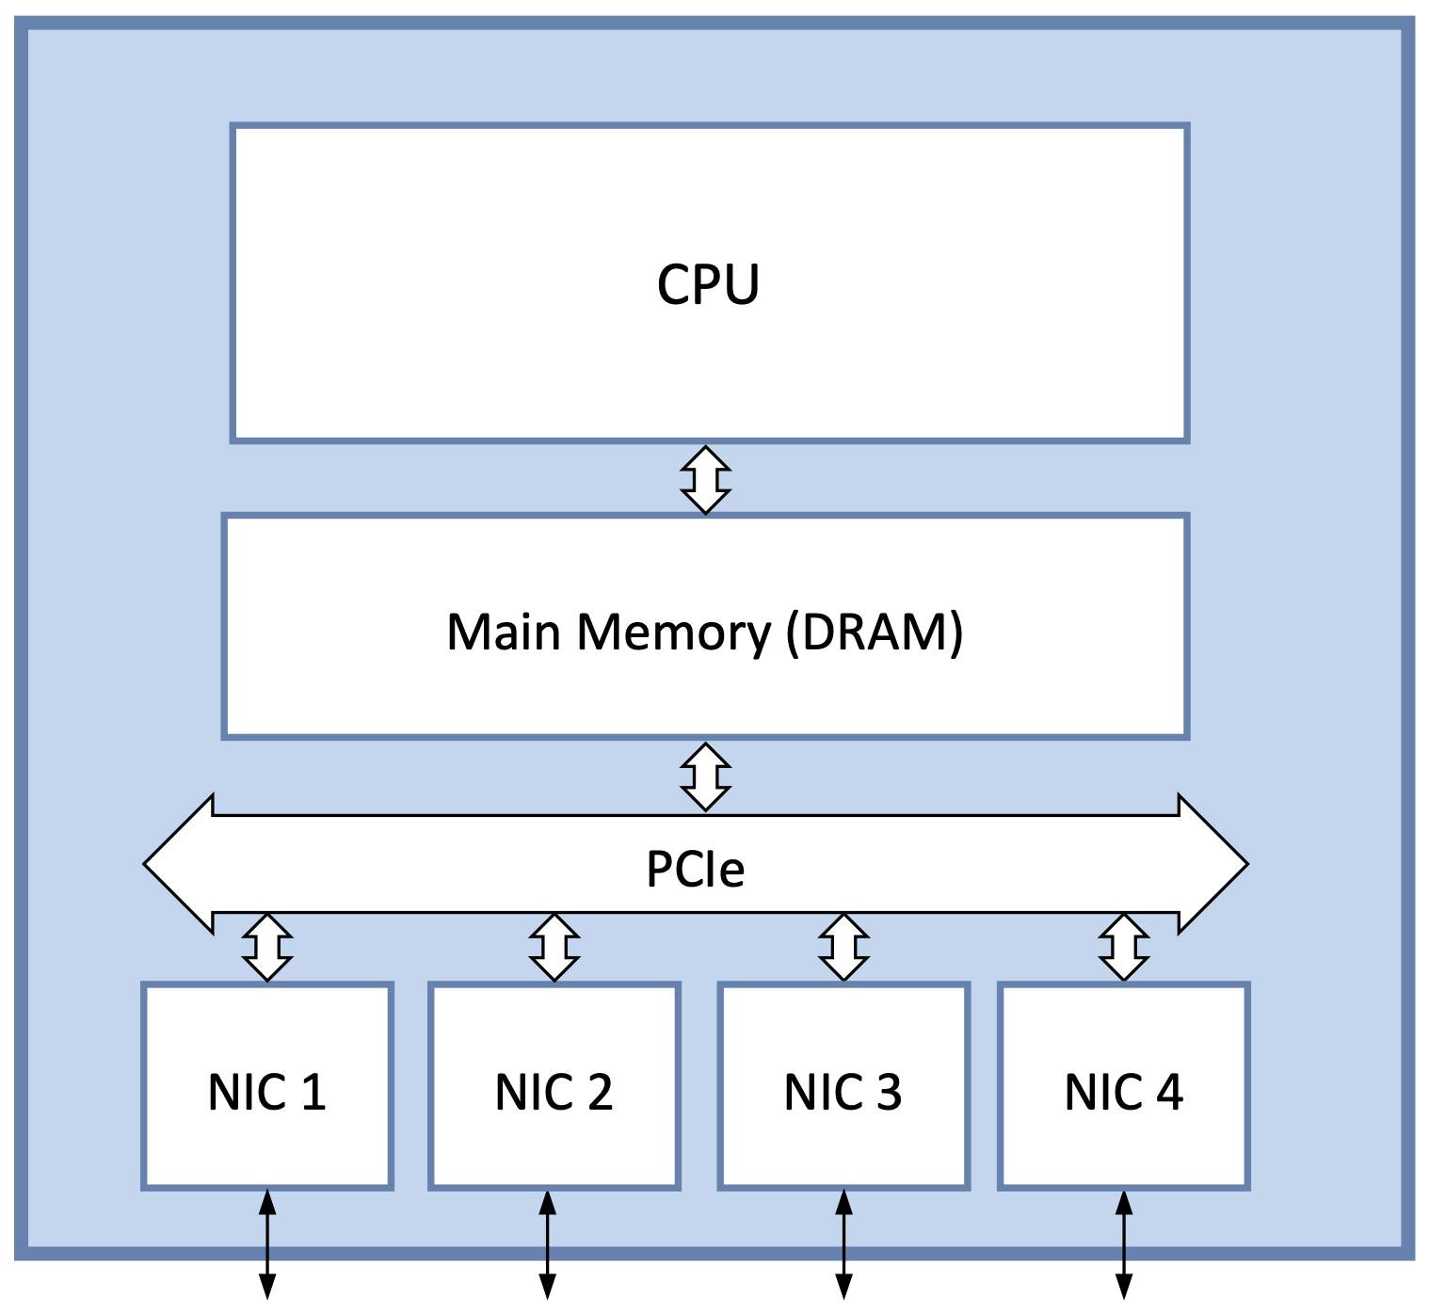
Software Switch
Commodity server + multiple NICs
  Packets stored in main memory
  Both control & data plane run on CPU
  PCI bus serves as “cross-connect”
Bus limitations (large packets)
  Cross bus twice per packet
  100 Gbps implies ~5 x 10-Gbps NICs
CPU limitations (small packets)
  40M pps is a reasonable target
  Throughput = pps x BitsPerPacket
  = 40 x 10⁶ x 64 x 8
  = 2048 × 10⁷
  = 20 Gbps

Slide 15
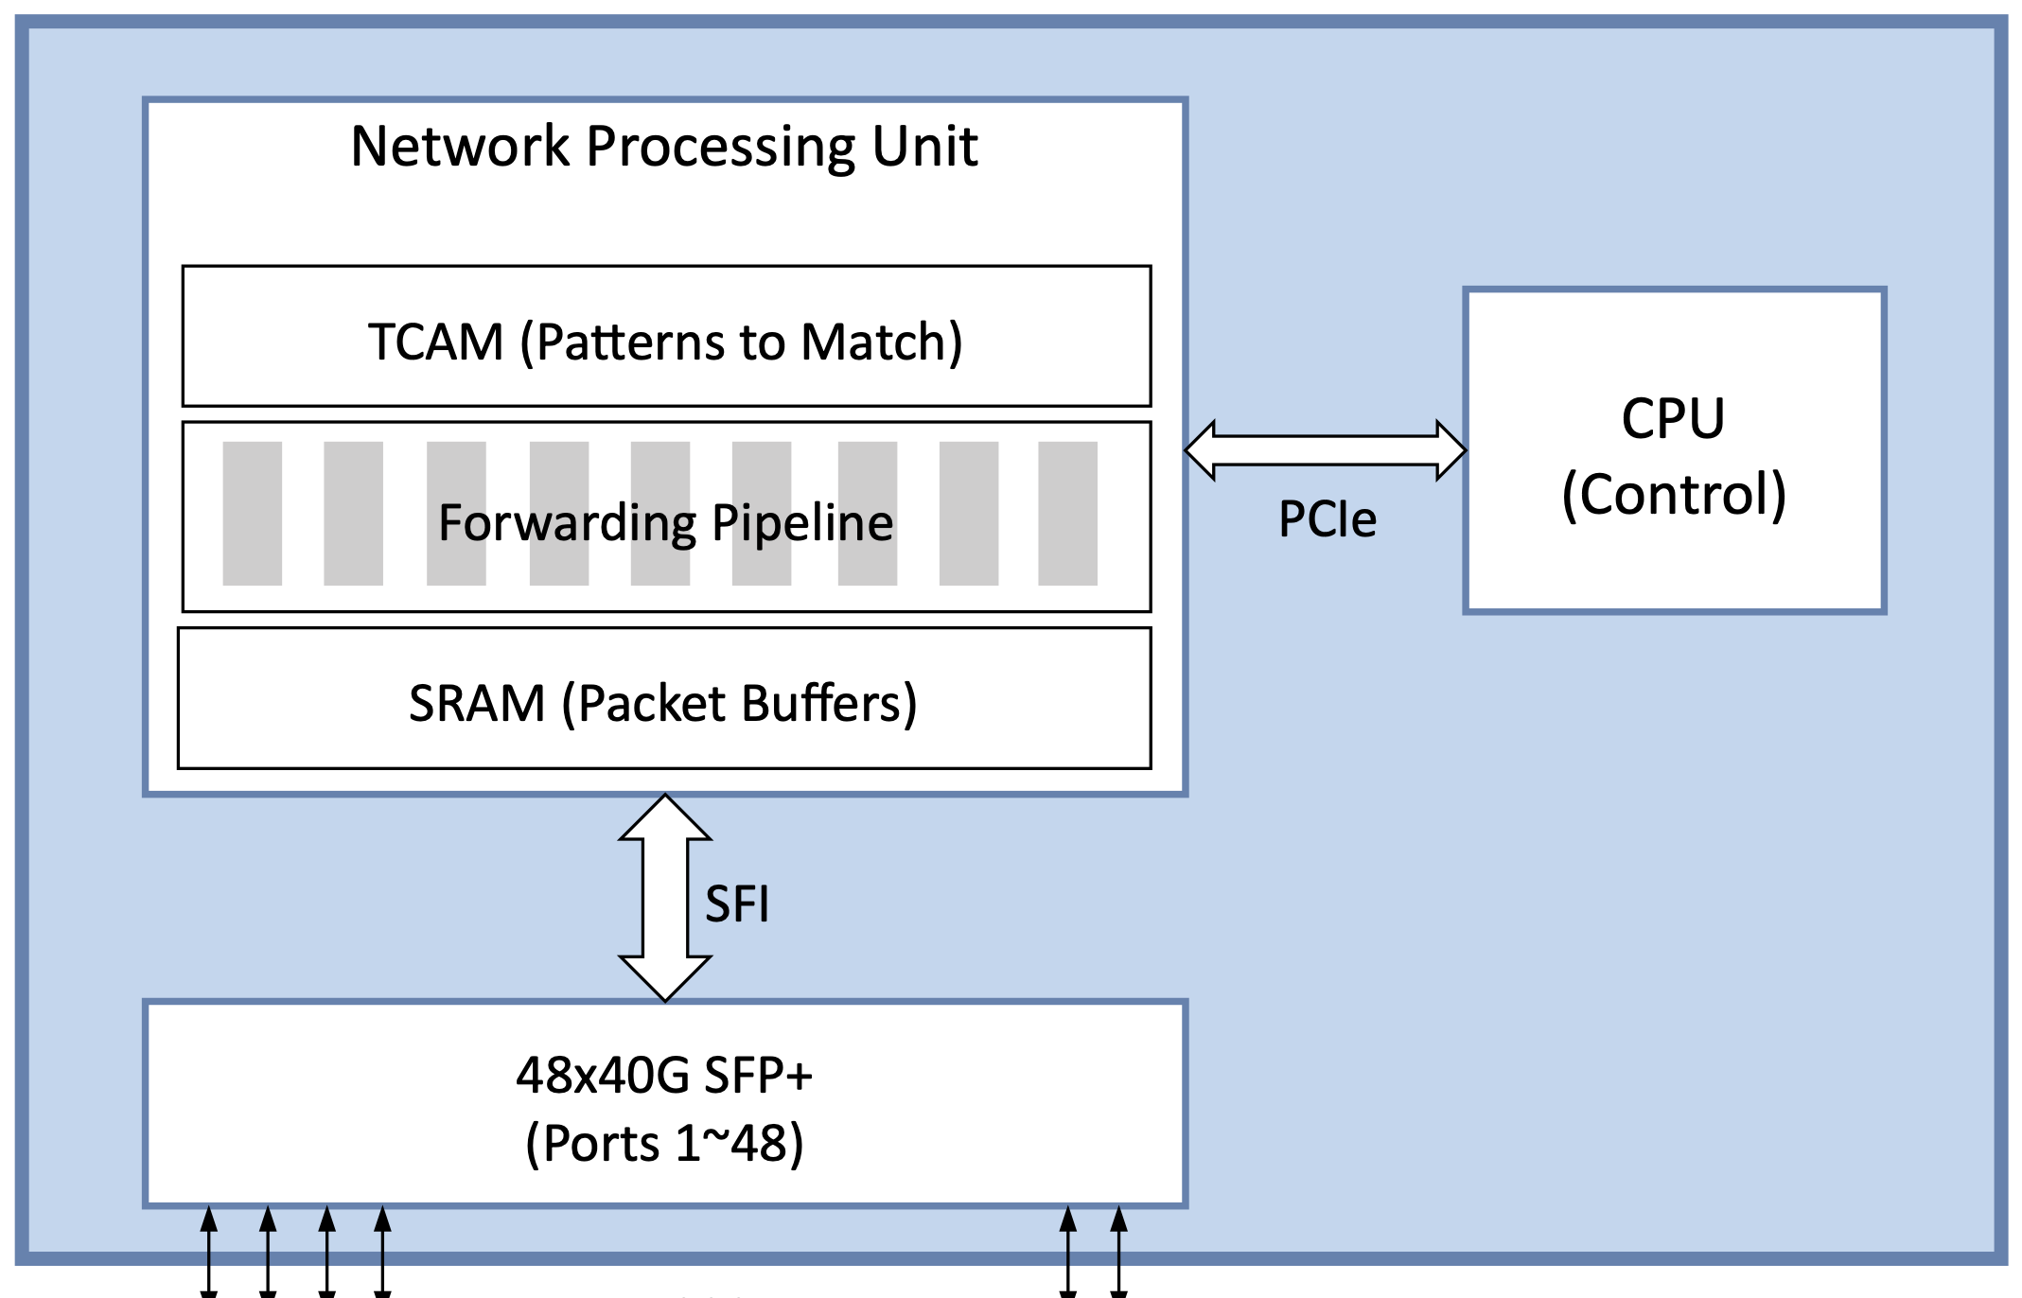
Hardware Switch
Switching Chip
  Domain Specific Architecture
  Similar to GPU (graphics), TPU (AI)
Forwarding Pipeline
  Implements matching logic
TCAM
  Stores patterns to match
  Ternary supports wildcard matches
SRAM
  Buffers packets
  Faster than DRAM
Bare-metal switches available
  Includes high-speed ports
  Just add software

Slide 16
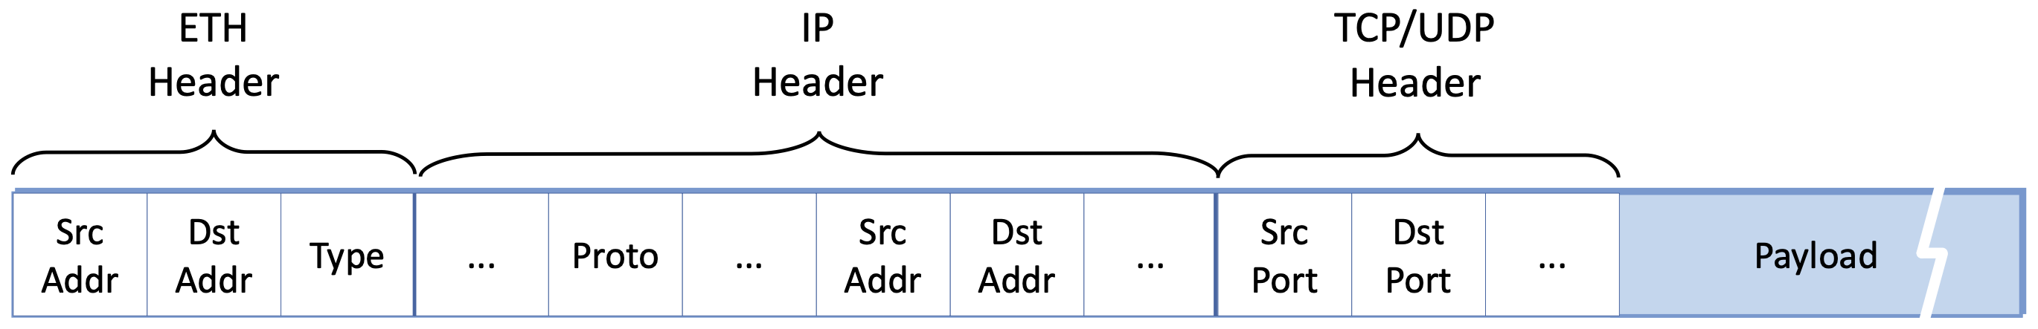
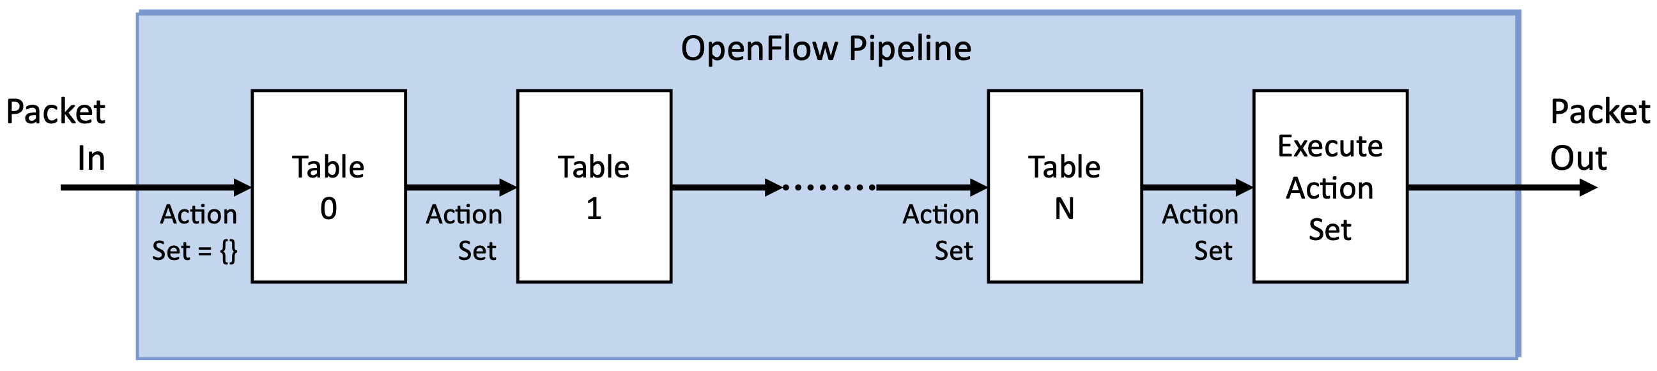
Flow Rules
OpenFlow
  Set of <Match, Action> rules
Match
  Combination packet header fields
Action
  Forward to specified port
  Drop
  Modify header & forward
  Pass up to controller
Forwarding Pipeline
  Sequence of “Lookup Tables”
  Processes packets in parallel
  Accumulate Actions to execute at the end

Slide 17
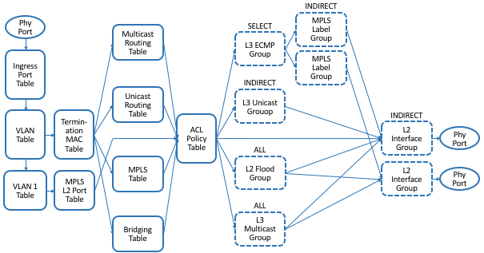
OpenFlow
Full Pipeline (Many of these tables covered in later chapters)

Slide 18
Programmable Pipeline
OpenFlow uses a Fixed Pipeline
  Each table is hardwired to specific hearer field(s)
  Change requires a change to the standard
  Vendors introduced vendor-specific features
  A programmable alternative is more flexible
P4: Programming Protocol-independent Packet Processors
  Language for defining custom packet processing
  Similar to C, but with constructs for matching headers
PISA: Protocol-independent Switch Architecture
  Forwarding pipeline with programmable stages/tables
  Serves as the target “instruction set” for P4 compiler
Toolchain for generating Control/Data Plane API from P4 programs

Slide 19
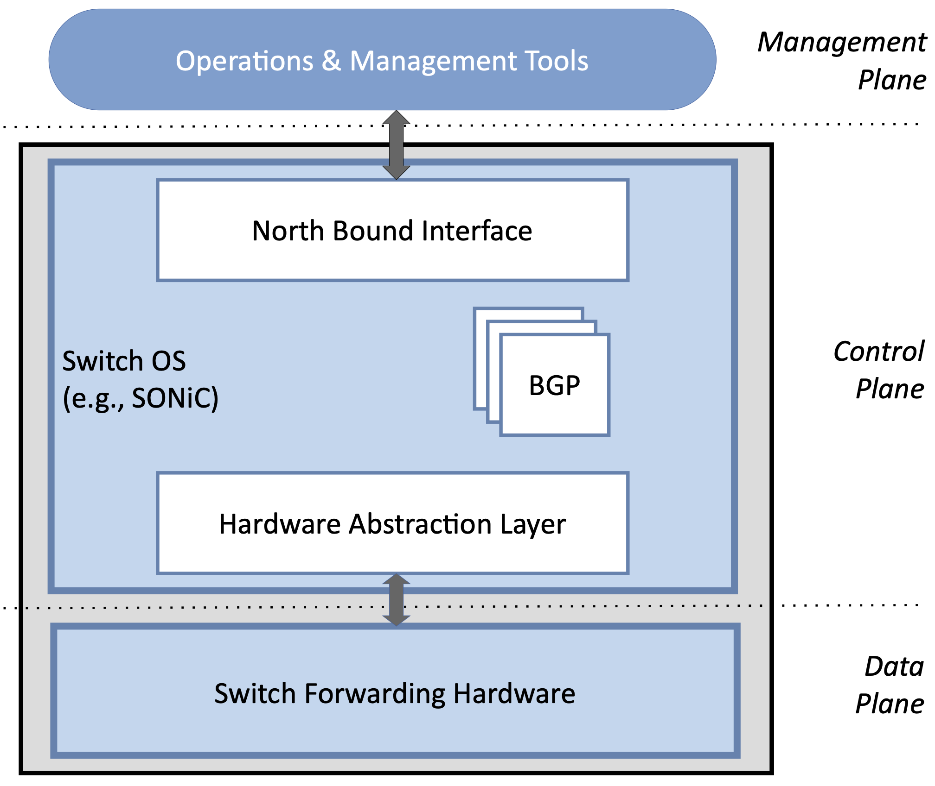
Switch OS
Switch OS runs on switch CPU
  SONIC: open Linux-based option
Switch OS hosts the Control Plane
  Offers Northbound Interface (NBI)
Off-Switch Management Plane
  Uses NBI to manage switch

Slide 20
Circuit Switching

Slide 21
Overview
Focused on Packet Switching up to this point
  Built around statistical multiplexing
  Adopts Store-and-Forward model
Alternative is Circuit Switching
  Set up end-to-end path before using
  Reserve link bandwidth and switching capacity along circuit
  Bits (or signals) flow through switch without buffering
Two Examples
  Modern: All-optical networks using Wave Division Multiplexing
  Legacy: Electrical switches (optical fiber) using Time Division Multiplexing

Slide 22
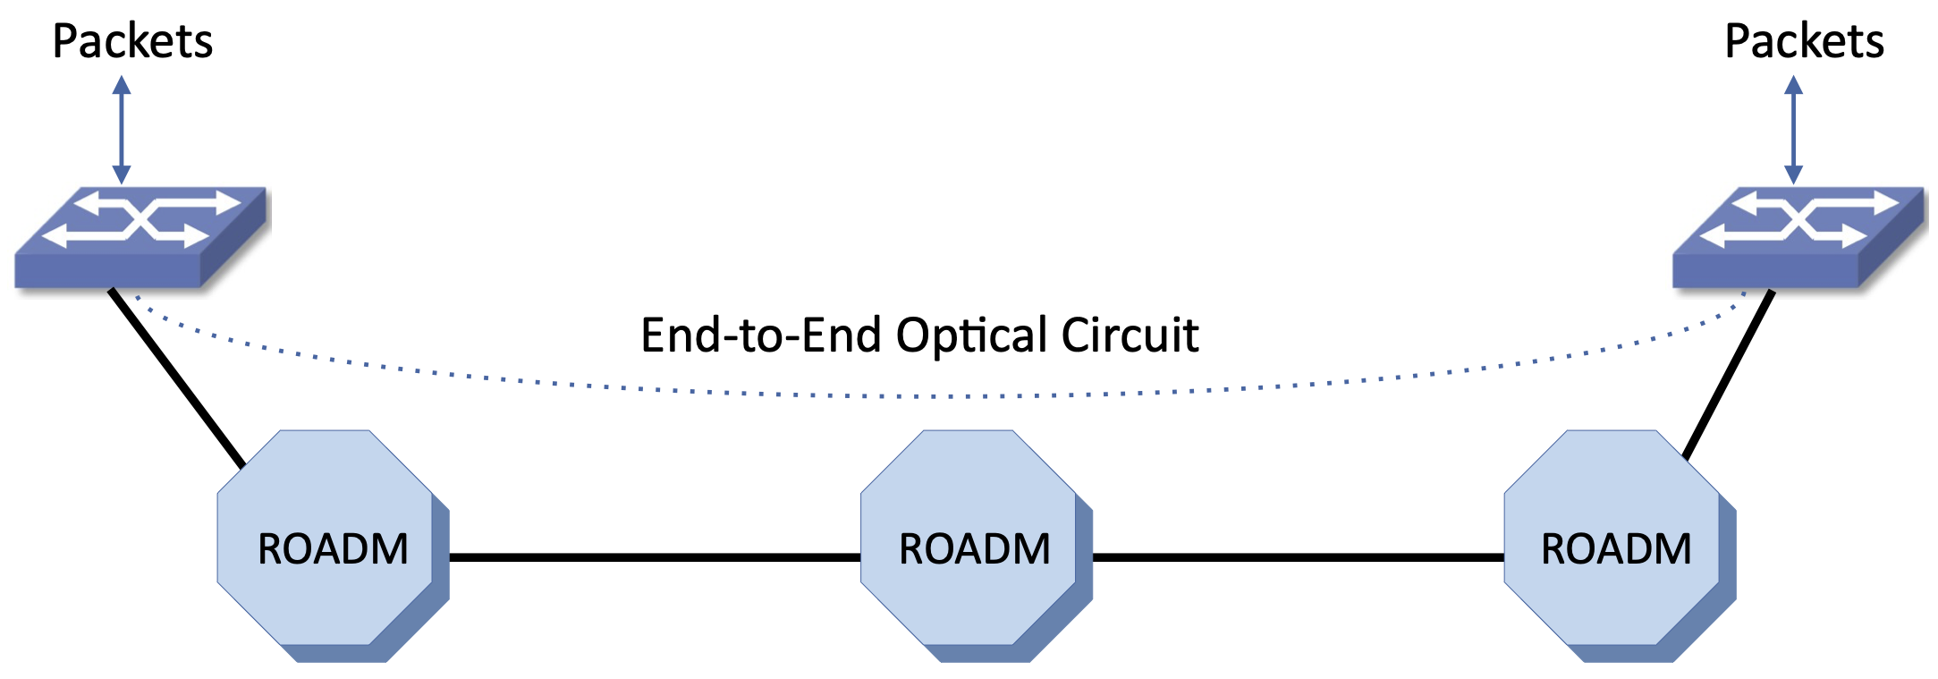
All-Optical Networks
DWDM
  Multiple "colors" share one fiber
  80+ channels at 100 Gbps each
ROADM
  Individual wavelengths routed end-to-end without converting to electrical signals
  Packet switches at either end of an all-optical circuit

Slide 23
SONET
Synchronous Optical Networking
  Comes out of Telephony Networks
Hierarchy of byte-streams (circuits) switched end-to-end
Multiplex by sending a frame every 125 µs
Base level is STS-1 = 51.84 Mbps (810 bytes per frame)
STS-1 can carry 810 x 64-Kbps voice circuits
  One byte for each voice circuit every 125 µs
Aggregating STS-1 yields higher bandwidth circuits
  Three STS-1 yields STS-3 = 155.52 Mbps
  N STS-1 yields STS-N = Nx51.84 Mbps
  Tops out at STS-768 = 39,813.12 Mbps (~40 Gbps)

