Slide 1
Chapter 4: Routing
Computer Networks: A Systems Approach

Slide 2
Overview
Once a network grows beyond a single switch, we need a way to determine the path packets need to follow to reach their destination. This is the job of the routing algorithm. This chapter describes four different approaches.

Slide 3
Routing vs Forwarding
Forwarding: Data Plane
  Lookup destination address in the forwarding table
Routing: Control Plane
  Collect information about network topology and capacity
  Calculate best next hop for each destination
Independent decision at at different levels
  L2: Based on “best” path to destination’s Ethernet address
  L3: Based on ”best” path to destination’s IP address
Scope: Intradomain routing
  Works within a single routing domain (ISP backbone, enterprise network)
  Scales to hundreds of switches
  Will look at interdomain routing later

Slide 4
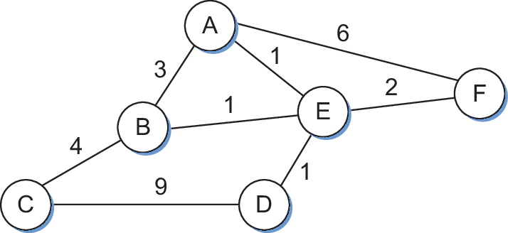
Network as a Graph
Nodes: hosts, switches, routers, networks
Edges: links, each with a cost
Goal: lowest-cost path between any two nodes
Why not just precompute static routes?
  Doesn't handle failures
  Doesn't handle new nodes or links
  Costs may change over time

Slide 5
Spanning Tree Protocol

Slide 6
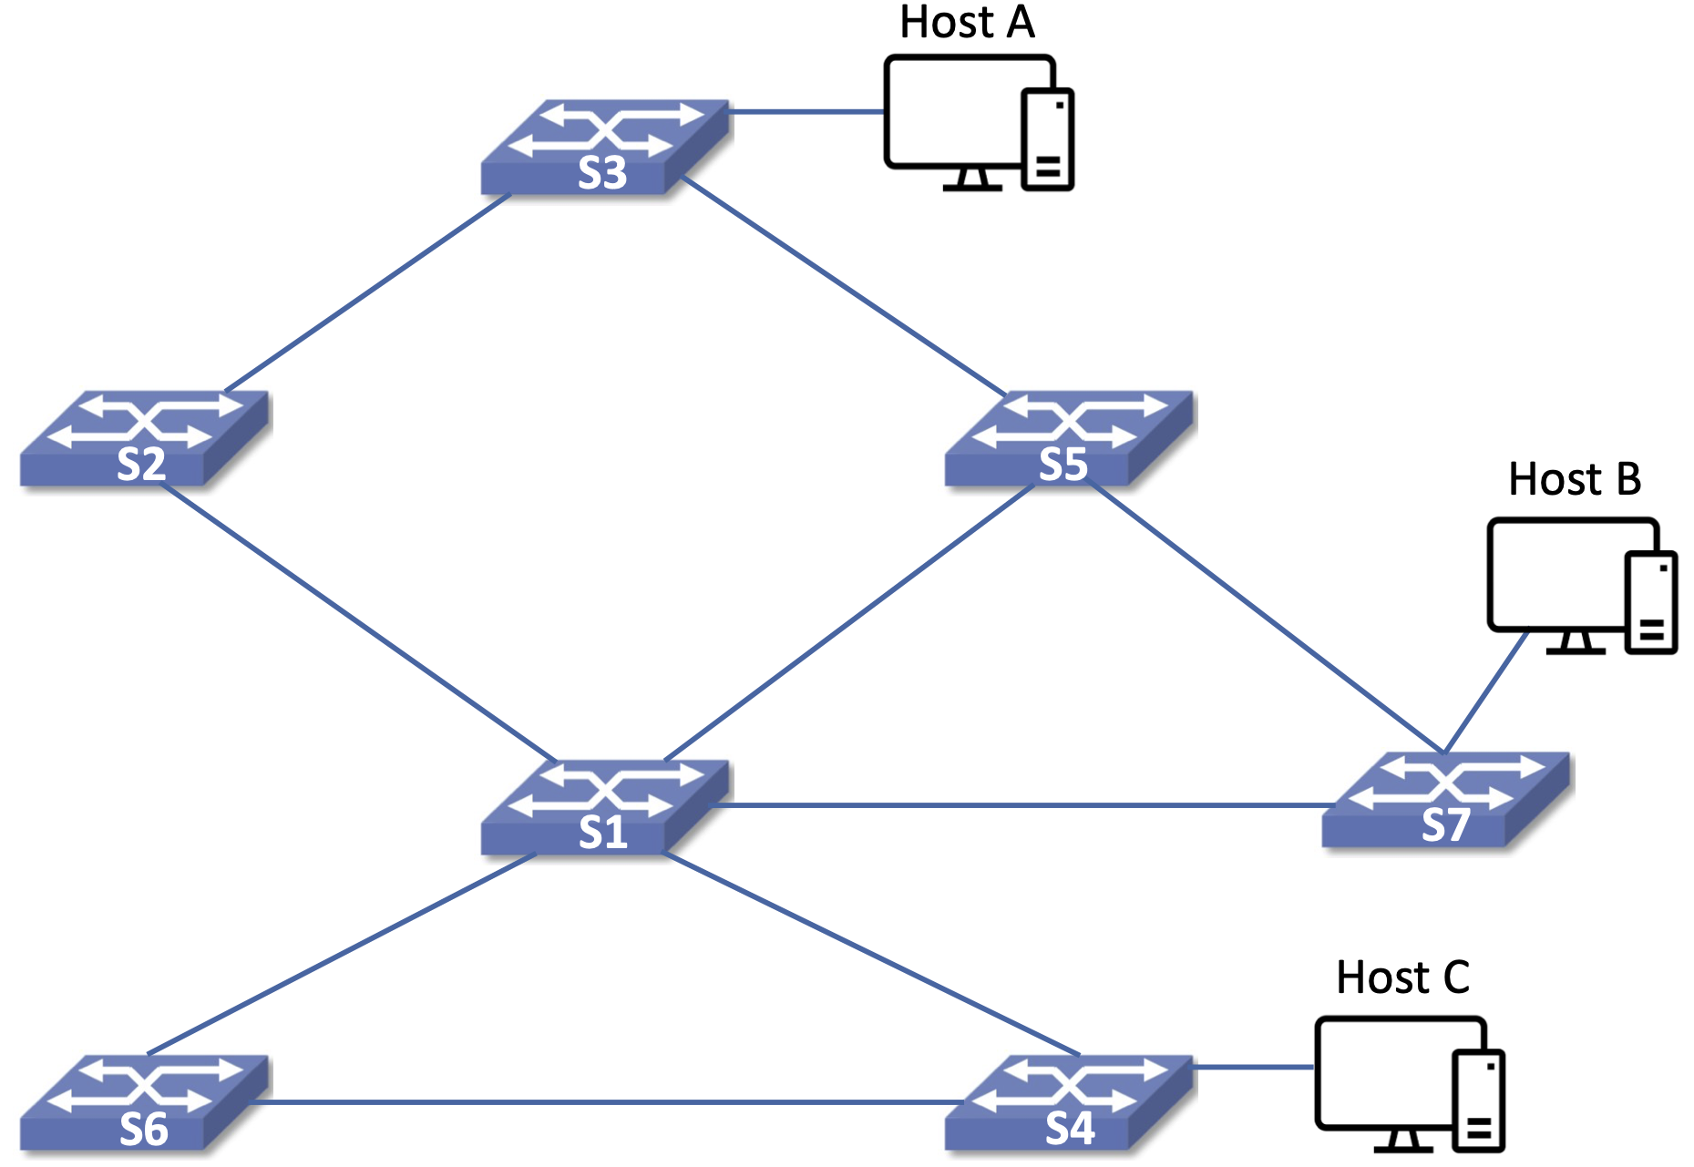
Ethernet Basics
Simple bridges (L2 switches)
  Forward onto all outgoing ports
Learning bridges
  Record (input port / source addr) pairs
  Use for future destination addr
  Discard pair if not refreshed
Loops are possible
  Ethernet has no TTL to stop them
Why loops happen
  Multiple administrators, accidental redundancy
  Intentional redundancy for failure recovery

Slide 7
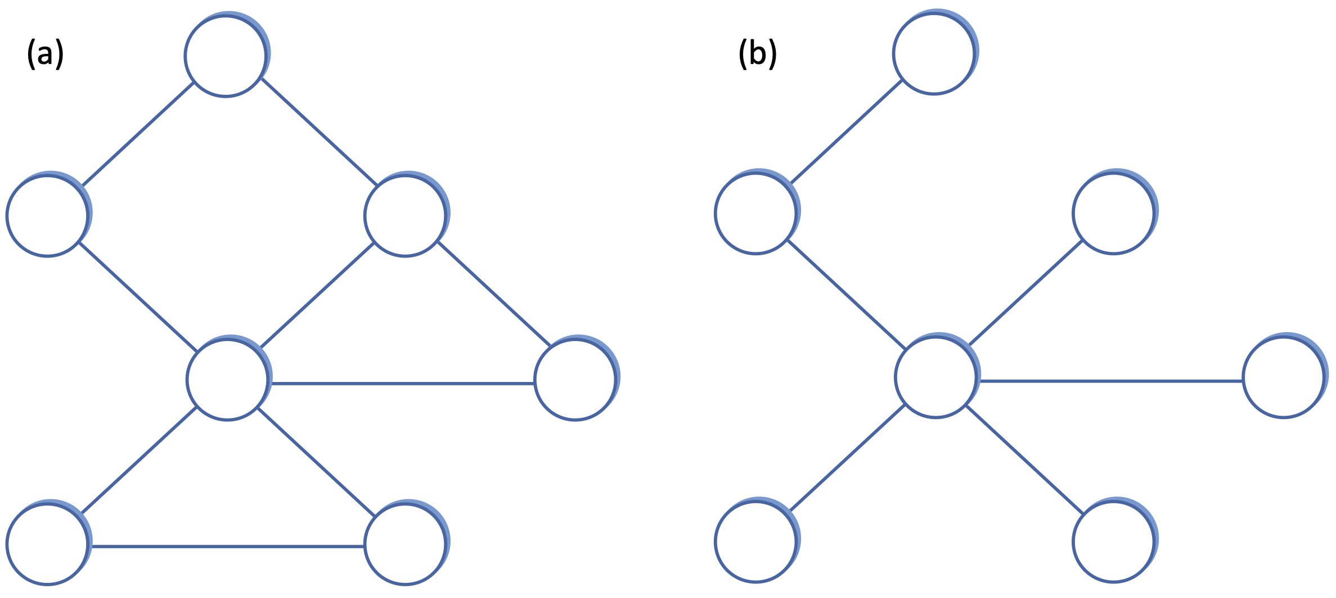
Spanning Trees
Spanning Tree
  Subgraph with no cycles
  Forward packets “down” the tree
Challenge
  Multiple spanning trees possible
  Reach agreement on a single tree

Slide 8
Spanning Tree Protocol
Distributed Algorithm
  Developed by Radia Perlman
  Basis for IEEE 802.1
Each switch has a unique ID
Elect a root switch
  Smallest ID wins
Elect a designated switch per link
  Closest to root
  ID breaks ties
Dynamic: Reconfigures on failure

Slide 9

Building the Tree
Configuration message
  (root ID, distance, switch ID)
Switch adopts a message if it's "better"
  Smaller root ID
  Or shorter distance
  Or smaller switch ID
Only root and designated switches keep sending
Stabilizes into a single loop-free tree
Failure causes switches to start over

Slide 10
Link-State Routing

Slide 11
Overview
Widely used among service providers and enterprises
Every node learns the state of its own links
Two mechanisms
  Reliable dissemination of link-state info
  Shortest-path calculation from that info
Converges when aall nodes share a common view

Slide 12
Reliable Flooding
Link-State Packet (LSP) contents
  Node ID
  List of neighbors and link costs
  Sequence number
  Time to live
Forward new LSPs to all neighbors but one
  Not back to the sender
Sequence numbers and TTL prevent stale or looping LSPs

Slide 13
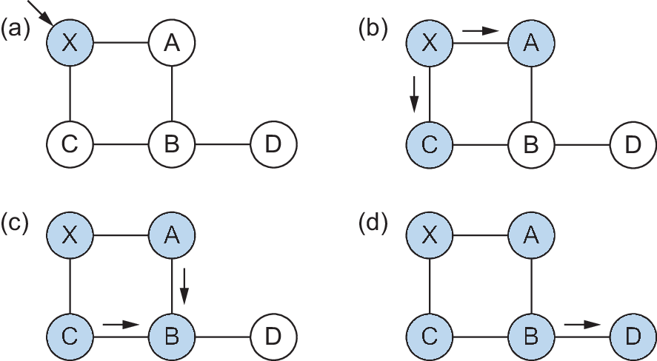
Flooding Example
LSP arrives at node X
X floods to neighbors A and C
A and C flood onward, but not back to X
Duplicate copies are recognized and dropped

Slide 14
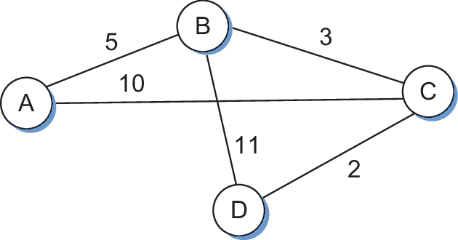
Forward Search Algorithm
Variant of Dijkstra’s Shortest-Path Algorithm
Confirmed = { (self, 0, -) }
Tentative = {}
loop:
Next = node just added to Confirmed
for each Neighbor of Next (from Next's LSP):
Cost = cost(self, Next) + cost(Next, Neighbor)
if Neighbor not in Confirmed or Tentative:
add (Neighbor, Cost, NextHop) to Tentative
elseif Neighbor in Tentative and Cost < its current cost:
replace with (Neighbor, Cost, NextHop)
if Tentative is empty:
stop
move lowest-cost Tentative entry to Confirmed

Slide 15
Building Node D's Table
Confirmed list starts with D alone, at cost 0
Lowest-cost tentative entry moves to Confirmed each round
  Its LSP may reveal cheaper paths to others
Early guess of cost 11 to B is later replaced by cost 5
Step | Confirmed | Tentative
1 | (D,0,–) | —
2 | (D,0,–) | (B,11,B) (C,2,C)
3 | (D,0,–) (C,2,C) | (B,11,B)
4 | (D,0,–) (C,2,C) | (B,5,C) (A,12,C)
5 | (D,0,–) (C,2,C) (B,5,C) | (A,12,C)
6 | (D,0,–) (C,2,C) (B,5,C) | (A,10,C)
7 | (D,0,–) (C,2,C) (B,5,C) (A,10,C) | —

Slide 16
OSPF
Open Shortest Path First
  Version 2 defined in RFC 2328 (most widely used)
  Version 3 adds IPv6 support (RFC 5340)
  IS-IS (Intermediate System to Intermediate System) is another option
Features
  Supports balances across equal-cost routes
  Adds another level of hierarchy (areas)
  Supports authentication of update messages

Slide 17
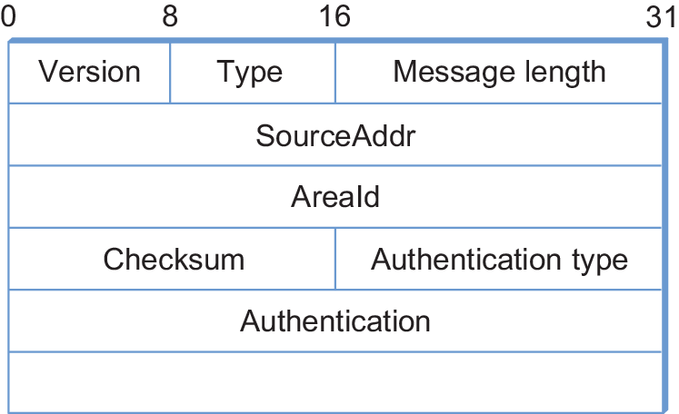
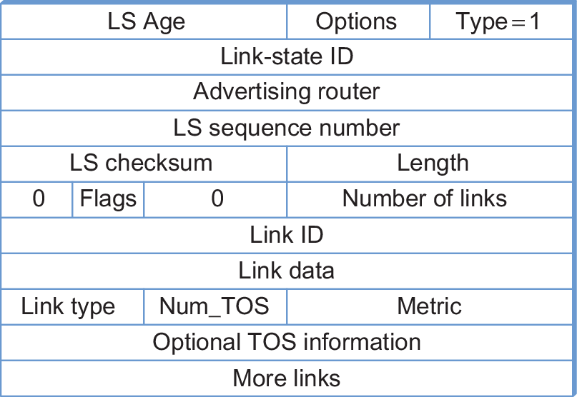
OSPF Header
Common header for all message types
Link-State Advertisement (Type=1)

Slide 18
Distance-Vector

Slide 19
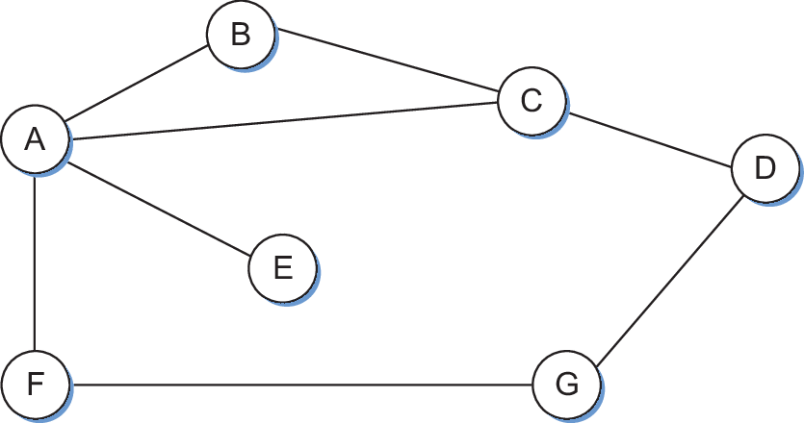
Overview
Also known as Bellman-Ford
Each node keeps a vector of costs to all destinations
Shares that vector with direct neighbors only
No node ever sees the whole topology

Slide 20
Initial Distances
 | A | B | C | D | E | F | G
A | 0 | 1 | 1 | ∞ | 1 | 1 | ∞
B | 1 | 0 | 1 | ∞ | ∞ | ∞ | ∞
C | 1 | 1 | 0 | 1 | ∞ | ∞ | ∞
D | ∞ | ∞ | 1 | 0 | ∞ | ∞ | 1
E | 1 | ∞ | ∞ | ∞ | 0 | ∞ | ∞
F | 1 | ∞ | ∞ | ∞ | ∞ | 0 | 1
G | ∞ | ∞ | ∞ | 1 | ∞ | 1 | 0

Slide 21
Node A's Initial Table
A's row from the distance table
  viewed as a routing table
NextHop for a direct neighbor is that neighbor itself
Destination | Cost | NextHop
B | 1 | B
C | 1 | C
D | ∞ | –
E | 1 | E
F | 1 | F
G | ∞ | –

Slide 22
Node A's Updated Table
F advertises reaching G at cost 1
  A adds its own cost to F (1): reaches G at cost 2
C advertises reaching D at cost 1
  A adds its own cost to C (1): reaches D at cost 2
Destination | Cost | NextHop
B | 1 | B
C | 1 | C
D | 2 | C
E | 1 | E
F | 1 | F
G | 2 | F

Slide 23
Final Distances
 | A | B | C | D | E | F | G
A | 0 | 1 | 1 | 2 | 1 | 1 | 2
B | 1 | 0 | 1 | 2 | 2 | 2 | 3
C | 1 | 1 | 0 | 1 | 2 | 2 | 2
D | 2 | 2 | 1 | 0 | 3 | 2 | 1
E | 1 | 2 | 2 | 3 | 0 | 2 | 3
F | 1 | 2 | 2 | 2 | 2 | 0 | 1
G | 2 | 3 | 2 | 1 | 3 | 1 | 0

Slide 24
Convergence
Updates sent periodically and whenever topology changes
If a neighbor advertises a shorter path
  Node adopts it and re-advertises
Ripples through the network until stable
Link failure can cause routes to inflate indefinitely
  Nodes keep "discovering" longer paths through each other
  Stops once cost reaches an assumed “infinity” (e.g., 16 in RIP)
Avoiding Loops
  Don't advertise a route back to where it came from
  Poison reverse: Advertise it back, but with infinite cost

Slide 25
Updating the Routing Table
void
mergeRoute (Route *new)
{
for (i = 0; i < numRoutes; ++i) {
if (new->Destination == routingTable[i].Destination) {
if (new->Cost + 1 < routingTable[i].Cost) break;
else if (new->NextHop == routingTable[i].NextHop) break;
else return;
}
}
routingTable[i] = *new;
routingTable[i].TTL = MAX_TTL;
++routingTable[i].Cost;
}

Slide 26
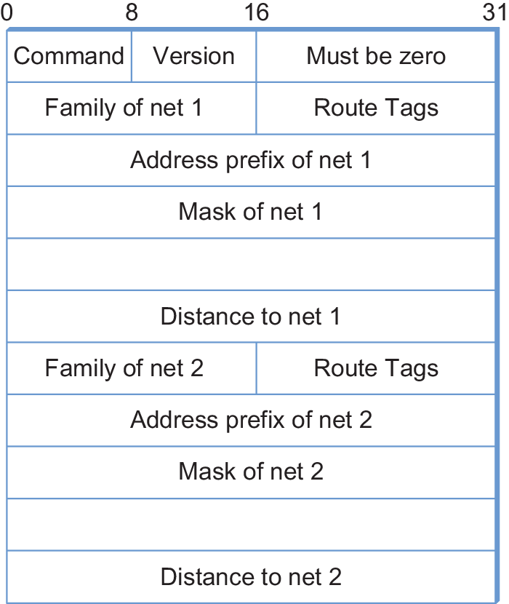
RIP
Routing Information Protocol
Distributed with BSD Unix; historically popular
Advertises reachable networks, not just routers
All link costs equal to 1
  Minimum-hop routing
Infinity = 16
  Limits RIP to small networks

Slide 27
Datacenter Fabric

Slide 28
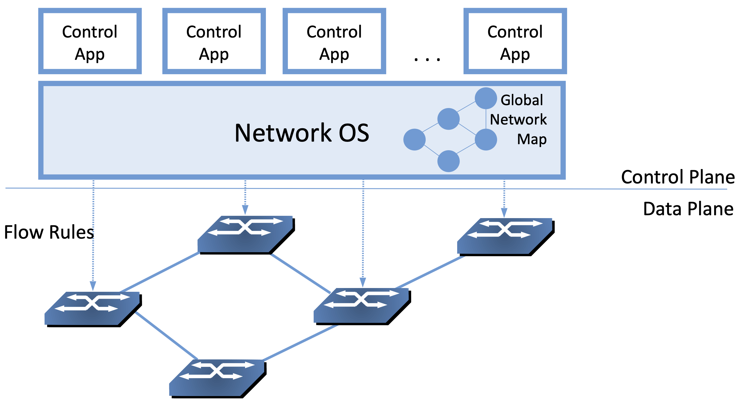
Software-Defined Networking
Datacenters often use a centralized approach
SDN separates control plane from data plane
  Standard interface between the two
Network Operating System (NOS)
  Centralized point of control
  Platform for control applications
Enables new routing algorithms
  e.g., Google B4, Microsoft SWAN

Slide 29
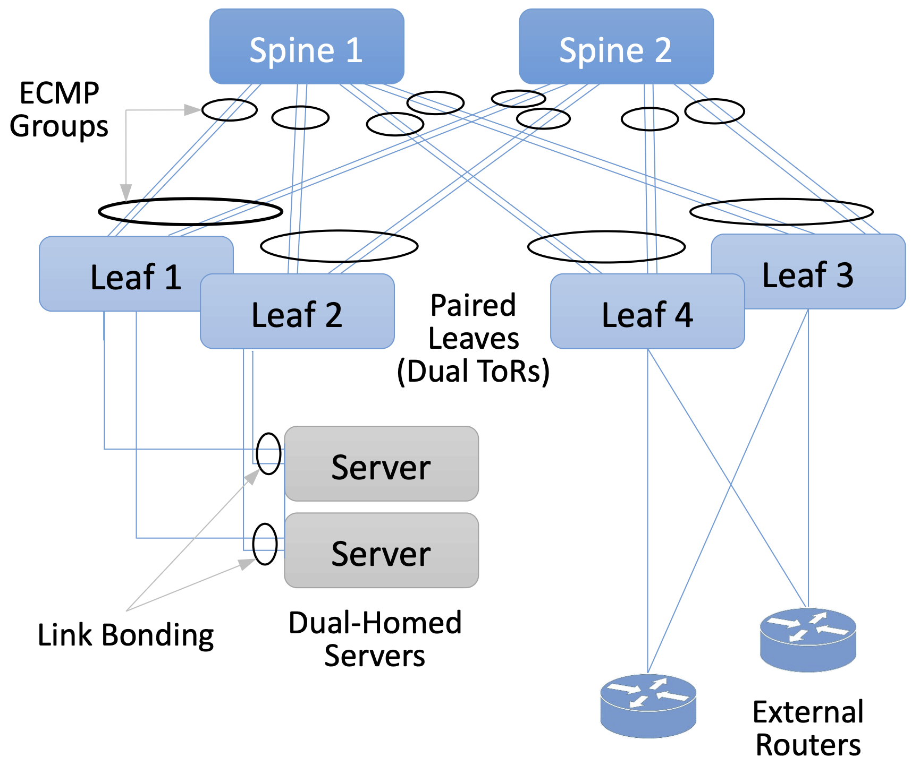
Link Aggregation
Leaf-spine Fabric
Each server dual-homed
Link bonding
  OS-level aggregation on servers
ECMP groups
  Switch-level aggregation across equal-cost paths
Same flow kept on the same path
  Avoids reordering for protocols like TCP

Slide 30
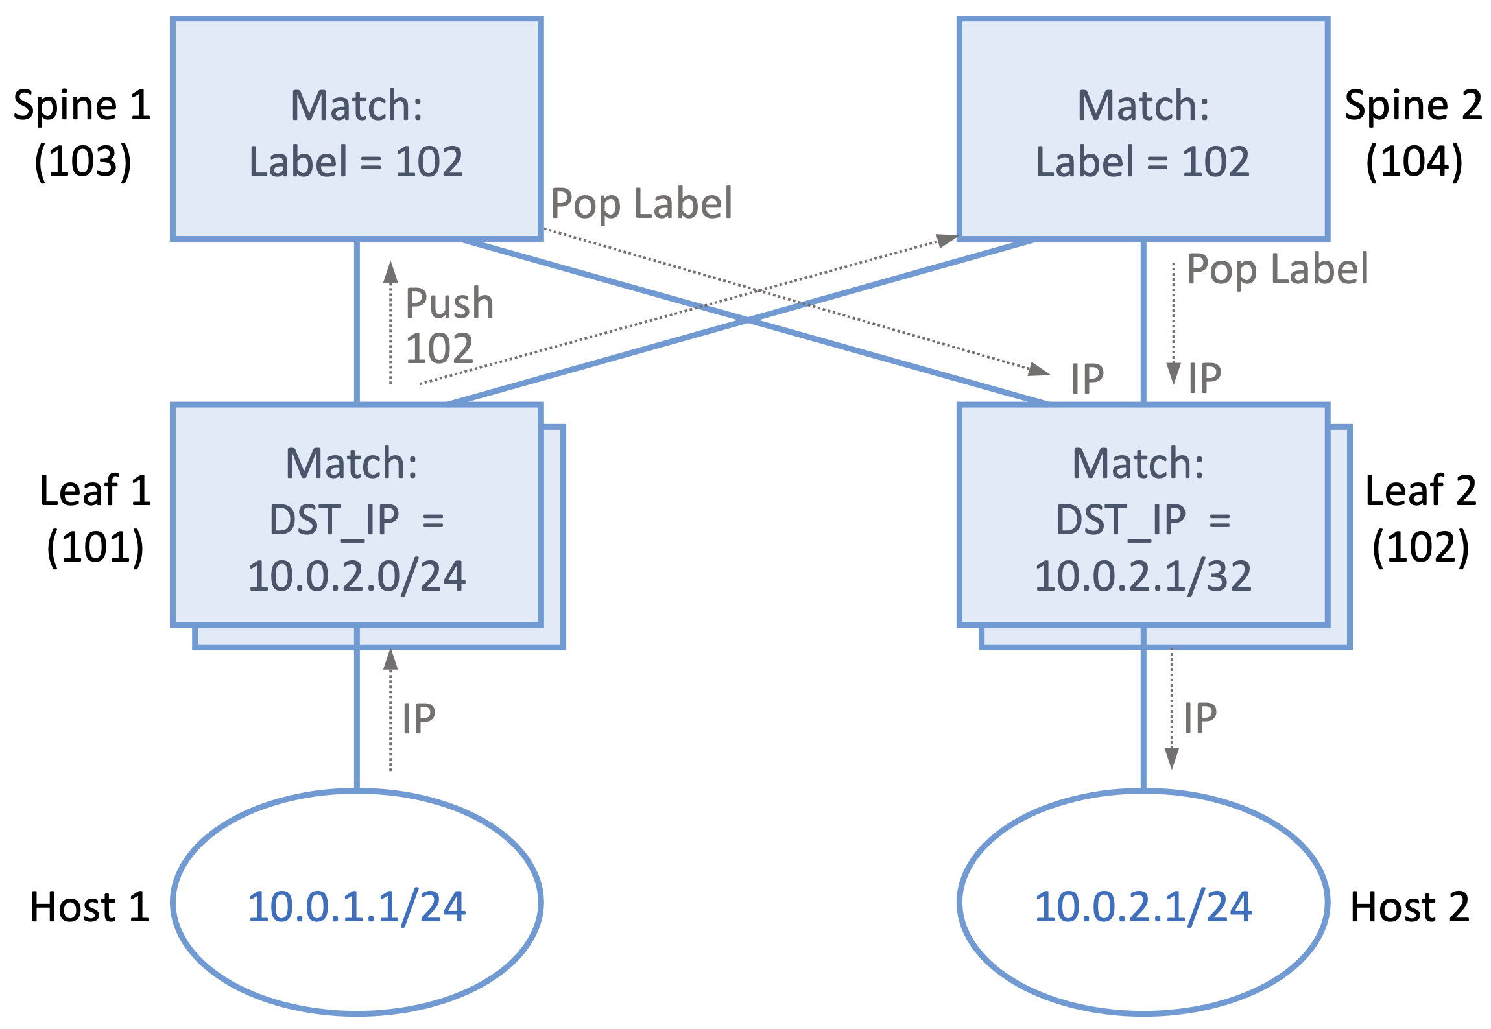
Segment Routing
End-to-end path built from a sequence of segments
Two segments per path
  Leaf-to-spine, spine-to-leaf
Segments identified by labels
Centralized controller pre-computes paths

Slide 31
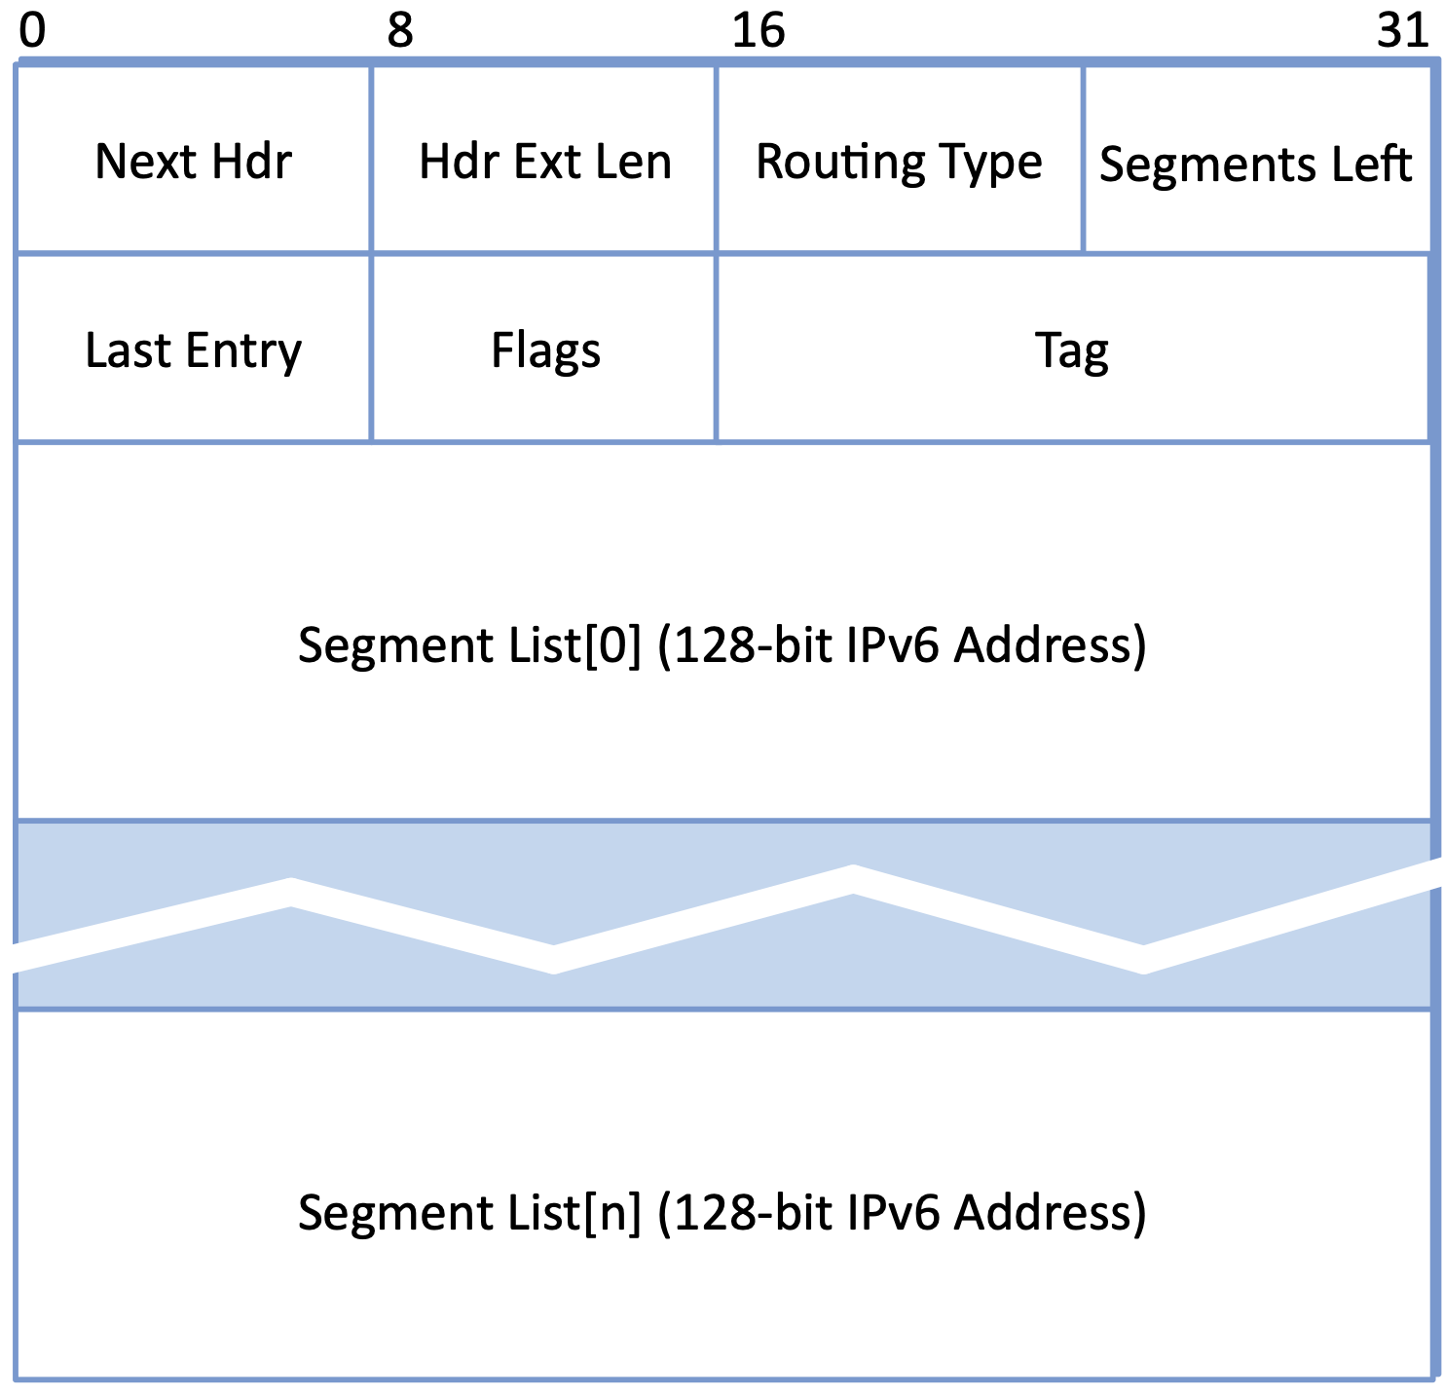
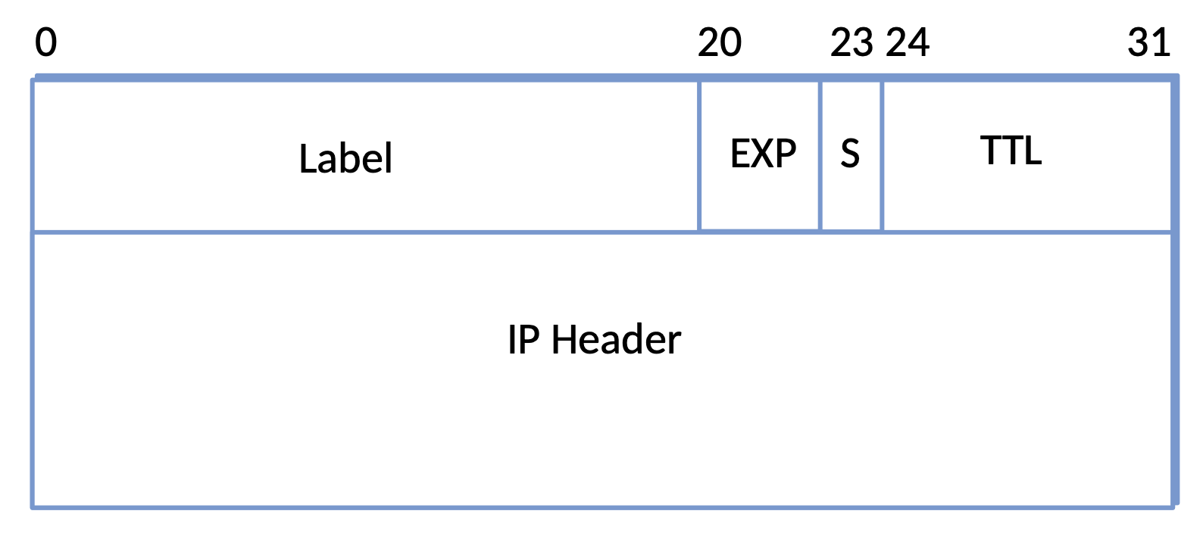
Label Switching
MPLS
  20-bit label (locally defined)
  Labels can be stacked
  Push, Pop, and Swap operations
SRv6
  Extension Header to IPv6
  List of 128-bit Segment IDs
  Segments Left field marks current segment

Slide 32
Distributed vs. Centralized
Distance-Vector
  Talk only to neighbors
  Share everything you know
Link-State
  Talk to everyone (flood updates)
  Share only what you're sure of (direct links)
Centralized (SDN)
  Collect topology information centrally
  Compute globally optimal routes
  Distribute tables to switches

